Slide 1

IILM UNIVERSITY, GREATER NOIDA
INTERNSHIP REPORT PRESENTATION
Student Result Processing System
Java Full Stack Development Internship
AICTE – EduSkills Virtual Internship Program | Java Full Stack Development With Project
Shivam Singh
Roll No. 2410030363 | B.Tech CSE
June – August 2026

Slide 2






ABOUT THE STUDENT
Candidate Profile
Roll Number
2410030363
Shivam
Singh
Institute
IILM University, Greater Noida, U.P.
B.Tech – Computer Science & Engineering
Programme
B.Tech CSE, Batch 2024–2028
Internship Domain
Java Full Stack Development With Project
Duration
8 Weeks | June – August 2026
Student Result Processing System • Shivam Singh
02

Slide 3



ABOUT THE PROGRAM
EduSkills, AICTE & Industry Mentorship
EduSkills Academy delivers the AICTE – EduSkills Virtual Internship Program under the patronage of the AICTE National Internship Portal, run by the Ministry of Education. For the Java Full Stack Development track, the program pairs a structured, mentor-guided LMS curriculum with hands-on project work, culminating in the “Student Result Processing System” project completed under the guidance of industry mentor Ms. Sagarabala Behera.
AICTE Patronage
EduSkills LMS
Industry Mentorship
Run under the AICTE National Internship Portal, Ministry of Education.
8-week structured curriculum delivered via the EduSkills virtual learning platform.
Guided throughout by industry mentor Ms. Sagarabala Behera.
Student Result Processing System • Shivam Singh
03

Slide 4





PROBLEM STATEMENT
From Raw Marks to Ranked Results
Academic institutions regularly need to convert raw student performance data into structured, meaningful insights. This project addresses that need by taking raw student performance data, typically supplied in CSV format, and transforming it into comprehensive analytical results — normalizing input, aggregating subject-wise marks, computing percentages, assigning grades, and generating a ranked list of students, all while adhering to strict JSON output standards for interoperability.
This internship addressed that gap — building the full data-processing pipeline:
→
→
→
→
Parse CSV
Calculate Totals
Compute %
Assign Grades
Rank Students
Student Result Processing System • Shivam Singh
04

Slide 5




PROJECT OBJECTIVES
What the Internship Set Out to Achieve
Backend Pipeline
Parsing, Calculation & Sorting
Design and implement a backend pipeline that processes raw student CSV data into structured results.
Apply appropriate parsing, calculation, and sorting logic for accurate result generation.
JSON Compliance
Optimize Quality
Ensure all output conforms to JSON standards for downstream integration with academic platforms.
Optimize the solution for accuracy, performance, and overall code quality.
Student Result Processing System • Shivam Singh
05

Slide 6




TECHNOLOGIES & TOOLS
The Toolkit Behind the Project
Java
Python
CSV Parsing
Math Operations
Core programming language
Core programming language
Reading & normalizing raw data
Totals & percentage logic
Sorting Algorithms
JSON Formatting
Conditional Logic
EduSkills LMS
Descending rank by total marks
Interoperable structured output
Grade-band determination
Virtual internship environment
Student Result Processing System • Shivam Singh
06

Slide 7


SYSTEM ARCHITECTURE
A Sequential, Pipeline-Based Design
Raw CSV Input
Student names & subject-wise marks supplied as CSV
Parsing & Normalization
Lines cleaned, whitespace stripped, fields validated
Total Marks Calculation
Marks across three subjects summed per student
Percentage Calculation
Total ÷ maximum possible score (300) × 100
Grade Determination
Grading policy maps percentage ranges to letter grades
Student Ranking
Records sorted by total marks, descending
Final Ranked Output (JSON)
JSON-compliant output ready for downstream integration
Student Result Processing System • Shivam Singh
07

Slide 8
METHODOLOGY
The 8-Week Learning Journey
1
WEEK
2
WEEK
3
WEEK
4
WEEK
Orientation & Setup
Data Parsing
Total Marks Calculation
Percentage Calculation
LMS onboarding; Java/Python & full-stack fundamentals refresher
Reading raw CSV lines and normalizing student marks data
Summing subject-wise marks into per-student totals
Computing overall percentage from total & max score
5
WEEK
6
WEEK
7
WEEK
8
WEEK
Grade Determination
Student Ranking
JSON Output & Integration
Testing & Final Submission
Designing the grading policy to map percentages to letter grades
Sorting all records by total marks in descending order
Ensuring JSON-compliant output with error handling at each stage
End-to-end testing, documentation, and project submission
Student Result Processing System • Shivam Singh
08

Slide 9

EXPECTED OUTCOMES
Skills & Capabilities Gained
A working pipeline capable of converting raw CSV student data into accurate, structured results
Correctly computed totals, percentages, and grades for each student record
A final, ranked list of students ordered by total marks
JSON-compliant output at every stage, ready for integration into larger academic platforms
Strengthened practical skills in data parsing, algorithmic design, and structured output formatting
Completed the 8-week AICTE–EduSkills virtual internship with an “E – Excellent” grade
Student Result Processing System • Shivam Singh
09

Slide 10
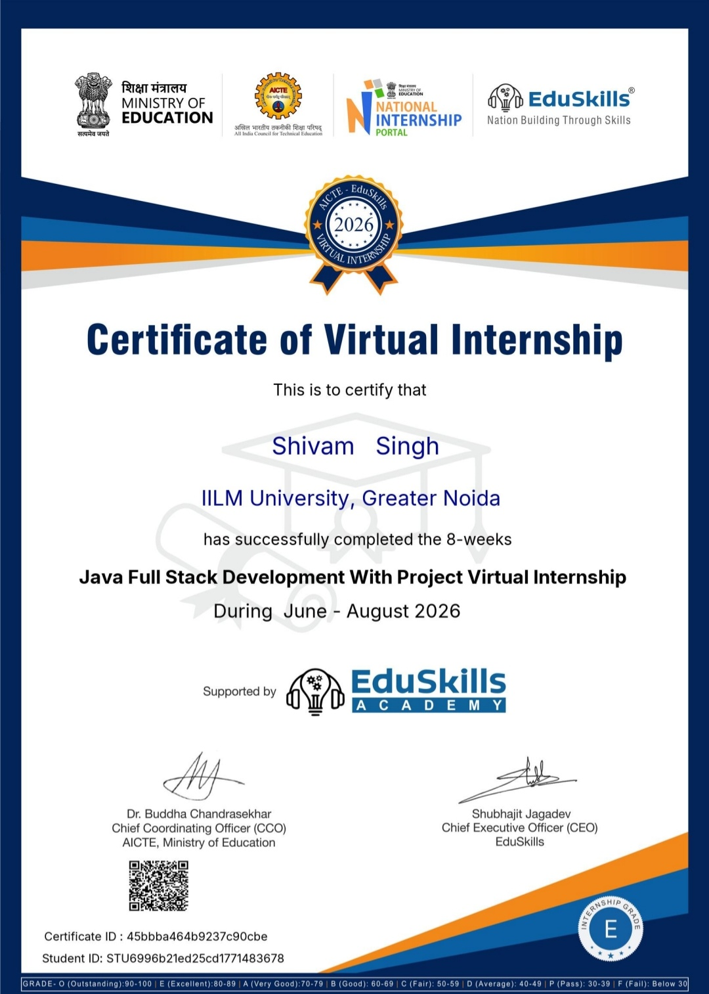



CERTIFICATION
Successfully Completed
Grade
E – Excellent
Certificate ID
45bbba464b9237c90cbe
Student ID
STU6996b21ed25cd1771483678
Duration
8 Weeks | June – August 2026
Student Result Processing System • Shivam Singh
10

Slide 11
Thank You
Student Result Processing System | AICTE – EduSkills Program
Shivam Singh
Roll No. 2410030363 | IILM University, Greater Noida

