Slide 2
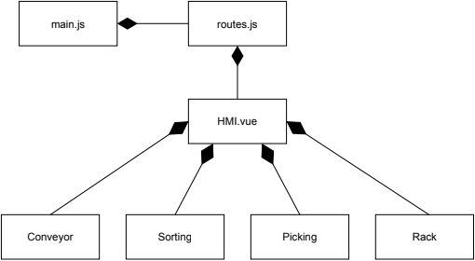
Monolithic Web Based HMI

