Slide 1
Web base HMI: Monolithic to microservice
Team 1:
Bahman Bahman-Zangi, Muddasir Shakil and Virendra Ashiwal

Slide 2
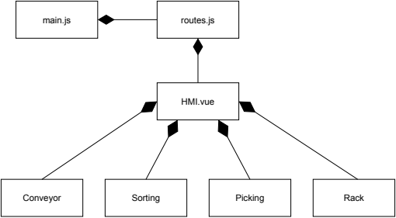
Monolithic Web Based HMI

