Slide 1
Sales Performance Insight
Overview of Sales and Profit Metrics
BY Ashiya Lambu

Slide 2
Dashboard Overview
This dashboard provides a comprehensive analysis of sales and profit data for 2013 in Canada across various segments and product categories. It includes key performance metrics, monthly trends, and comparisons between different products and segments.

Slide 3
Key Metrics
- Total Sales: $118,726,350
- Total Profit: $16,893,702
- Total Gross Sales: $127,931,599
These key metrics provide a snapshot of the overall sales and profit performance for the year. They are crucial for assessing the business's financial health.

Slide 4
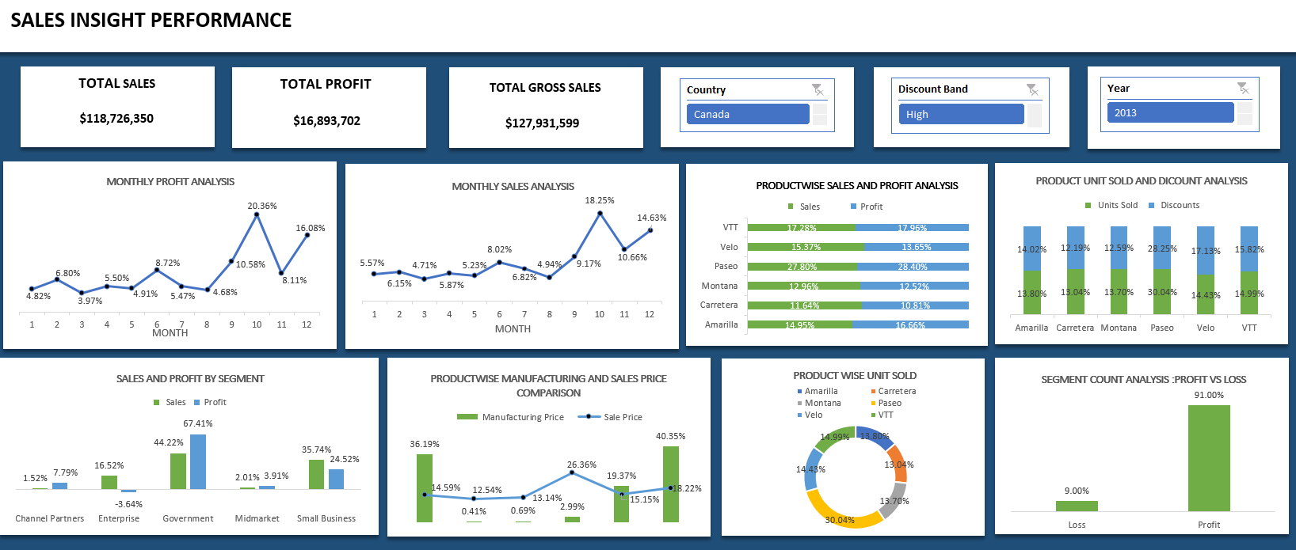

Slide 5
Monthly Profit Analysis
This chart tracks the monthly profit trends throughout the year. Significant profit peaks can be observed in October (20.36%) and December (16.08%), indicating potential seasonal factors or successful marketing strategies.

Slide 6
Monthly Sales Overview
The Monthly Sales Overview chart shows the sales performance each month. There is a correlation between sales and profit, with significant sales spikes in October and December, which align with the profit peaks, indicating strong sales performance during these months.

Slide 7
Product Sales & Profit Analysis
This chart compares sales and profit across different products. The 'Paseo' product stands out with the highest profit margin of 28.40%, indicating it is a key contributor to the overall profitability of the business.

Slide 8
Segment Count Analysis: Profit vs. Loss
This pie chart illustrates the distribution of profit and loss across various segments. The majority of segments are profitable (91% segments), while only a small portion incurs losses (9% segments). This highlights the segments that need strategic attention.

Slide 9
Sales & Profit by Segment
This chart compares sales and profit across different segments. The 'Government' segment shows the highest sales and profit percentage at 44.22%(sales) and 67.41%(profit) indicating it is the most profitable segment for the business.

Slide 10
Product Manufacturing & Sales Price Comparison
The chart compares manufacturing and sales prices, showing profit margins for each product. Products like VTT and Amarilla, with high manufacturing costs but strong sales prices, have high margins.

Slide 11
Product-wise Unit Sales Analysis
This donut chart shows the breakdown of units sold by product. Top-selling products are identified, such as 'Velo' and 'Paseo', highlighting their contribution to overall sales performance.

Slide 12
Product Unit Sales & Discount Analysis
This chart compares units sold and discounts given for each product. The 'Paseo' product has the highest discount rate of 28.25%, which may be driving higher sales. Analyzing the impact of discounts on sales volume can inform future pricing strategies.

Slide 13
Conclusion & Recommendations
The dashboard provides valuable insights into sales and profit performance across various segments and products. Key recommendations include focusing on high-margin products addressing underperforming segments, and optimizing the pricing strategy to maximize profitability.

