Slide 1

How Do You DevOps
Jon Ash

Slide 2
Who Is Jon Ash
Worked for HMB nearly 3 years
Married and Father of 3 (5yrs , 3yrs, 1yr)
Love Cooking(Eating) and Games
Co-Host of the 6FigureDeveloper Podcast

Slide 3
Overview
Definition of DevOps
How Can We Measure Success
Does DevOps Matter
How Can We Improve

Slide 4
Definition of DevOps
DevOps is the union of people, process, and technology to enable continuous delivery of value to customers.
- Donovan Brown, League of Extraordinary Cloud DevOps Advocates (LoECDOA)

Slide 5
The Union of People, Process, and Technology
People > Process > Technology

Slide 6

To Enable Continuous Delivery of Value to Customers
Primary keyword is: Value
Secondary keyword is: Enable

Slide 7
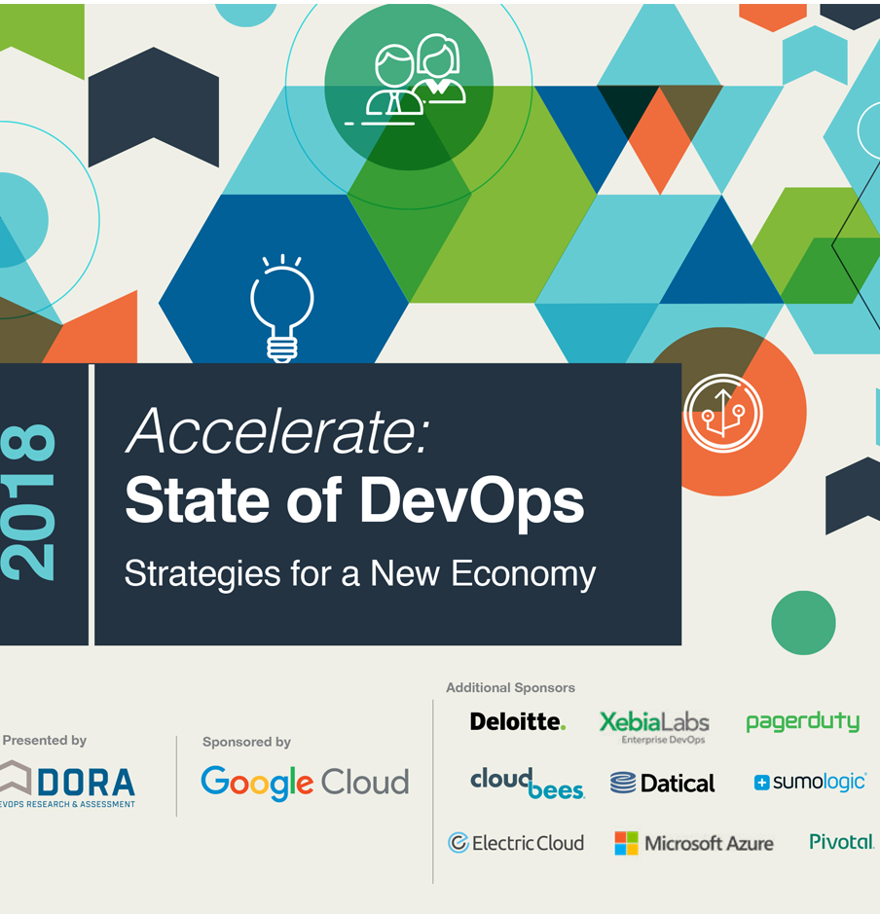
How Can We Measure Success
DevOps Research & Assessment (DORA)
Accelerate: State of DevOps Report 2018
Based on the DORA research, any team across any industry, across all industry verticals, whether subject to a high degree of regulatory compliance or not has the opportunity to achieve a high degree of software delivery performance

Slide 8
Software Delivery & Operational Performance
Throughput
Lead Time
Deployment Frequency
Stability
Change Failure
Time to Restore
Availability

Slide 9
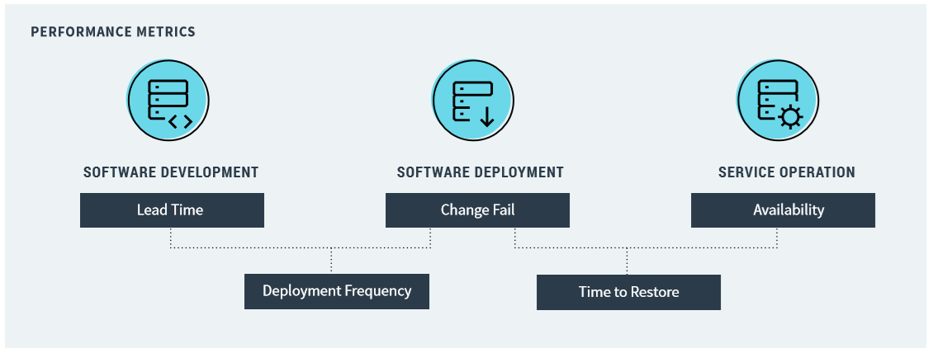
Software Development Lifecycle

Slide 10
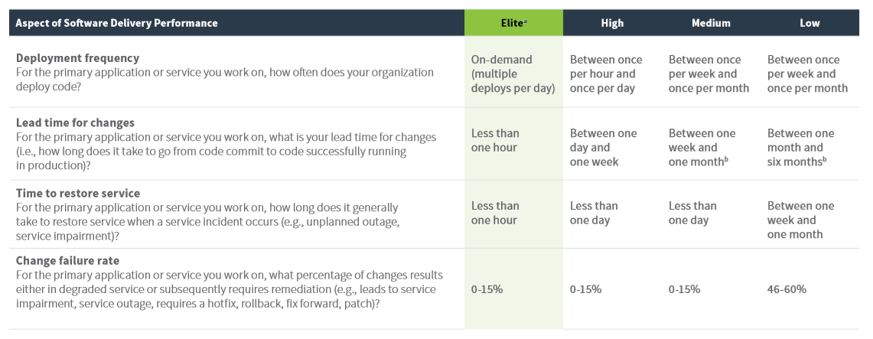
Does DevOps Matter
The 4.5 Groups of Performance
Elite Performers
High Performers
Medium Performers
Low Performers
Misguided Performers

Slide 11
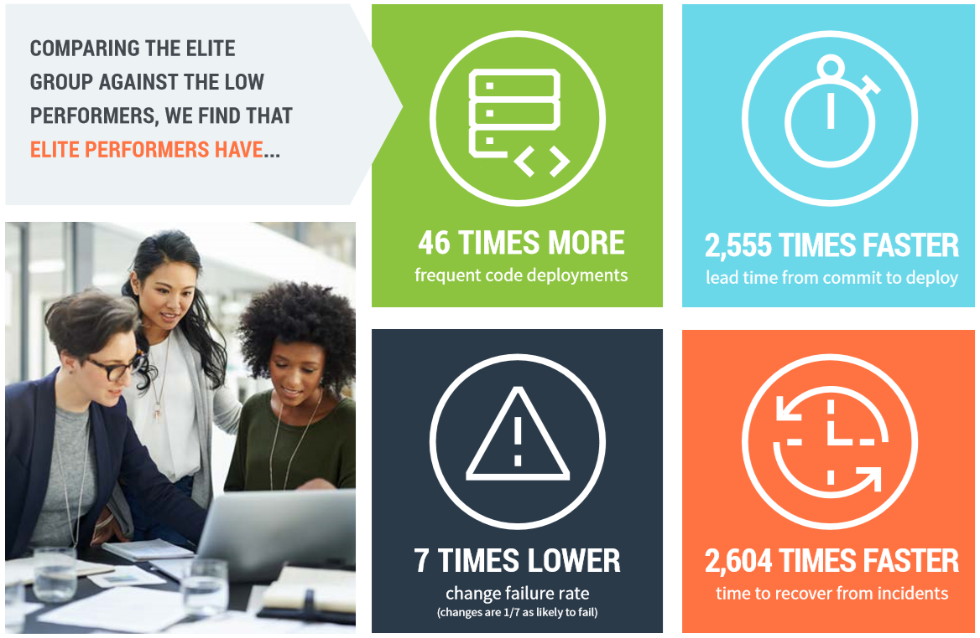
Compare Elite Performers to Low Performers
46x More Frequent Deployments
7x Lower Change Failure
2604x Faster Time to Recover
2555x Faster Lead Time

Slide 12
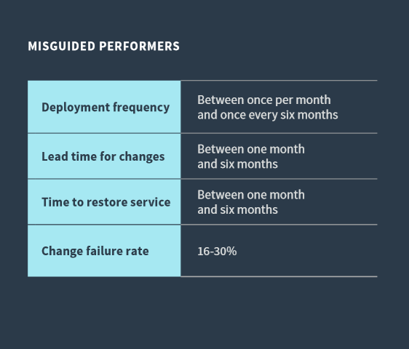
Misguided Performers
They have many characteristics of Low Performers but over-achieved in a couple key areas.
Often they have over-achieved in those areas by becoming more similar to the Low Performers in the other metrics.

Slide 13
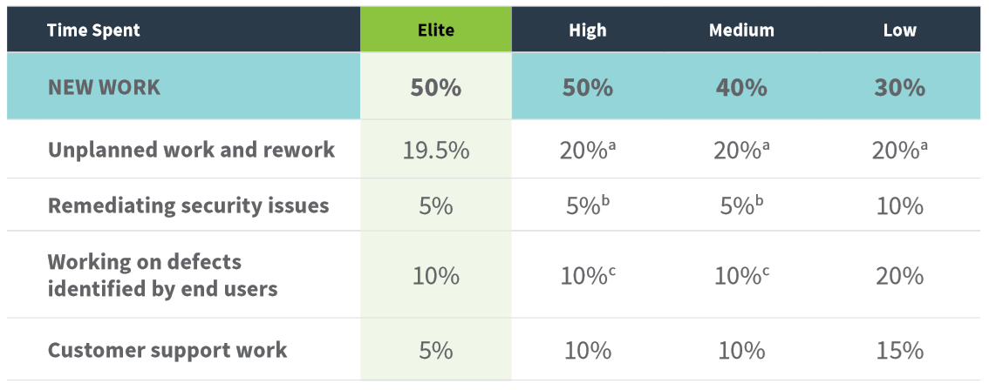
Time Spent

Slide 14
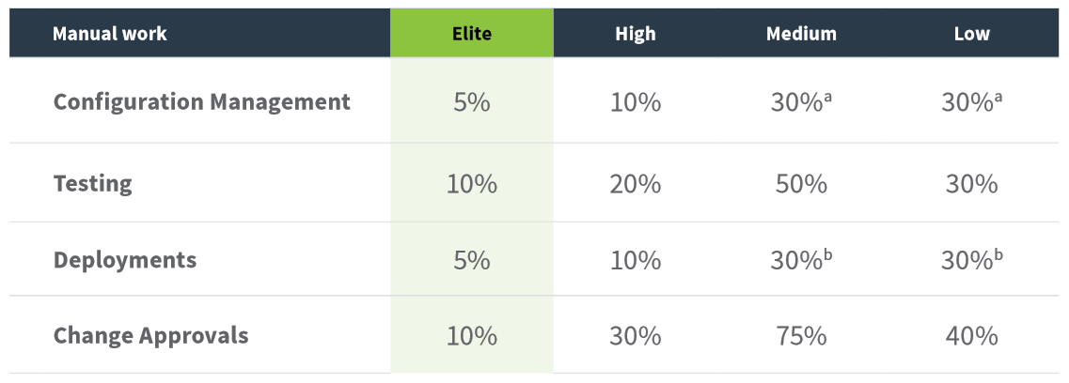
Manual Time

Slide 15
How Do We Improve
The 3 Ways – DevOps HandBook (Gene Kim, Jez Humble)
The First Way: Systems Thinking
The Second Way: Amplify Feed Back Loops
The Third Way: Culture of Continual Experimentation and Learning

Slide 16
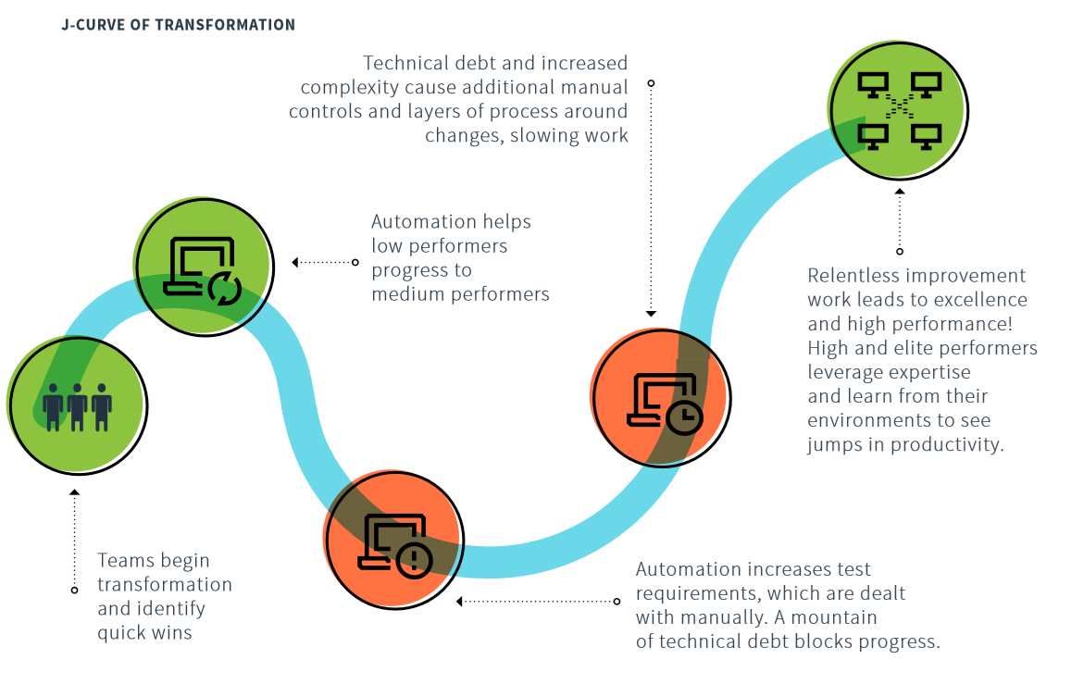
J-Curve of Transformation

Slide 17
Technical Practices
Deployment Automation
Continuous Integration
Trunk-Based Development
Loosely Coupled Architecture
Continuous Testing
Monitoring & Observability
Managing Database Changes
Proactive & Reactive Security

Slide 18
Adopting Characteristics of the Cloud
On-Demand Self-Service
Broad Network Access
Resource Pooling
Rapid Elasticity
Measured Service
Leverage Platform as a Service
Leverage Infrastructure as Code

Slide 19
Lean Approach to Product Development
Small Batches Release Frequently
The extent to which teams slice up products and features into small batches that can be completed in less than a week and release frequently, including the use of minimum viable products (MVPs)
Feedback Loop Drives Changes
Whether organizations actively and regularly seek customer feedback and incorporate this feedback into the design of their products
Autonomy to Change Process Bottom-Up
Whether development teams have the authority to create and change specifications as part of the development process without requiring approval

Slide 20
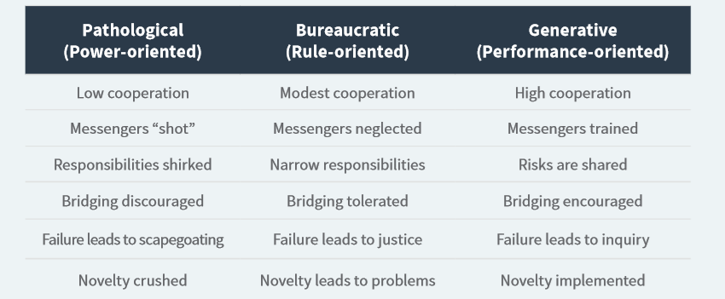
Culture is Key

Slide 21
Extension of Agile
We are uncovering better ways of developing software by doing it and helping others do it. Through this work we have come to value:
Individuals and interactions over processes and tools
Working software over comprehensive documentation
Customer collaboration over contract negotiation
Responding to change over following a plan

Slide 22
Summary
DevOps is the union of people, process, and technology to enable continuous delivery of value to customers.
A teams success can be measured by throughput and stability.
DevOps impact can be massive.
Follow the 3 Ways of DevOps for Improvement

Slide 23
Questions?

