Slide 1
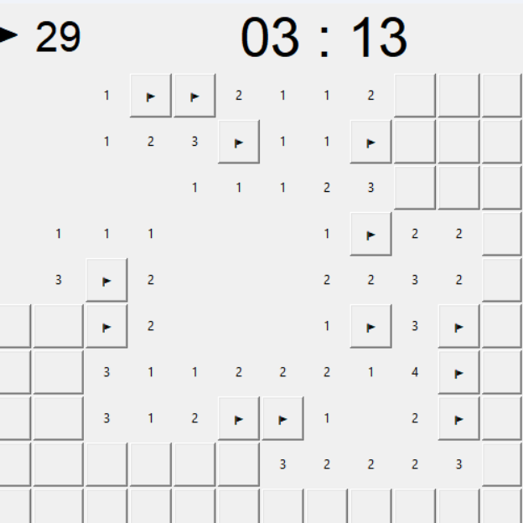
Minesweeper in Python
Astrid Kristiaan
Kiki van Elsen
Oscar van Zelm
Stijn te Braake

Slide 2
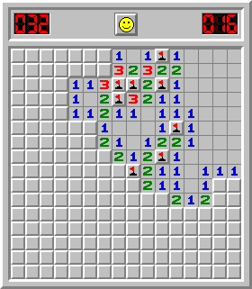
Case description
What is minesweeper?
Why minesweeper?
Challenges

Slide 3
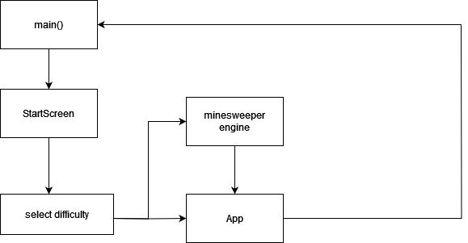
Code overview
Engine class
Rules of the game
Config class
Configurations regarding difficulty and board size
App class
GUI
Main class
Launches the GUI

Slide 4
Code highlights
def reveal(self, row, col): # lays mines after the first tile has been selected, so the first tile will never be a mine if self.pristine: self.lay_mines(row, col) self.assign_numbers() self.pristine = False # selects tile tile = self.board[row][col] # only reveals tiles that are neither revealed nor flagged if not tile.revealed and not tile.flagged: tile.revealed = True # reveals all surrounding tiles recursively if no mines are adjacent if tile.number == 0: for neighbour in self.adjacent(row, col): self.reveal(neighbour.row, neighbour.col) # checks for game over after reveal self.game_over()

Slide 5
def new_difficulty_level_window(self): """ Creates the buttons with which the player can set the difficulty for the game (easy/normal/hard). Clicking the button initialises the creation of the board based on the settings the player selected. """ button_frame = tk.Frame(self) button_frame.pack(pady=20) label = tk.Label(button_frame, text="Select difficulty level:") label.grid(row=0, column=0, columnspan=3) easy_button = tk.Button(button_frame, text="Easy", command=self.easy) easy_button.grid(row=1, column=0) normal_button = tk.Button(button_frame, text="Normal", command=self.normal) normal_button.grid(row=1, column=1) hard_button = tk.Button(button_frame, text="Hard", command=self.hard) hard_button.grid(row=1, column=2)

Slide 6
def easy(self): """ Initialised when the player presses the easy button generated in the new_difficulty_level_window function. The starting screen is killed and a new minesweeper GUI is generated on easy settings (low mine count, large safe radius). """ app = App(int(self.ROWS.get()), int(self.COLUMNS.get()), int(self.ROWS.get()) * int(self.COLUMNS.get()) // 6, 2, self.OS.get()) self.destroy() app.mainloop() def normal(self): """ Initialised when the player presses the normal button generated in the new_difficulty_level_window function. The starting screen is killed and a new minesweeper GUI is generated on normal settings (medium mine count, large safe radius). """ app = App(int(self.ROWS.get()), int(self.COLUMNS.get()), int(self.ROWS.get()) * int(self.COLUMNS.get()) // 4, 2, self.OS.get()) self.destroy() app.mainloop()
def hard(self): """ Initialised when the player presses the hard button generated in the new_difficulty_level_window function. The starting screen is killed and a new minesweeper GUI is generated on hard settings (high mine count, small safe radius). """ app = App(int(self.ROWS.get()), int(self.COLUMNS.get()), int(self.ROWS.get()) * int(self.COLUMNS.get()) // 2, 1, self.OS.get()) self.destroy() app.mainloop()

