Slide 1
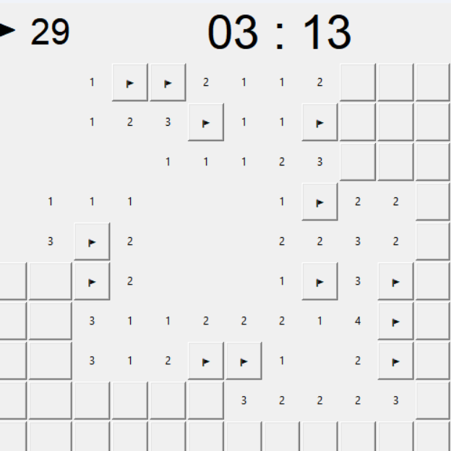
Minesweeper in Python
Astrid Kristiaan
Kiki van Elsen
Oscar van Zelm
Stijn te Braake

Slide 2
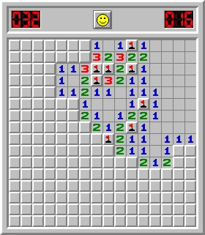
Case description
What is minesweeper?
Why minesweeper?
Challenges

Slide 3
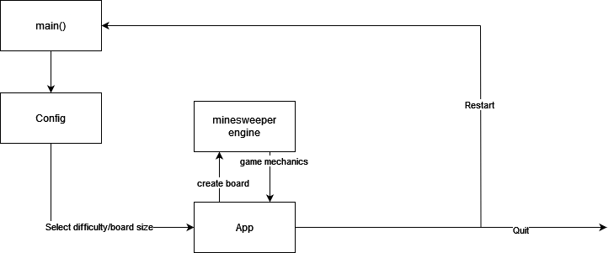
Code overview
Main class
Launches GUI defined in config
Config class
Configurations regarding difficulty, board size, and OS
App class
GUI mine sweeper board
Engine class
Logic of the game
Information on tiles on the board

Slide 4
Code highlights
def reveal(self, row, col):
if self.pristine: self.lay_mines(row, col) self.assign_numbers() self.pristine = False
tile = self.board[row][col] if not tile.revealed and not tile.flagged: tile.revealed = True
if tile.number == 0: for neighbour in self.adjacent(row, col): self.reveal(neighbour.row, neighbour.col)
self.game_over()

Slide 5
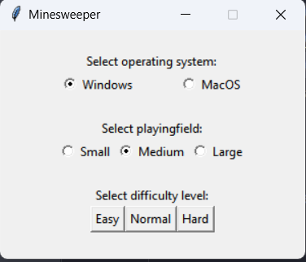

Slide 6
def set_difficulty(self): """ Creates the buttons with which the player can set the difficulty for the game (easy/normal/hard). Clicking the button initialises the creation of the board based on the settings the player selected. """ button_frame = tk.Frame(self) button_frame.pack(pady=20) label = tk.Label(button_frame, text="Select difficulty level:") label.grid(row=0, column=0, columnspan=3) easy_button = tk.Button(button_frame, text="Easy", command=self.easy) easy_button.grid(row=1, column=0) normal_button = tk.Button(button_frame, text="Normal", command=self.normal) normal_button.grid(row=1, column=1) hard_button = tk.Button(button_frame, text="Hard", command=self.hard) hard_button.grid(row=1, column=2)

Slide 7
def hard(self): app = App(self.playfield.get(), self.playfield.get(), self.playfield.get() ** 2 // 2, 1, self.OS.get()) self.destroy() app.mainloop()
class App(tk.Tk): def __init__(self, rows, cols, mines, safe_radius, right_click=3):

Slide 8
def loss(self): self.ticking = False self.show_popup("You lost!") if self.OS == 3: import winsound winsound.PlaySound('assets\\explosion.wav', winsound.SND_FILENAME | winsound.SND_ASYNC)

