Slide 1


Capital Market Management Dashboard

Slide 2

Outline
Introduction
Key features
Demo App Specification
Demo App

Slide 3
Introduction
Parsing a Web Page (i.e. TGJU.org, index: dollar, updating every minute)
Save To Database
Show in a Web App
Update and Refresh

Slide 4

Key features
Real-time Data: Timely insights for swift decision-making.
Intuitive Visuals: Simplified data through user-friendly visuals.
Trend Analysis: Stay ahead with market trend insights.

Slide 5
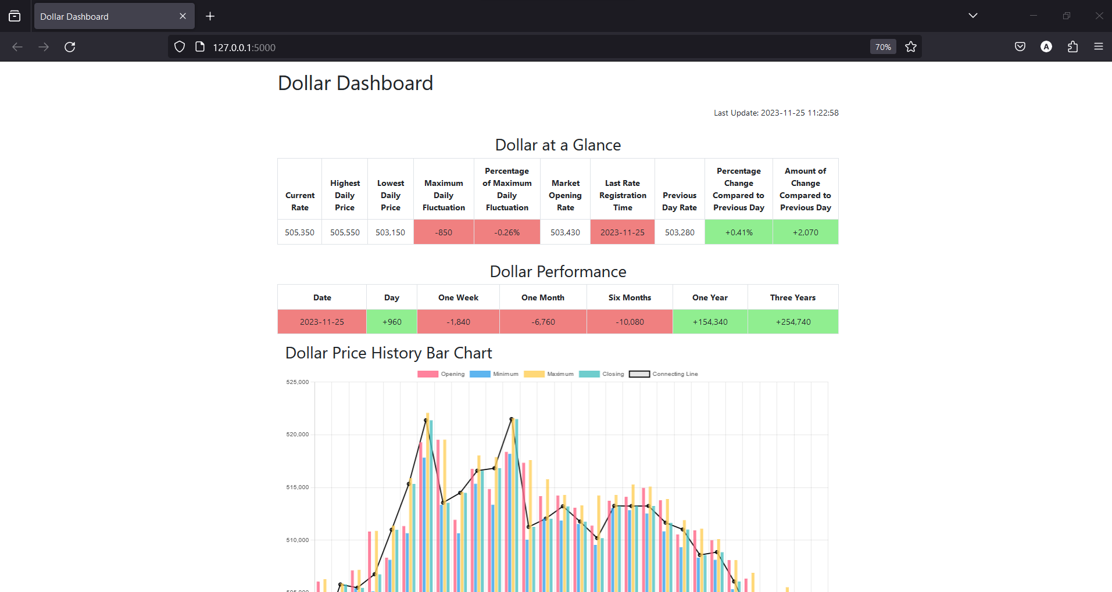
Demo App View
Demo App

Slide 6
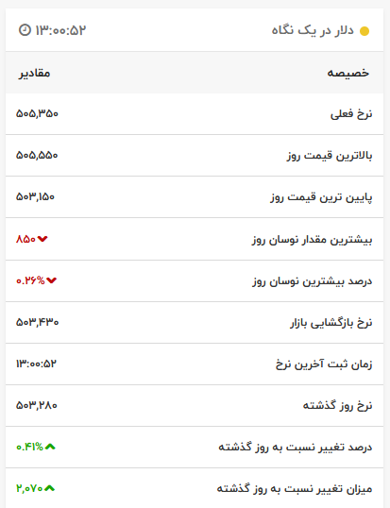
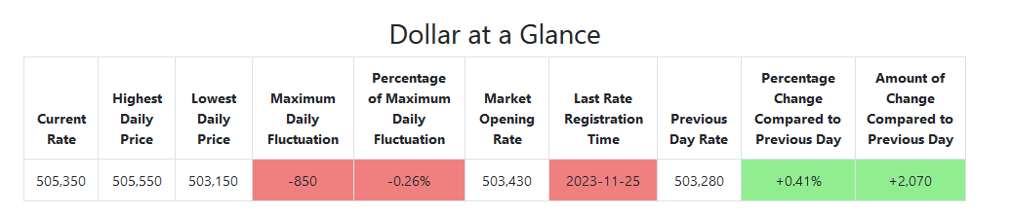
Dollar At a Glance

Slide 7
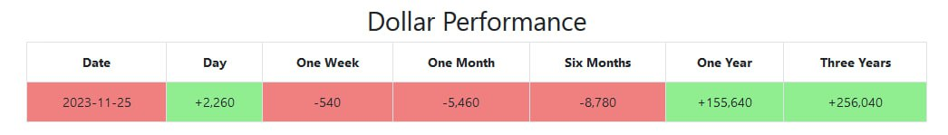
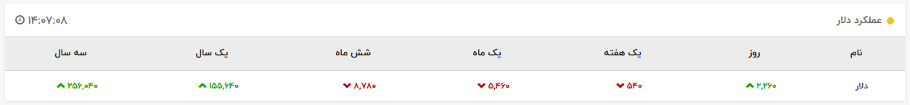
Dollar Performance

Slide 8
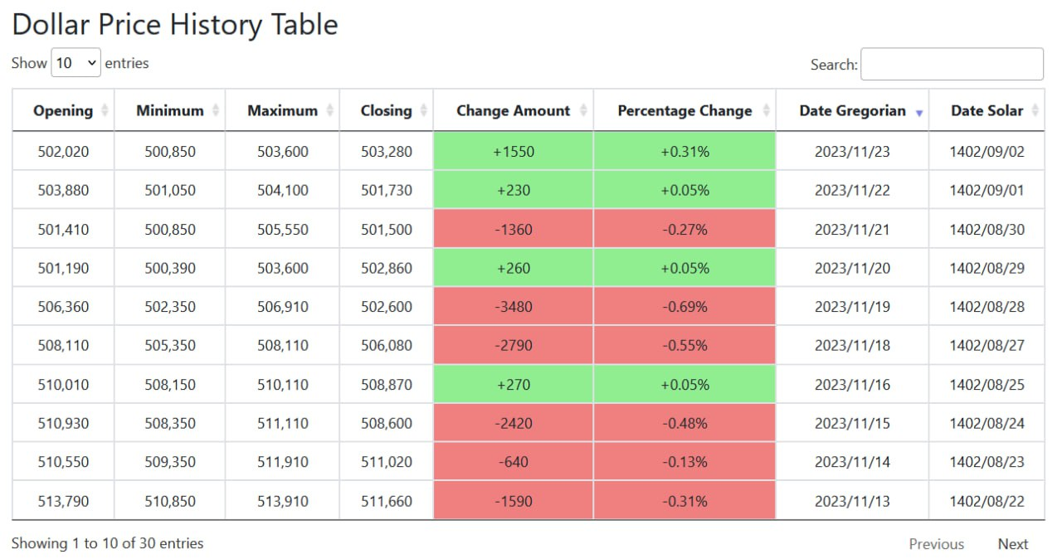
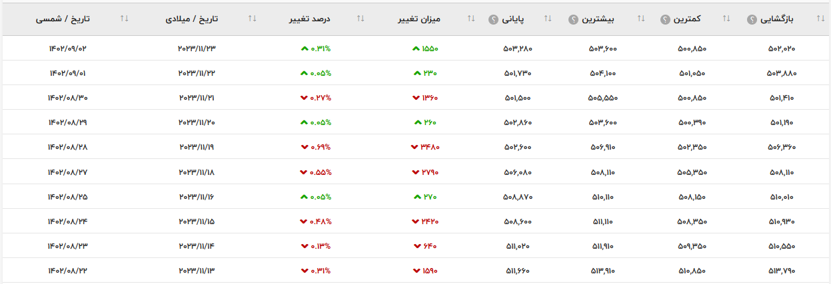
Dollar Price History Table

Slide 9
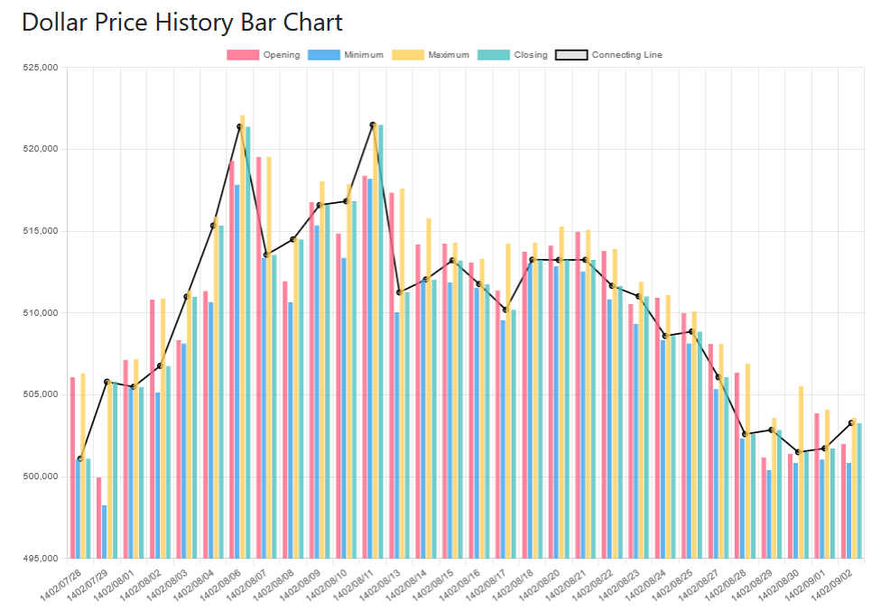
Dollar Price History Bar Chart

Slide 10
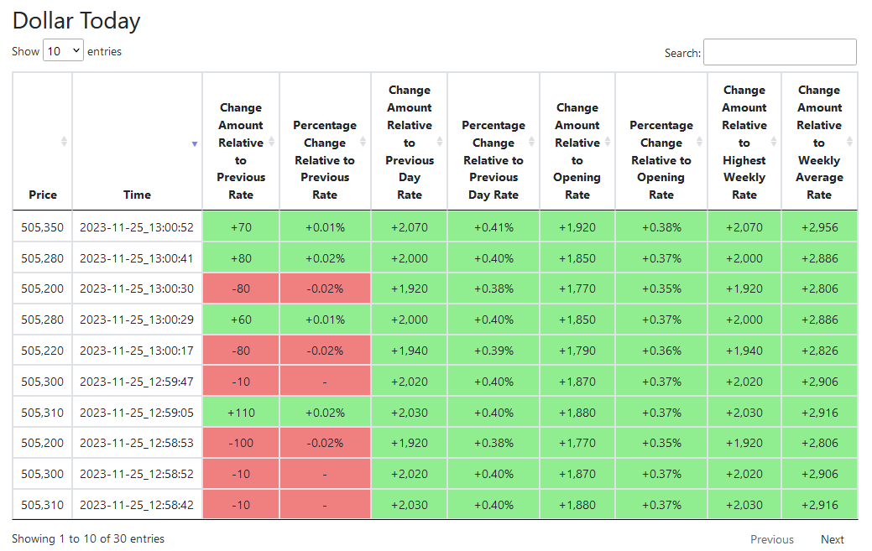
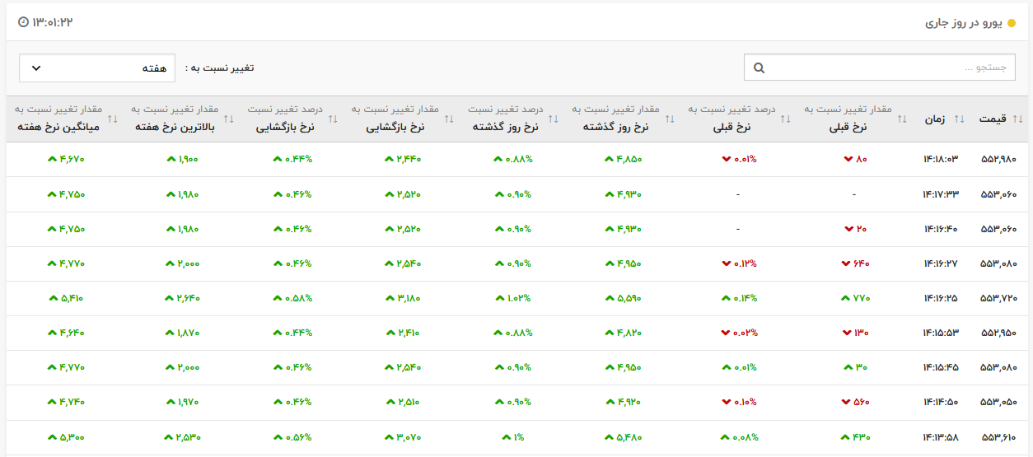
Dollar Price Today

Slide 11
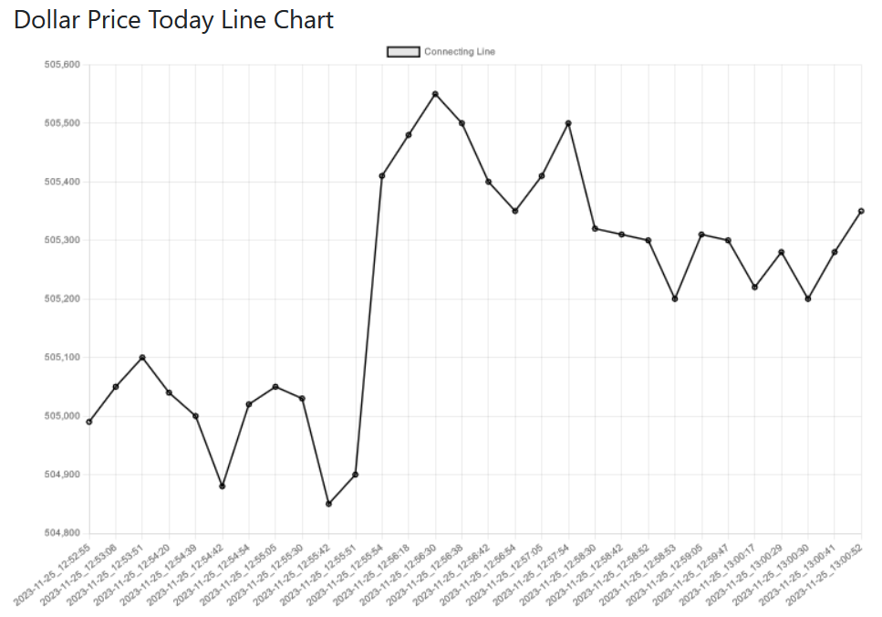
Dollar Price Today Line Chart

