Slide 1
A Comprehensive Evaluation of Fisher-Weighted Model Merging Methods
Based on the paper Merging Models with Fisher-Weighted Averaging
Ashkan Ansarifard

Slide 2
Timeline
Merging on two MLP/CNN models trained on MNIST with Fisher and isotropic approaches.
The impact of Fisher weighting, layer-specific merging, and Fisher scaling on model performance.
Literature
Merging Two MLPs / CNNs
Divergent Model Merging
Ablation Studies
Robustness to Noise
A brief review of merging and fisher-info matrix
Merging across models trained on different datasets or with different hyperparameters.
How well merging handles noisy models

Slide 3
Timeline
Evaluated the ability of merged models to transfer knowledge to related downstream tasks (e.g., CIFAR-10 → CIFAR-100).
Visualized Fisher Information layer-wise to understand which layers contribute most to model merging.
Sensitivity to Fisher Weighting
Fisher Information Visualization
Performance Across Architectures
Generalization to Downstream Tasks
Replicated Figure 3 of the paper to analyze the effect of Fisher scaling parameter β on merged model performance.
Merging techniques across diverse architectures (e.g., ResNet vs. VGG, CNNs, and transformers).

Slide 4
Literature
What is Model Merging?
Combining multiple models' parameters to create a single model that retains their capabilities.
Traditional Approach:
Isotropic merging: Averaging parameters with uniform weights.
Motivation:
Efficient transfer of knowledge between models.
Overcoming limitations of traditional transfer learning (e.g., gradient-based fine-tuning).
Applications:
Model ensembling, robust fine-tuning, intermediate-task transfer.
Notes:
Model merging is a concept where the parameters of multiple models are combined to create a single, unified model that can inherit the knowledge and capabilities of the originals. Traditionally, isotropic merging, which averages parameters with equal weights, has been the go-to method. However, it doesn't always perform well, especially when models have different importance across layers or tasks. The motivation behind model merging is clear: we want an efficient way to transfer knowledge between models without the heavy computational cost of retraining or fine-tuning. This has applications in areas such as ensembling, where multiple models' outputs are combined for better performance, or robust fine-tuning, where pre-trained models are improved for specific tasks while retaining their original capabilities.

Slide 5
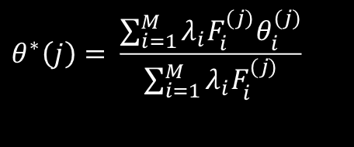
Literature
What is Fisher-Weighted Merging?
An advanced approach to model merging using the Fisher Information matrix.
Key Idea:
Use Fisher Information to weight parameters based on their contribution to the model's performance.
Advantages Over Isotropic Merging:
Better generalization by considering the importance of parameters.
Improved performance on tasks such as intermediate-task transfer learning.
Core Equation:
$$θ^{∗}\left(j\right)= \frac{\sum_{i=1}^{M}{λ_{i}F_{i}^{(j)}θ_{i}^{(j)}}}{\sum_{i=1}^{M}{λ_{i}F_{i}^{(j)}}}$$
Notes:
Fisher-weighted merging builds upon isotropic merging by incorporating the Fisher Information matrix into the process. The Fisher matrix measures the sensitivity of a model's parameters to the training data, effectively indicating which parameters are more critical for the model's performance. By using this information, we can weigh parameters during merging based on their importance, resulting in a more effective transfer of capabilities. Compared to isotropic merging, this method provides a significant advantage, especially in cases where parameter importance varies across layers or tasks. The core equation shows how the Fisher weights are applied to balance the contributions of each model's parameters.

Slide 6
Literature
Applications:
Ensembling: Combining multiple models for better predictions.
Transfer Learning: Efficiently transferring knowledge across tasks and domains.
Robust Fine-Tuning: Balancing pre-trained and task-specific performance
Challenges:
Computational Cost: Estimating the Fisher matrix is resource-intensive.
Divergent Models: Merging models trained on different datasets or with different architectures.
Unmergeable Parameters: Handling task-specific heads or incompatible layers.
Future Directions:
Exploring better Fisher approximations (e.g., Kronecker-factorization).
Scaling to diverse architectures and datasets.
Notes:
Fisher-weighted merging builds upon isotropic merging by incorporating the Fisher Information matrix into the process. The Fisher matrix measures the sensitivity of a model's parameters to the training data, effectively indicating which parameters are more critical for the model's performance. By using this information, we can weigh parameters during merging based on their importance, resulting in a more effective transfer of capabilities. Compared to isotropic merging, this method provides a significant advantage, especially in cases where parameter importance varies across layers or tasks. The core equation shows how the Fisher weights are applied to balance the contributions of each model's parameters.

Slide 7
Model Merging CLI Tool
A Python-based CLI tool for automating model merging workflows.
Key Features:
Supports training, merging, evaluating, and fine-tuning models.
Implements Fisher-weighted merging and isotropic merging techniques.
Handles diverse architectures and datasets (e.g., MLPs, CNNs, transformers).
Customization Options:
Adjustable parameters: Fisher weighting factor, learning rate, dataset selection.
Fine-tuning and evaluation on downstream tasks.
python main.py --model_type cnn --dataset mnist --merge_type fisher --fine_tune True

Slide 8
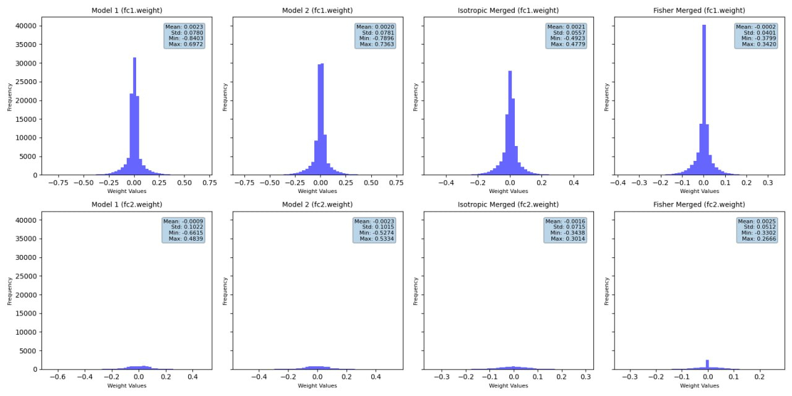
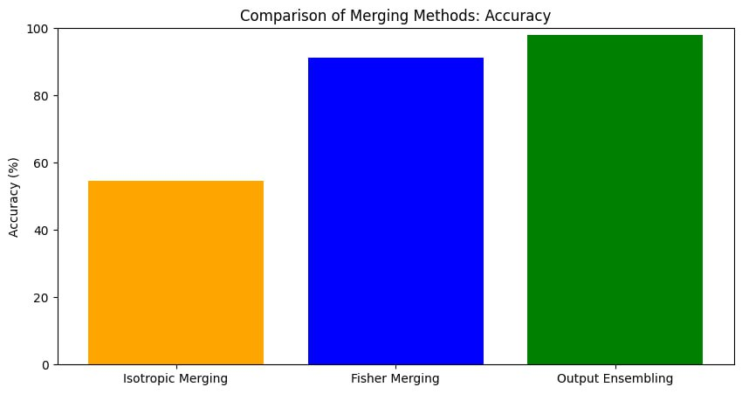
Merging Two MLPs
 | Model1 | Model2 | Fisher | Isotropic | Ensembling
loss | 0.0877 | 0.0831 | 1.2159 | 0.9213 | 0.0668
accuracy | 0.9724 | 0.9746 | 0.9169 | 0.7221 | 0.9788
f1_score | 0.9723 | 0.9746 | 0.9180 | 0.7181 | 0.9788
precision | 0.9726 | 0.9748 | 0.9252 | 0.7977 | 0.9789
recall | 0.9724 | 0.9746 | 0.9169 | 0.7221 | 0.9788
python main.py --command train merge validate visualize --dataset mnist --model mlp

Slide 9
Merging Two CNNs
 | Model1 | Model2 | Fisher | Isotropic | Ensembling
loss | 0.0373 | 0.0402 | 1.3938 | 1.7843 | 0.02967
accuracy | 0.9913 | 0.9913 | 0.9436 | 0.8079 | 0.9926
f1_score | 0.9912 | 0.9912 | 0.9434 | 0.7977 | 0.9925
precision | 0.9913 | 0.9913 | 0.9483 | 0.8356 | 0.9926
recall | 0.9913 | 0.9913 | 0.9436 | 0.8079 | 0.9926
python main.py --command train merge validate visualize --dataset mnist --model cnn

Slide 10
Divergent Model Merging
 | Model1 | Model2 | Fisher | Isotropic | Ensembling
loss | 0.0877 | 0.0831 | 1.2159 | 0.9213 | 0.0668
accuracy | 0.9724 | 0.9746 | 0.9169 | 0.7221 | 0.9788
f1_score | 0.9723 | 0.9746 | 0.9180 | 0.7181 | 0.9788
precision | 0.9726 | 0.9748 | 0.9252 | 0.7977 | 0.9789
recall | 0.9724 | 0.9746 | 0.9169 | 0.7221 | 0.9788
python main.py --command train merge validate visualize --dataset mnist fashion-mnist --model cnn

Slide 11
Ablation Studies

Slide 12
Robustness to Noise

Slide 13
Sensitivity to Fisher Weighting

Slide 14
Performance Across Architectures

Slide 15
Generalization to Downstream Tasks

Slide 16
Thank you!

