Slide 1
We first want to install the required tools including the python and latex compiler. If you have these already installed you can jump to the section of “install the GAME”.

Slide 2
Install anaconda (optional)
For linux:
cd /tmp
curl -O https://repo.anaconda.com/archive/Anaconda3-2019.03-Linux-x86_64.sh
sha256sum Anaconda3-2019.03-Linux-x86_64.sh
bash Anaconda3-2019.03-Linux-x86_64.sh
For windows:
https://www.anaconda.com/distribution/

Slide 3
Make a fresh environment (optional)
In a command prompt with conda enabled:
conda create --name <your-env-name>
conda env list --> to list all available enviroments

Slide 4
Install Jupyter notebook and Spyder
To work easier with python scripts, these are good tools: In a command prompt with conda enabled:
conda install jupyterlab
conda install notebook
conda install spyder

Slide 5
Install pdflatex, pythontex (or any other compiler is required to compile your tex file)
For linux:
sudo apt-get install texlive-base
sudo apt-get install texlive-extra-utils
sudo apt-get install texlive-fonts-extra
sudo apt-get install texlive-fonts-recommended
sudo apt-get install texlive-generic-recommended
sudo apt-get install texlive-latex-base
sudo apt-get install texlive-latex-extra
sudo apt-get install texlive-latex-recommended
For windows:
https://miktex.org/

Slide 6
Install the GAME
- The GAME package
in a termina cd to a folder that you want to save the GAME package then:
git clone https://github.com/ashkans/GAME
cd GAME
pip install –user –e .
- The training folder
git clone https://github.com/ashkans/GAME_training

Slide 7
Working with GAME
You can run the GAME in two modes:
using GAME standard format,
An explanation is provided in: “GAME_training/assignmentGenerator-StandardFormat.ipynb” This file could be read using jupyter notebook.
To run:
In a terminal cd to the training folder, then run (jupyter notebook). You can find the training file there.
introducing a pre-defined Tex file to just be reproduced for all students. This method is explained in the next slides.

Slide 8
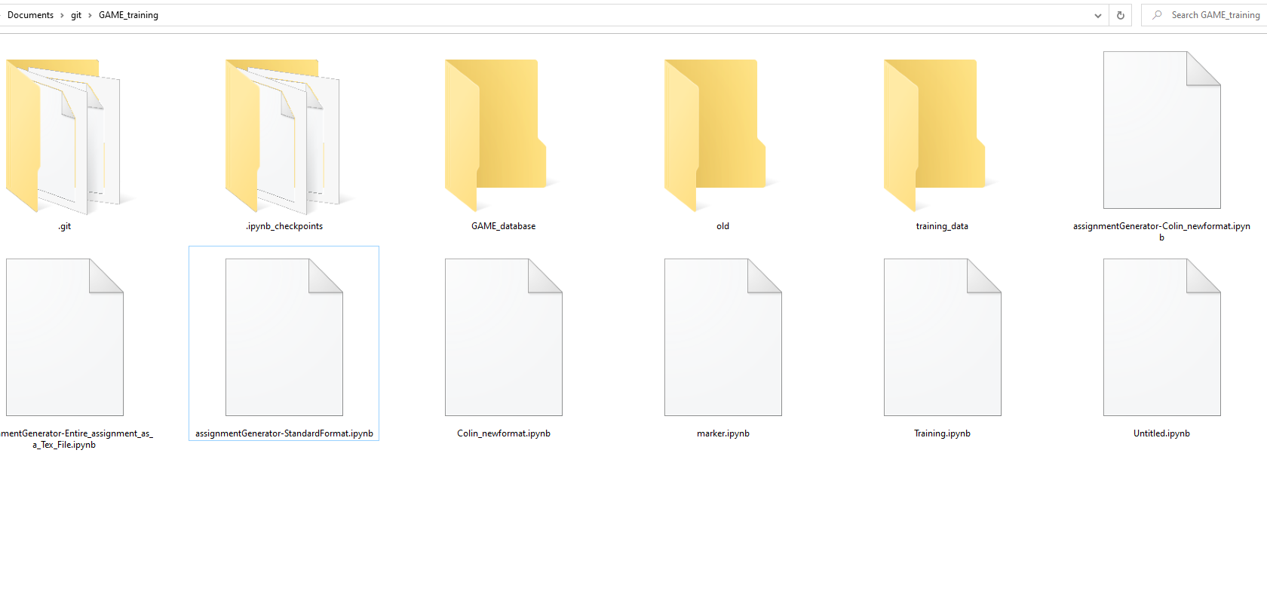
Pre-define tex file (probably with pythontex for randomization)
To work with GAME, you need a GAME_database which contains all the questions and assignments as subfolder.

Slide 9
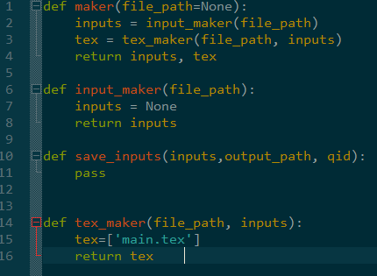
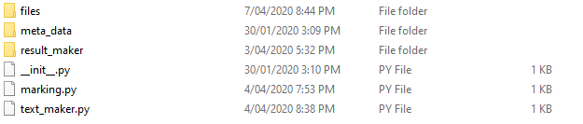
The folder named “Colin” is a sample template. This folder contains all the files that GAME needs to generate randomized pdfs for students. To make a new template, you need to:
make a copy of this folder,
delete all the files in the “files” folder, and replace them with the new files. Any required files which is needed for the comiling the tex file should be placed in this folder.
in the tex_maker.py in the “tex_maker” function “tex = [‘main.tex’]” should be pointing to the main tex file in “files” folder

Slide 10
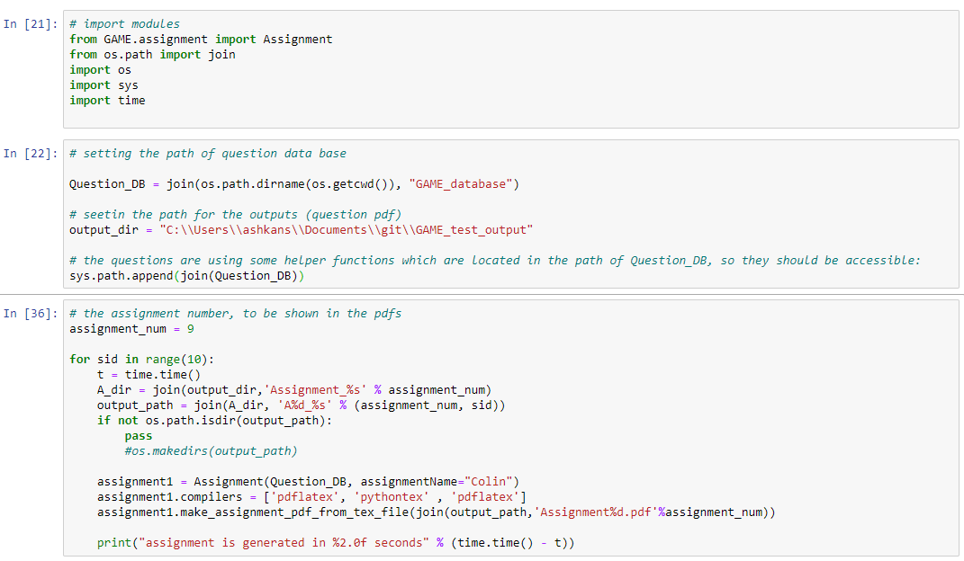
Now the template is ready. You can run:
"GAME_training/assignmentGenerator-Entire_assignment_as_a_Tex_File.ipynb” python notebook
or
“GAME_training/assignmentGenerator-Entire_assignment_as_a_Tex_File.py” script
This should refer to the database folder
This should refer to the output folder
Name of the template folder
The compilers sequence which the tex file should be compiled with. These should be already installed.

