Slide 1
Software Engineering
Weekly report LumberLads
Gennady Evtodiev
01.06.2019

Slide 2
Project CHARTER
Project goals and vision
Interactive web site
Working with real clients for real lumber company
Project description
Buy and store lumber in multiple destinations
Cut logs of different dimensions into lumber

Slide 3
Architecture, high level design
Github, MySQL server, php server
PHP, Javascript, HTML, CSS, SQL
Heroku, webhost or any other free host to deploy the project

Slide 4
Organizational Structure
Project manager, Designer, Developer, Tester: Gennady Evtodiev
The owner and client: Evgeniy Philipov
Budget: 171 hours
Notes:
CRM – customer relationship manager / teacher

Slide 5
Communication Model
Everyday brainstorm on my own of what I have accomplished and what still have to be done. Progress check up
Weekly reports to a client
Weekly presentation of the project

Slide 6
Key Accomplishments For Reporting Period
Kick off, SOW, PMP, Project report, Test report
Finished database and testing it.
3038 lines of code so far what I have done
Front page, Uploading documents with dimensions page
Inventory page and connecting to database
Lumber order page
Recipe page
Cutting wood option
Updating database ability

Slide 7
Schedule Accuracy
Past Accomplishments | Plan | Actual
Task/Milestone | DD-MMM-YYYY | DD-MMM-YYYY
Creating order function | 06-05-2019 | 06-05-2019
Create page recipes | 06-05-2019 | 06-05-2019
Ability to check recipe by number | 13-05-2019 | 13-05-2019
Connect recipes to database for update and functionality | 13-05-2019 | 13-05-2019
Future Milestones | % | Plan | Forecast
Task/Milestone | % | DD-MMM-YYYY | DD-MMM-YYYY
Testing and bug fixing |  | 31-05-2019 | 31-05-2019
Deploying of the project |  | 31-05-2019 | 31-05-2019

Slide 8
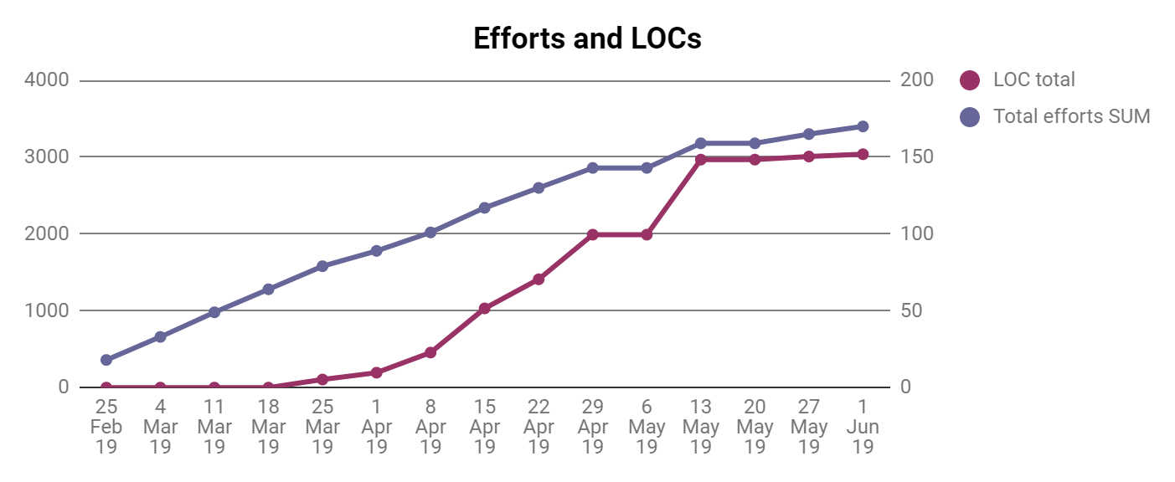
Development

Slide 9
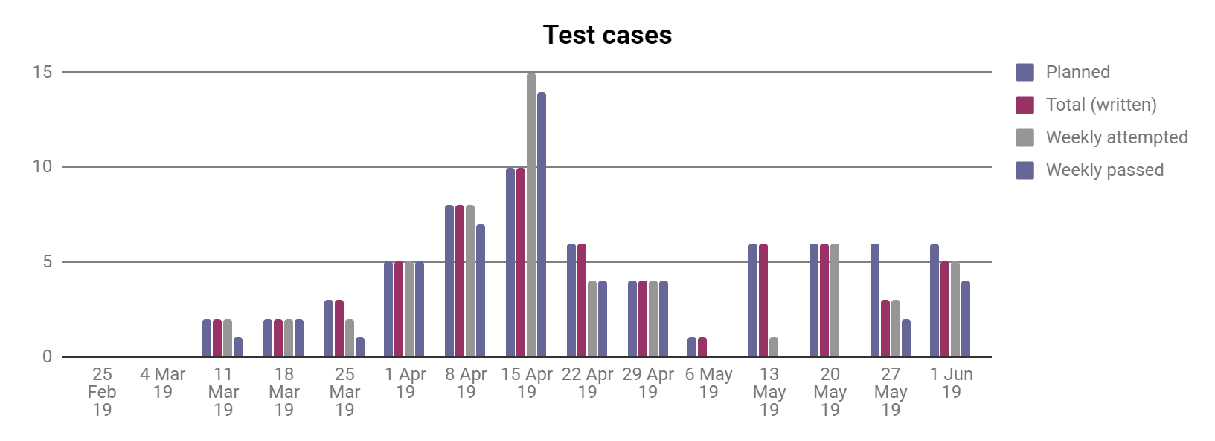
Testing

Slide 10
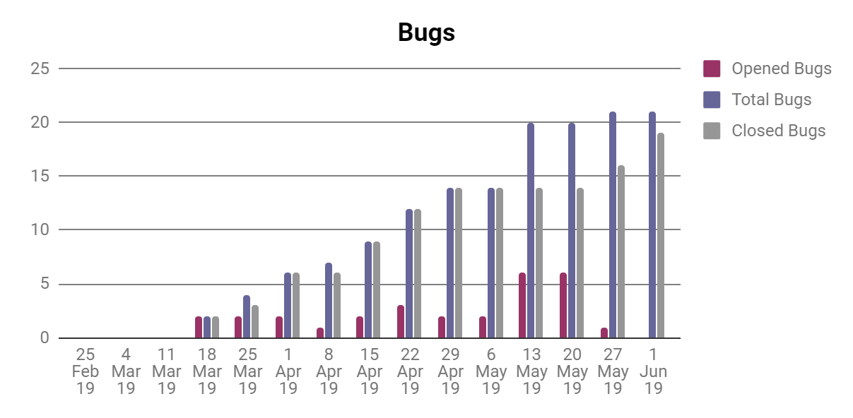
Quality metrics
Notes:
As we can see again total bugs opening and closing rate is being quite active. More tests I do, more bugs I am able to close.

Slide 11
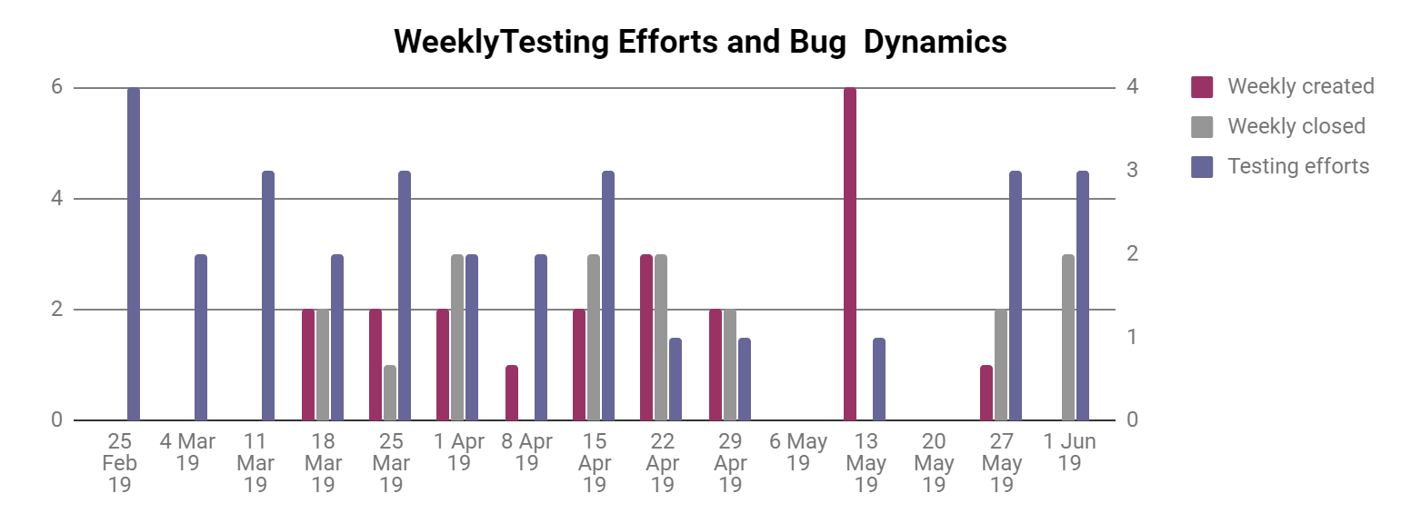
Quality metrics

Slide 12
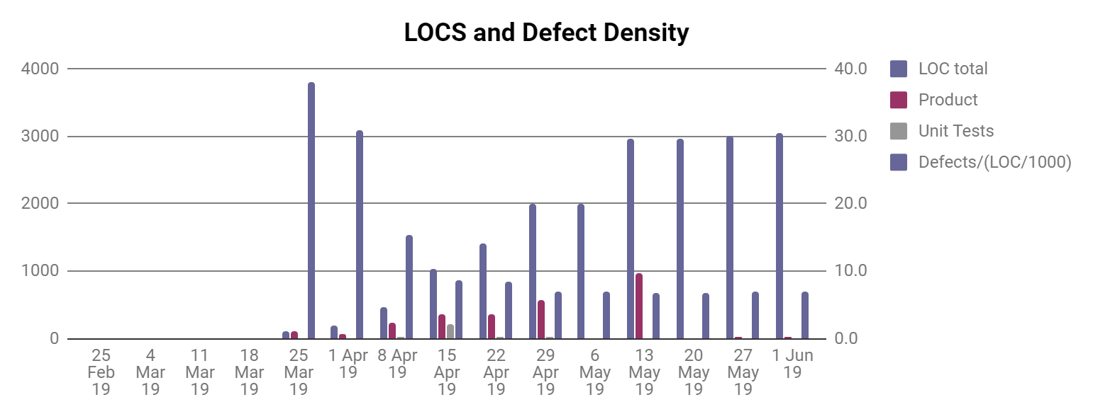
Quality metrics

Slide 13
Risks and Issues
Risk/Риск | Possibility(1-5)/Вероятность | Effect on the project, possible solution/Влияние на проект, возможные решения
Health issues | 4 | It will delay the speed and later quality of the project. Postpone the dates of report and so on. I will try to catch up with timing and work faster or more when healed up.
Other classes and work | 3 | It will delay all the due dates and increase the possibility of mistakes and bugs due to trying to catch up. Work more, sleep less, try to work faster.
Technical issues with hardware | 2 | It will delay all the due dates. I shall try to take care of my hardware and upgrade in timely manner.
Third-party code won’t be working properly | 2 | More time on learning and fixing. A slight delay in overall work. Might downgrade the functionality.
Third-party servers don’t work properly | 1 | Just delay in deployment and integration.
Not enough resources to complete desired features | 1 | Slight changes in the design and planning. Communication with client upon those questions.
Family business related issues | 5 | Do the overkill on the weeks where I have time and get done as much as possible
Notes:
Risks didn’t change so far

Slide 14
Thank you

