Slide 1
Технологии разработки ПО / Software Engineering
Weekly report LumberLads
Gennady Evtodiev
13.05.2019

Slide 2
Описание проекта / Project CHARTER
Цели и видение проекта / Project goals and vision
Interactive web site
Working with real clients for real lumber company
Краткое описание проекта / Project description
Buy and store lumber in multiple destinations
Cut logs of different dimensions into lumber

Slide 3
Архитектура, техническое решение / Architecture, high level design
Github, MySQL server, php server
PHP, Javascript, HTML, CSS, SQL
Heroku or any other free host to deploy the project

Slide 4
Организационная структура / Organizational Structure
Project manager, Designer, Developer, Tester: Gennady Evtodiev
The owner and client: Evgeniy Philipov
Budget: 170 hours
Notes:
CRM – customer relationship manager / teacher

Slide 5
Коммуникационная Модель / Communication Model
Everyday brainstorm on my own of what I have accomplished and what still have to be done. Progress check up
Weekly reports to a client
Weekly presentation of the project

Slide 6
Основные Достижения Отчетного Периода / Key Accomplishments For Reporting Period
Kick off, SOW, PMP
Finished database and testing it.
2968 lines of code so far what I have done
Front page, Uploading documents with dimensions page
Inventory page and connecting to database
Lumber order page
Recipe page
Cutting wood option
Updating database ability

Slide 7
Выполнение Графика /Schedule Accuracy
Past Accomplishments | Plan | Actual
<Task/Milestone> | <n>% | DD-MMM-YYYY
connecting database to a project | 22-04-2019 | 22-04-2019
page with inventory | 22-04-2019 | 22-04-2019
function to order lumber, ability to store lumber and update database after cut | 29-04-2019 | 29-04-2019
Finished Algorithm of the most efficient cut, tested | 29-04-2019 | 29-04-2019
Future Milestones | % | Plan | Forecast
<Task/Milestone> | <n>% | DD-MMM-YYYY | DD-MMM-YYYY
Creating order function |  | 06-05-2019 | 06-05-2019
Create page recipes |  | 06-05-2019 | 06-05-2019
Ability to check recipe by number |  | 13-05-2019 | 13-05-2019
Connect recipes to database for update and functionality |  | 13-05-2019 | 13-05-2019

Slide 8
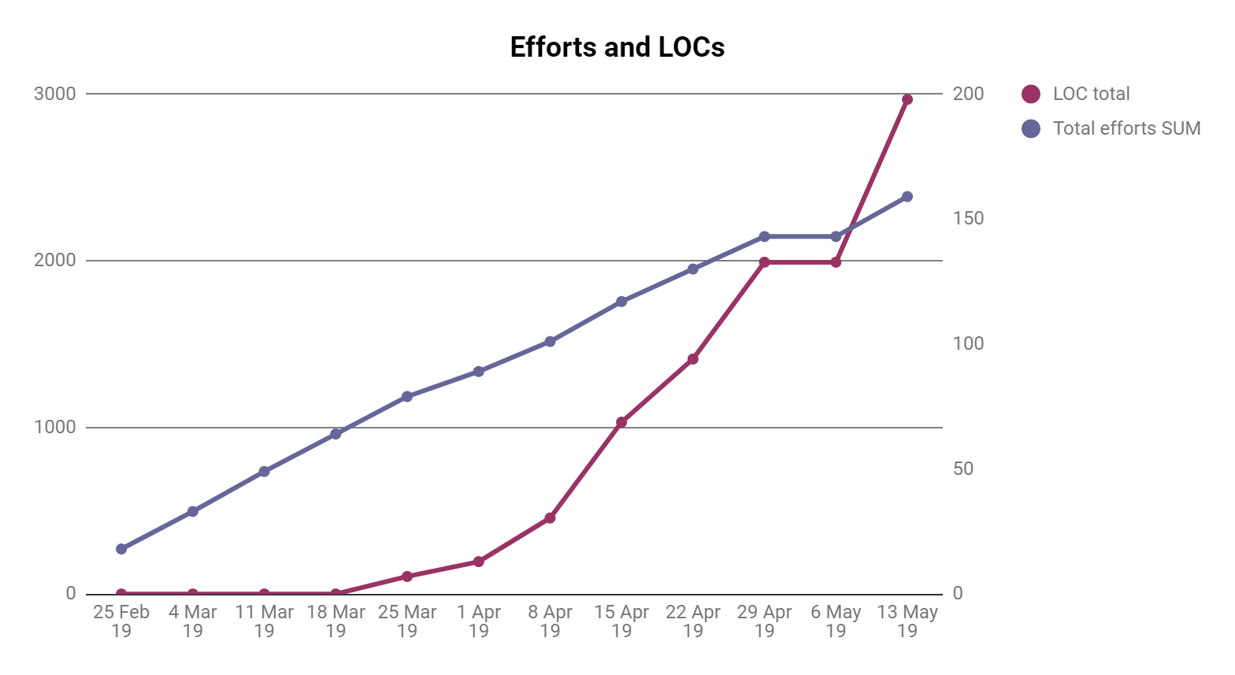
Разработка
Now we can see that my ratio is very good and LOC exceeded total efforts and bugs and summary which I am very happy with

Slide 9
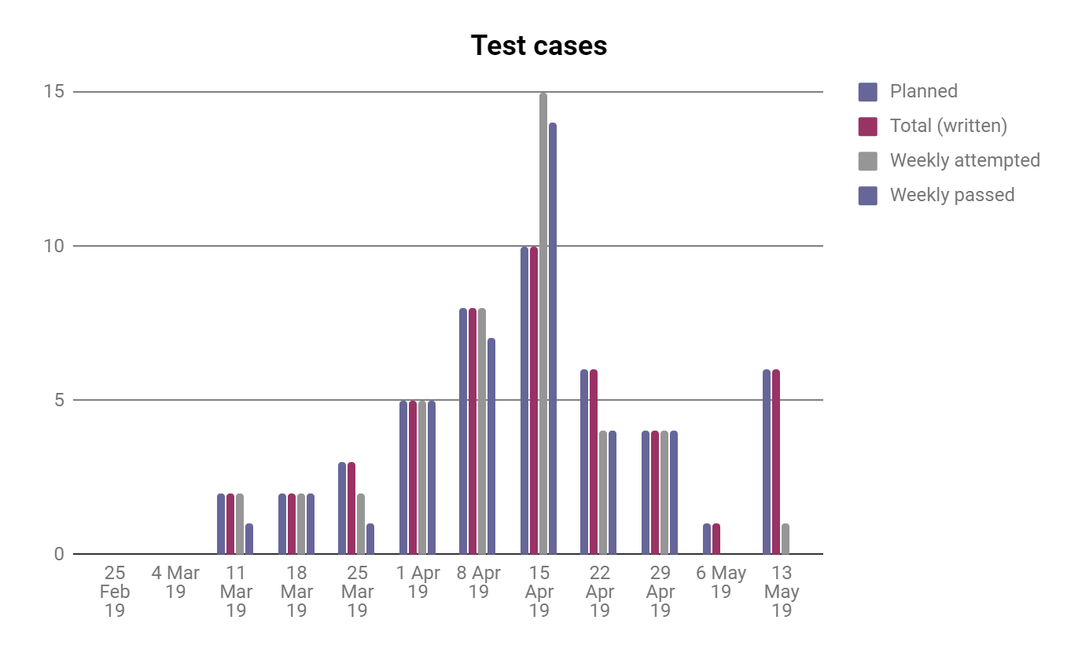
Тестирование
So, we can see that as more I code the more bugs I create and more bugs I have to fix. So far fixed all new and old ones

Slide 10
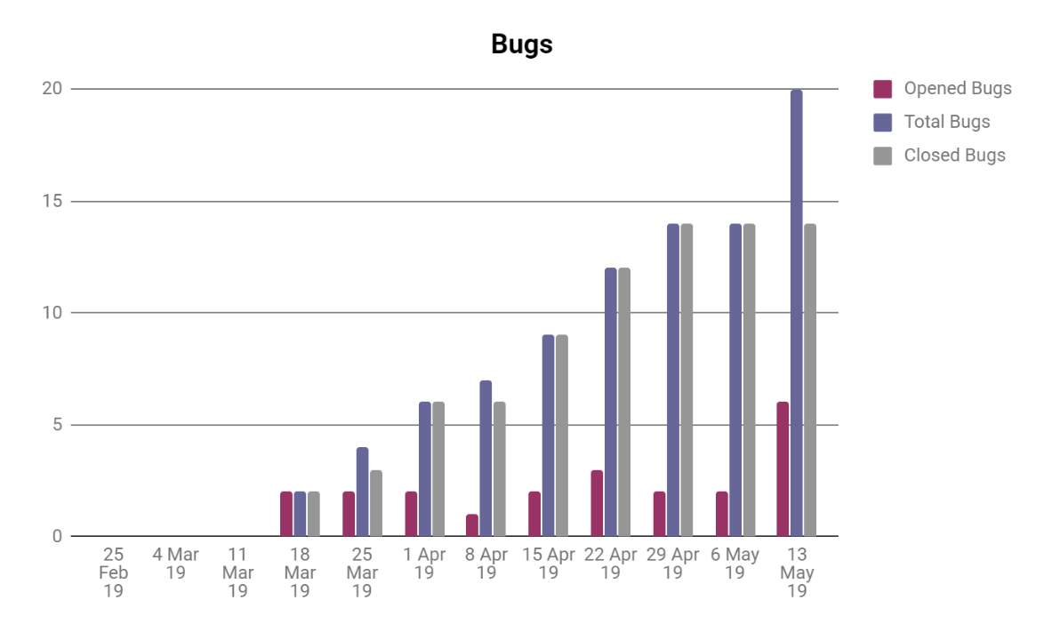
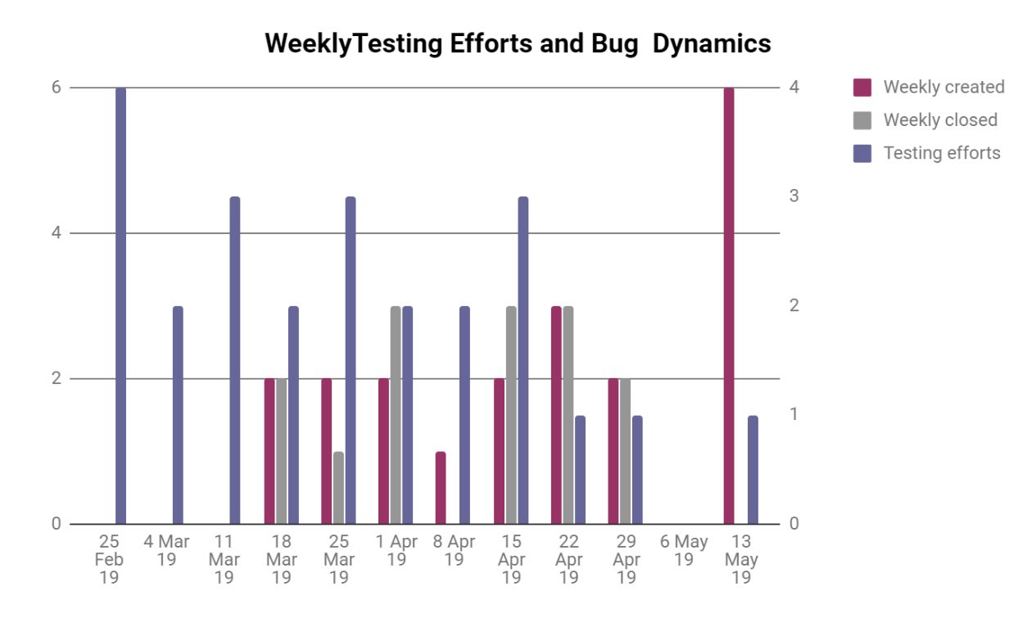
Метрики по качеству
Notes:
As we can see again total bugs opening and closing rate is being quite active. More tests I do, more bugs I am able to close.

Slide 11
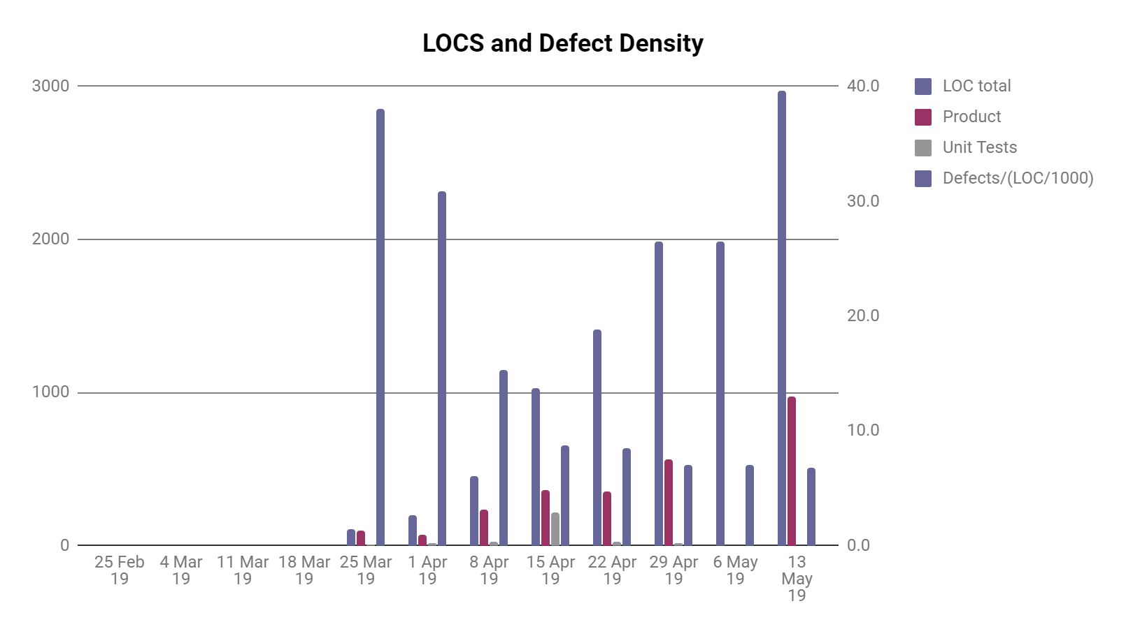
Метрики по качеству
Here we can see that more lines of codes I have, less defects density I have, so this number will only get smaller with time hopefully. To compare I used to have 67.4 defects ratio at one point which is very high due to a low amount of code, now this number is 6.7 which is very good and satisfying number

Slide 12
Риски и Проблемы / Risks and Issues
Risk/Риск | Possibility(1-5)/Вероятность | Effect on the project, possible solution/Влияние на проект, возможные решения
Health issues | 4 | It will delay the speed and later quality of the project. Postpone the dates of report and so on. I will try to catch up with timing and work faster or more when healed up.
Other classes and work | 3 | It will delay all the due dates and increase the possibility of mistakes and bugs due to trying to catch up. Work more, sleep less, try to work faster.
Technical issues with hardware | 2 | It will delay all the due dates. I shall try to take care of my hardware and upgrade in timely manner.
Third-party code won’t be working properly | 2 | More time on learning and fixing. A slight delay in overall work. Might downgrade the functionality.
Third-party servers don’t work properly | 1 | Just delay in deployment and integration.
Not enough resources to complete desired features | 1 | Slight changes in the design and planning. Communication with client upon those questions.
Family business related issues | 5 | Do the overkill on the weeks where I have time and get done as much as possible
Notes:
Risks didn’t change so far

Slide 13
Планы На Следующий Отчетный Период / Plans for future Reporting Period
Fix bugs
Test new features
Think about improvements

Slide 14


Slide 15
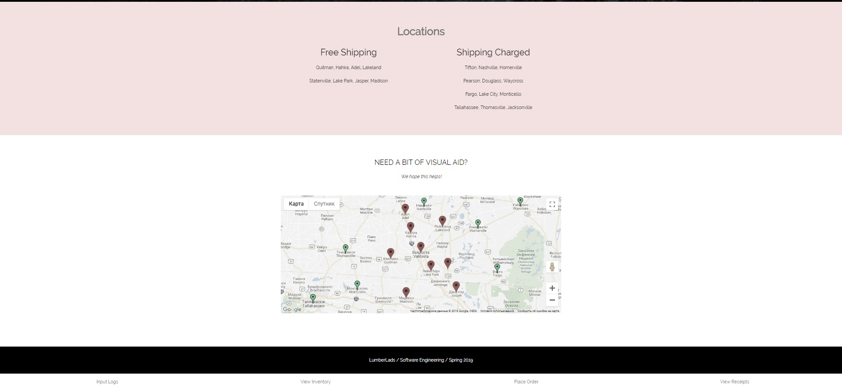

Slide 16
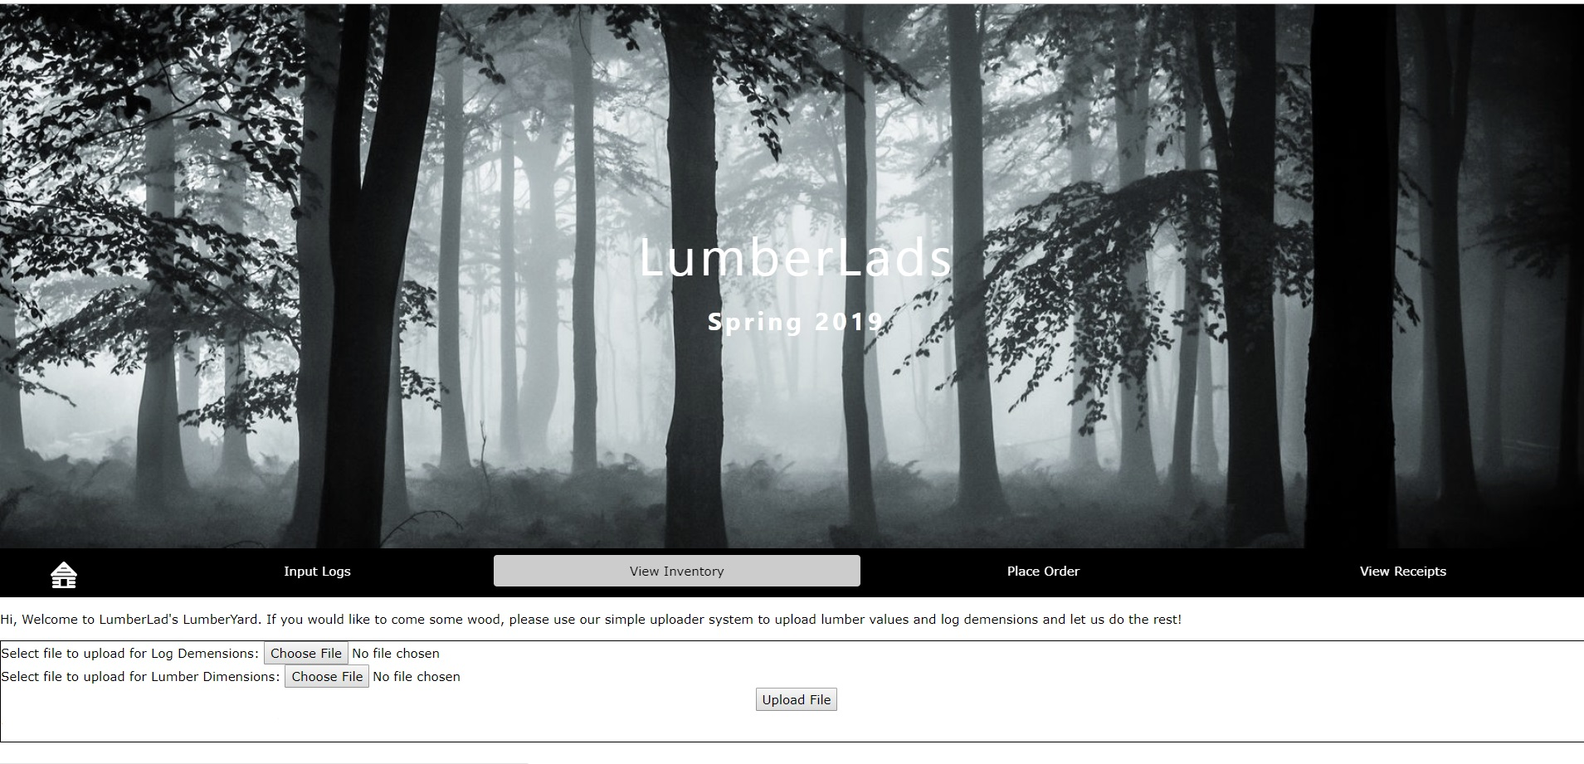

Slide 17
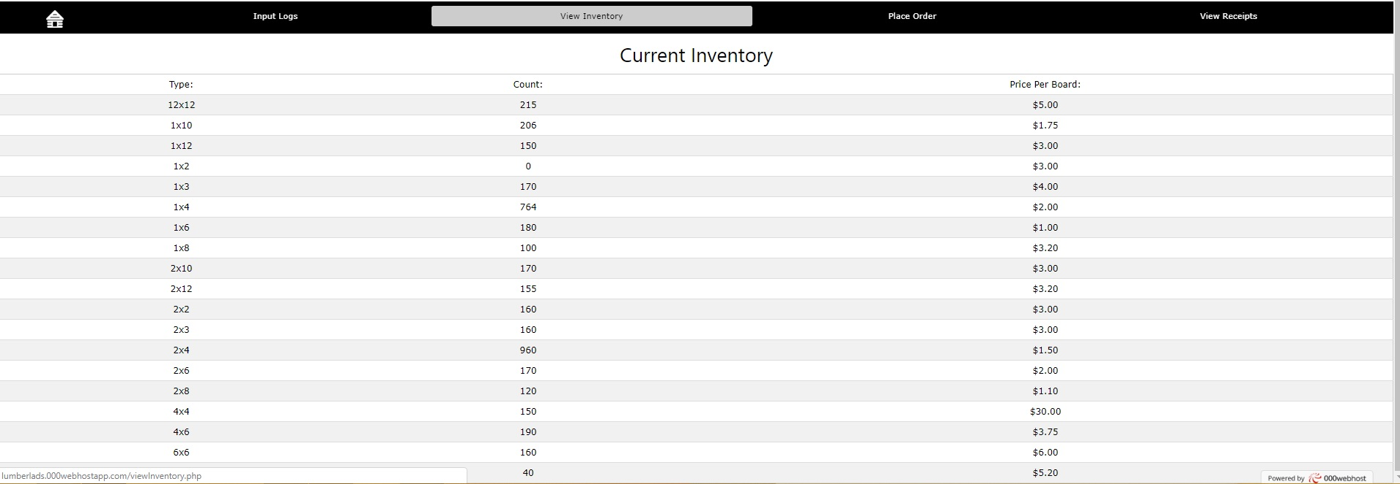
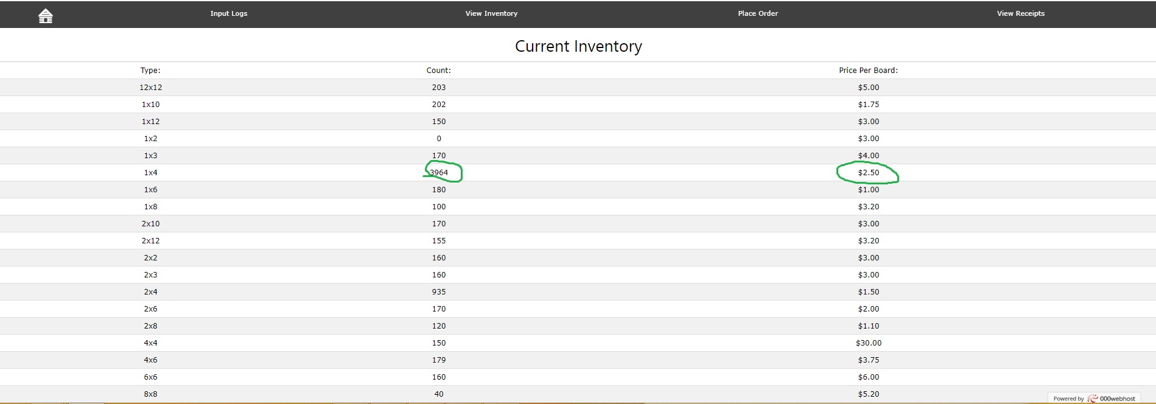

Slide 18
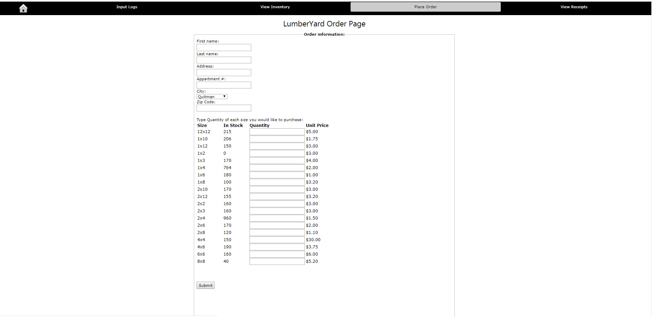

Slide 19
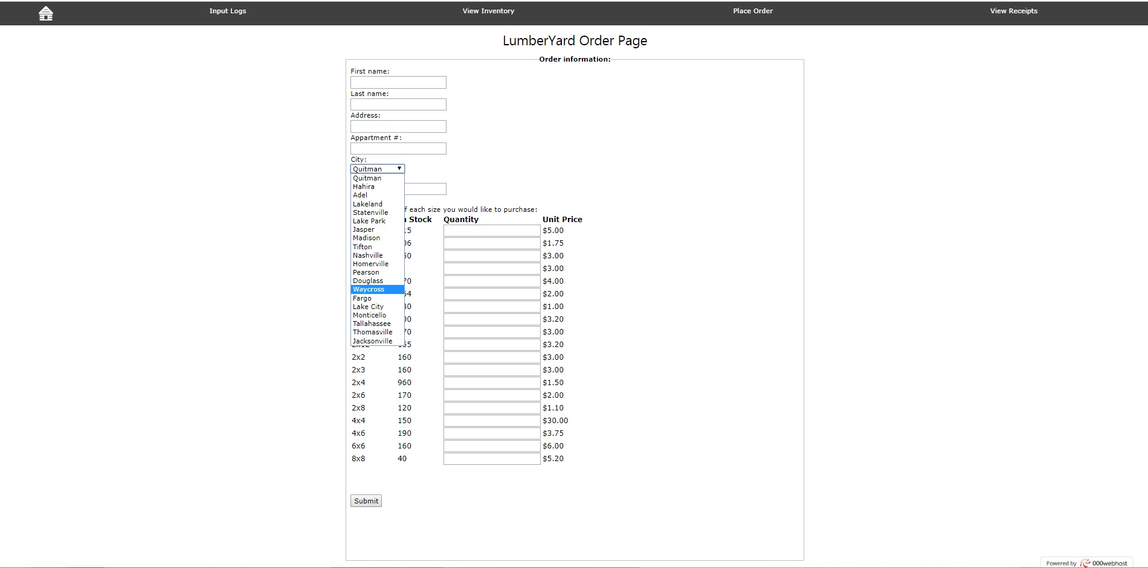

Slide 20
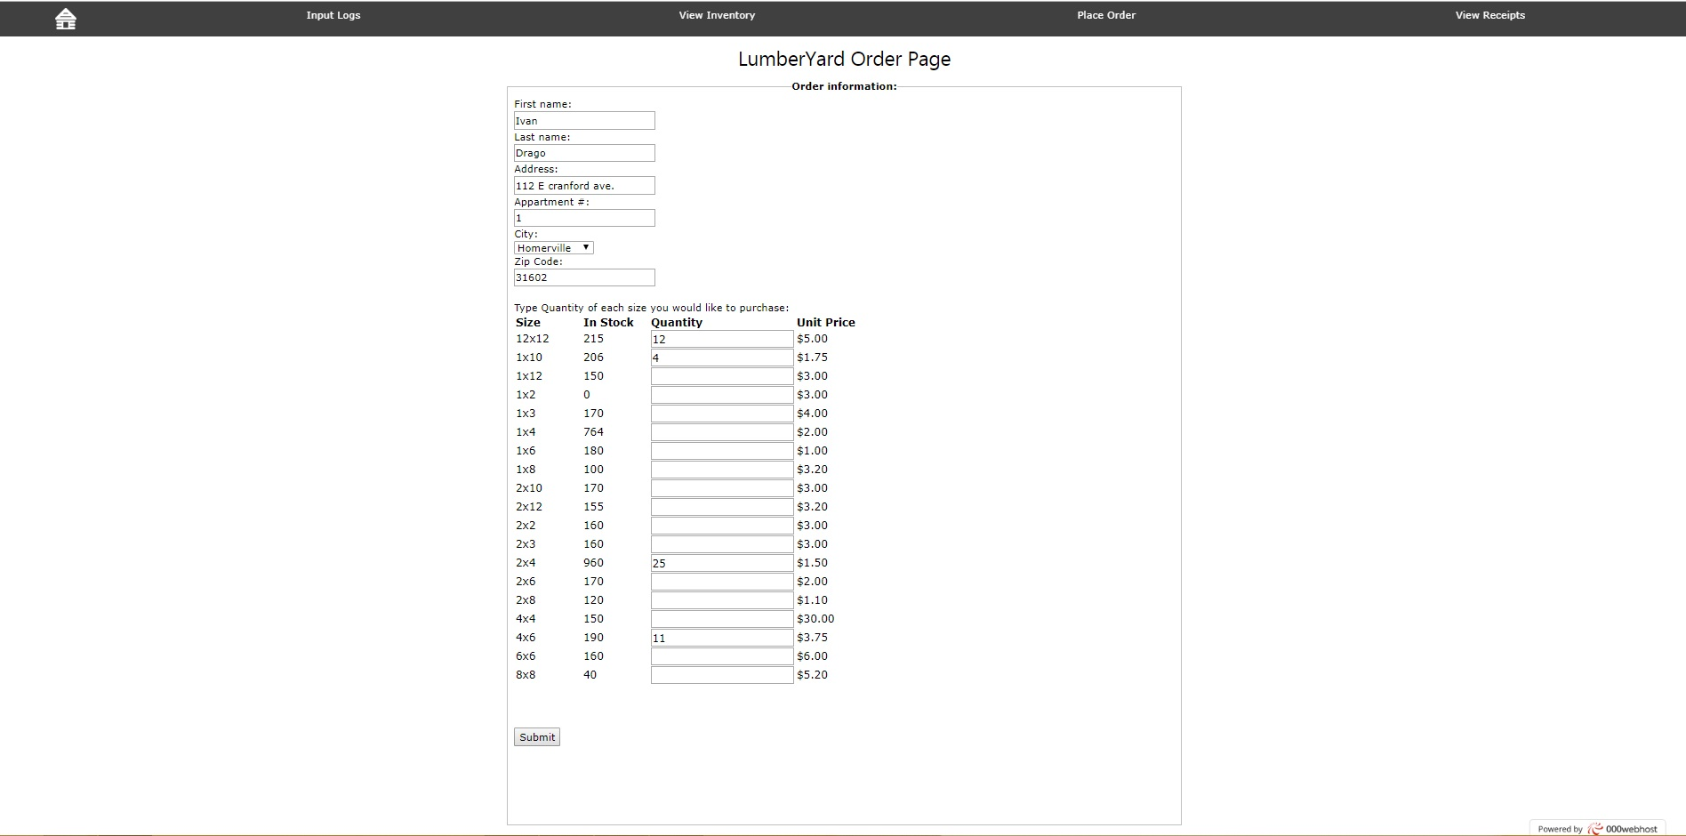

Slide 21
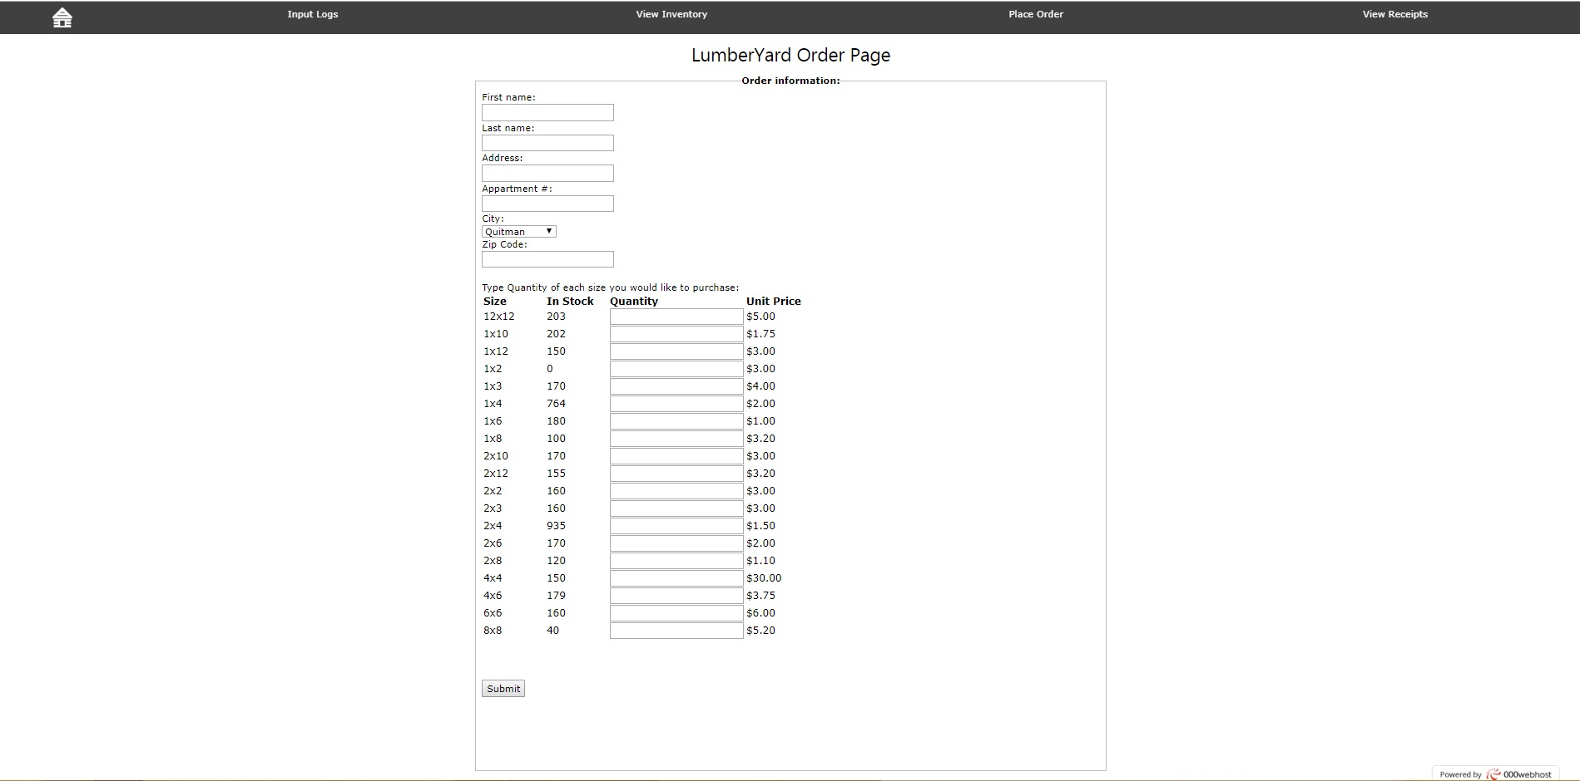

Slide 22
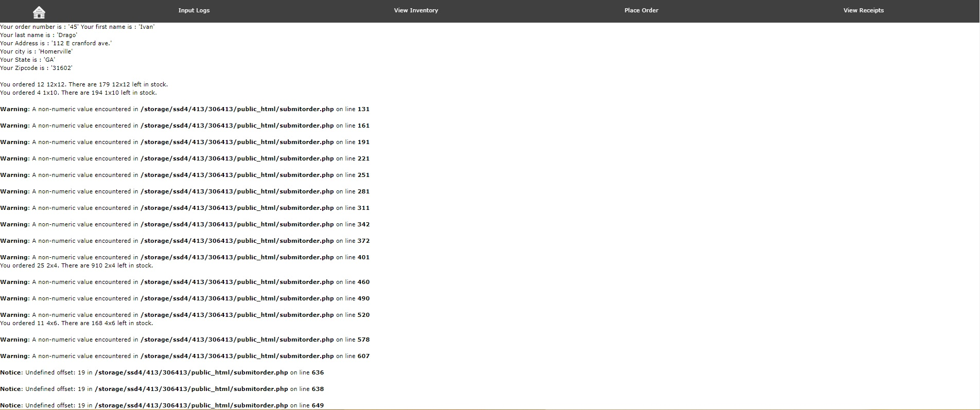

Slide 23
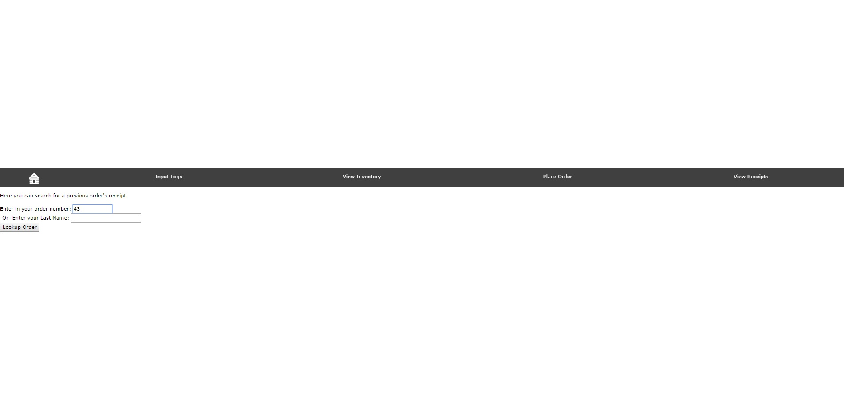

Slide 24
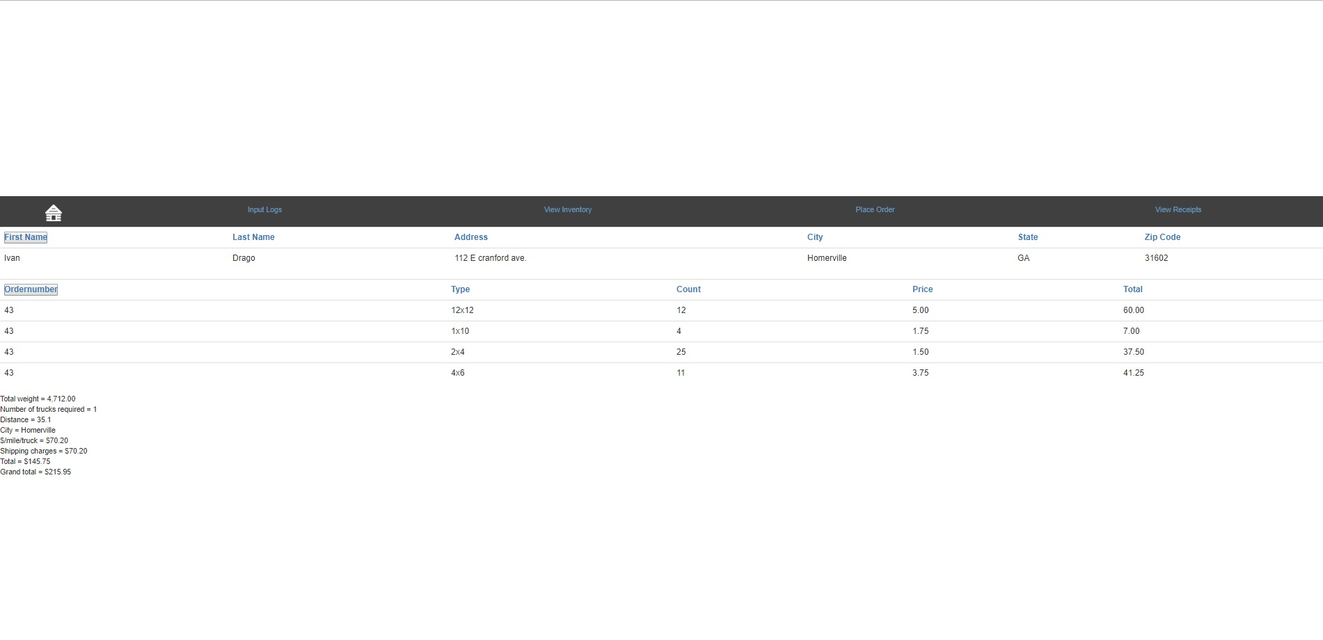

Slide 25
Спасибо

