Slide 1
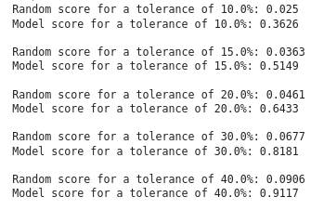
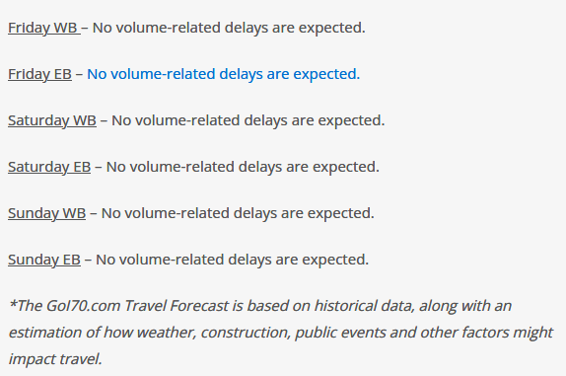
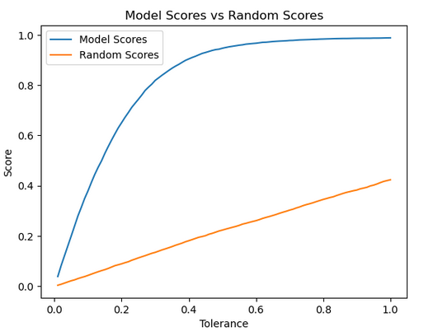
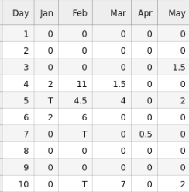
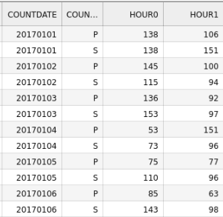

Predicting I-70 Traffic
Kevin Ash, Jacob McKinney, Parker Banks
Machine Learning [CSCI 4622] – Spring 2023, Dr. Quigley
Problem Space
Predicting I-70 Hourly Traffic
Features:
Month
Year
Day
Day of Week
Hour
Snow Depth
Daily Snow Total
Target
Traffic Volume
Results
Discussion
Past Work³:
Differences:
Hourly Predictions
By-Station Predictions
Impact in Field:
Consumer Predictions
Infrastructure Planning
Future Work:
Add predictors: Construction, Public Events and Holidays
Create an app for consumers to predict traffic
Approach
Data Colleciton and Transformation
Model Selection and Training
Neural Network, TensorFlow Library
Sequential Model
ReLU Activation
Multiple Dense Layers
Dropout Regularization
Mean Squared Logarithmic Error Loss Function
Adam Optimizer
Evaluation
Trained for 20 Epochs
Batch size of 64
References
(1) “Daily Summaries Station Details.” Daily Summaries Station Details:
WINTER PARK, CO
US, GHCND:USC00059175 | Climate Data Online (CDO) | National Climatic Data Center (NCDC), National Oceanic and Atmospheric Administration, https://www.ncdc.noaa.gov/cdo-web/datasets/GHCND/stations/GHCND:USC00059175/detail.
(2) “CDOT-Otis Online Transportation Information System.” Traffic Data
Explorer, Online
Transportation Information System, https://dtdapps.coloradodot.info/otis/trafficdata#ui/2/0/0/station/000120/criteria/000120/.
(3) “Travel Forecast.” goi70, CSBOX, 4 May 2023,
https://goi70.com/travel.
Data
Winter Park Daily Snow¹:
Traffic Volume²:

