Slide 1

Capstone
By
Ashok Kumar Singh (11602516), Shivam Sharma (11602462), Rakesh Kumar (11607344) & Konda Venkateswarlu (11602951)
ON
Metro Bike Share Trip Data
Analysis & Prediction

Slide 2
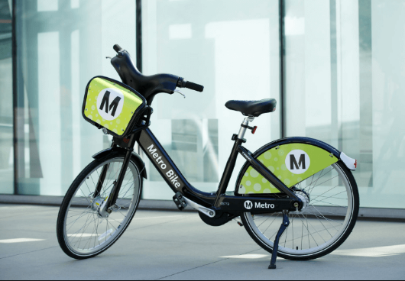
Introduction
Bike sharing is a service which provides available bikes as a shared use for individuals on a short term basis, either free or at a reasonable price. A metro bike sharing system allows users to rent a bike from one station and return it at any other station within the system.
Metro bike share system have been deployed in various cities around the world since the second half of 20th century and become more popular in recent years.
These systems provide access to bicycles for short-distance trips as an alternative to private vehicles or motorized public transport such as bus or subway in an urban area. In addition, they help reduce the traffic congestion, air pollution and noise.

Slide 3
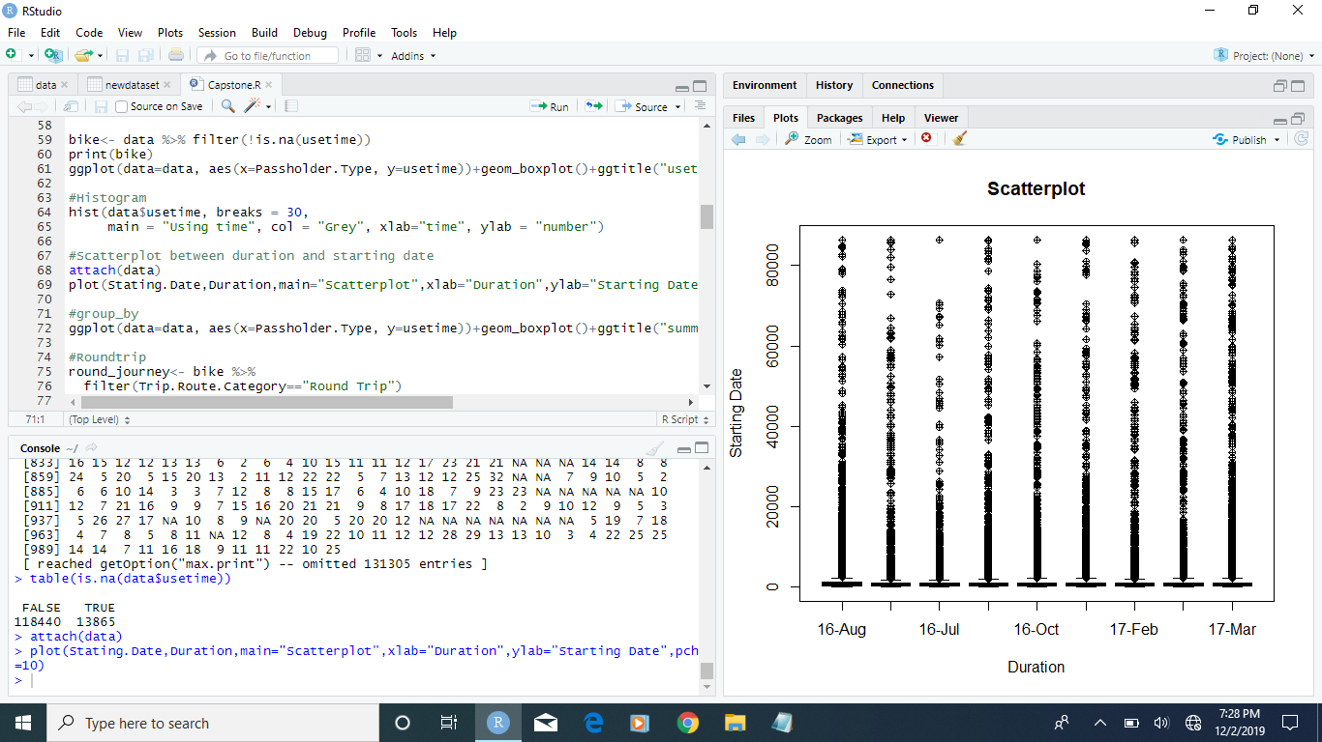
R

Slide 4
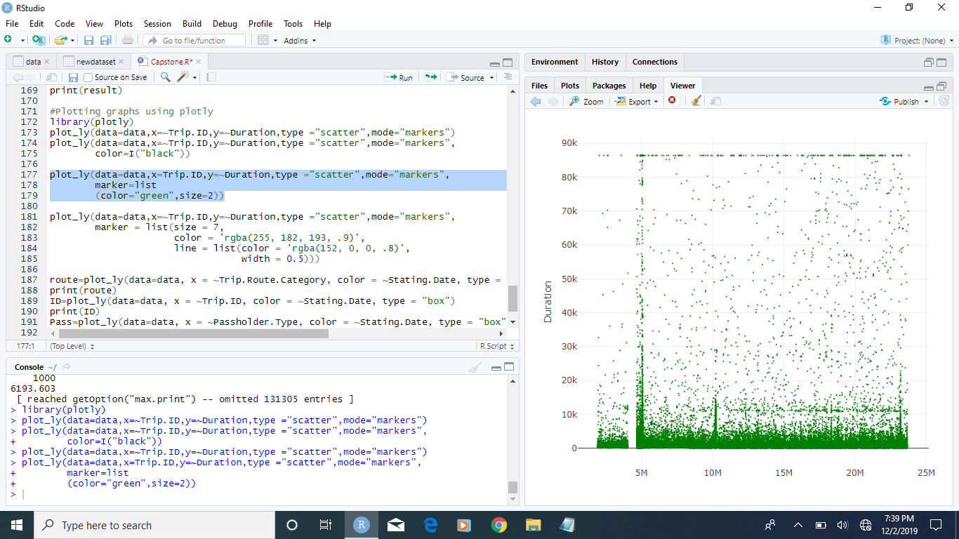

Slide 5
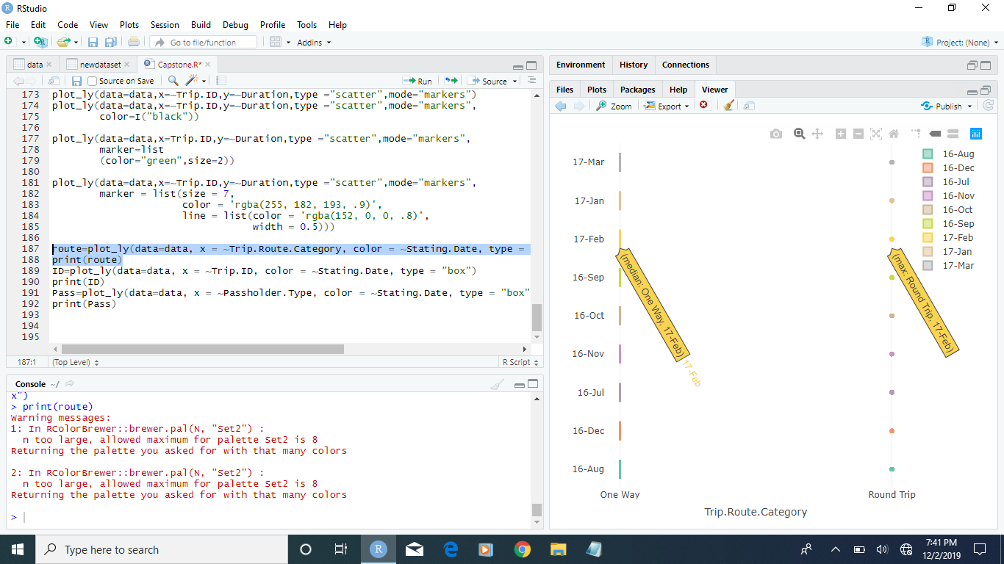

Slide 6
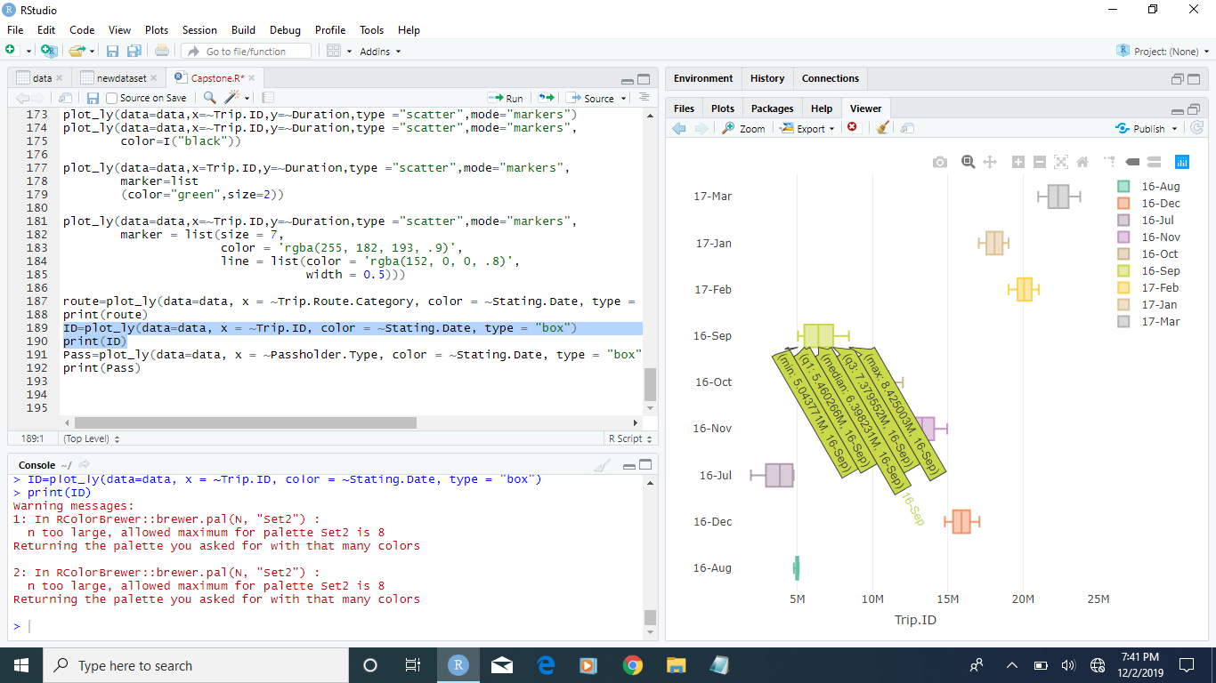

Slide 7
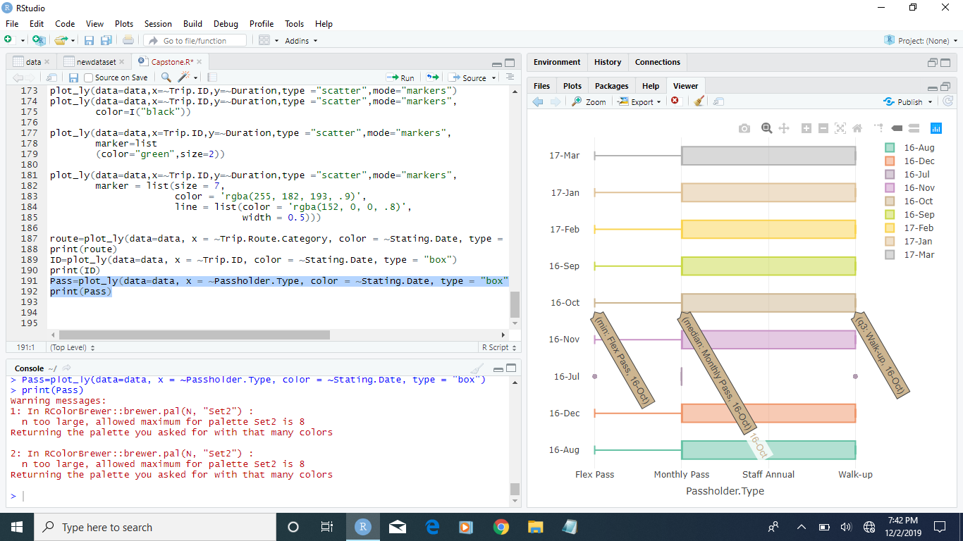

Slide 8
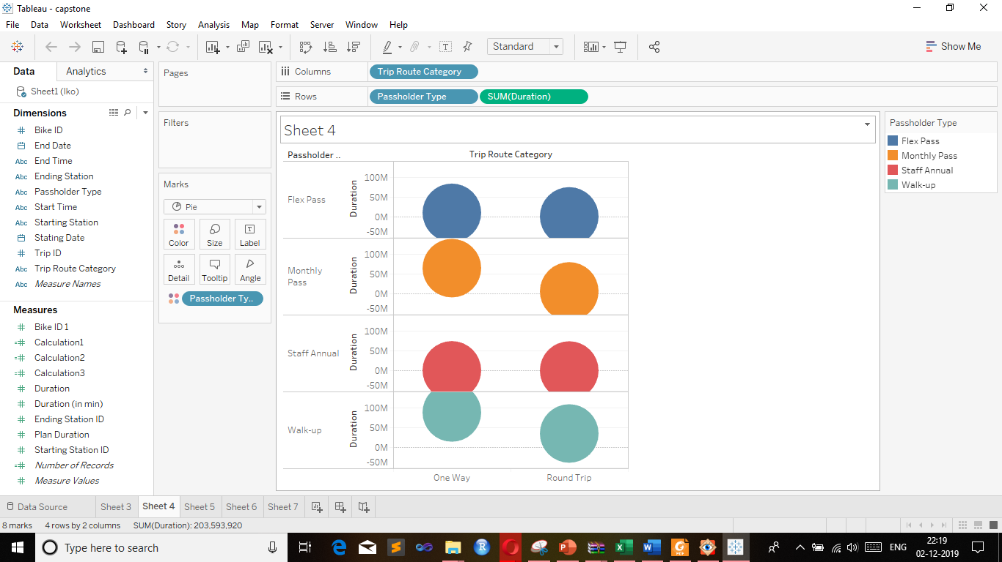
Tableau Pass Visualization

Slide 9
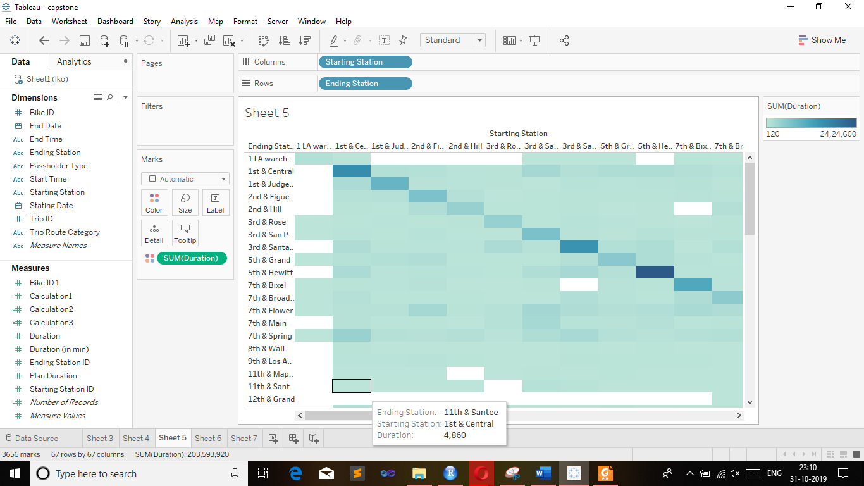
Station Rush

Slide 10
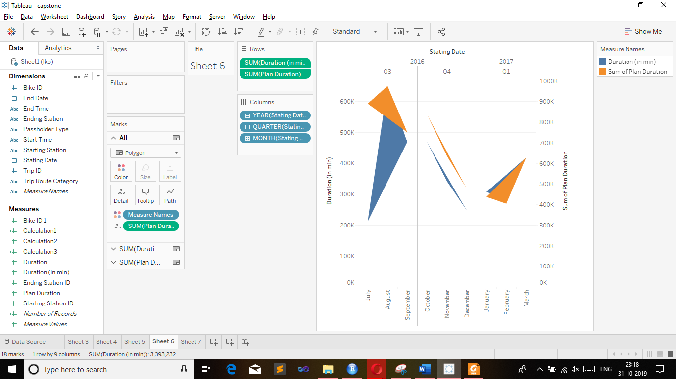
Consumer Behaviour

Slide 11
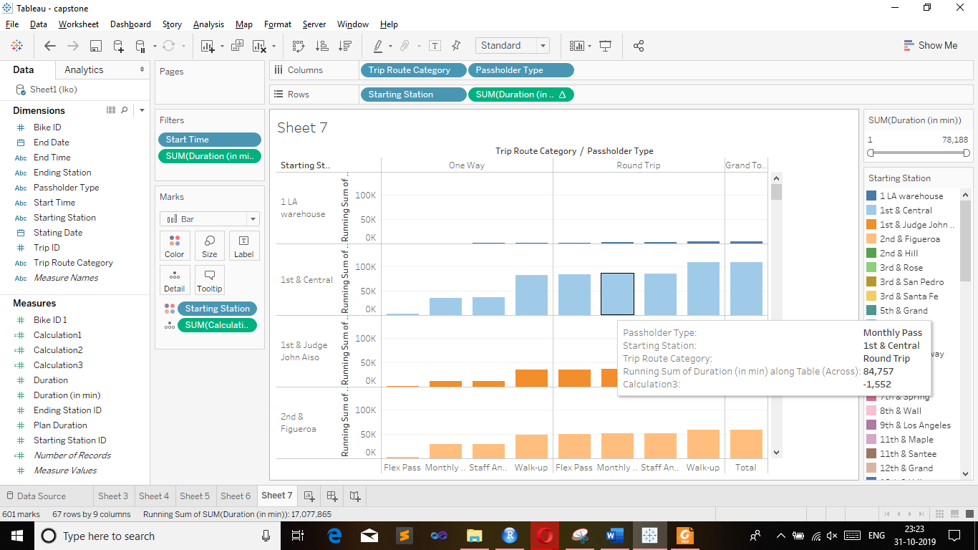
Duration Contrast

Slide 12
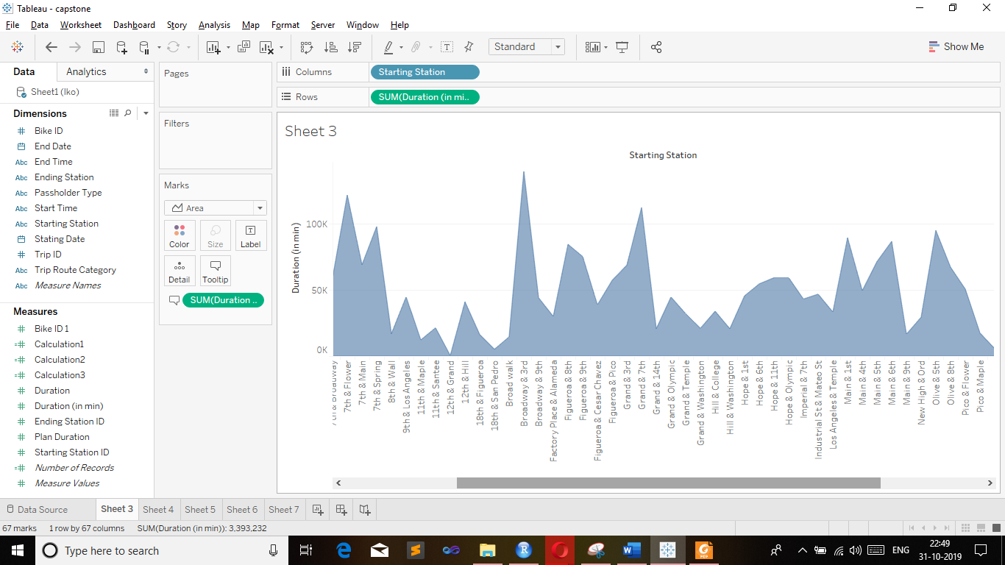
Station Mapping

Slide 13
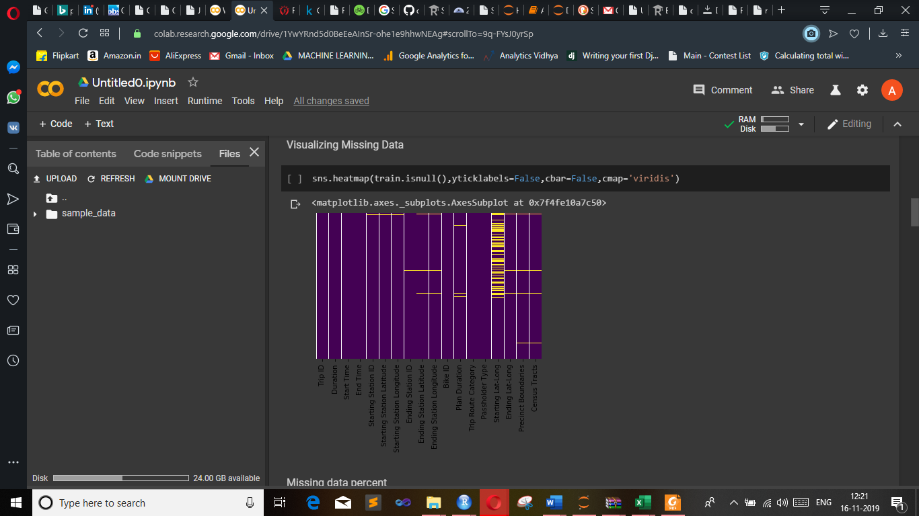
Python Data Cleaning

Slide 14
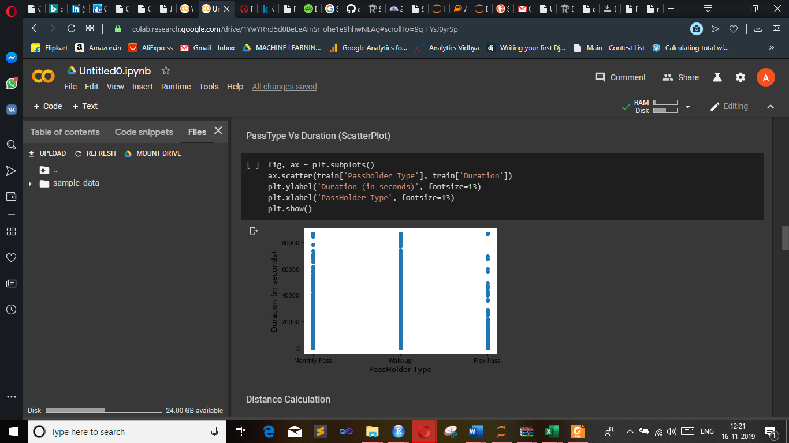

Slide 15
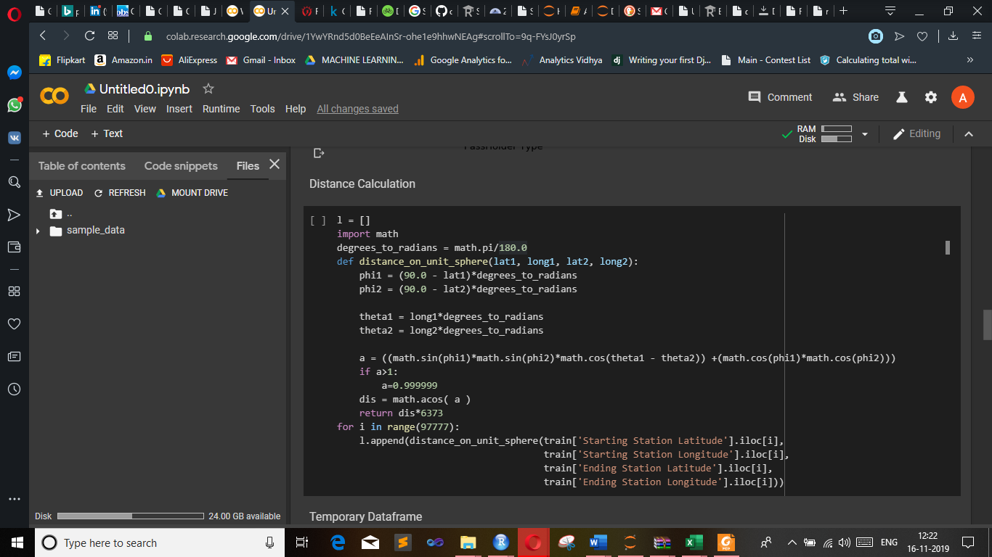
Distance Calculation and Model Build

Slide 16
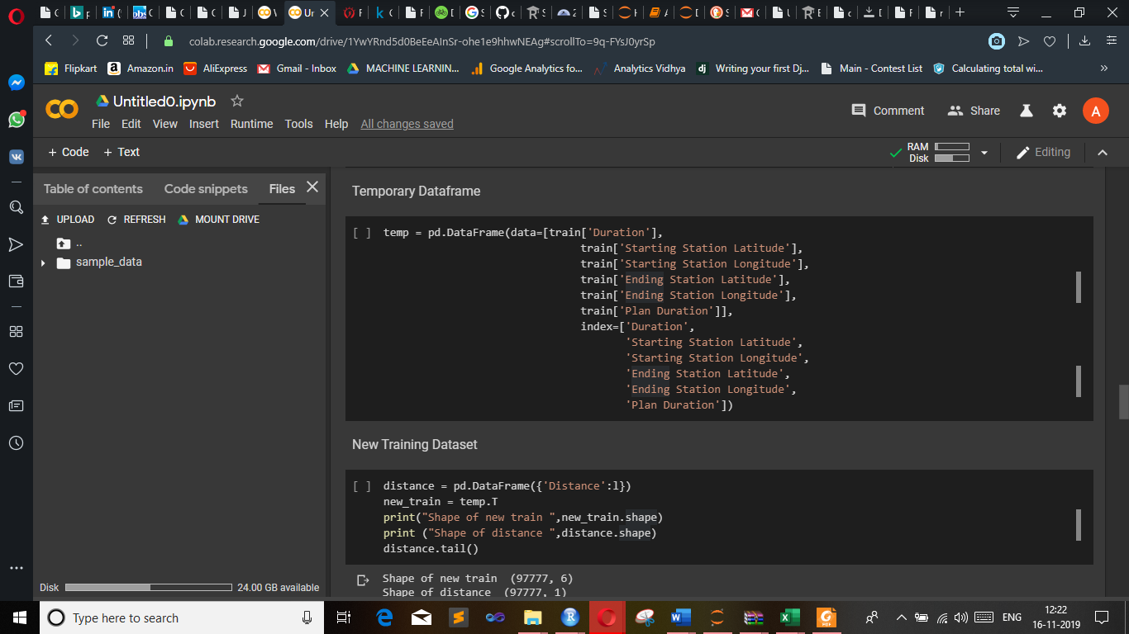

Slide 17
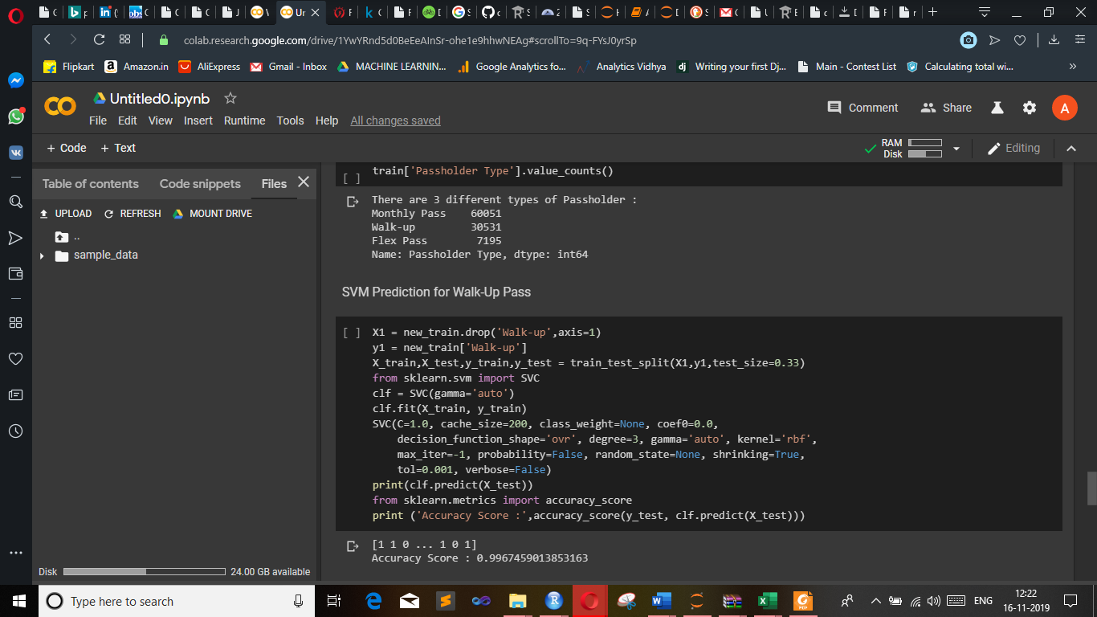
Prediction

Slide 18
Thank You!!

