Slide 1
Vehicle Accidents Dashboard
By Vincent Heningburg and Ashlee Pounds

Slide 2
U.S. Vehicular Accidents 2016-2019 Dataset
Main Columns
Location: (Latitude, Longitude, State, City)
Date: (Year, Month, Day, Hour, Minute, Second)
Severity: (Scale 1-4)

Slide 3
E.T.L Main Issues
Data has approximately 3,000,000 records
Need to reduce data without introducing unnecessary bias
Separate data based on year, then randomly choose a subset of records based on number of total records per year.

Slide 4
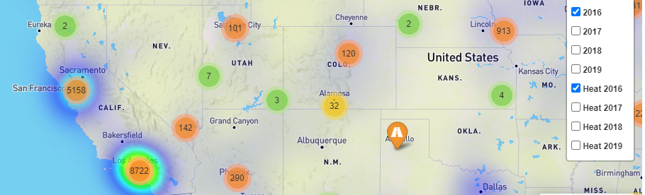
Leaflet Map
Map includes data for the entire continental United States.
Data is separated by year and organized using marker clusters and heat maps as overlay.

Slide 5
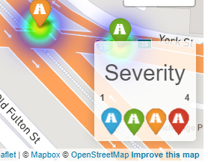
Map Legend
Added legend to show severity of accidents based on color of the marker.

Slide 6
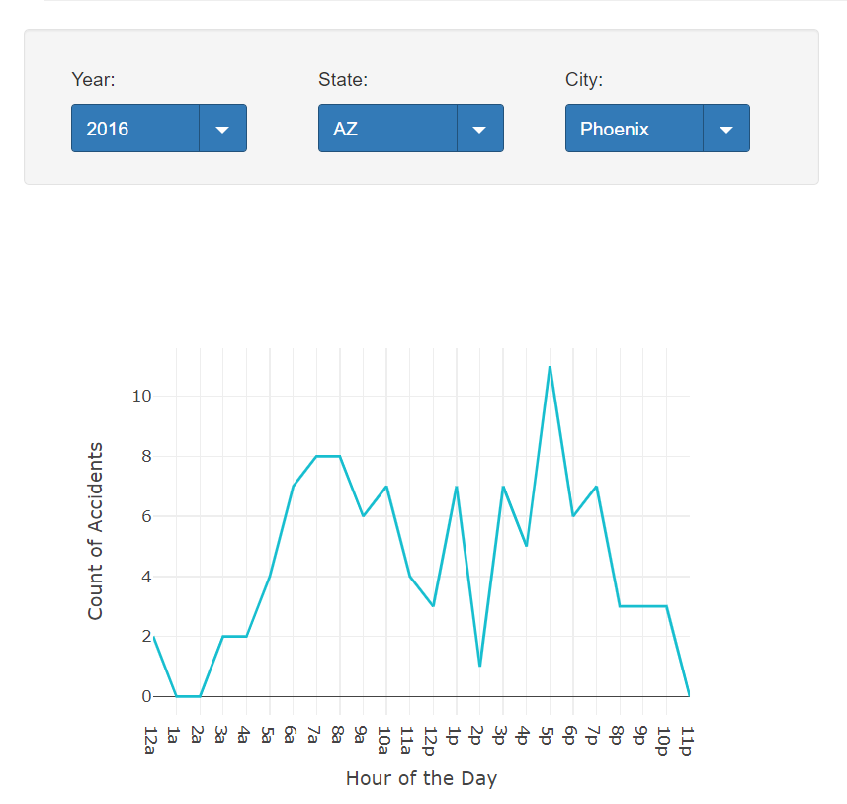
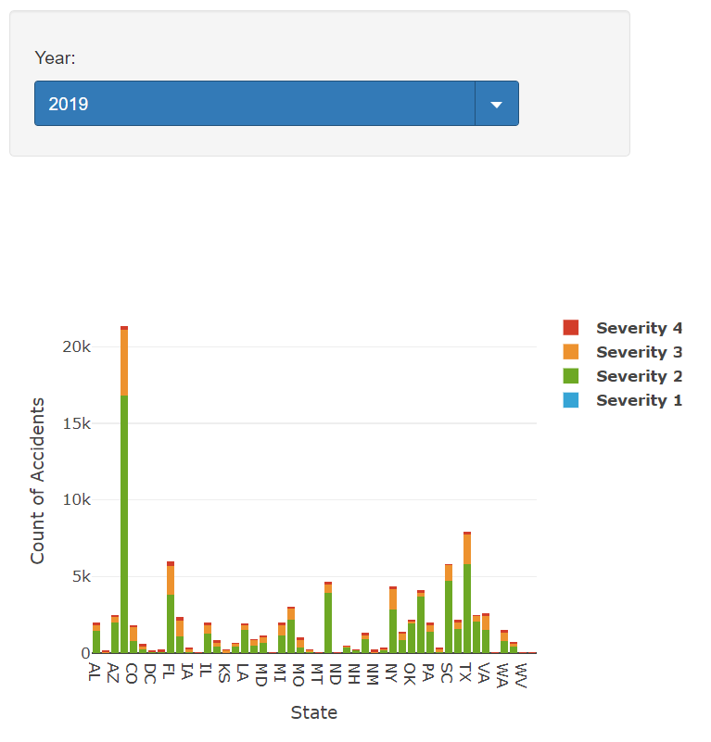
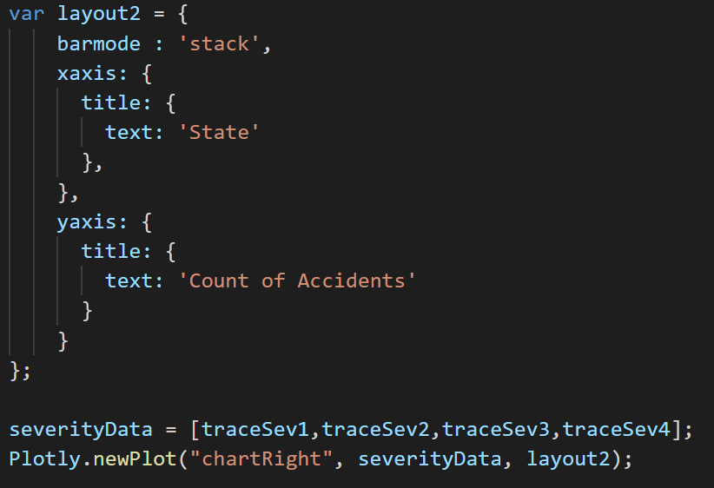
Plotly/D3
Plotly was used to create two different graphs for the data set.
Left Graph – Time of Day vs Number of Accidents
Line chart with time on the x-axis and number of accidents occurring on that data on the y-axis
Right Graph – State vs Number of Accidents with Severity Bars
Stacked bar chart using different bar colors for severity with States on the x-axis and total year number of accidents on the y-axis.
Dropdowns are monitored with a D3 listener to call an optionChanged function
Each time a dropdown is changed, d3.select looks at each dropdown to determine the filters to use for the dataset and Plotly.restyle function is called to redraw the graph

Slide 7
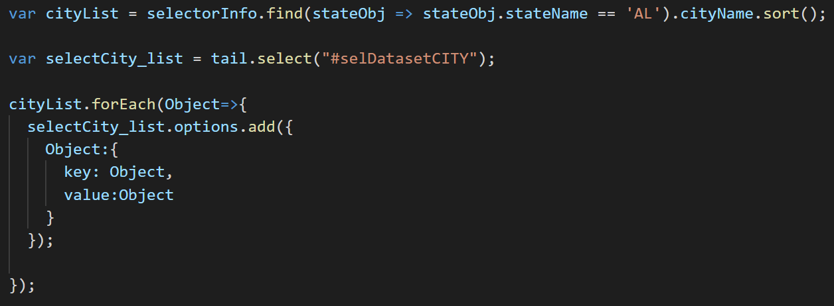
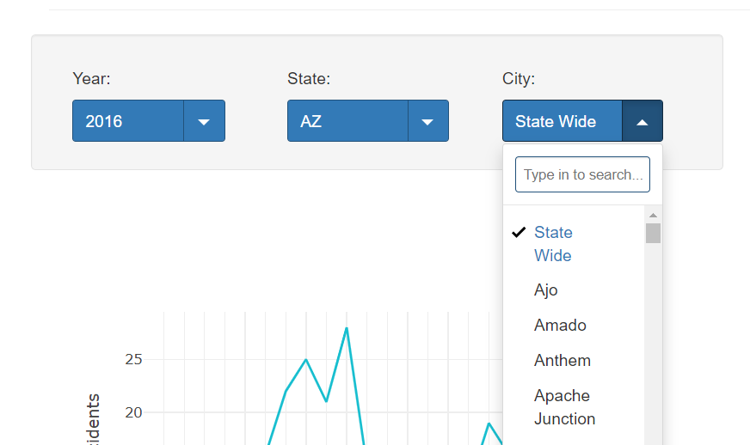
tail.select Library – Dropdowns
tail.select is a new JS Library created to beautify search bars and selection utilities
We used this to increase functionality with the ability to search the long list of States of Cities, less scrolling needed!
Dropdowns are used to select the desired data being fed into graphs
Left Graph
Year, State, and City correspond to different levels of filtering
State and City Dropdowns are searchable
City list will repopulate corresponding to a change in State and default to State Wide
Right Graph
Selector for year controls the data for total number of accidents for that year

Slide 8
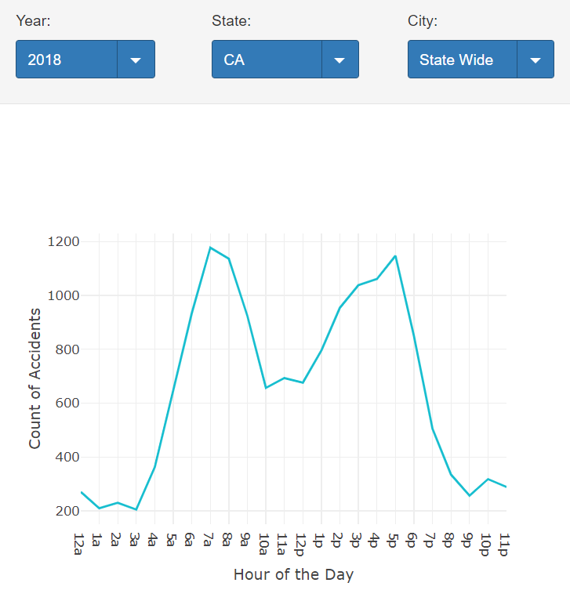
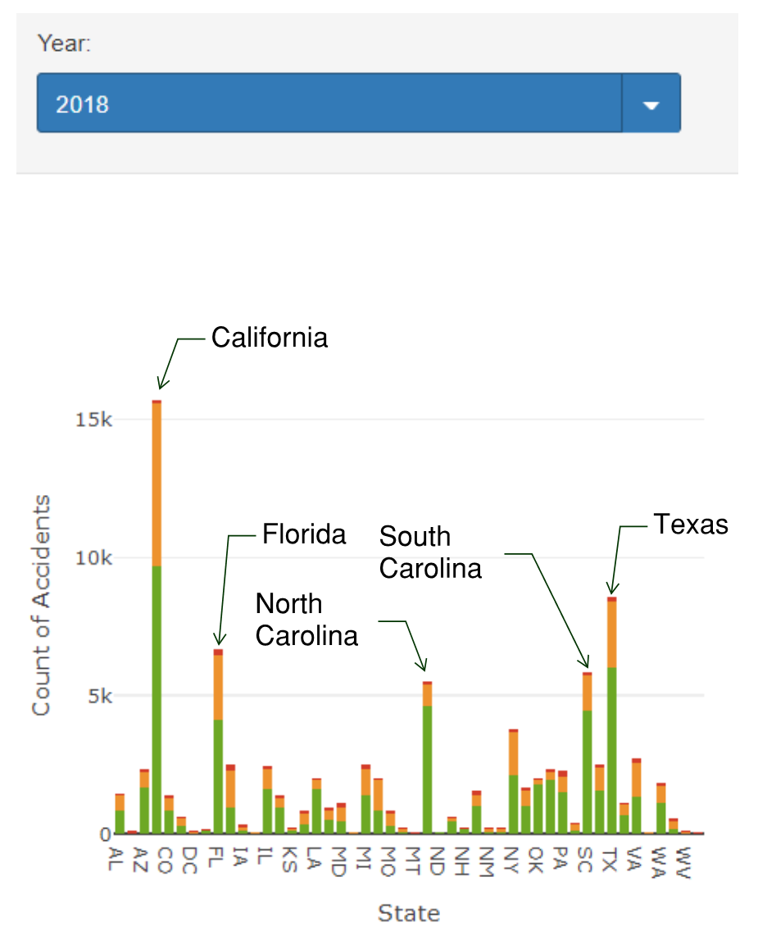
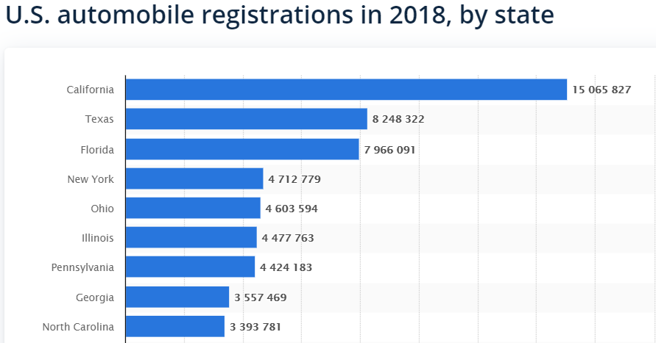
Story
Time of Day vs Number of Accidents-
Before diving into the data we figured there would be an increase of accidents occurring at the peak traffic times (~8am and ~5pm)
When we analyzed the data, we did see this trend
State vs Number of Accidents
Our initial hypothesis was that we would see higher counts of accidents in a given year in states with more cars
From the data, we did find that the top 3 states with accidents in our data set matched a statistic found about automobile registration
https://www.statista.com/statistics/196010/total-number-of-registered-automobiles-in-the-us-by-state/

