Slide 1



JSON REST API’s
By: Ashleigh Lyman

Slide 2

What are JSON API’s?
A browser service that allows for two-way data exchange with any JSON data server without exposing users or organization to any harm (Crockford, 2006)
It exchanges data between scripts on pages with JSON servers in the web (Crockford, 2006)

Slide 3
Why is it important?
RESTful API’s allow for easy and simplified data exchange between systems using HTTP
REST API’s make communication between devices easier, and responses to requests are more intuitive.

Slide 4
Benefits of using REST
Reduces number of requests and data amount between clients and servers (Prakash, 2017)
Scalability
Better performance
Flexible
Better for mobile

Slide 5
SOAP vs JSON API’s
SOAP JSON REST
Protocol Architectural style
Strict Schema Loose schema
Not cacheable Cacheable
High security Low security
More bandwidth Less bandwidth
Only XML Multiple formats
Complex Simple

Slide 6
JSON Request Header
REST headers contain information that help you track down issues when you encounter them (soapui.org, 2020)
Request and Response body
Request Authorization
Response Caching
Response Cookies
HTTP headers are:
Content-type: application/json
Accept: application/json
(Atlassian.com, 2020)

Slide 7
JSON Request Body
Generally used with POST, PUT, and PATCH commands
Data sent by the client to your API

Slide 8
JSON Response Body
A response body is data that the API sends back to you, the client

Slide 9
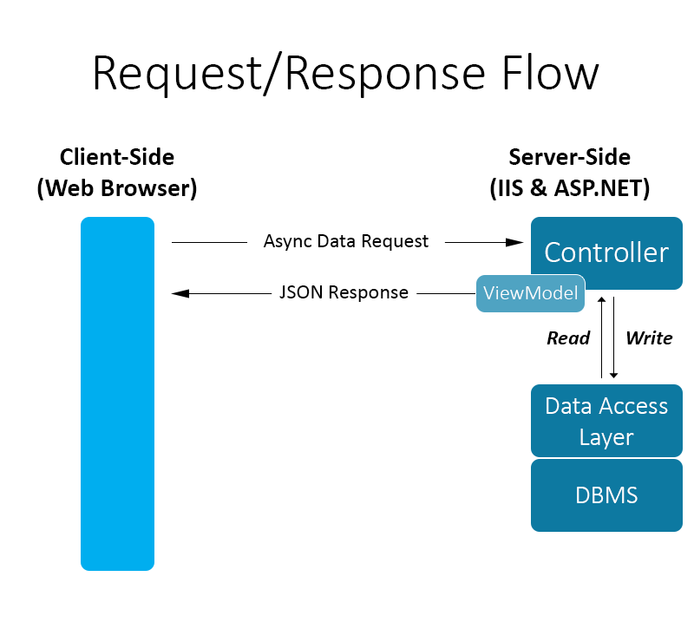
Parse JSON data from REST API
Store URL in variable
Create a request with http request object instance
Use chosen method (GET/POST)
(developer.mozilla.org)

Slide 10
References
Crockford, D. (2006). JSON Request. Retrieved May 21, 2020, from http://json.org/JSONRequest.html
Prakash, N. (2017, October 06). An overview of JSON API: A text-based data exchange format. Retrieved May 21, 2020, from https://www.valuebound.com/resources/blog/overview-of-json-api
Understanding REST Headers and Parameters. (n.d.). Retrieved May 21, 2020, from https://www.soapui.org/learn/api/understanding-rest-headers-and-parameters/
Crowd Server Developer. (n.d.). Retrieved May 21, 2020, from https://developer.atlassian.com/server/crowd/json-requests-and-responses/
Working with JSON. (n.d.). Retrieved May 24, 2020, from https://developer.mozilla.org/en-US/docs/Learn/JavaScript/Objects/JSON

