Slide 1
Service-Oriented Architecture & Enterprise Service Bus
By: Ashleigh Lyman

Slide 2
What is Service-Oriented Architecture (SOA)?
SOA is an architectural approach that allows services to communicate across different platforms and languages to form applications using a loose coupling system to either pass data or coordinate an activity (Rouse, 2020).
The 3 major objectives of SOA are:
Aims to structure procedures or software components as services
Provide a mechanism for publishing services
Control the use of these services to avoid security and governance problems
(Rouse, 2020)

Slide 3
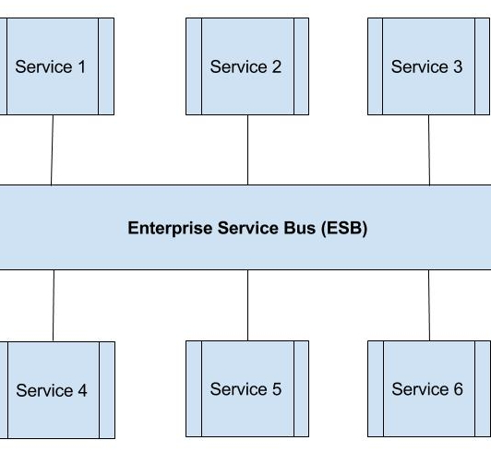
What is Enterprise Service Bus (ESB)?
The ESB is a software architecture which connects all the services together over a bus like infrastructure (tutorialspoint.com, 2020).
Bus is a communication system that transfers data between computers and interconnects the hard disk drives, CD ROM, graphics adapters and other chips (tutorialspoint.com, 2020).

Slide 4
What is the relationship between ESB & SOA?
ESB acts as a communication center in the SOA by allowing linking multiple systems, applications and data and connects multiple systems with no disruption (tutorialspoint.com, 2020).
An ESB is an essential component of SOA. You could implement an SOA without an ESB, but application owners would each have to find their own unique way to expose service interfaces, which is a lot of work (ibm.com, 2019).

Slide 5
How is data transmitted through a SOA environment?
SOA uses a “loose coupling” system when communicating.
Loose coupling – refers to the client of a service, and its ability to remain independent from the service. It can communicate with the service even if they are not closely related (Hughes, 2018).
This communication is achieved through the implementation of a specified interface that can perform the necessary actions to allow for data transmission (Hughes, 2018).
SOA uses either SOAP or REST as an outlet for systems to communicate.
SOAP – XML-based and is most commonly sent over HTTP
REST – client-service architecture based on request/response design (Hughes, 2018)

Slide 6
What are the advantages of SOA?
Components are easy to configure – Smooth operations
Flexibility – Ability to assemble different services and mix-and-match
Reuse & reconfiguration – Simple and easy when service needs updated or changed (Hughes, 2018)
Scalability – Less interaction between clients and services
Location flexibility– Services can be published from anywhere and even on several different ones

Slide 7
What are the disadvantages of SOA?
Costly initial investment – Can and will save you money down the road, however, it is expensive upon starting up (WATTS, 2017)
Heavy loads – Between communication there are validations, which causes longer run times and heavier loads

Slide 8
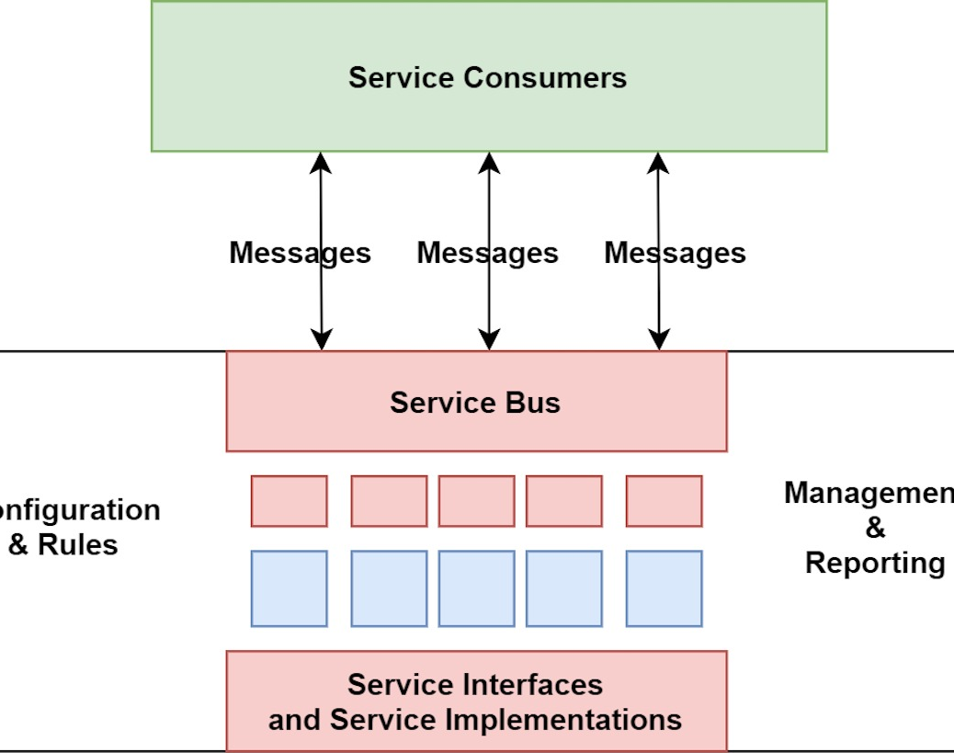
How is software deployed and managed in SOA?
To implement SOA you start with the basic service architecture, then provide the infrastructure, meaning protocols and other tools that enable communication and interoperability (Tyson, 2020).

Slide 9
How to scale a SOA environment?
By using an SOA where there is a standard communication protocol in place, enterprises can drastically reduce the level of interaction that is required between clients and services (Watts, 2017).
This reduction means that applications can be scaled without putting added pressure on the application, as would be the case in a tightly-coupled environment (Watts, 2017).

Slide 10
References:
Rouse, M. (2020, February 28). What is SOA? Understanding Service-Oriented Architecture. Retrieved June 12, 2020, from https://searchapparchitecture.techtarget.com/definition/service-oriented-architecture-SOA
Tutorialspoint.com, S. (2020). SOA - Enterprise Service Bus. Retrieved June 13, 2020, from https://www.tutorialspoint.com/soa/soa_enterprise_service_bus.htm
Cloud Education, I. (2019). Enterprise Service Bus (ESB). Retrieved June 13, 2020, from https://www.ibm.com/cloud/learn/esb
Hughes, A. (2018). Blog: The Ins and Outs of a Service-Oriented Architecture (SOA). Retrieved June 13, 2020, from https://www.cleo.com/blog/knowledge-base-soa-service-oriented-architecture
Watts, S. (2017, May 31). What is SOA? Service-Oriented Architecture Explained. Retrieved June 13, 2020, from https://www.bmc.com/blogs/service-oriented-architecture-overview/
Tyson, M. (2020, March 12). What is service-oriented architecture? Retrieved June 14, 2020, from https://www.javaworld.com/article/2071889/what-is-service-oriented-architecture.html

