Slide 1


SOAP (Simple Object Access Protocol)
By: Ashleigh Lyman

Slide 2
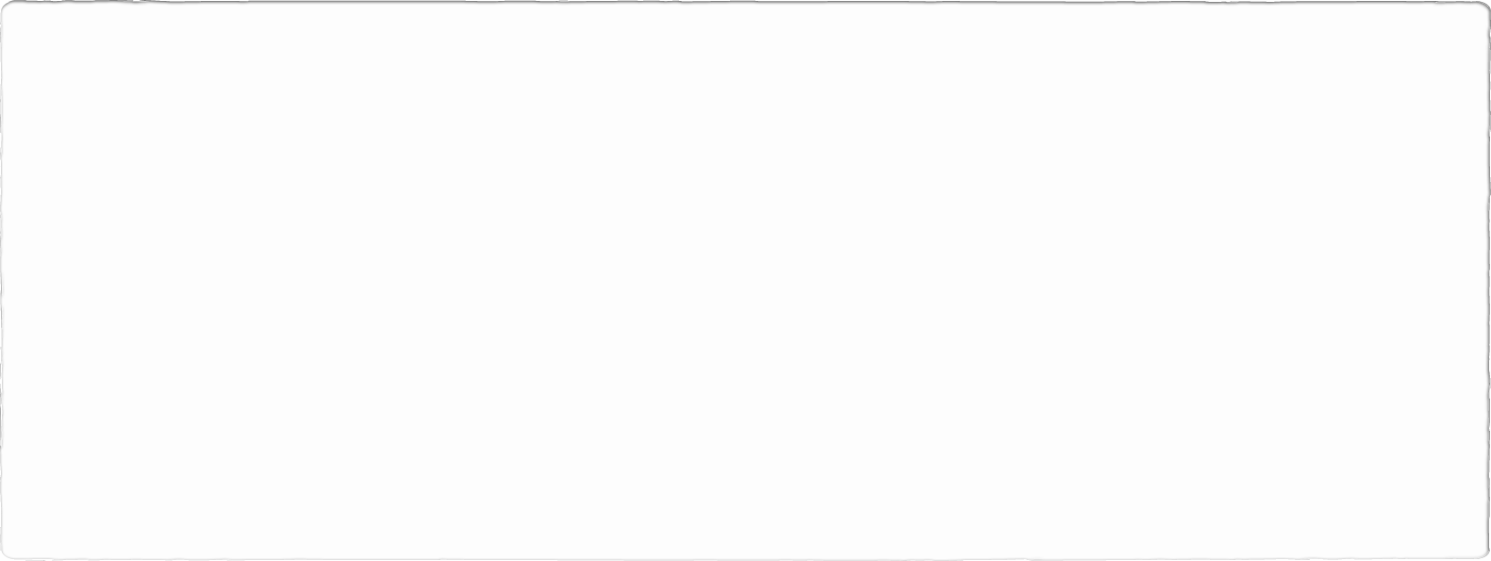
What is SOAP?
SOAP is a protocol that uses XML to communicate between devices
It uses a strict schema to create a messaging framework (soapui.org)

Slide 3
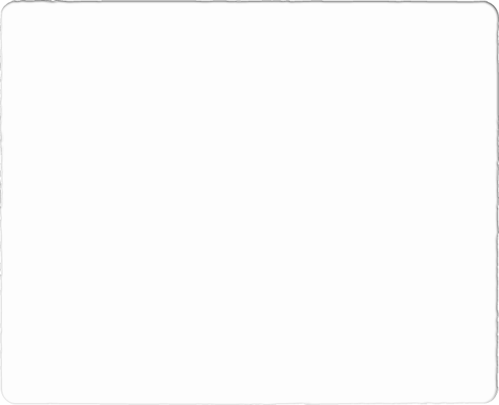
WHY IS SOAP IMPORTANT?
An API is a form of agreement between web services on how they are going to exchange data (altexsoft.com, 2020).
SOAP creates a structured and secure transmission of data
It is able to transmit complex and a heavy amount of data through XML and HTTP

Slide 4
Is SOAP good or bad?
Pros
Cons
Language, platform, and transport independent (soupui.org, 2020).
Built-in error handling
Standardized
Provides pre-build extensibility (soapui.org,2020).
Strict schema
Only uses XML to transport data
Larger learning curve

Slide 5
SOAP vs REST
REST
Uses fewer resources and bandwidth
Architectural style in web service communication
SOAP
Larger sized files
Larger learning curve
Protocol in web service communication
Uses XML format
Multiple formats, such as JSON and XML
Smaller learning curve

Slide 6

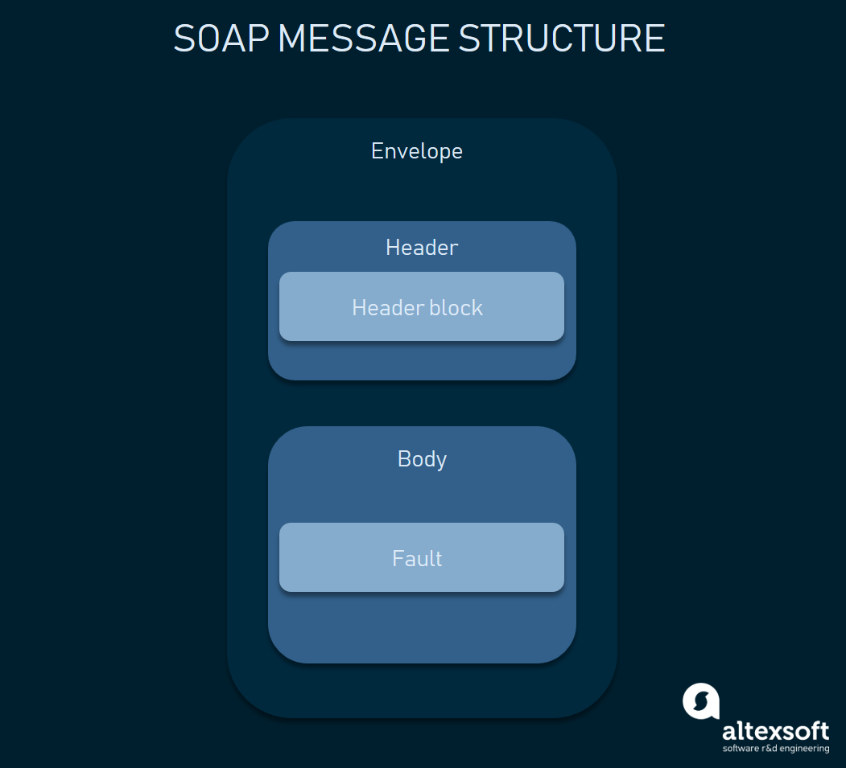
ENVELOPES
SOAP packages its messages in a certain way
Everything is contained in an envelope that consists of four elements; Header, Header block, Body, and Fault
Each element has specific functions
It is the core of every message, which begins and concludes messages with its tags envelopiong it (altexswoft.com)

Slide 7
HEADERS
One of the four elements in a SOAP envelope
The header determines the specifics, extra requirements for the message

Slide 8
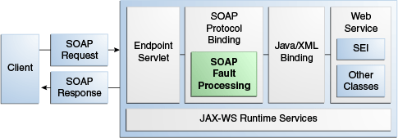
FAULTS & FAULT CODES
Fault shows all data about any errors that could emerge throughout the API request and response (altexsoft.com)
When a SOAP fault occurs, a message is displayed that gives information on the error
This is accomplished with a <Fault> element

Slide 9
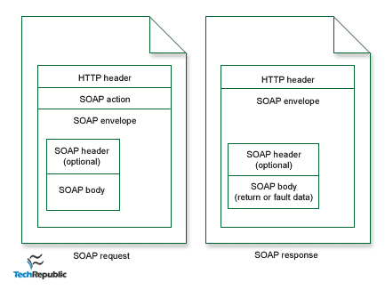
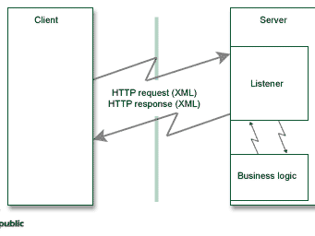
SOAP Data Flow
The client wraps a method call in SOAP/SML, which is sent through HTTP to the server (techrepublic.com, 2001)
The request is then processed and sent back to the client, which contains the data
The server uses a “listener” to process SOAP requests (techrepublic.com, 2001)

Slide 10
References
Contributor, Guest. “An Introduction to the Simple Object Access Protocol (SOAP).” TechRepublic, TechRepublic, 2 Apr. 2001, www.techrepublic.com/article/an-introduction-to-the-simple-object-access-protocol-soap/.
Editor. (2020, February 28). What is SOAP: Formats, Protocols, Message Structure, and How SOAP is Different from REST. Retrieved from https://www.altexsoft.com/blog/engineering/what-is-soap-formats-protocols-message-structure-and- how-soap-is-different-from-rest/
“Fusion Middleware Programming Advanced Features of JAX-WS Web Services for Oracle WebLogic Server.” Handling Exceptions Using SOAP Faults, 13 Jan. 2012, docs.oracle.com/cd/E24329_01/web.1211/e24965/faults.htm.
SOAP vs REST 101: Understand The Differences. (n.d.). Retrieved from https://www.soapui.org/learn/api/soap-vs-rest-api/

