Slide 1
Microservices
By: Ashleigh Lyman

Slide 2
What are microservices?
This is an architectural style that structures an application as a collection of services that are (Richardson, 2020):
Highly maintainable and testable
Loosely coupled
Independently deployable
Owned by a small team
Organized around business capabilities
This architectural style enables rapid, frequent and reliable delivery of large, complex applications (Richardson, 2020).

Slide 3
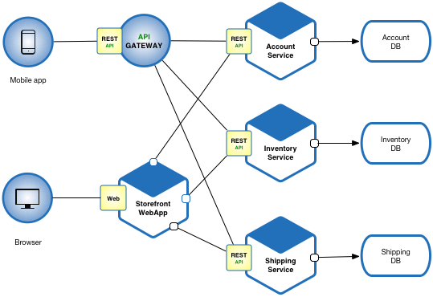
Microservice diagram
https://microservices.io/patterns/microservices.html

Slide 4

Who uses Microservices?
Netflix, eBay, Amazon, Twitter, PayPal, and many other large-scale websites and applications have all evolved from monolithic to microservices architecture (apiumhub.com, 2018).

Slide 5
What is an API gateway?
An API gateway is an API management tool that sits between a client and a collection of backend services (redhat.com, 2020)
It acts as a reverse proxy to accept all API calls, aggregate the various services required to fulfill them, and return a result (redhat.com, 2020).

Slide 6
Advantages of microservices
Easier to build and maintain applications – Microservice breaks applications or code in smaller chunks and you can execute each service with a different programming language (skelia.com, 2020).
Organized around business capabilities – The same service can be reused in more than one business process or over different business channels (skelia.com, 2020).
Faster – By breaking down applications into manageable and smaller services they develop faster.
Flexible and scalable – The microservice architecture allows decoupled services written in different programming languages to mesh perfectly with other services (skelia.com, 2020).

Slide 7
Disadvantages of microservices
The design style is complex, which makes maintaining and testing is more difficult (raygun.com, 2018).
Performance is poor
Harder to maintain, has less fault tolerance (raygun.com, 2018).
Does not operate without proper tools (raygun.com, 2018)
Security issues (raygun.com, 2018).

Slide 8
How are microservices deployed and managed?
Microservices are generally run as cloud applications, because they are lightweight and easy to scale and deploy (raygun.com, 2018).
Being run in the cloud, they are usually deployed in containers. Besides, containers are isolated, run anywhere, and create a predictable environment (raygun.com, 2018).

Slide 9
How are microservices scaled?
Microservices are not automatically scalable when developed.
Developers must take special care to make sure that centralized services or databases are also designed to be scalable (Bradley, 2019).
The “scale cube” is composed of an X-axis, Y-axis, and Z axis. The traditional method of scaling by running multiple copies of an application load-balanced across servers is the X-axis (Bradley, 2019).

Slide 10
References:
Richardson, C. (2020). What are microservices? Retrieved June 17, 2020, from https://microservices.io/
Redhat.com, R. (2020). What does an API gateway do? Retrieved June 18, 2020, from https://www.redhat.com/en/topics/api/what-does-an-api-gateway-do
Skelia, S. (2020, May 20). 5 Major Benefits of Microservice Architecture. Retrieved June 18, 2020, from https://skelia.com/articles/5-major-benefits-microservice-architecture/
|, A. (2018, October 08). What are microservices? The pros, cons, and how they work. Retrieved June 18, 2020, from https://raygun.com/blog/what-are-microservices/
Bradley, T. (2019, January 22). The challenges of scaling microservices. Retrieved June 19, 2020, from https://techbeacon.com/app-dev-testing/challenges-scaling-microservices
*, N. (2018, November 27). Benefits & examples of Microservices architecture. Retrieved June 19, 2020, from https://apiumhub.com/tech-blog-barcelona/microservices-architecture-implementation/

