Slide 1

Open Authentication (OAuth)
By: Ashleigh Lyman

Slide 2
What is open authentication?
OAuth is an open standard authorization framework for token-based authorization on the internet (Rouse, 2020). It enables an end user’s account information to be used by third-party services, such as Facebook and Google, without exposing the user’s account credentials to the third-party (Rouse, 2020).
It acts as an intermediary on behalf of the end user, providing the third-party service with an access token that authorizes specific account information to be shared, (Rouse, 2020).
The process for obtaining the token is called an authorization flow (Rouse, 2020)).

Slide 3
How does oauth work?
There are six steps in the authorization flow of a typical 2.0 implementation
There is a request from a client to access protected information or data from the resource owner by directing the user to the authorize endpoint (Rouse, 2020).
The owner validates the user's identity (authenticates) and authorizes the resource access request from the application, and the authorize endpoint returns an authorization grant to the client (Rouse, 2020). There are 4 types of grants.
Authorization code
Client Credentials
Device Code
Refresh Token

Slide 4
How does oauth work? Cont…
3. The client requests an access token from the authorization server by presenting the grant returned from the authorize endpoint along with authentication of its own identity to the token endpoint, which is a URL (Rouse, 2020).
4. If the above steps are all successful, the authorization server or authentication provider will issue an access token to the client (Rouse, 2020).
5. The client can now request the protected information or data by presenting the access token for authentication (Rouse, 2020).
6. Considering the access token is valid, the resource server returns the requested resources to the client (Rouse, 2020).

Slide 5
Disadvantages of oauth?
The OAuth process is when users are redirected to the service provider’s website where they must enter their credentials, if that website turned out to be malicious, they might direct users to a site that looks just like Facebook (swoopnow.com, 2017). They can then take your password and username.
Without the right specifications, OAuth tokens don’t expire. As a result, these tokens are vulnerable to attacks. If a hacker gains access to a token or the secret that verifies the token, they would be able to trick the system into making unauthorized requests (swoopnow.com, 2017).

Slide 6
Where did Oauth come from?
OAuth 1.0 was first released in 2007 as an authorization method for the Twitter API (Rouse, 2020). In 2010 the IETF OAuth Working Group published the first draft of the OAuth 2.0 protocol
Just like the original OAuth, the next generation provides users with the ability to grant third-party application access to web resources without sharing a password (Rouse, 2020).
However, it is a completely new protocol, and is not backward compatible with the original (Rouse, 2020). Updated features include a new authorization code flow to accommodate mobile applications, simplified signatures and short-lived tokens with long-lived authorizations (Rouse, 2020).

Slide 7
Oauth 1.0 VS OAUTH 2.0
1.0
Security is not delegated to HTTPS/TLS – Transport-independent (Synopsys Editorial Team, 2019).
Founded in cryptography, especially digital signatures
2.0
Most security defenses are delegated to HTTPS/TLS – Transport-independent (Synopsys Editorial Team, 2019).
Centered around bearer tokens.
Messages are each individually cryptographically signed (Synopsys Editorial Team, 2019).
Much easier to work with (Synopsys Editorial Team, 2019).
More flexible
Better separation of duties (Synopsys Editorial Team, 2019).
Basic signature workflow (Synopsys Editorial Team, 2019).

Slide 8
Why is oauth popular?
It’s the most secure flow because you can authenticate the client to redeem the authorization grant, and tokens are never passed through a user-agent (Raible, 2017).
It protects users’ credentials while being very easy to use
Having a secure way to share information across different websites means that companies can collaborate more often and provide convenient services for their users (swoopnow.com, 2017).
Since it is a type of token-based authentication method, it can also be used as a way to replace the need for a user to have a separate set of credentials for every website (swoopnow.com, 2017).
It is more secure than sharing credentials and allows users to utilize services across multiple platforms (swoopnow.com, 2017).

Slide 9
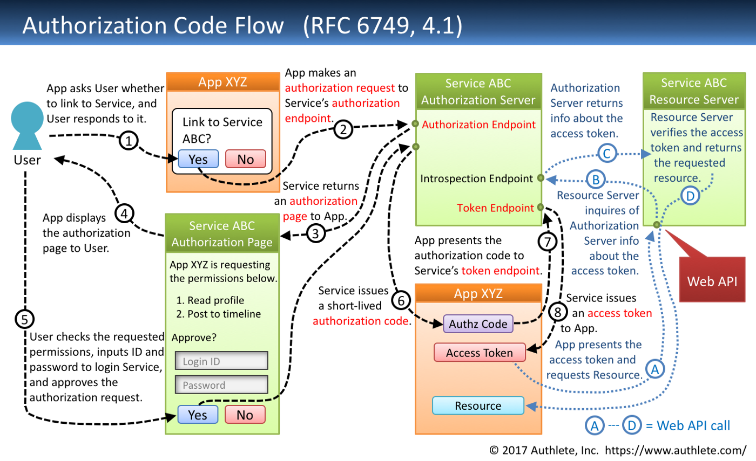
Data flow of an oauth api?

Slide 10
References
Rouse, M. (2020, February 07). What is OAuth and How Does it Work? Retrieved June 23, 2020, from https://searchapparchitecture.techtarget.com/definition/OAuth
Synopsys Editorial Team, A. (2019, January 17). What's the difference between OAuth 2.0 and OAuth 1.0?: Synopsys. Retrieved June 23, 2020, from https://www.synopsys.com/blogs/software-security/oauth-2-0-vs-oauth-1-0/
Raible, M. (2017, June 21). What the Heck is OAuth? Retrieved June 23, 2020, from https://developer.okta.com/blog/2017/06/21/what-the-heck-is-oauth
Swoopnow.com, A. (2020, June 12). What is OAuth?: Learn the Basics of Open Authorization. Retrieved June 23, 2020, from https://swoopnow.com/what-is-oauth/
Kawasaki, T. (2019, October 07). Diagrams And Movies Of All The OAuth 2.0 Flows. Retrieved June 23, 2020, from https://medium.com/@darutk/diagrams-and-movies-of-all-the-oauth-2-0-flows-194f3c3ade85

