Slide 1

RESTFUL Api’s
BY: Ashleigh Lyman

Slide 2
What is a restful api?
API stands for “Application programming interface”, which is a set of rules that allow programs to talk to each other (Zell & Liew, 2018). This allows the client to talk to it.
REST stands for “Representational State Transfer”, this simply a set of rules that determines how the API looks. These can be used over any protocol, typically uses HTTP.

Slide 3
How are restful api’s used?
Receiving data in a convenient format
Creating new data
Updating data
Deleting data
(Redka, 2016)

Slide 4
Using an api
A URL request is sent for a resource
A response is sent back with the resource
(Redka, 2016)

Slide 5
Benefits of RESTFUL API’S
No need to install additional software or libraries when creating a REST API (mulesoft, 2020)
Flexibility
Can return multiple formats
Easier for user, no remembering specific parameters in specific order

Slide 6
Disadvantages of restful api’s
Cannot maintain state in REST(mulesoft, 2020)
Bound by constraints
More difficult for newer developers to use

Slide 7
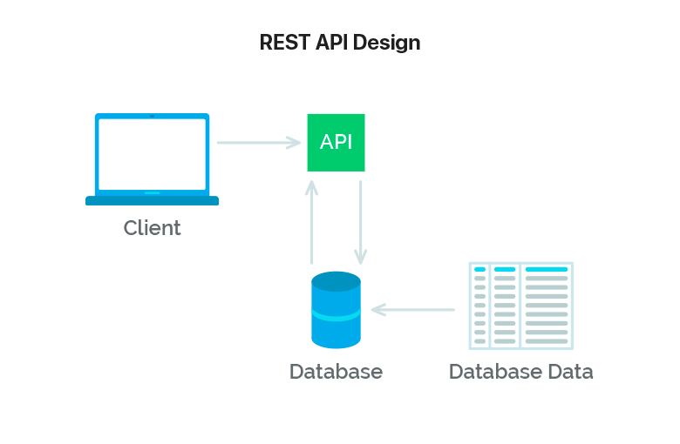
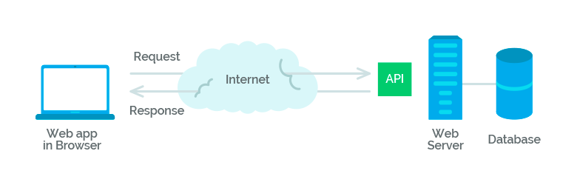
Steps in communication
(Redka, 2016)

Slide 8
Differences in uri & url
URI (Uniform Resource Identifier)
URL (Uniform Resource Locator)
String of characters
Identifies a web resource by name or location
URI is used to distinguish one resource from another (geeksforgeeks.org, 2020)
Example: Your name
String of characters
Directs you to an address
Tells you how to access it
This is a type of URI (geeksforgeeks.org, 2020)
Example: Your address

Slide 9
Big picture
Think of RESTful API’s as a way of living or thinking. You live your life and view your surroundings in a certain way that can make it easier and simpler. Rules or guidelines are put in place to makes things more user-friendly and efficient. It is simply a style of designing.

Slide 10
References
(n.d.). Retrieved from https://mlsdev.com/blog/81-a-beginner-s-tutorial-for-understanding-restful-api
anonymous007Check out this Author's contributed articles., anonymous007, & Check out this Author's contributed articles. (2020, February 6). Difference between URL and URI. Retrieved from https://www.geeksforgeeks.org/difference-between-url-and-uri/
What is a RESTful API? (n.d.). Retrieved from https://www.mulesoft.com/resources/api/restful-api
Zell, & Liew. (2018, January 17). Understanding And Using REST APIs. Retrieved from https://www.smashingmagazine.com/2018/01/understanding-using-rest-api/

