Slide 1
Cryptocurrencies
Group Members:
Terrell Bradford and Ashleigh DeVito

Slide 2
Motivation & Summary
Does cryptocurrency value track with traditional stock market value?
There is a weak correlation
Does social media have an influence on value?
There is a correlation between change in price and number of comments primarily with Dow Jones
Notes:
Inspiration: The Reddit and RobinHood “GameStop-Gate”
Define the core message or hypothesis of your project. Describe the questions you asked, and why you asked them Describe whether you were able to answer these questions to your satisfaction, and briefly summarize your findings

Slide 3
Questions & Data
Financial Data was taken from:
Pandas DataReader Library
Social Media Data was scraped from:
Reddit via the PushShift API
Notes:
Elaborate on the questions you asked, describing what kinds of data you needed to answer them, and where you found it

Slide 4
Data Cleanup & Exploration
Exploration & Insights
Vast amount of data
High and Low vs Daily Range
Meaning of Volume
Problems
Date incongruities
Polysemy of ‘Tether’
Dual Index
Timestamp objects
API rate limited
Notes:
Describe the exploration and cleanup process Discuss insights you had while exploring the data that you didn't anticipate Discuss any problems that arose after exploring the data, and how you resolved them Present and discuss interesting figures developed during exploration, ideally with the help of Jupyter Notebook

Slide 5
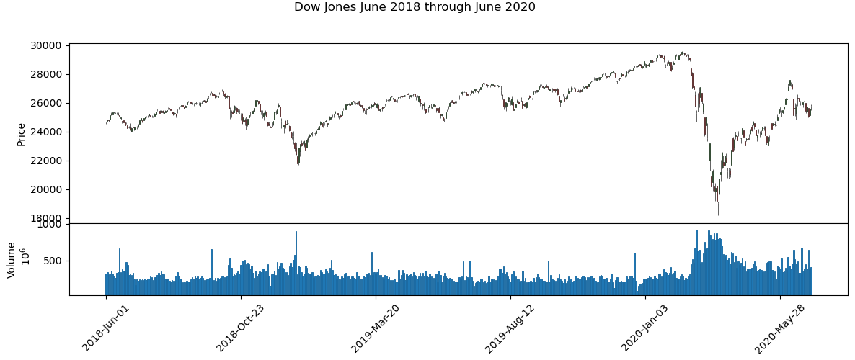
Data Exploration

Slide 6
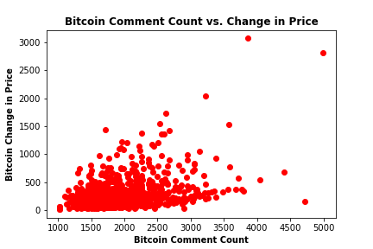
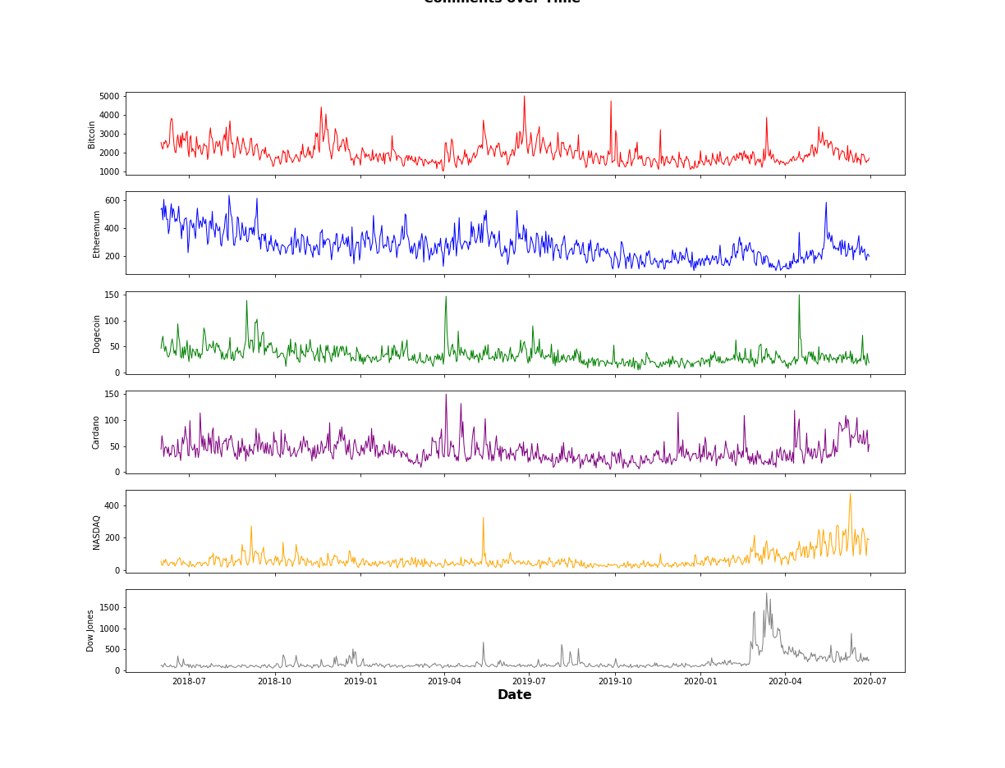
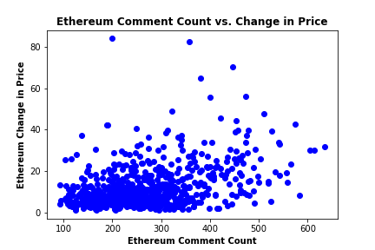
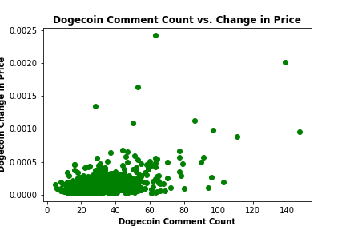
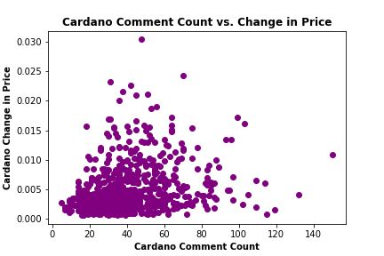
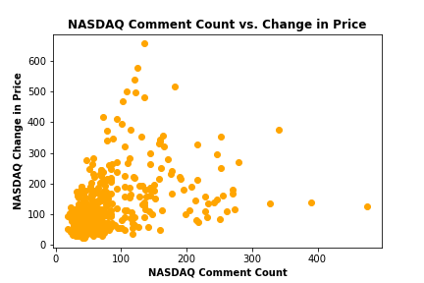
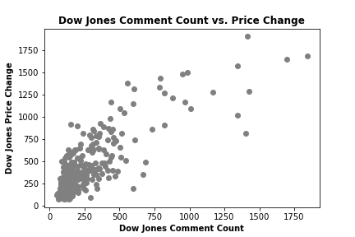
Data Exploration
Comments over Time

Slide 7
Data Analysis
Steps for Analysis
Volume vs Daily Range of Price
Reddit Comments
Does social media have an influence on value?
Examined correlation relationship between cryptocurrencies/stock exchanges and number of comments on Reddit
Notes:
Discuss the steps you took to analyze the data and answer each question you asked in your proposal Present and discuss interesting figures developed during analysis, ideally with the help of Jupyter Notebook

Slide 8
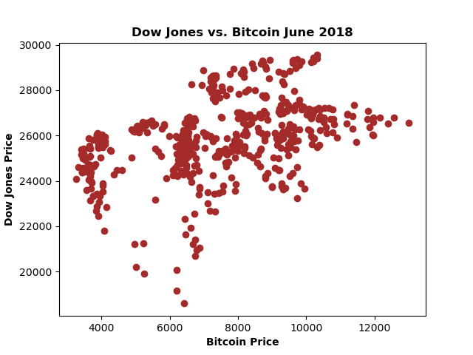
Analysis

Slide 9
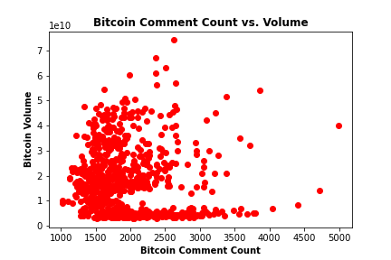
r = .3838
Jupyter Notebook
r = -.077
Notes:
Bitcoin not as correlated as we may have thought

Slide 10
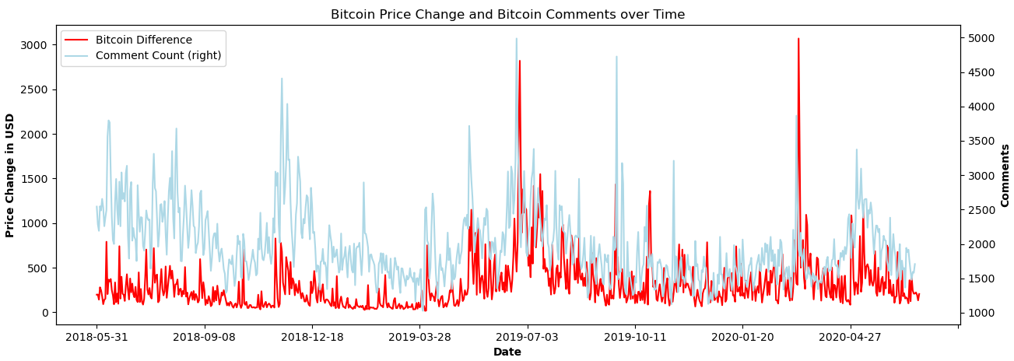
Strongest correlation
Notes:
Strongest correlation between Dow Price and comment count

Slide 11
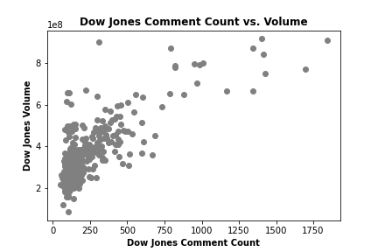
r =.8208
r =.7775
Notes:
Strongest correlation between Dow Price and comment count

Slide 12
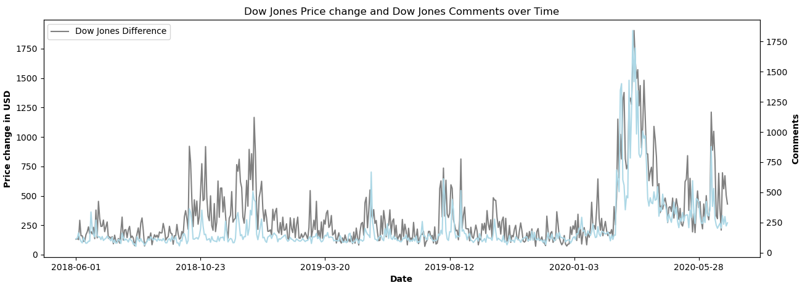
Strongest correlation

Slide 13
Discussion
Expected
Relationship between social media activity and cryptocurrency fluctuations
(digital chatter to digital currency)
Correlation between Volume and Comment Count
(more talking more transactions)
Result
Stronger relationship between social media activity and traditional stock fluctuations
(digital chatter to analogue value)
Stronger correlation between daily price differences and comment count
(more talking about rapid price variation)
Notes:
Discuss your findings. Did you find what you expected to find? If not, why not? What inferences or general conclusions can you draw from your analysis?

Slide 14
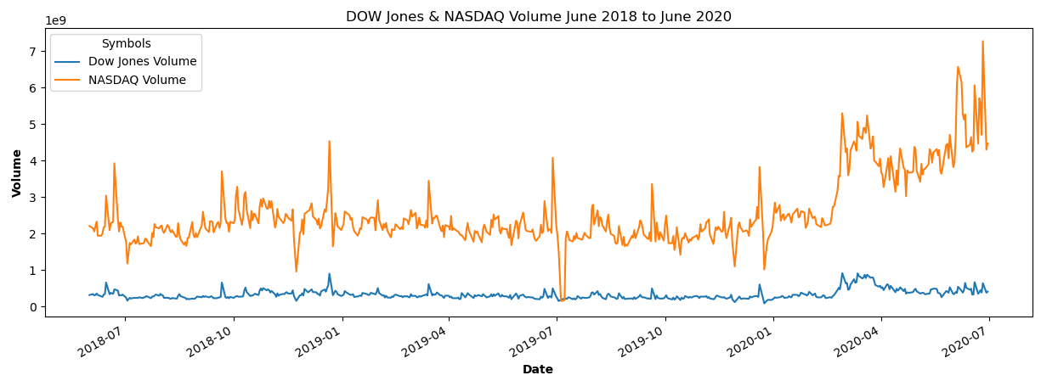
Implications
Notes:
Dow has less activity than NASDAQ (also higher price) – less fluctuation, more chatter, higher correlation?

Slide 15
Post Mortem
Difficulties
‘Twitter’ API inaccessible historically
If we had more time
Look into different sectors, or if individual stocks may correlate
Expand or contract time frame
Notes:
Discuss any difficulties that arose, and how you dealt with them Discuss any additional questions that came up, but which you didn't have time to answer: What would you research next, if you had two more weeks?

Slide 16
Questions
Notes:
Open-floor Q&A with the audience

