Slide 1
Cryptocurrencies
Group Members:
Terrell Bradford and Ashleigh DeVito

Slide 2
Motivation & Summary
Does cryptocurrency value track with traditional stock market value?
There is a correlation
Does social media have an influence on value?
There is a correlation between change in price and number of comments
To satisfaction: no
Notes:
Inspiration: The Reddit and RobinHood “GameStop-Gate”

Slide 3
Questions & Data
Financial Data was taken from the Pandas DataReader Library
Social Media Data was scraped from Reddit through the PushShift API

Slide 4
Data Gathering
Jupyter Notebook

Slide 5
Data Cleanup & Exploration
Describe the exploration and cleanup process
Discuss insights you had while exploring the data that you didn't anticipate
Discuss any problems that arose after exploring the data, and how you resolved them
Date incongruities
Polysemy of Tether
Present and discuss interesting figures developed during exploration, ideally with the help of Jupyter Notebook

Slide 6
Data Cleaning and Exploration
Jupyter Notebook

Slide 7
Data Analysis
Analysis
Discuss the steps you took to analyze the data and answer each question you asked I
Present and discuss interesting figures developed during analysis, ideally with the help of Jupyter Notebook and your proposal

Slide 8
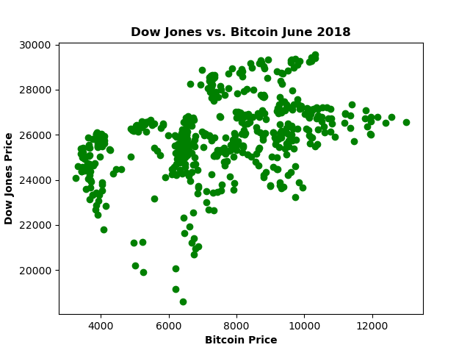
Analysis
Jupyter Notebook

Slide 9
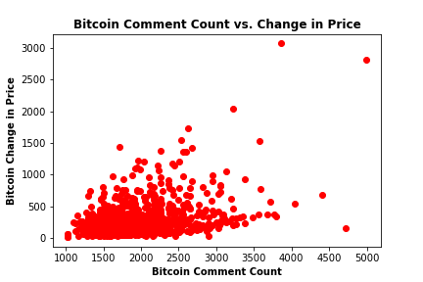
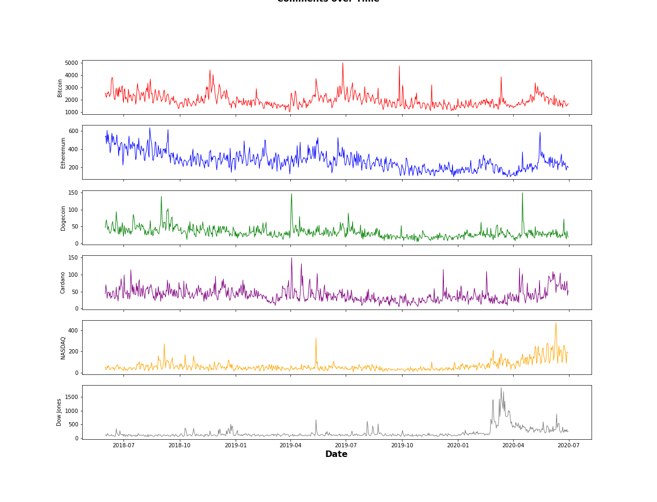
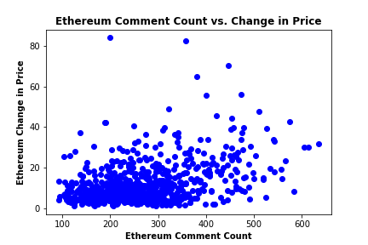
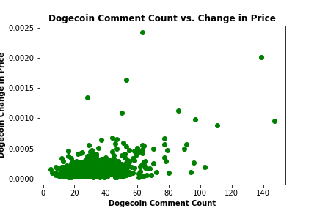
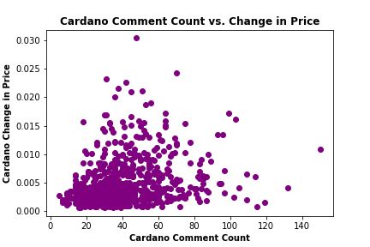
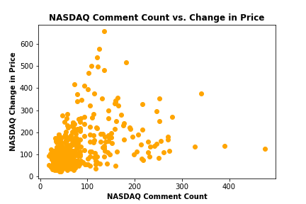
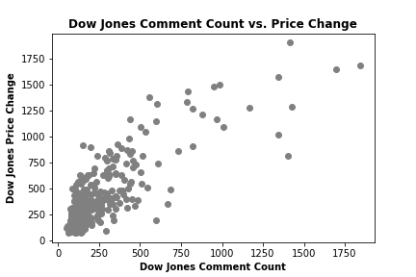
Data Analysis
Comments over Time

Slide 10
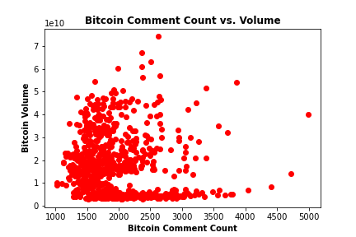
r = .3838
Jupyter Notebook
r = -.077
Notes:
Bitcoin not as correlated as we may have thought

Slide 11
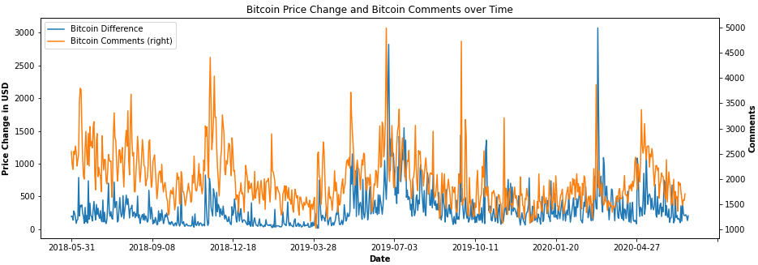
Jupyter Notebook

Slide 12
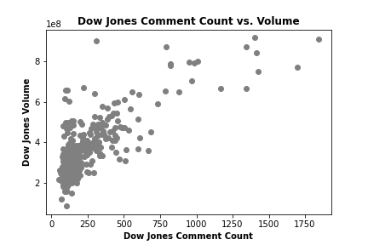
r =.8208
Jupyter Notebook
r =.7775
Notes:
Strongest correlation between Dow Price and comment count

Slide 13
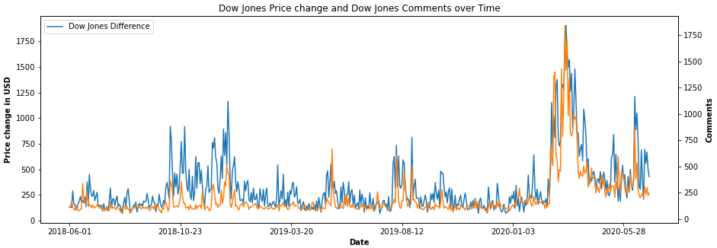
Strongest correlation
Jupyter Notebook

Slide 14
Discussion
Expected:
Stronger relationship between social media activity and cryptocurrency fluctuations
Correlation between Volume and Comment Count
Result:
Stronger relationship between social media activity and traditional stock fluctuations
Stronger correlation between daily price differences and comment count

Slide 15
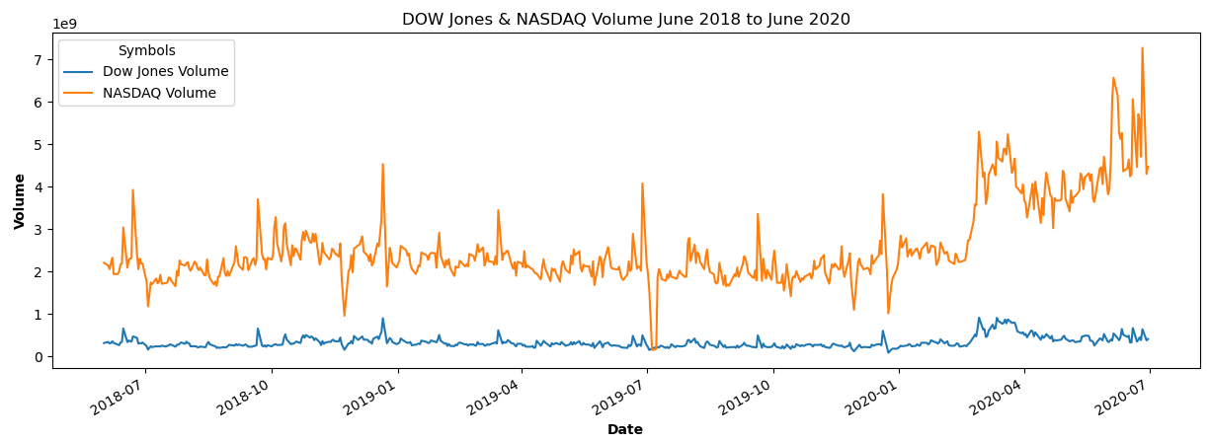
Jupyter Notebook
Notes:
Dow has less activity than NASDAQ – less fluctuation, more chatter, higher correlation

Slide 16
Conclusions
Jupyter Notebook

Slide 17
Post Mortem
Difficulties:
Twitter API
Loss of project member
If we had more time:
Look into different sectors, or if individual stocks may correlate
Expand or contract time frame

Slide 18
Questions

