Slide 1
Cryptocurrencies
Group Members:
Terrell Bradford and Ashleigh DeVito

Slide 2
Motivation & Summary
Does cryptocurrency value track with traditional stock market value?
There is a weak correlation
Does social media have an influence on value?
There is a correlation between change in price and number of comments primarily with Dow Jones
To satisfaction?
No
Notes:
Inspiration: The Reddit and RobinHood “GameStop-Gate”

Slide 3
Questions & Data
Financial Data was taken from:
Pandas DataReader Library
Social Media Data was scraped from:
Reddit via the PushShift API

Slide 4
Data Cleanup & Exploration
Exploration & Insights
Vast amount of data
High and Low vs Daily Range
Meaning of Volume
Problems
Date incongruities
Polysemy of ‘Tether’
Dual Index
Timestamp objects
API rate limited

Slide 5
Data Cleaning

Slide 6
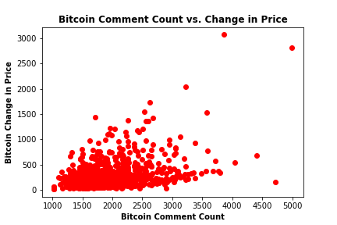
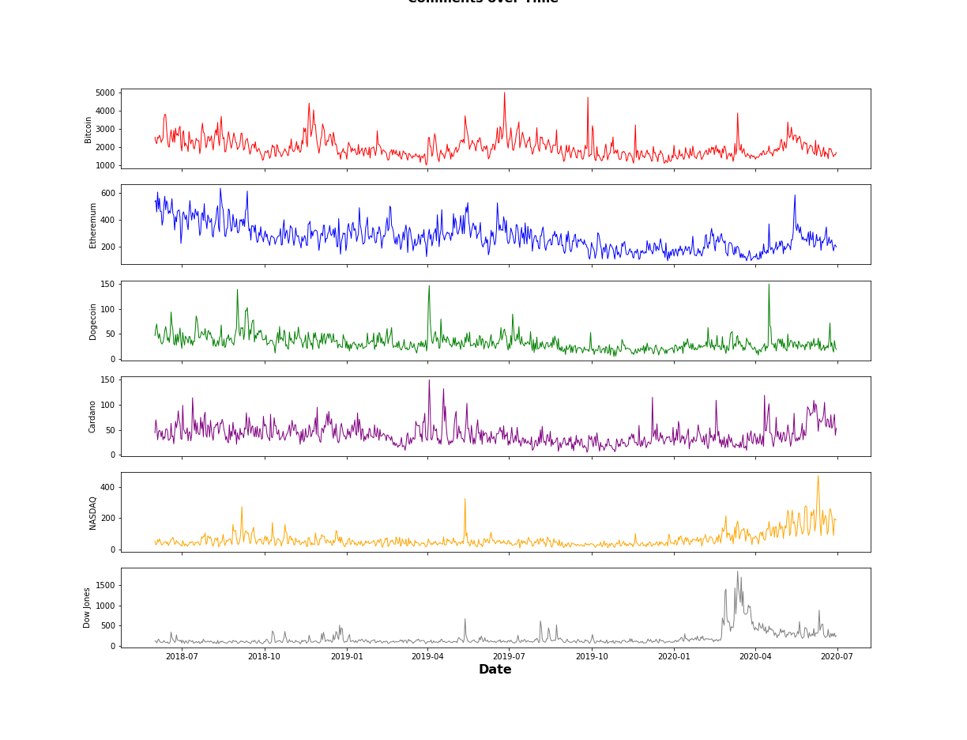
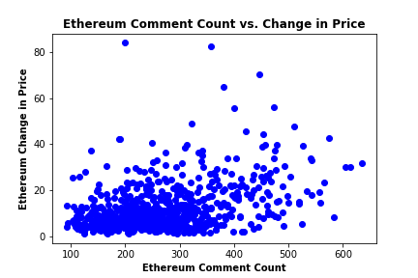
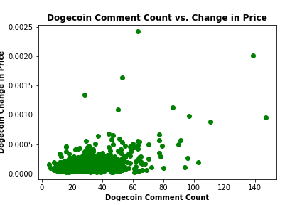
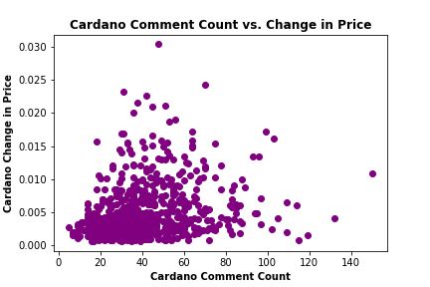
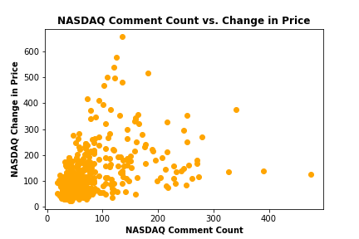
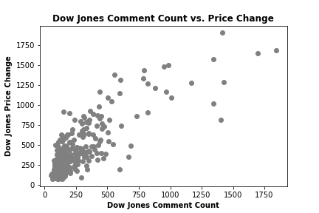
Data Exploration
Comments over Time

Slide 7
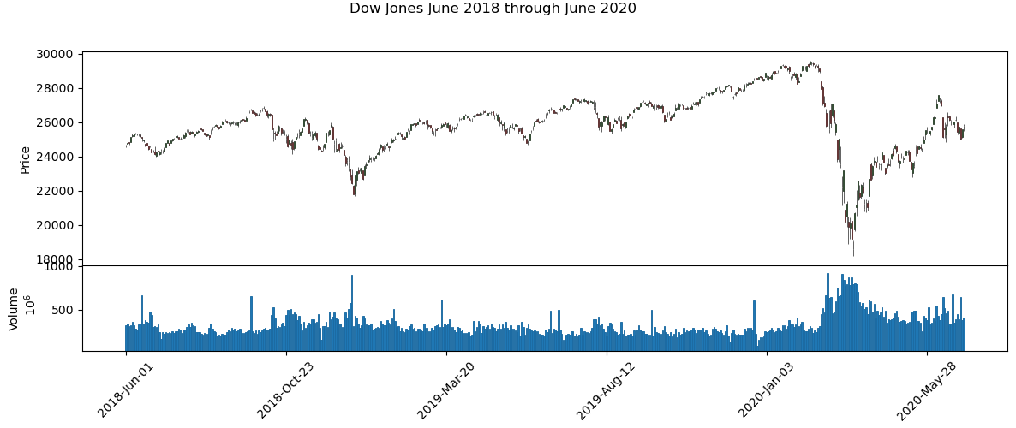
Data Exploration

Slide 8
Data Analysis
Steps for Analysis
Volume vs Daily Range of Price
Reddit Comments
Does social media have an influence on value?
Examined correlation relationship between cryptocurrencies/stock exchanges and number of comments on Reddit

Slide 9
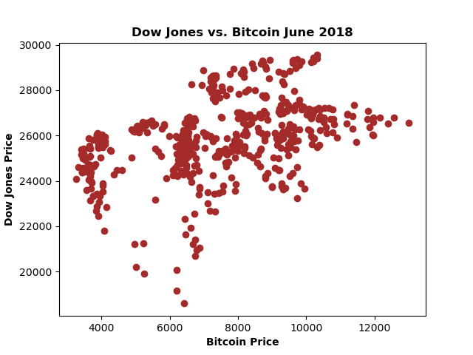
Analysis

Slide 10
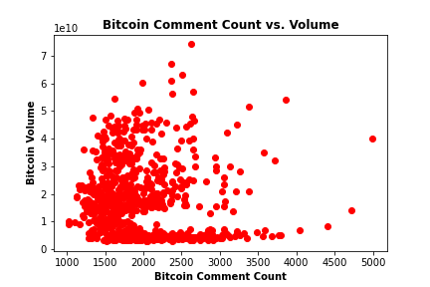
r = .3838
Jupyter Notebook
r = -.077
Notes:
Bitcoin not as correlated as we may have thought

Slide 11
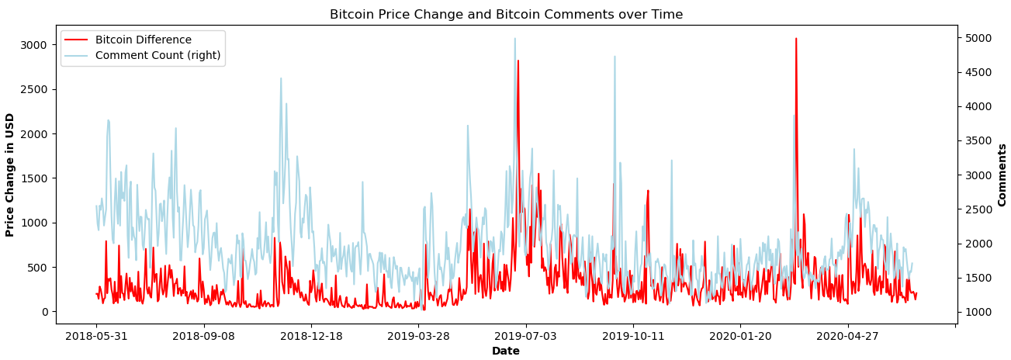
Strongest correlation
Notes:
Strongest correlation between Dow Price and comment count

Slide 12
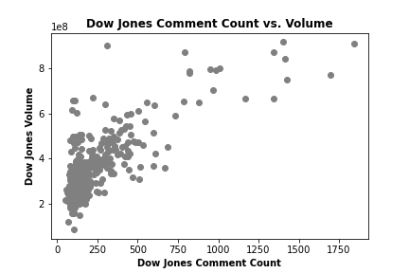
r =.8208
r =.7775
Notes:
Strongest correlation between Dow Price and comment count

Slide 13
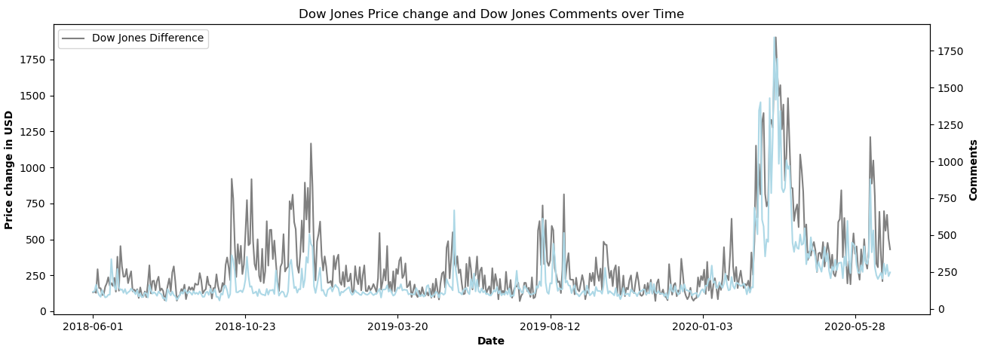
Strongest correlation

Slide 14
Discussion
Expected
Stronger relationship between social media activity and cryptocurrency fluctuations
Correlation between Volume and Comment Count
Result
Stronger relationship between social media activity and traditional stock fluctuations
Stronger correlation between daily price differences and comment count

Slide 15
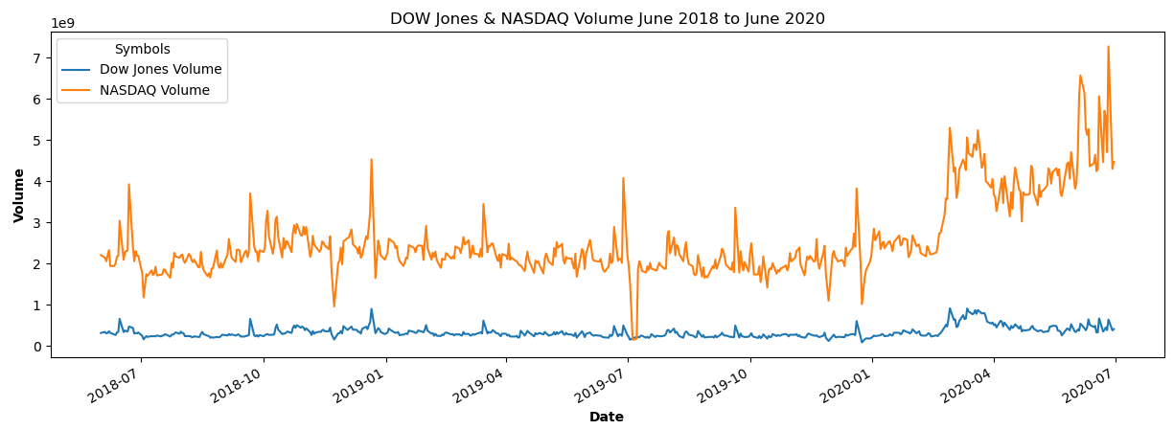
Conclusions
Notes:
Dow has less activity than NASDAQ – less fluctuation, more chatter, higher correlation

Slide 16
Post Mortem
Difficulties
‘Twitter’ API inaccessible historically
If we had more time
Look into different sectors, or if individual stocks may correlate
Expand or contract time frame

Slide 17
Questions

