Slide 1
Predicting Movie Box office sales
Team: Terrell Bradford, Michael Cipriani, Ashleigh DeVito, Laura Kemp, Sam Pierce

Slide 2


Purpose
Analyze box office success over the last 15 years (2006-present)
Provide a tool that can be used to predict a range of box office earnings for future debuts

Slide 3




Our Data
OMDb
IMDb
The Numbers
Google Trends
Notes:
Budget & Top 500 Largest BoxOffice Sellers, data was gathered from thenumbers.com
The data on movies that were to be released was gathered from Imdb.
Buzz, our metric for marketing, was gathered through Google Trends analysis of the movie titles.

Slide 4





Extract Transform load
Jupiter Notebook
Flask
PostgreSQL
Heroku
AWS
Notes:
Data was cleaned using Jupyter notebook scripts.
Omitted data included: studio, language, plot, tagline, directors, writers, actors. Release date information was converted to Month. Dummy columns were created for genre and movie rating
CSVs containing the final cleaned data were imported into the AWS database via Jupyter notebook scripts connecting to PostgreSQL. pgAdmin was our preferred client.

Slide 5
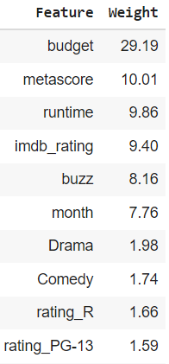
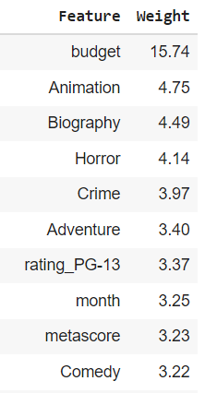
Machine Learning Models
Random Forest
XG Boost
Initially used Linear Regression, Random Forest Models, and a Neural Network
Settled on XG Boost

Slide 6








website
Contains
Predictor
Project Outline
Team Page

Slide 7
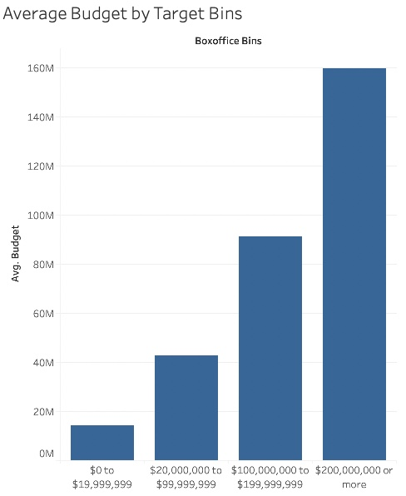
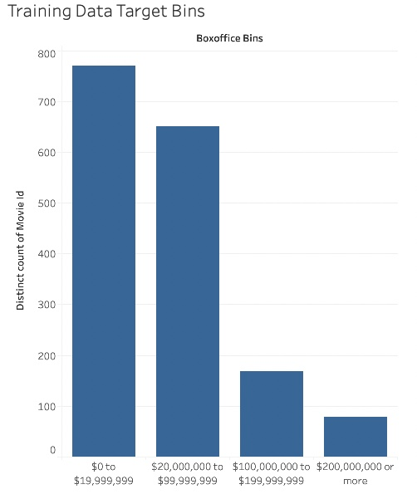
Findings
Gather probabilities on sales for several upcoming films

Slide 8

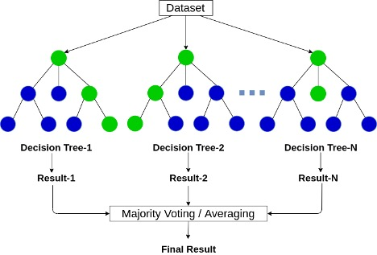
conclusion
Limitations
Film financial data is guarded by the industry. It was difficult to find accurate and reliable, publicly available information
Issues
Paywalls, settling on a model

Slide 9


questions

