Slide 1


INSTITUTE FOR ADVANCED COMPUTING AND SOFTWARE DEVELOPMENT AKURDI, PUNE
HOTEL RECOMMENDATION SYSTEM
Presented by-
Anuj Thawre-239508
Ashlesh Chinchkhede-239511

Slide 2

Contents:
Introduction
Problem Statement
Data Analysis Steps
Data Preview
Requirement Specifications
Data Summary
Future Scope
Conclusion

Slide 3
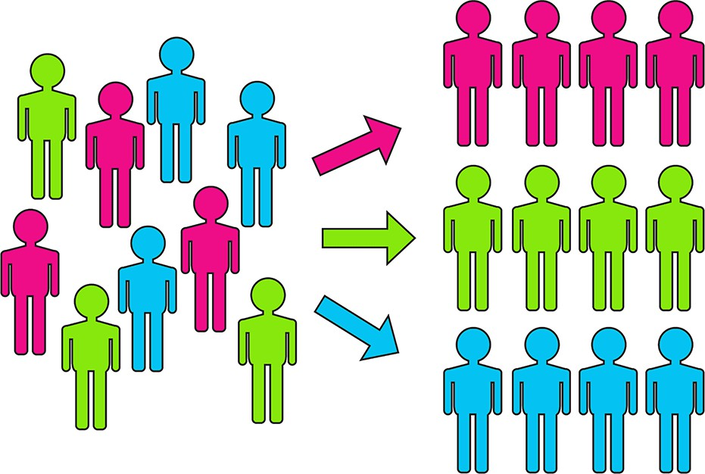
Introduction:
Motivation
In this project we are building a hotel recommender system for the customer who needs an insight about how their hotel is ranked compared with other hotels from scratch
Abstract
The objective of this project is to develop a machine learning-based hotel recommendation system that assists users in finding suitable accommodations based on their preferences and requirements. By employing various machine learning algorithms, the system aims to enhance user experience and satisfaction in the hotel booking process. Therefore the aim of this project is to predict the quality of the question using ML models so that the user can make a calculated guess before posting the question.

Slide 4
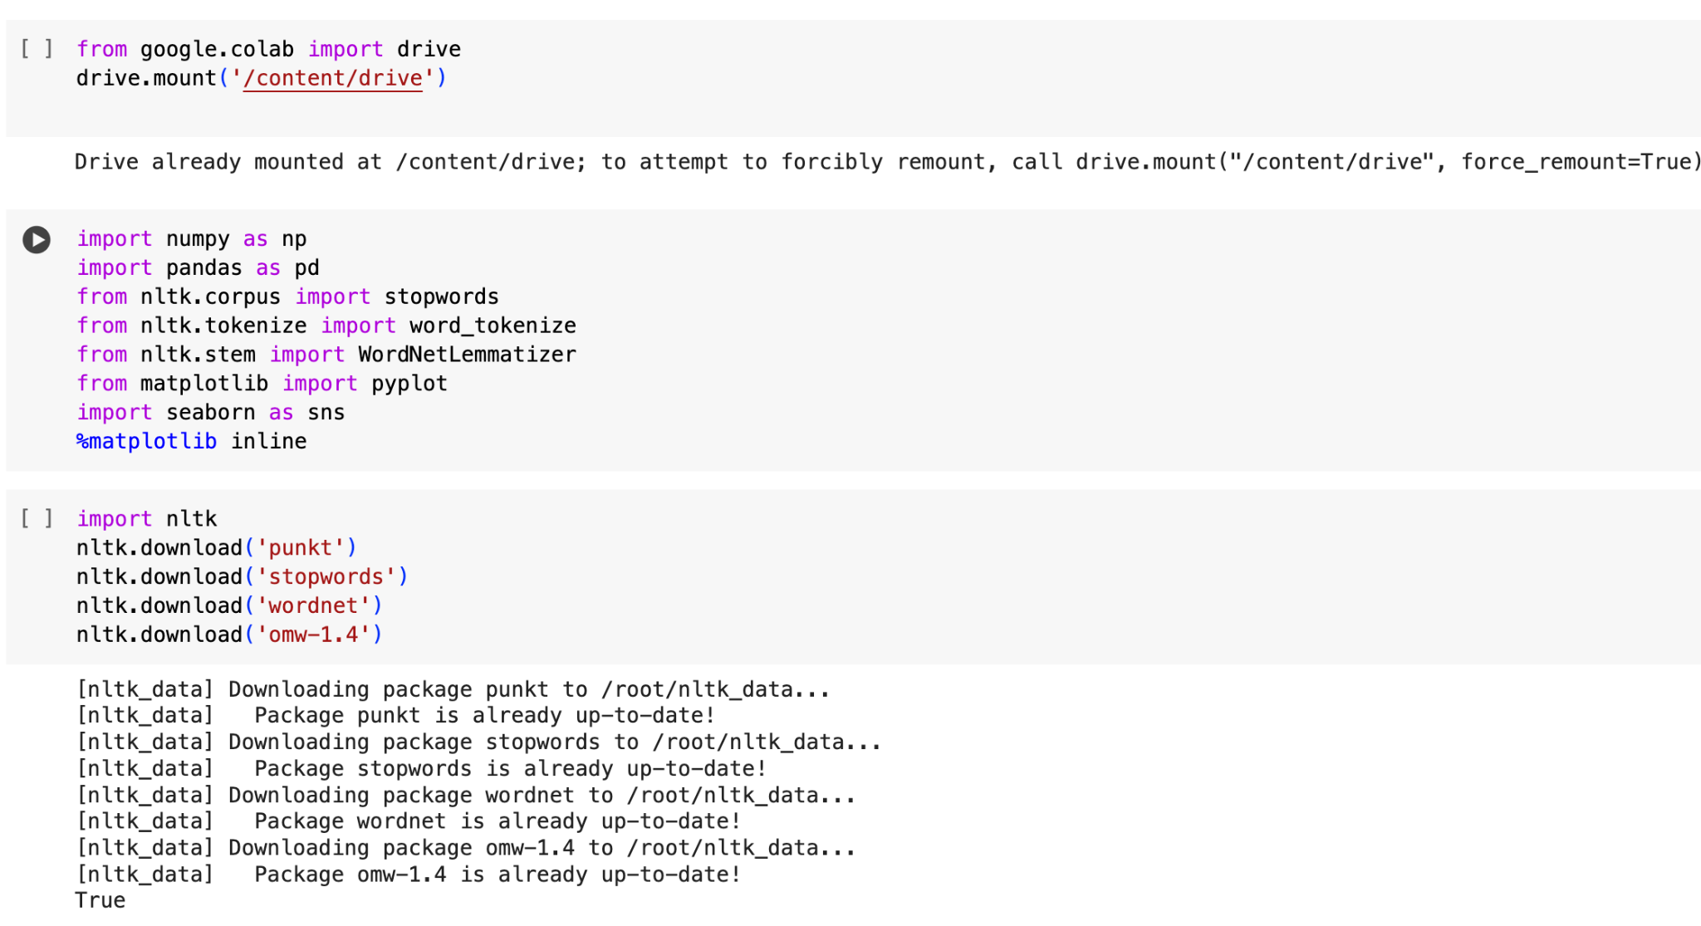
Importing Required Libraries

Slide 5
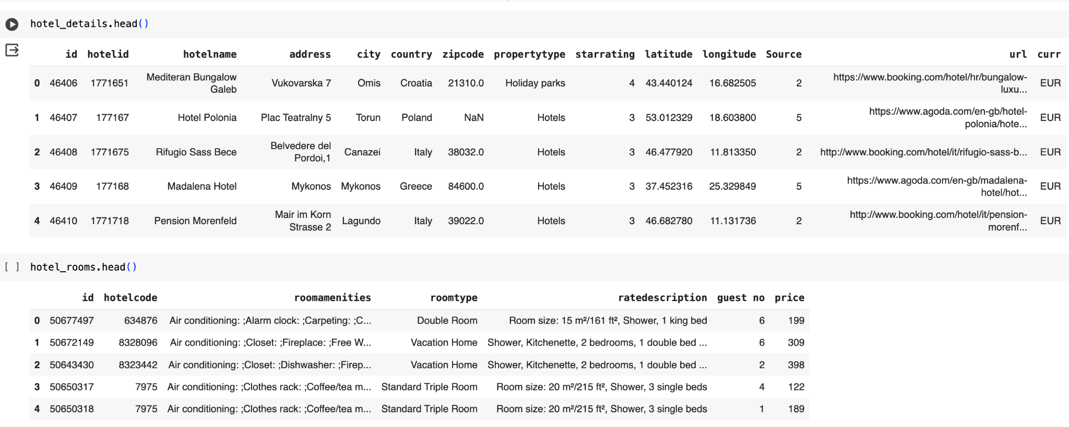
Data Exploration

Slide 6
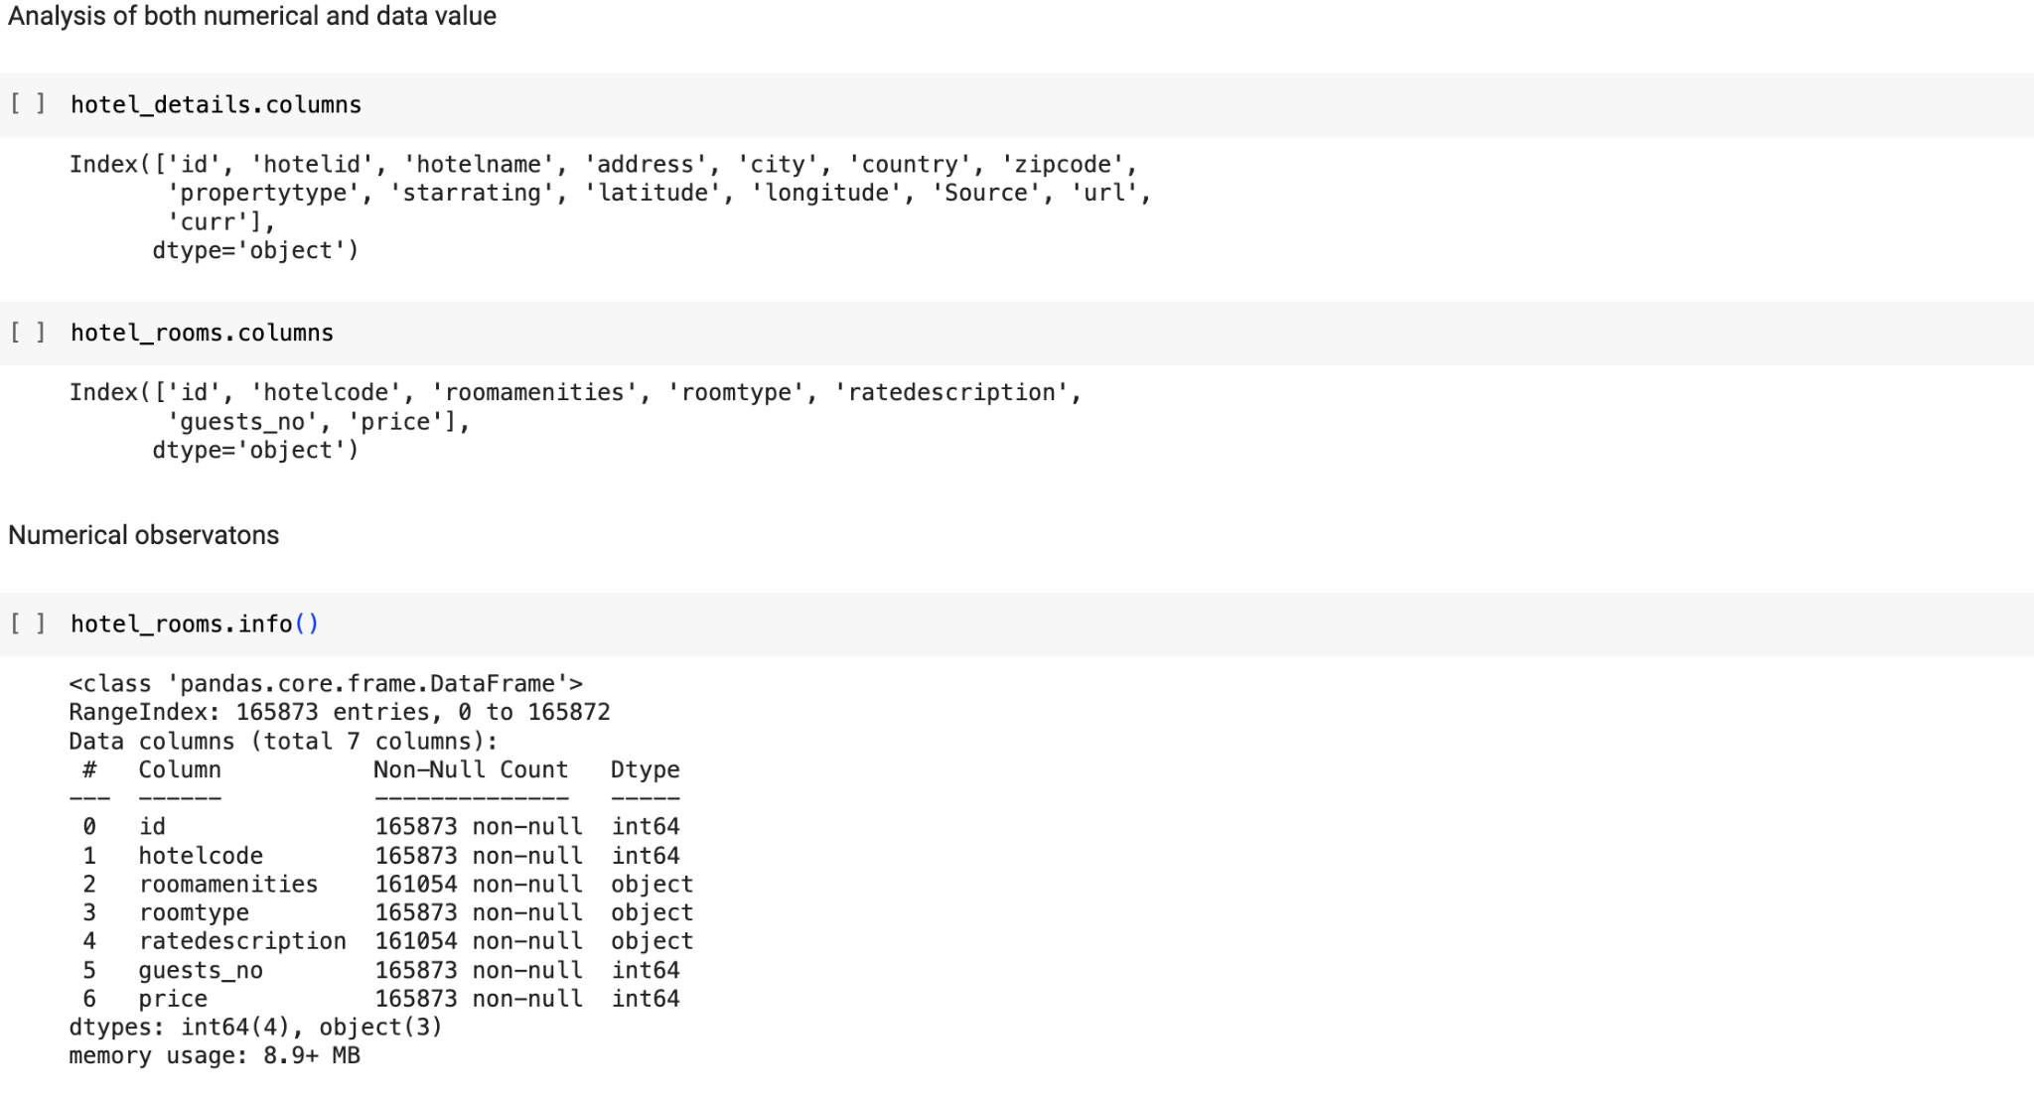

Slide 7
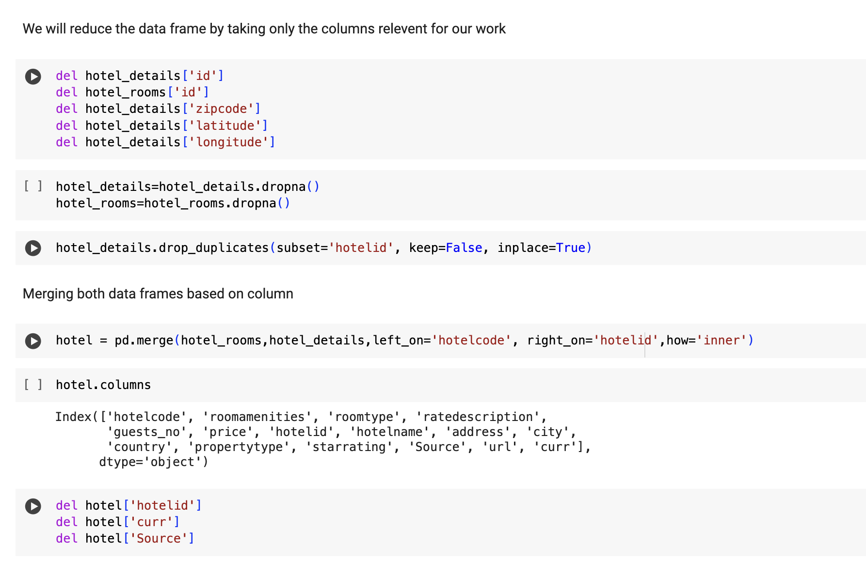
Data Cleaning and Transformation

Slide 8
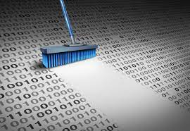
Checking for duplicate
Removing the duplicate values
Checking for missing values

Slide 9
Data Visualization
Data visualization is the graphical representation of information and data. By using visual elements like charts, graphs, and maps, data visualization tools provide an accessible way to see and understand trends, outliers, and patterns in data.
Maps and charts used-
Figure A Workflow Diagram
Figure 1 Correlation heatmap between variables
Figure 2 Below graph shows the Correlation between Price of Hotel vs Star Rating
Figure 3 Showing count of hotels having ratings 2,3,4
Figure 4 Top 10 most booked Hotels
Figure 5 Top 10 cities where hotels are most booked
Figure 6 Top 10 countries where hotels are most booked
Figure 7 Graph showing count of hotels in each country
Figure 8 Top property types preferred by users while hotel booking

Slide 10
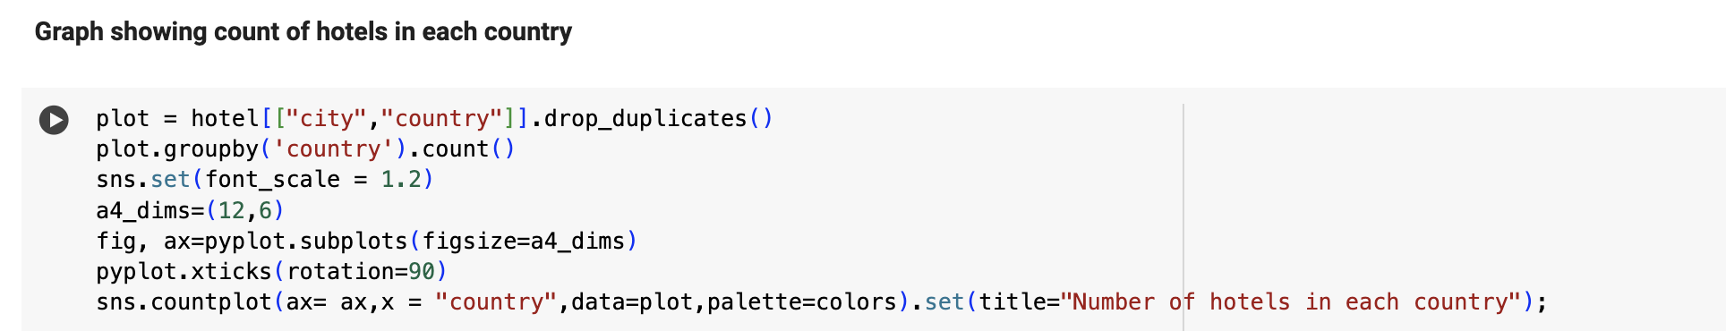
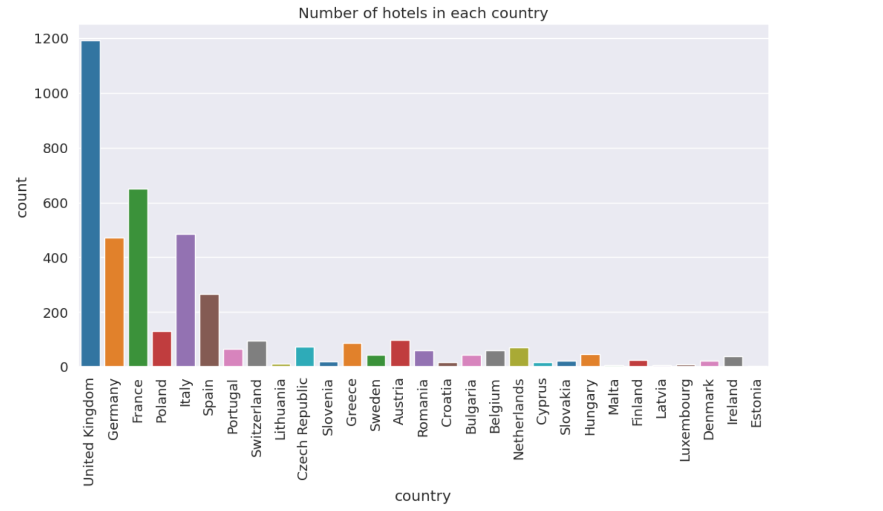

Slide 11
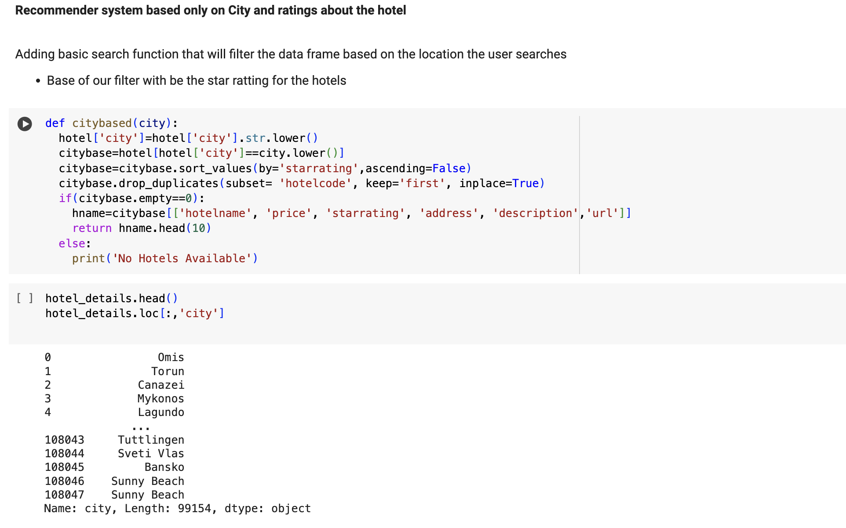

Slide 12
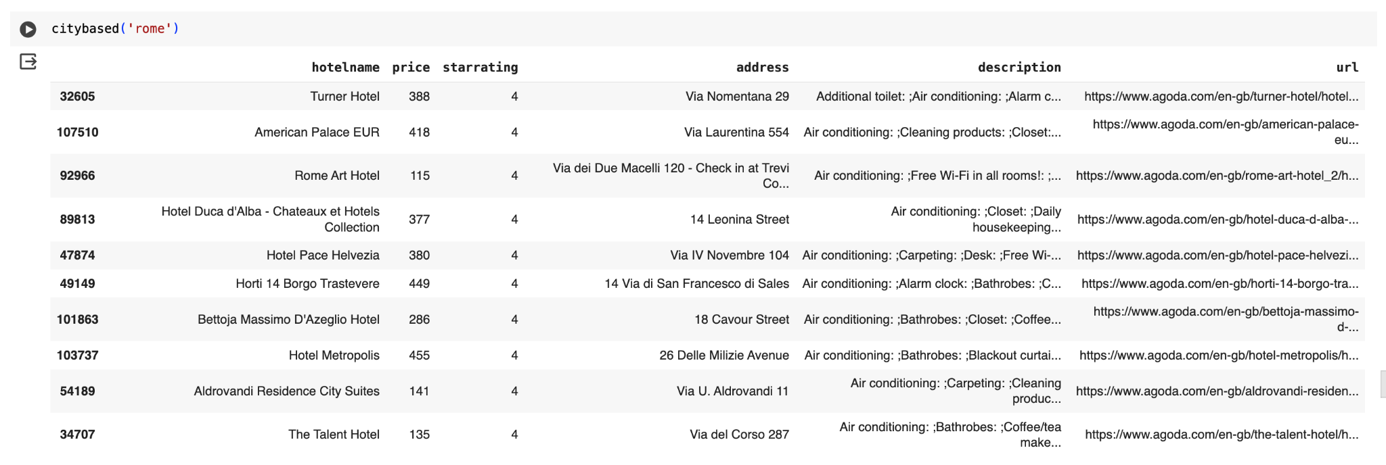
The below shown is- Most booked Hotel in city Rome based on starrating

Slide 13
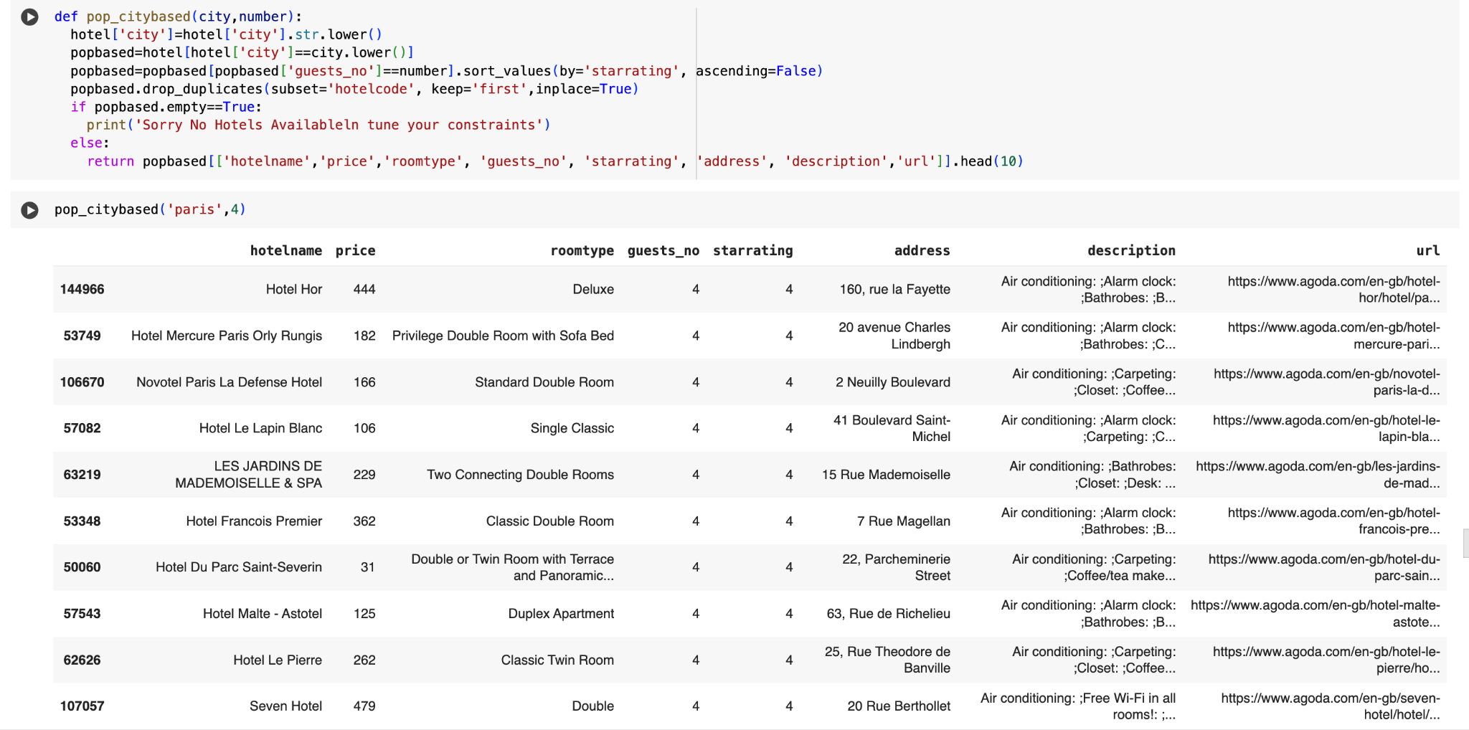
Recommender based on requirement and special needs

Slide 14
Approach based on requirement of the user
Using content based collaborative filtering for recommending Hotels here. Using user inputs like
* location of trip
* his nationality
* trip type like leisure or business
* number of travellers
We create user profile(as we have in dataset as features).
Using input, we directly filter users and reduce data on which we can build regression model to filter the hotels.
Since dataset contains features which are mix of user details like room-amenities and hotel reviews related features predicting rating on mix of features requires a different approach as entire row has predictors which cannot be asked from user.
Linear Regression methods like Ridge performed well when applied on entire dataset's numerical features indicating good predictor qualities in those features.
Hence for each Hotel we assumed first row as user and trained the regression model on the rest of the data of that Hotel
This approach helps predict rating as user selected is as good as random and similar to real user. Also we have rating of the
assumed user which helps us evaluate how our model performs. Once ratings of all the Hotels are predicted, top 10 predicted
ratings are pulled and corresponding Hotels are recommended.
Library used for Text Pre processing: NLTK Library used for context understanding WordNetLemmatizer is a library that is imported from nltk. stem which looks for lemmas of words from the WordNet Database.

Slide 15
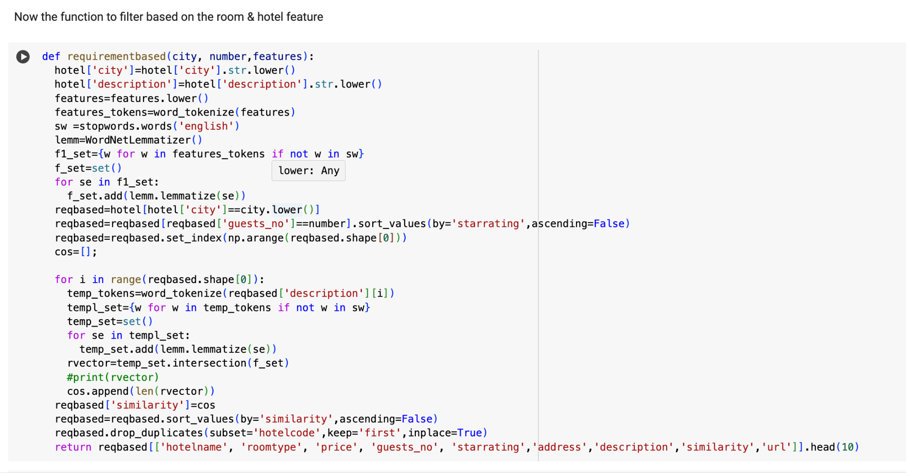

Slide 16
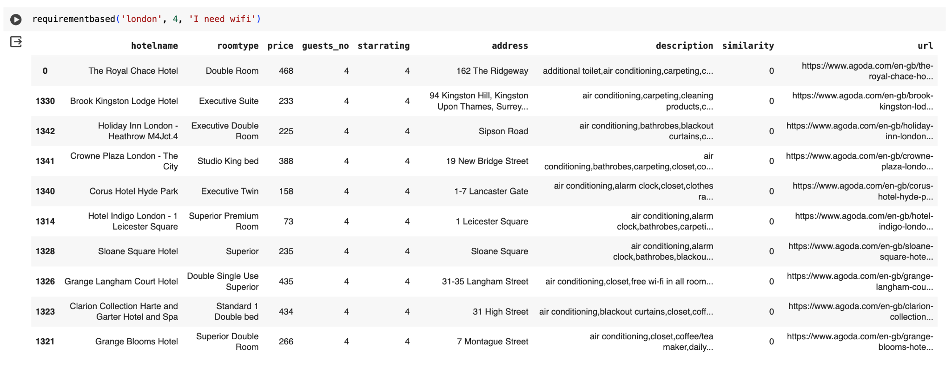
The recommender will suggest hotels based on the requirement of the customer + City and guest no

Slide 17
THANK YOU

