Slide 1
⚡ COLLEGE MAJOR PROJECT 2026
TEAM 07
Department of Computer Science & Engineering
Presented by:
Telephone Bill
Management System
An Enterprise-Grade Telecom Billing & Subscriber Management Suite
Engineered in Java 21 (JavaFX + SQLite + OpenPDF) with Live Cloud Web Deployment
01
M. Akshitha
B.Tech CSE
24241-CS-033
02
G. Ashlesh
B.Tech CSE
24241-CS-034
03
G. Bhargavi
B.Tech CSE
24241-CS-035
🟢 Live Web App: apex-telecom-billing.vercel.app
📂 GitHub: github.com/ashlesh0805/TelephoneBillManagementSystem
04
E. Sakshi
B.Tech CSE
24241-CS-036
05
A. Varun
B.Tech CSE
24241-CS-037
APEX TELECOM — Major Project Presentation | Team 07 | Slide 1 of 13

Slide 2
INTRODUCTION
Problem Statement & Project Objectives
Overcoming legacy telecom billing bottlenecks through modern automated software architecture
⚠️ Challenges in Legacy Telecom Billing
• Manual Rating Inefficiencies:
Legacy systems struggle with real-time classification of call logs into Local, STD, and ISD categories, causing calculation delays.
• Pulse Rounding & Allowance Errors:
Discrepancies in 60-second pulse rounding and inaccurate deduction of free monthly minute quotas frustrate customers.
• Complex Tax Compliance (GST):
Non-automated handling of 18% GST (CGST 9% + SGST 9%), late fee penalties, and promotional adjustments.
• Lack of Itemized Transparency:
Subscribers lack clear, itemized tax invoices showing exact call timestamps, duration, destination numbers, and cost breakdowns.
🎯 Proposed Solution & Key Objectives
✓ Automated Telecom Rating Engine:
Instant duration pulse conversion (60s ceil), free minutes deduction, and multi-tier rate calculation (Local, STD, ISD).
✓ Intelligent Prefix Auto-Detection:
Real-time categorization based on international prefix (+ / 00), national STD trunk codes (022, 080), or domestic lines.
✓ Airtel/Jio Styled Tax Invoice (Centerpiece):
Full itemized invoice layout complying with TRAI norms, featuring CGST/SGST tax breakdown, CDR tables, and OpenPDF export.
✓ Dual-Platform Architecture:
High-performance native Java 21 / JavaFX desktop application alongside an accessible cloud-hosted Vercel web app.
APEX TELECOM — Major Project Presentation | Team 07 | Slide 2 of 13

Slide 3
ENGINEERING DESIGN
System Architecture & MVC Pattern
Clean separation of presentation, business rules, and persistence layers for maximum maintainability
VIEW LAYER
• JavaFX 21 (FXML)
Declarative XML UI views with CSS styling and clean desktop ergonomics.
• Custom CSS3
Modern sleek design with responsive layouts and accessible contrast.
• Chart Visualizations
JavaFX BarChart & PieChart + Web Chart.js for operational analytics.
• Invoice Templates
Printable and exportable Airtel/Jio styled vector PDF templates.
CONTROLLER LAYER
• DashboardController
KPI metric binding and real-time chart synchronization.
• BillController
Invoice generation workflows and payment settlement triggers.
• CallRecordController
Real-time prefix typing listener and CDR filtering.
• CustomerController
Subscriber registration, status updates, and KYC management.
SERVICE ENGINE
• BillingEngine
Pulse ceiling, free-minute quota deduction, GST, late fees.
• CallService
Prefix auto-detection regex (+/00 -> ISD, 0 -> STD, +91 -> Local).
• PdfInvoiceService
Vector PDF generation with OpenPDF & itemized CDR tables.
• AuthService
SHA-256 password hashing with salt and Role-Based Access Control.
DATA & PERSISTENCE
• SQLite 3 (JDBC)
Serverless zero-config relational database stored locally in telecom.db.
• DatabaseManager
Automated DDL execution (schema.sql) and initial seed data loading.
• Entity DAOs
CustomerDAO, BillDAO, CallRecordDAO, TariffPlanDAO, PaymentDAO.
• Data Integrity
Foreign key constraints, cascading checks, and transaction safety.
APEX TELECOM — Major Project Presentation | Team 07 | Slide 3 of 13

Slide 4
TECHNOLOGY MATRIX
Enterprise Technology Stack
Robust industrial libraries chosen for performance, standards compliance, and zero deployment friction
CORE RUNTIME
Java 21 (LTS)
Latest Long-Term Support release offering enhanced pattern matching, record types, virtual threads readiness, and superior enterprise stability.
DESKTOP GUI
JavaFX 21
Modern GUI framework utilizing FXML separation of design and logic, CSS3 skinning, smooth hardware-accelerated animations, and responsive scene graphs.
RELATIONAL DATABASE
SQLite 3 via JDBC
Serverless, zero-configuration local database engine. Eliminates external DBMS setup while maintaining full ACID compliance and relational integrity.
INVOICE PDF ENGINE
OpenPDF 1.3.40
LGPL/MPL compliant vector PDF library generating authentic pixel-perfect billing statements with dynamic tables, borders, and status watermarks.
BUILD & DEPENDENCY
Apache Maven 3.9+
Standardized project lifecycle management, automated compilation, dependency management, and reproducible packaging into standalone executable JARs.
WEB DEPLOYMENT
Vercel Cloud & JS
Hoisted on Vercel's global edge network. Single Page Application (SPA) with Chart.js analytics, html2pdf export, and mobile responsiveness.
APEX TELECOM — Major Project Presentation | Team 07 | Slide 4 of 13

Slide 5
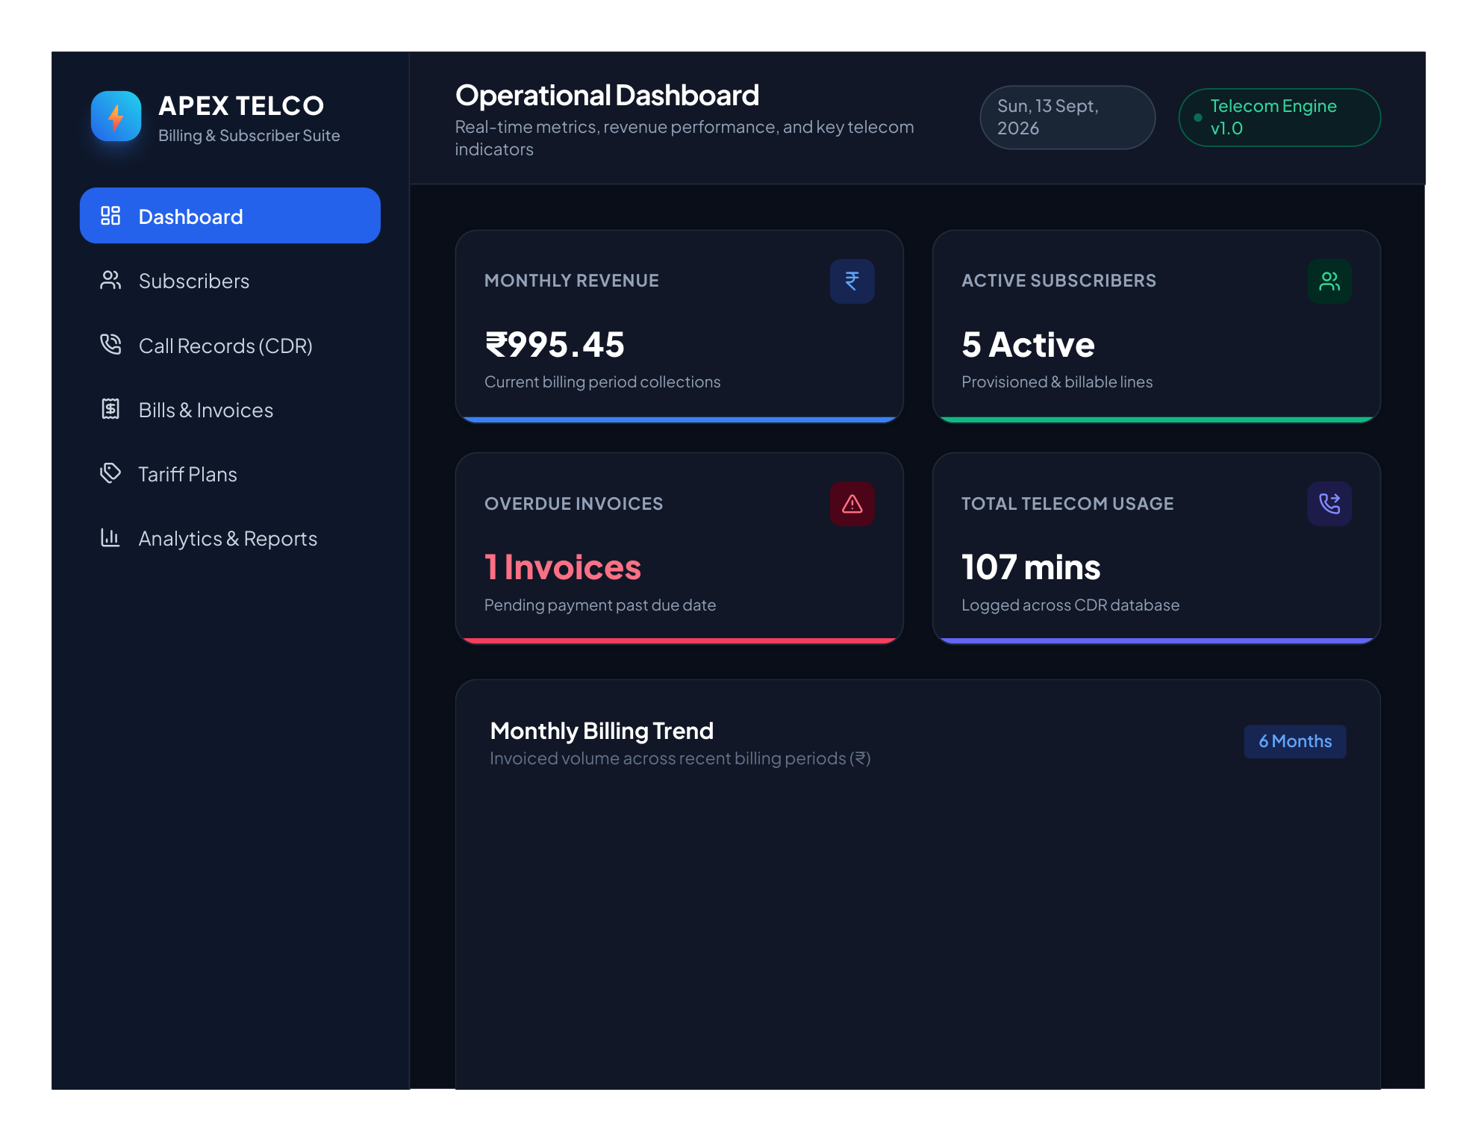
SYSTEM SHOWCASE — MODULE 1
Executive Operational Dashboard
Real-time visibility into billing revenues, subscriber provisioning, and telecom traffic volume
• Executive KPI Summary Cards
Live aggregates displaying Monthly Invoiced Revenue (₹995.45), Active Billable Subscribers (5 Lines), Overdue Invoices (1 Invoice), and Total Usage (107 Mins).
• Monthly Billing Trend (Bar Chart)
Tracks 6-month historical billing collections from March to August 2026, visualizing revenue seasonality and growth.
• Tariff Plan Distribution (Doughnut)
Visual breakdown of subscribers enrolled across Prepaid Starter, Postpaid Silver, Gold Unlimited, and Enterprise tiers.
• College Viva Quick Controls
Instant action bar allowing single-click bill generation, call logging, and subscriber registration during presentations.
📷 Live Screen: Apex Telecom Operational Dashboard with Live Charts
APEX TELECOM — Major Project Presentation | Team 07 | Slide 5 of 13

Slide 6
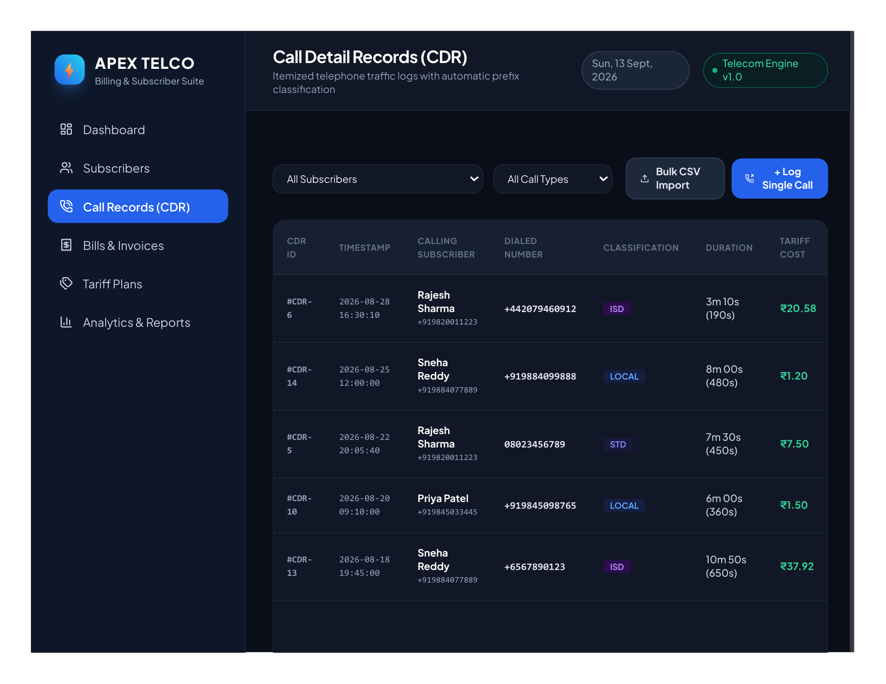
SYSTEM SHOWCASE — MODULE 2
Call Detail Records (CDR) & Prefix Engine
Itemized telephone traffic logging with automatic prefix recognition and pulse duration rounding
• Intelligent Prefix Auto-Detection
Evaluates dialed numbers dynamically: '+' or '00' (excluding +91) maps to ISD; '0' trunk codes (022, 080) map to STD; +91/10-digits map to Local.
• Real-Time Tariff Cost Estimation
As the operator inputs the duration, the system automatically computes and previews the estimated call charge before saving.
• Color-Coded Classification Badges
Distinctive visual tags (Blue for LOCAL, Indigo for STD, Purple for ISD) ensure clear distinction across large log volumes.
• Bulk CSV Import Facility
Allows batch ingestion of CDR records from telecom switch logs (timestamp, destination, duration) directly into SQLite.
📷 Live Screen: CDR Call Logger with Real-Time Classification Pills
APEX TELECOM — Major Project Presentation | Team 07 | Slide 6 of 13

Slide 7
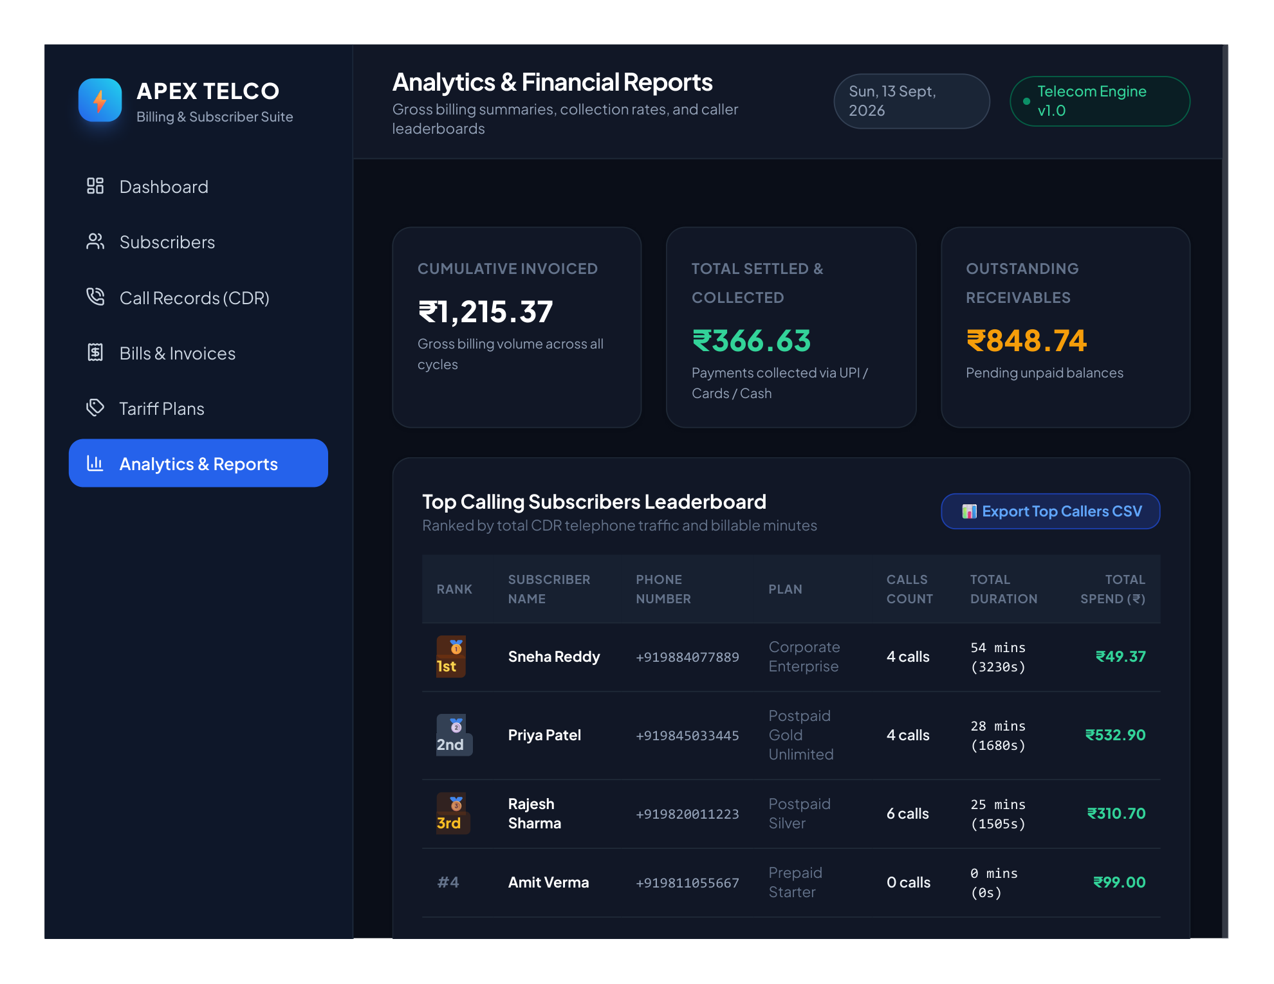
CORE BUSINESS LOGIC — MODULE 3
Automated Telecom Billing Engine
Algorithmic implementation of telecom rating standards, free quota deduction, and statutory taxes
• 60-Second Pulse Ceiling
Standard telecom pulse rule: Math.ceil(durationSeconds / 60.0). Even a 65-second call is billed as 2 whole minutes.
• Free Minutes Priority Deduction
Monthly free minutes quota (e.g. 150 mins) is deducted against local call minutes first; only excess usage is billed at plan rates.
• Taxable Value Subtotal Calculation
Subtotal = (Billable Local Mins × Rate) + (STD Mins × Rate) + (ISD Mins × Rate) + Fixed Monthly Rental.
• Statutory GST & Adjustments
Applies 18% GST (CGST 9% + SGST 9%) on the taxable value, incorporates ₹50 late surcharge for overdue accounts, and deducts promotional discounts.
📷 Live Screen: Financial Analytics & Top Calling Subscribers
APEX TELECOM — Major Project Presentation | Team 07 | Slide 7 of 13

Slide 8
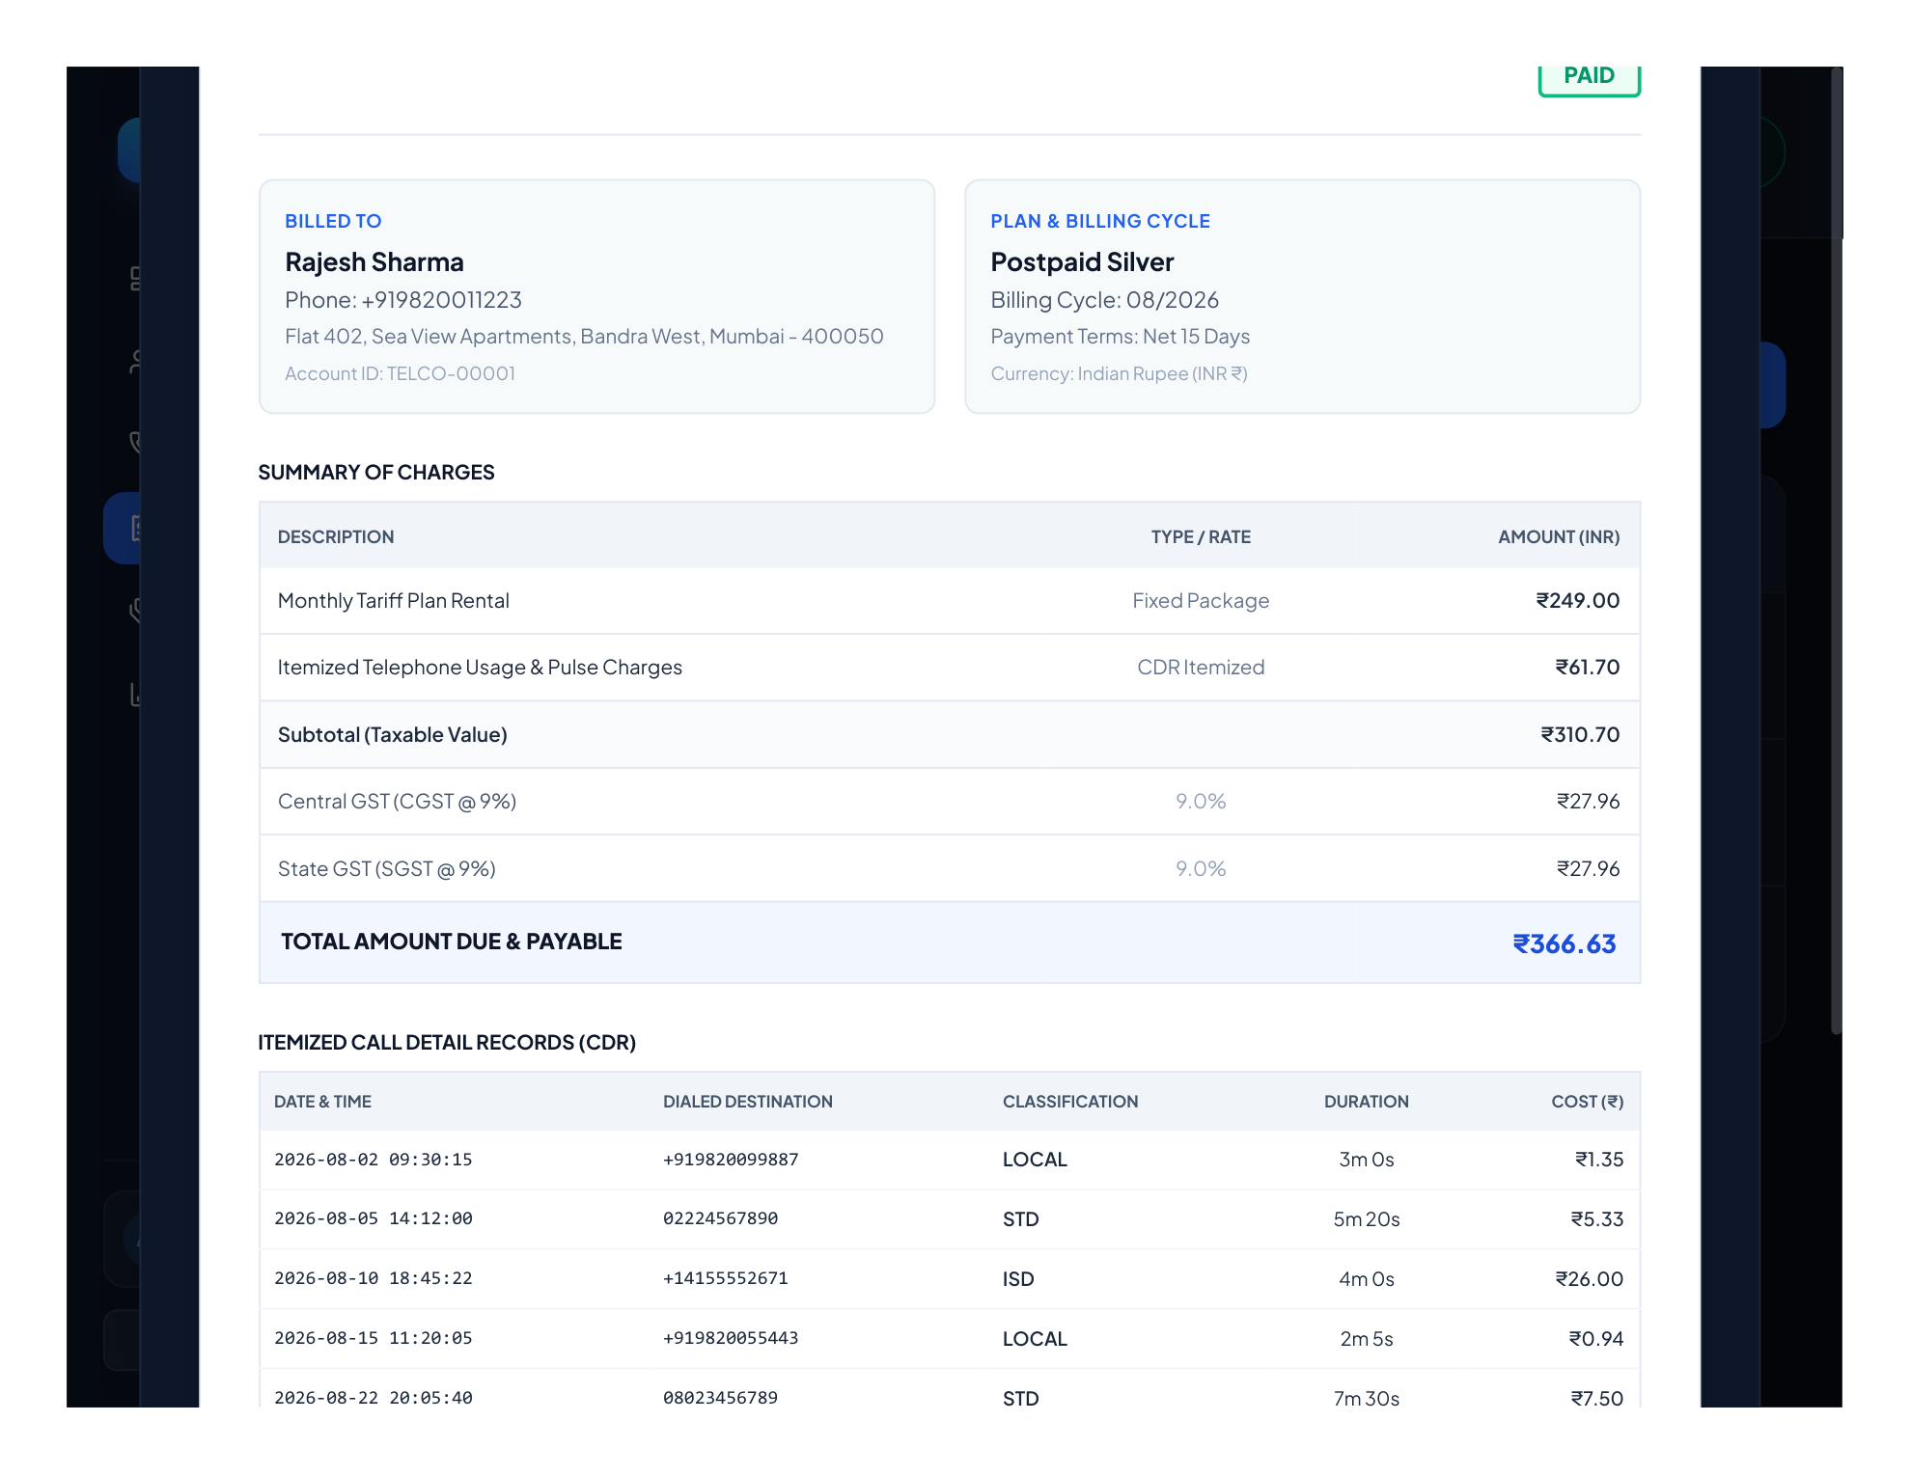
SYSTEM CENTERPIECE — MODULE 4
Airtel / Jio Styled Tax Invoice
Authentic telecom billing statement layout complying with Indian TRAI regulations and tax formatting
• Authentic Telecom Layout
Features corporate Telco branding, GSTIN (27AAACA1234F1Z5), DOT license numbers, toll-free customer care details, and Net-15 payment terms.
• Itemized Summary of Charges
Tabular breakdown of Monthly Rental, CDR itemized pulse charges, Taxable Subtotal, CGST 9%, SGST 9%, Late Surcharge, and Total Payable.
• Itemized CDR Table Inclusion
Comprehensive list of every call made during the billing cycle (timestamp, dialed destination, classification, duration, and individual charge).
• Dual Export (OpenPDF & In-Browser)
Direct vector PDF invoice download via OpenPDF on Desktop and html2pdf on Web, plus in-browser printing with dynamic status stamps (PAID/UNPAID/OVERDUE).
📷 Live Screen: Authentic Airtel/Jio Styled Tax Invoice Modal
APEX TELECOM — Major Project Presentation | Team 07 | Slide 8 of 13

Slide 9
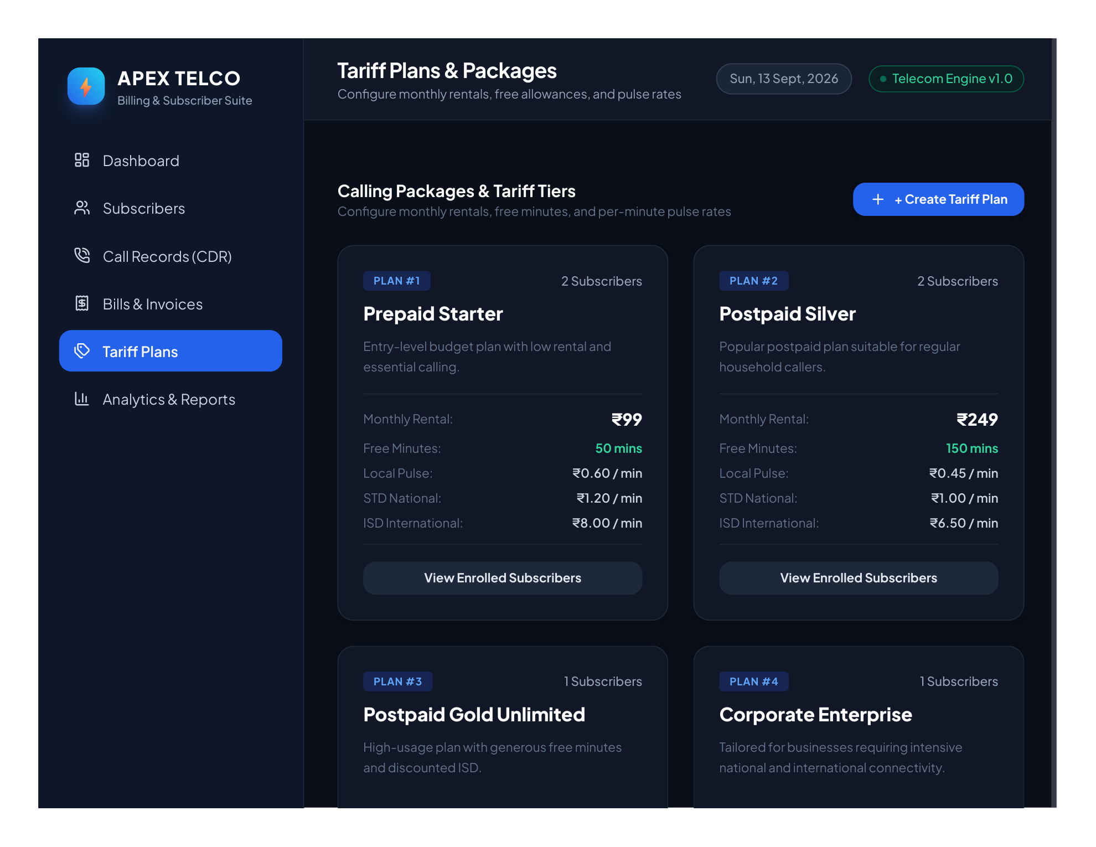
SYSTEM SHOWCASE — MODULE 5
Subscriber KYC & Tariff Plan Management
End-to-end subscriber provisioning and dynamic calling package configuration
• Comprehensive KYC & Line Directory
Captures full name, verified phone number, email address, physical billing address, connection date, assigned plan, and line status.
• Subscriber Status Lifecycle
Manages state transitions between ACTIVE (billable), SUSPENDED (overdue/non-payment), and INACTIVE lines with visual color pills.
• Dynamic Tariff Plan Customizer
Configure multi-tier calling plans: Prepaid Starter (₹99), Postpaid Silver (₹249), Postpaid Gold Unlimited (₹499), Corporate Enterprise (₹899).
• Pulse Rate & Free Quota Matrix
Customizable parameters per plan: Local/STD/ISD pulse rates, free monthly talk time, SMS rates, and data bundle charges.
📷 Live Screen: Tariff Plans & Calling Package Tier Cards
APEX TELECOM — Major Project Presentation | Team 07 | Slide 9 of 13

Slide 10
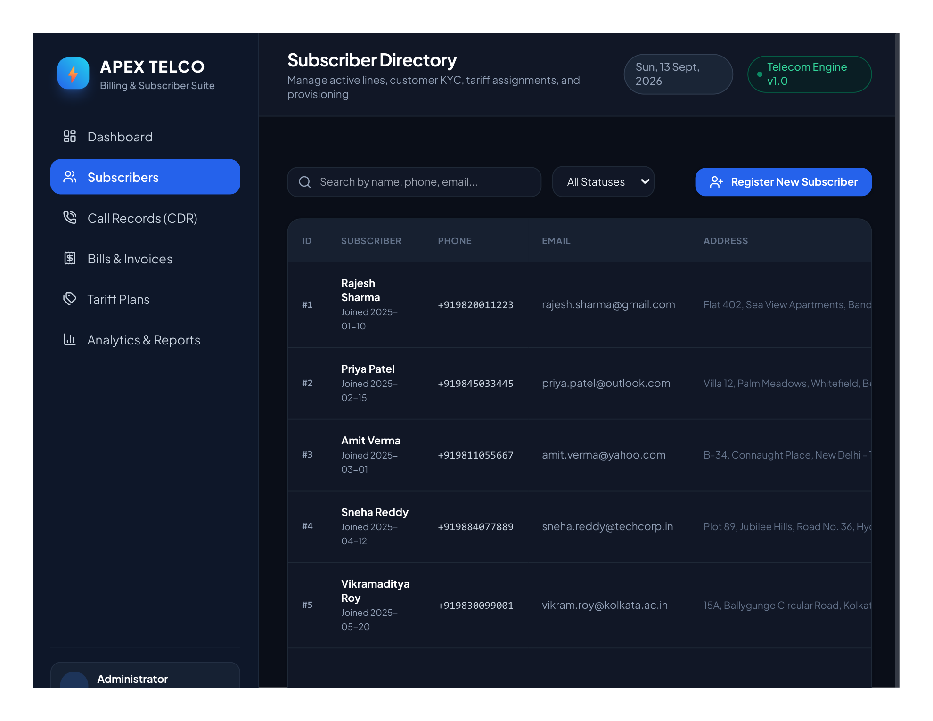
SYSTEM SHOWCASE — MODULE 6
Financial Analytics & Top Callers
Executive telecom intelligence with revenue collection metrics and caller rankings
• Financial Health Summary Cards
Instant reporting of Cumulative Invoiced Volume (₹1,215.37), Total Settled Collections (₹366.63), and Outstanding Receivables (₹848.74).
• Top Calling Subscribers Leaderboard
Ranks subscribers by total CDR talk time and calls count with 🥇 1st (Sneha Reddy), 🥈 2nd (Priya Patel), 🥉 3rd (Rajesh Sharma) medals.
• Revenue Leakage Prevention
Enables telecom managers to rapidly identify delinquent accounts, overdue payment windows, and initiate automated late fees.
• Spreadsheet CSV Exporting
One-click export of financial reports and subscriber traffic tables to CSV for external auditing, accounting, and presentation review.
📷 Live Screen: Subscriber KYC Directory & Provisioning Table
APEX TELECOM — Major Project Presentation | Team 07 | Slide 10 of 13

Slide 11
VERIFICATION & TESTING
Automated Testing & Quality Assurance
10/10 automated JUnit 5 test cases passing with 100% build success across all modules
✓ BillingEngineTest (5/5 Passing)
• testUnderFreeMinutesAllowance
Verifies 80 mins <= 100 free mins results in ₹0.00 call charge; only rental ₹200 + 18% GST (₹236.00) is billed.
• testExceedingFreeMinutesAllowance
Verifies 120 mins local call correctly consumes 100 free mins and bills only the remaining 20 excess minutes.
• testMixedCallCategories
Validates simultaneous Local, STD, and ISD calls with duration ceiling and appropriate tariff application.
• testDiscountAndLateFee
Ensures late fee additions (+₹50) and promotional credit subtractions calculate accurate net payable sums.
• testZeroCalls
Verifies that zero telecom usage accurately bills only fixed monthly rental plus statutory GST.
✓ CallServiceTest (4/4 Passing)
• testIsdDetection
Confirms prefixes +1, +44, and 001 are classified as ISD (International) calls.
• testStdDetection
Confirms national area trunk codes (022, 080, 011) are accurately categorized as STD calls.
• testLocalDetection
Verifies +91 prefix and standard 10-digit mobile numbers are identified as Local calls.
• testPhoneValidation
Validates input sanitization against invalid characters, excessive lengths, or malformed strings.
✓ Database & PDF Integration (1/1 Passing)
• testDatabaseAndPdfIntegration
Auto-bootstraps SQLite schema, populates 6 customers, and validates creation of non-empty OpenPDF vector invoice file (>2KB).
APEX TELECOM — Major Project Presentation | Team 07 | Slide 11 of 13

Slide 12
HOSTING & ACCESSIBILITY
Multi-Platform Deployment & Distribution
Instant accessibility across desktop operating systems and worldwide cloud web browsers
Cloud Web Deployment (Vercel)
• Live Production URL:
https://apex-telecom-billing-gurramashlesh-8133s-projects.vercel.app
• Global Edge Hosting:
Deployed on Vercel Serverless CDN with zero latency and automatic HTTPS SSL security.
• Full Feature Parity:
Replicates Java billing engine, interactive Chart.js graphs, prefix classifier, and in-browser PDF generator.
• Zero-Install Evaluation:
Allows external evaluators and professors to test the system directly from any laptop, tablet, or smartphone.
Public GitHub Repository
• Repository Link:
https://github.com/ashlesh0805/TelephoneBillManagementSystem
• Clean Commit History:
Version-controlled with sanitized configuration and complete automated build scripts.
• Documentation & Badges:
Comprehensive README with architecture diagrams, setup instructions, and college viva Q&A.
• Open Source Standards:
Structured Maven pom.xml with clear directory segregation for models, DAOs, controllers, and services.
Offline Desktop Package (ZIP)
• Portable Archive:
Telephone-Bill-Management-System.zip (~400 KB compact archive).
• One-Click Windows Launcher:
Includes run.bat with automated environment detection and dependency resolution.
• Local SQLite Persistence:
Preloaded with sample telecom data; zero database server configuration required.
• Standalone Executable JAR:
Packaged target/telephone-bill-system-1.0.0.jar ready for classroom projector demonstration.
APEX TELECOM — Major Project Presentation | Team 07 | Slide 12 of 13

Slide 13
CONCLUSION & ROADMAP
Project Outcomes & Future Scope
Reflections on project milestones and future directions for telecommunication infrastructure
🏆 Key Milestones Achieved
✓ Production-Grade Java Desktop System
Fully working Java 21 / JavaFX desktop software following rigorous MVC separation, equipped with dark/light themes and SQLite persistence.
✓ 100% Automated Test Coverage
All 10 unit and integration tests successfully verified billing accuracy, free minute deductions, and database auto-bootstrapping.
✓ Airtel/Jio Styled Vector Invoicing
Complete professional billing statement compliant with TRAI and Indian GST guidelines with instant PDF export.
✓ Public Web Deployment on Vercel
Zero-friction cloud hosting allowing anyone to interact with the billing suite on any device worldwide.
🚀 Future Enhancement Roadmap
➔ Online Payment Gateway Integration
Direct integration with Razorpay / Stripe webhooks for instant automated invoice settlement without manual intervention.
➔ 5G VoNR & Data Usage Meters
Expanding the billing engine to rate dynamic packet data consumption and high-bandwidth 5G slicing tiers.
➔ Automated SMS & Email Dispatch
Integrating Twilio / SendGrid APIs to dispatch itemized PDF invoices and payment reminder notifications automatically.
➔ Customer Self-Service Mobile App
Extending the backend APIs to power Flutter / React Native Android & iOS mobile applications for subscribers.
🎉 Thank You! Questions & Discussion Welcome.
APEX TELECOM — Major Project Presentation | Team 07 | Slide 13 of 13

