Slide 1

Sentiment Analysis and Automated Tweet Response Generation
Team Details
Sl. No. | Student Name | USN | Roll Num. | Division
1. | Ashlesha K | 01fe21bcs321 | 317 | C
2. | Gauri T | 01fe21bcs098 | 312 | C
3. | Sanjana H | 01fe21bcs020 | 302 | C
Guide: Prof. Sunil V.G., Prof. Satish C.

Slide 2

Motivation
Provide timely and contextually appropriate responses to enhance customer satisfaction.
Manage large volumes of social media interactions efficiently.
Generate relevant and meaningful replies by understanding the context and sentiment.

Slide 3

Problem Statement
Create a cutting-edge system to perform real-time sentiment analysis and generate automated tweet responses, improving social media engagement and offering personalized, context-aware interactions.

Slide 4
Dataset Creation
A custom dataset has been created specifically for tweet reply generation.
Includes a wide range of tweets along with their corresponding replies and sentiment labels.
Ensures models are trained to understand the nuances of Twitter interactions.

Slide 5
Objectives
Accurate Sentiment Analysis: Utilize BERT(Bidirectional Encoder Representations from Transformers) to accurately classify tweet sentiments as positive or negative ensuring precise understanding of user emotions.
Tweet Generation: An interface using GPT-2(Generative Pre-trained Transformer 2) where users can input topics and desired sentiment (positive/negative) to generate customized tweets using AI, enhancing user engagement and interaction.
Contextual Response Generation: Implement BART(Bidirectional and Auto-Regressive Transformers) to generate contextually relevant and coherent responses to tweets, maintaining alignment with the detected sentiment and context.

Slide 6
Components
Sentiment Analysis Module (BERT)
Tokenizes and encodes input text using BERT's tokenizer.
Passes encoded input through the BERT model for sentiment prediction (positive/negative/neutral).
Outputs sentiment label for user feedback.
Tweet Generation Module (GPT-2)
Uses GPT-2's tokenizer to encode the input topic.
Feeds the encoded topic into the GPT-2 model for text generation.
Produces a tweet based on the input topic.
Response Generation Module (BART)
Tokenizes and encodes the user's tweet using BART's tokenizer.
Inputs the encoded tweet into the BART model for response generation.
Outputs a contextually relevant response to the user's tweet.
These models are chosen for their state-of-the-art performance in their respective domains within NLP. Together, BERT, GPT-2, and BART offer a robust framework for handling diverse aspects of text processing and generation in real-time applications like social media management.

Slide 7
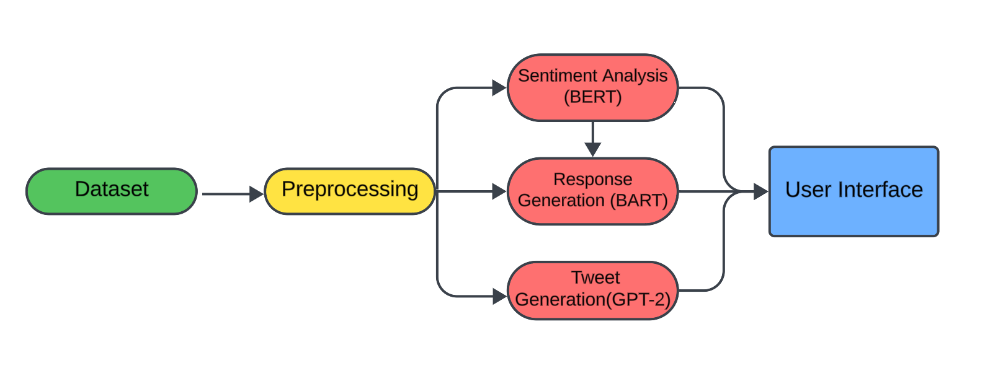
Flow Chart

Slide 8
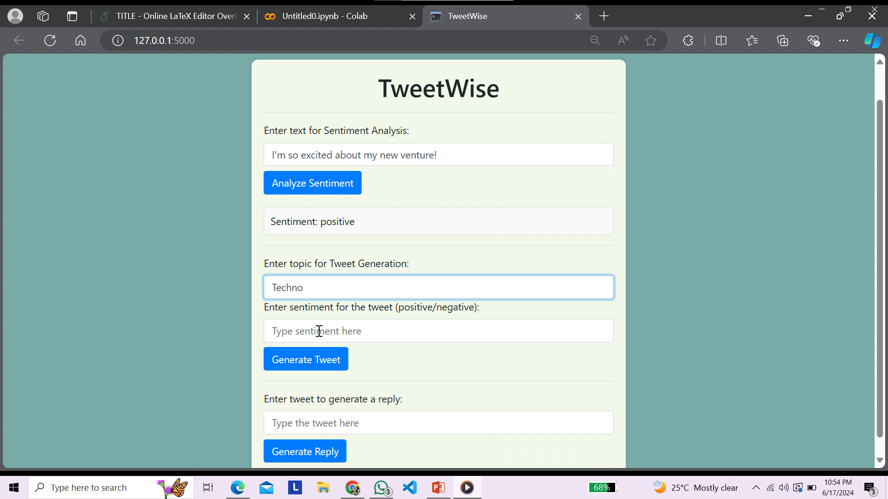
Interface

Slide 9
Thank you

