Slide 1
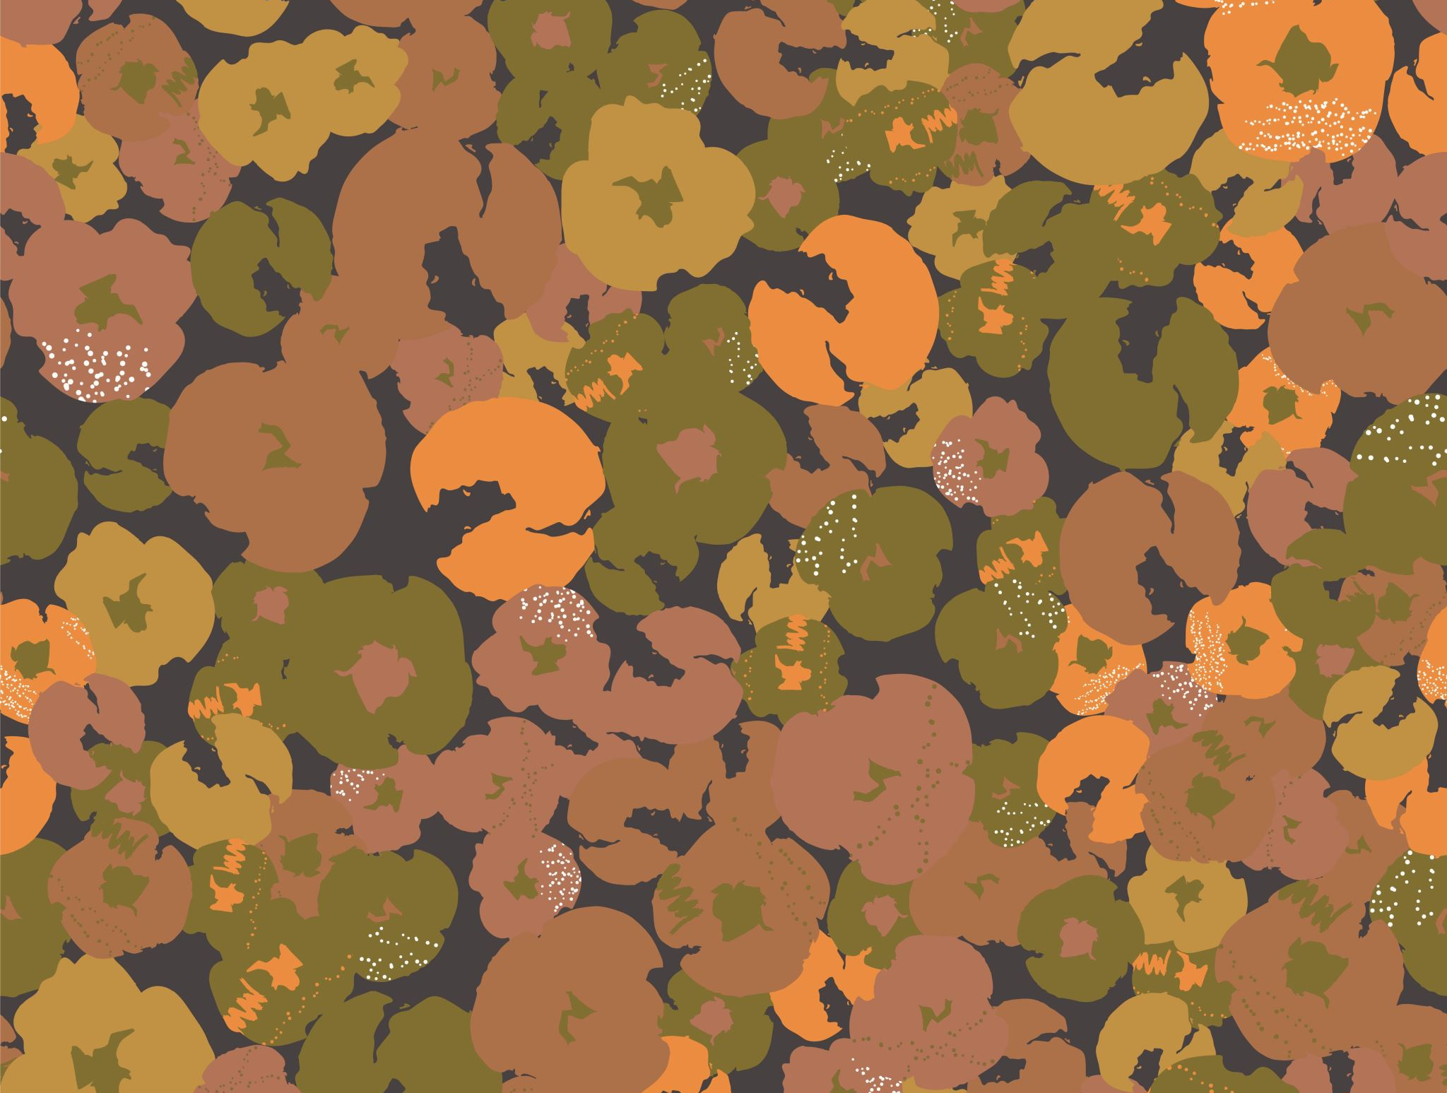
2015 Street Tree Census In New York Final Presentation
Anirudh Sharma
Ashlesha Kshirsagar
Sanjog KC
Shashan Pande
Siddharth Saxena

Slide 2
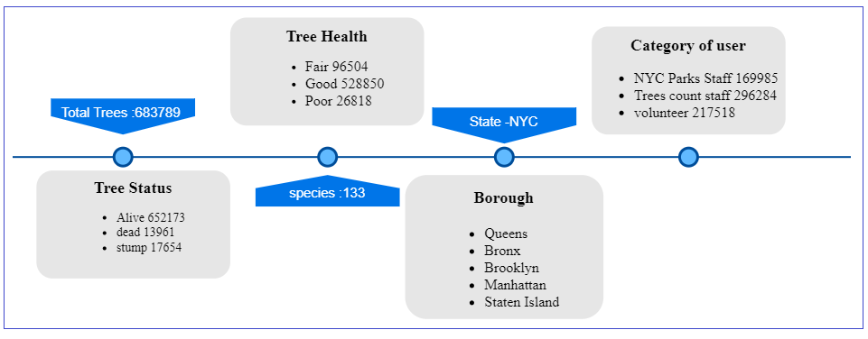
What is Trees Dataset ?

Slide 3

Business Objective
Which borough has the highest and the lowest number of trees?
Which borough has the most good health trees and which borough has the poor condition trees?
Why there are fewer trees in Manhattan? or what can be done to increase the trees count in this part?
Which borough needs more attention?
Which are the endangered species and when can we plant the seed again?

Slide 4
Five different boroughs
Bronx
Brooklyn
Manhattan
Queens
Staten Island

Slide 5
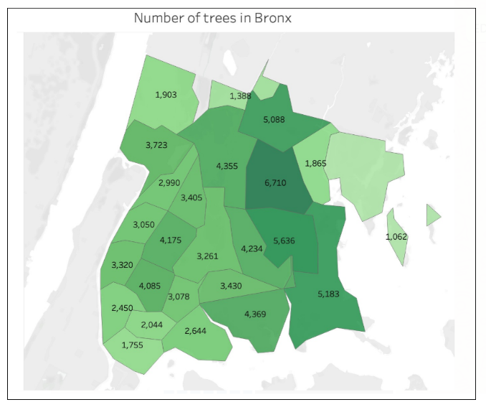
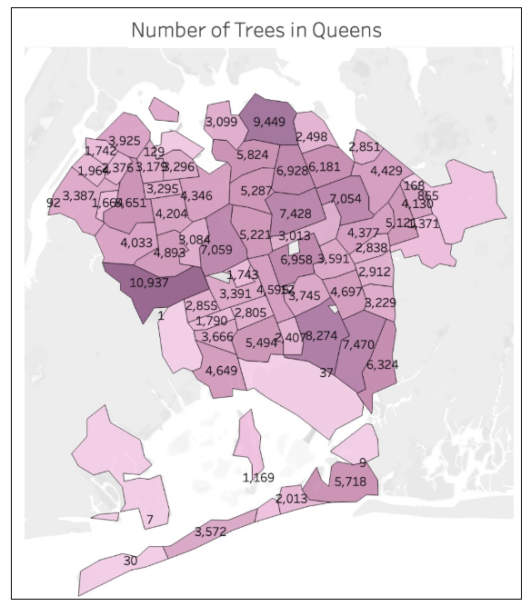
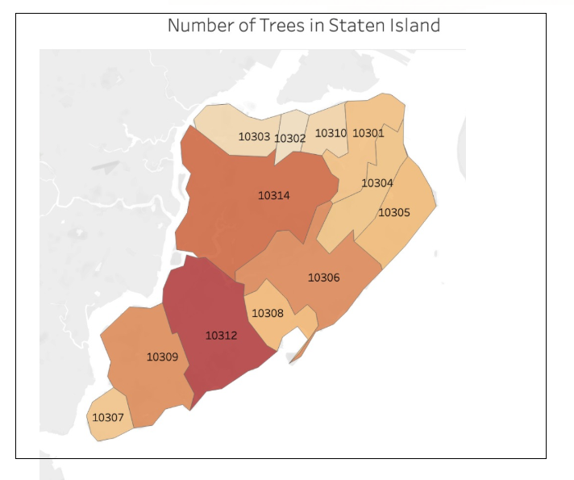
Number of trees in Bronx, Queens and Staten Island
we can see that the tree cover rate is denser in the areas / postal codes towards the South of the Queens borough

Slide 6
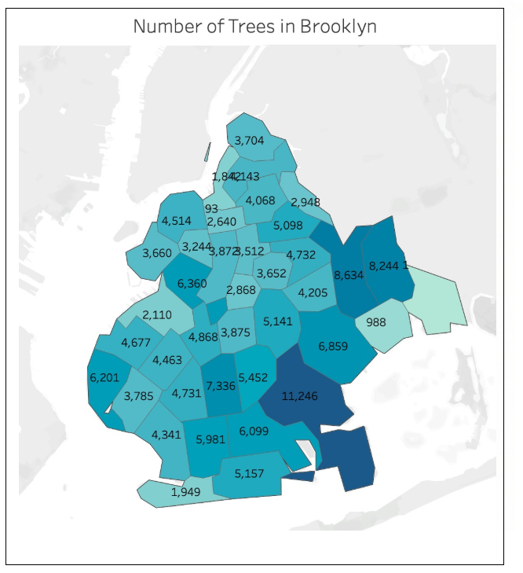
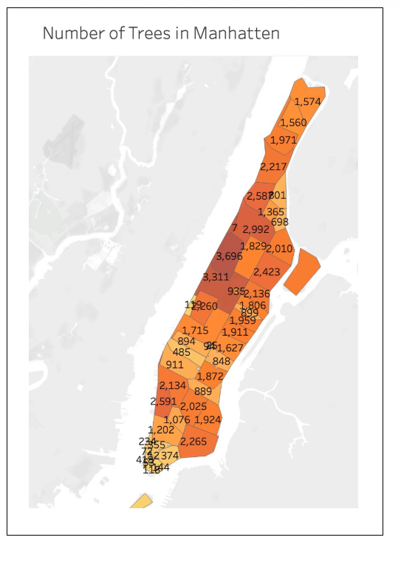
Number of Trees in Manhattan and Brooklyn
Manhattan has a smaller number of trees in all 5 Borough because more Industrial Area and most Popular Area.

Slide 7
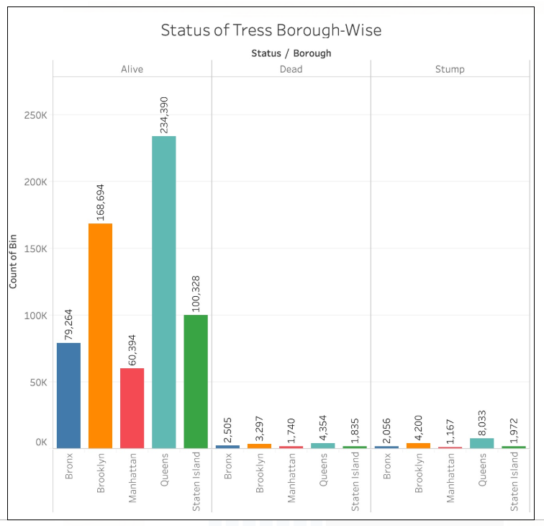
Which borough has the most alive trees and which borough has the highest dead trees?
Queens has the highest alive trees and Manhattan has the lowest Alive trees. Similarly, Manhattan has the lowest number of dead trees and stump trees

Slide 8
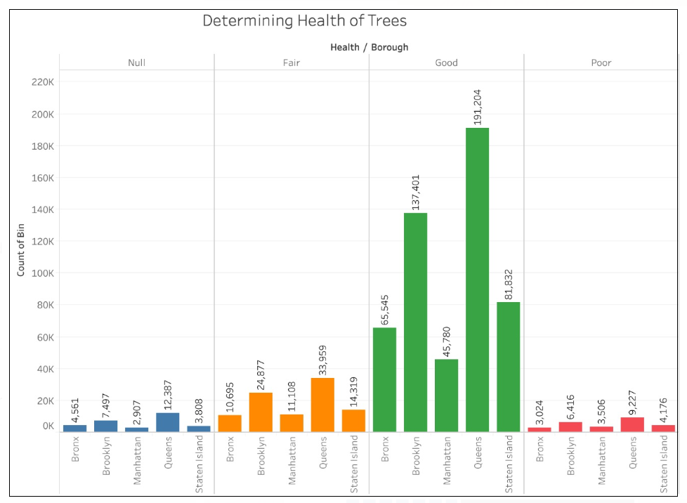
Which borough has the most good health trees and which borough has the poor condition trees?
The highest number of good trees are on Queens which is 191,204 and the lowest count of good trees in Manhattan 45,780.
Bronx has the lowest tree count on the poor health status. The highest number of poor trees is on Queens which is 9,227.

Slide 9
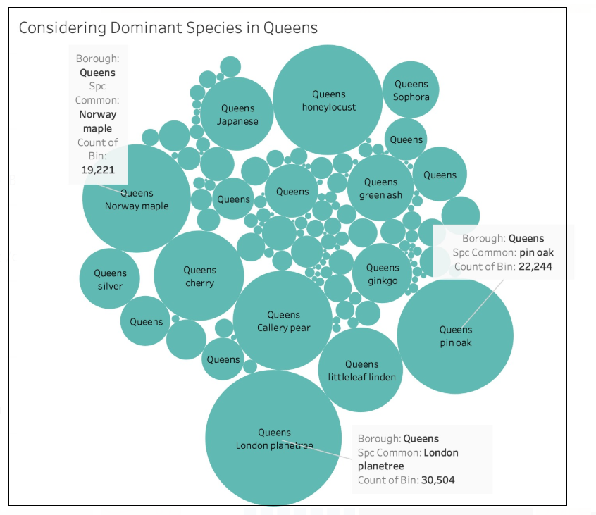
Dominant species in Queens

Slide 10
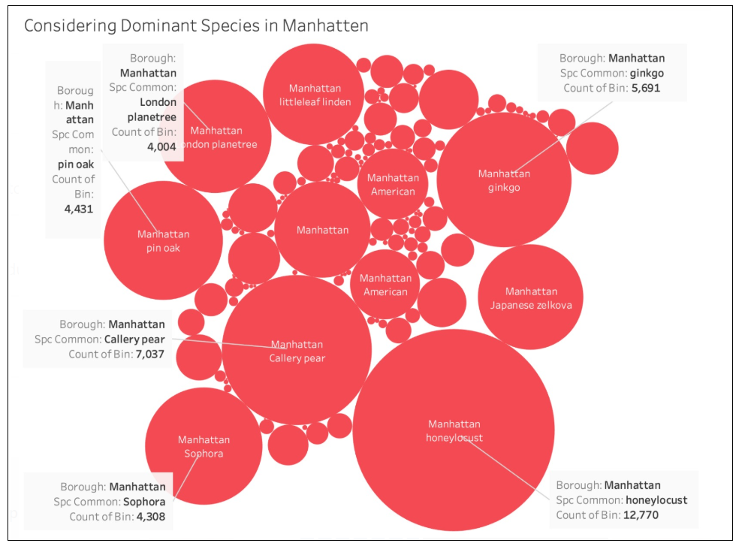
Dominant species in Manhattan

Slide 11
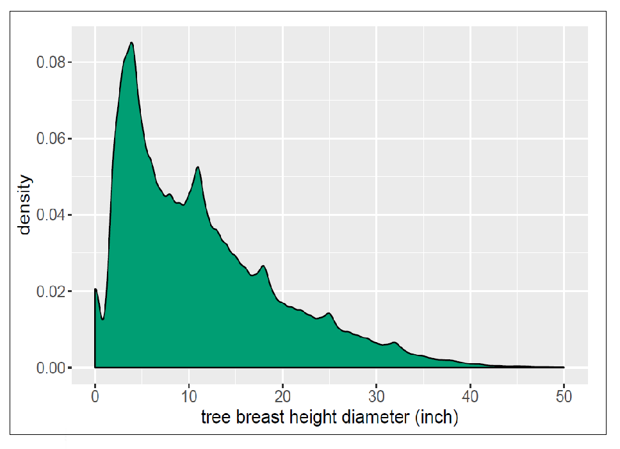
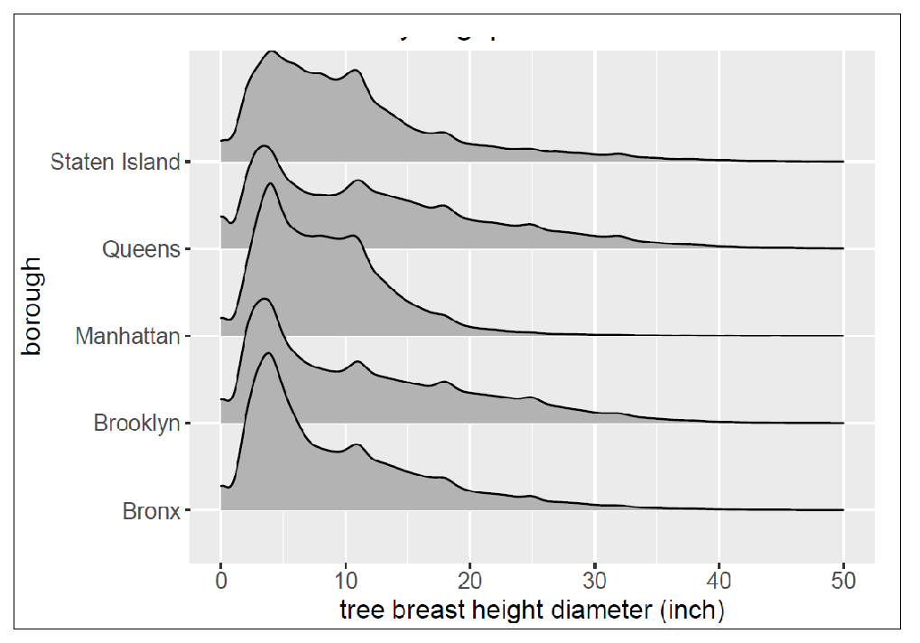
Density graph representing the Tree breast height diameter

Slide 12
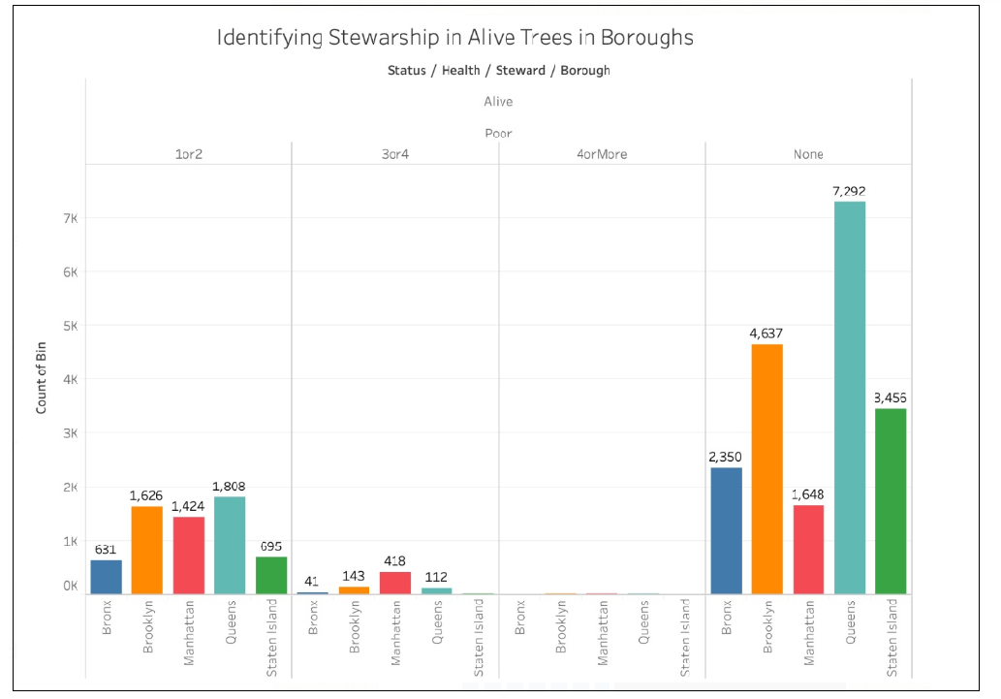
Stewardship on each boroughs

Slide 13
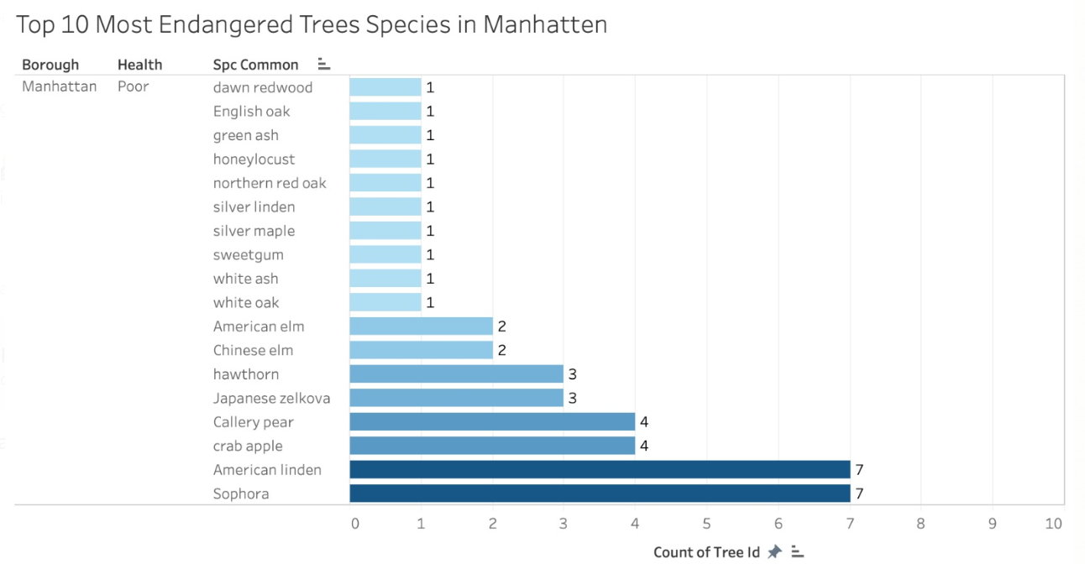
Top 10 Most Endangered Species of trees in Manhattan

Slide 14
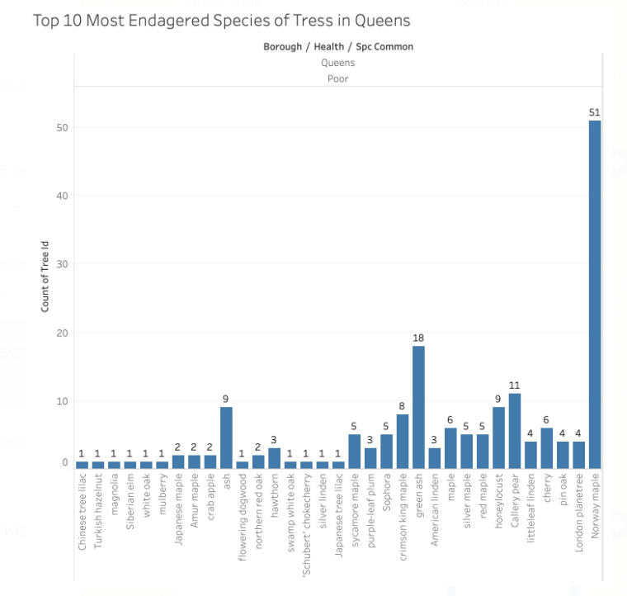
Top 10 Most Endangered Species of trees in Queens

Slide 15
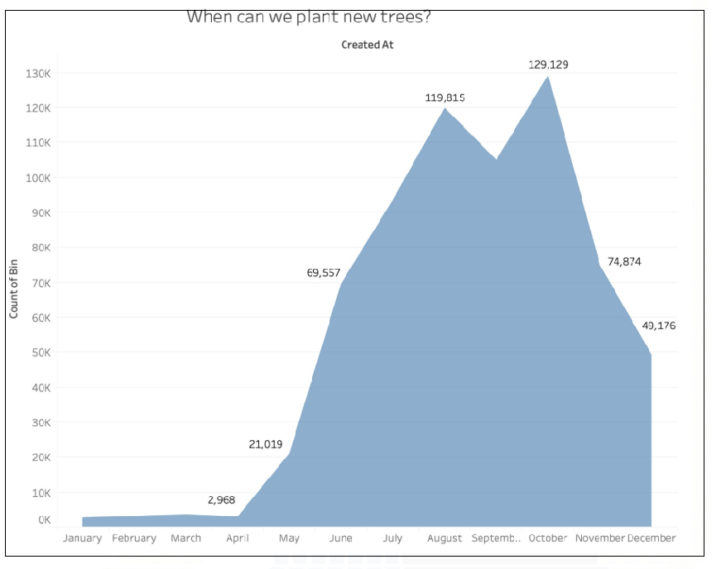
Monthly distribution of trees count

Slide 16
Conclusion
Queens has highest number of trees while Manhattan has lowest number of trees
Queens has most good health trees Alive trees.
Manhattan and Queens require more stewardship
Identified the time period when we can plant more seeds to preserve the species

Slide 17
Questions ?
Thank you

