Slide 1
Prison to Profession
A data analysis project exploring the intersection of incarceration, education, and employment opportunities in Kentucky.

Slide 2
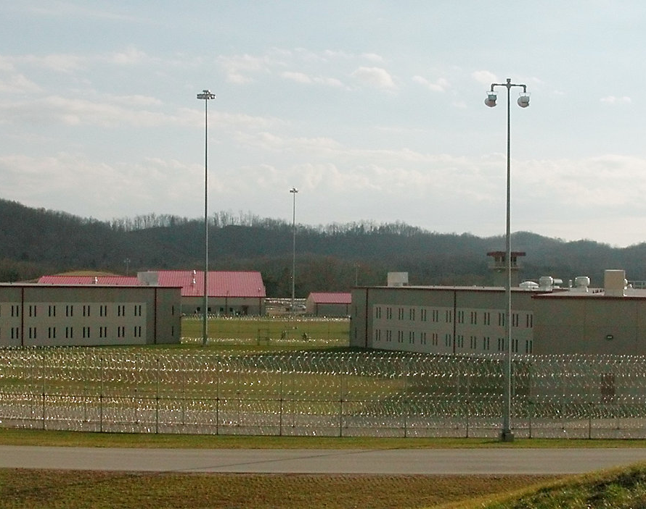
Project Overview
In February 2025, Ashland Community and Technical College began offering an Associate in Arts program at Little Sandy Correctional Complex in Sandy Hook, Kentucky.

Slide 3
Project Overview
By analyzing demographic microdata and occupational projections, the project highlights how educational attainment among incarcerated individuals aligns--or fails to align--with high-demand, high-wage jobs in the state.
By identifying these gaps, the college can better demonstrate need for the program—information that may support program planning, accreditation processes, grant applications, and outreach to potential students.

Slide 4
Key Findings

Slide 5
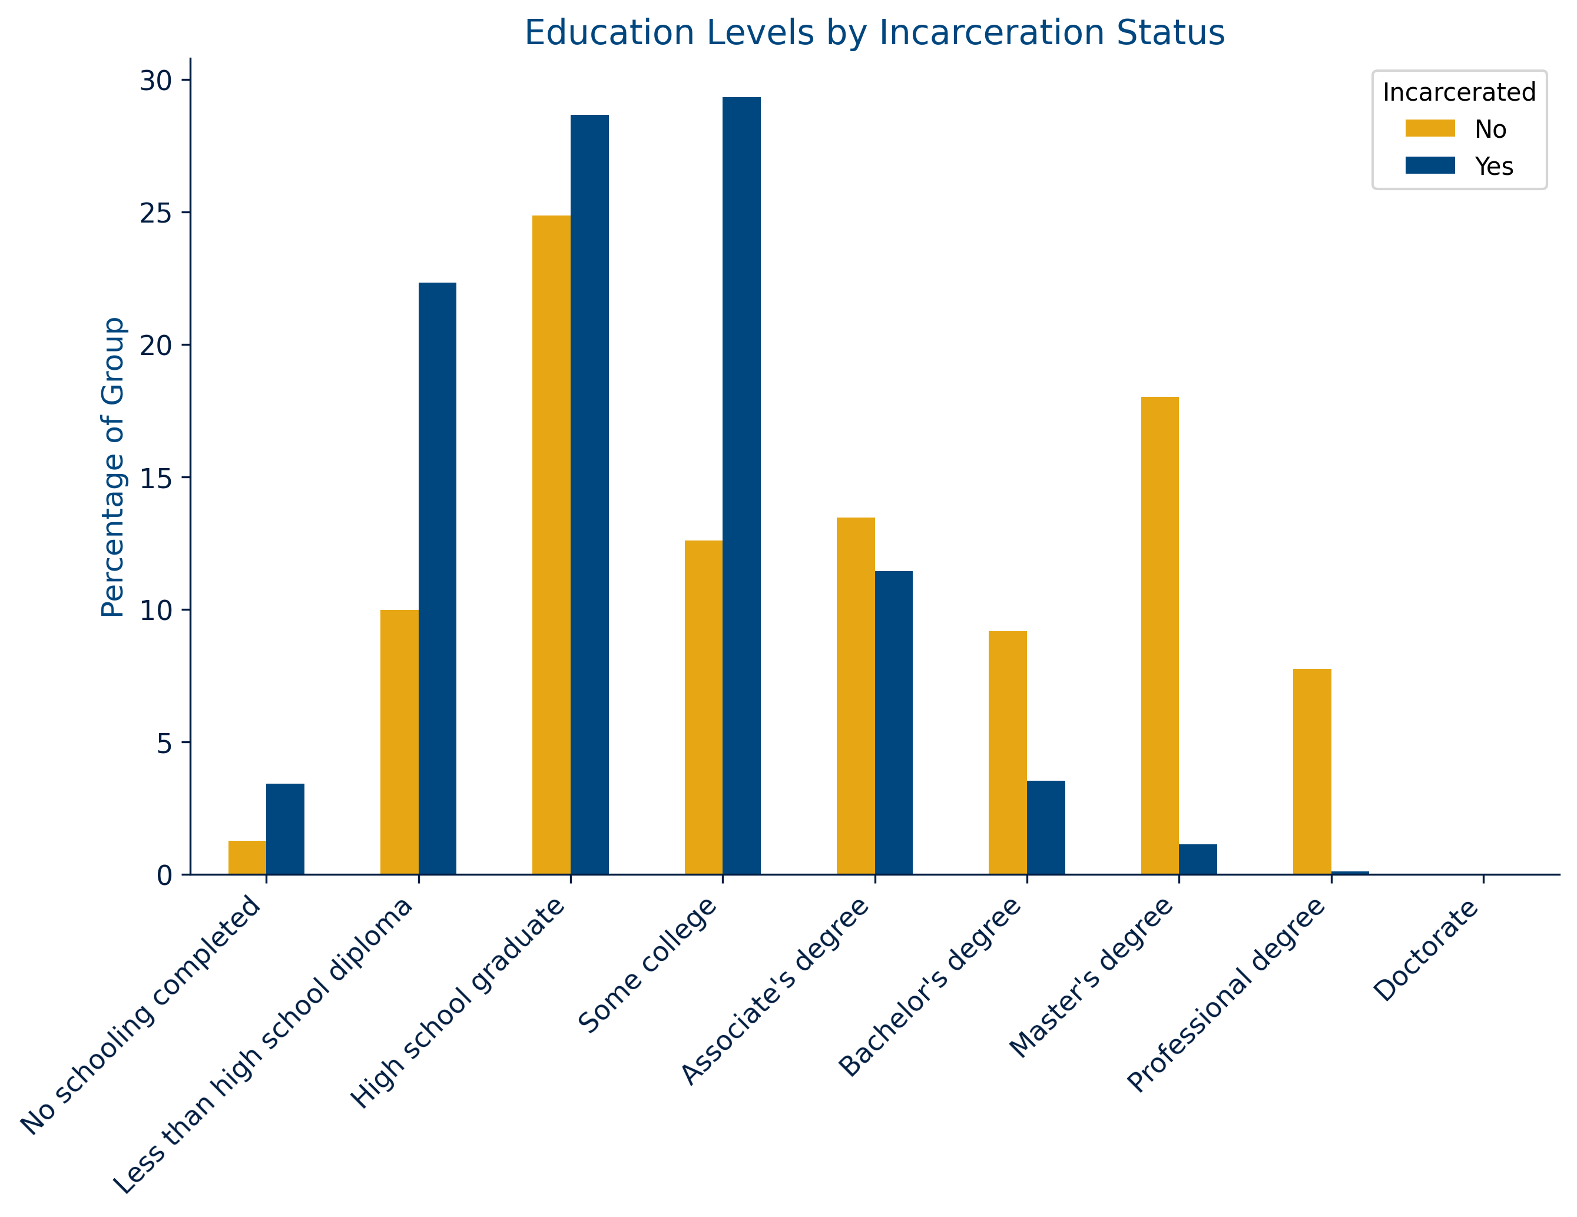
Finding # 1: Educational Attainment
Incarcerated individuals in Kentucky are more likely to have completed some college or less and are significantly less likely to hold a college degree compared to the general population.
This indicates a significant educational gap for incarcerated Kentuckians.

Slide 6
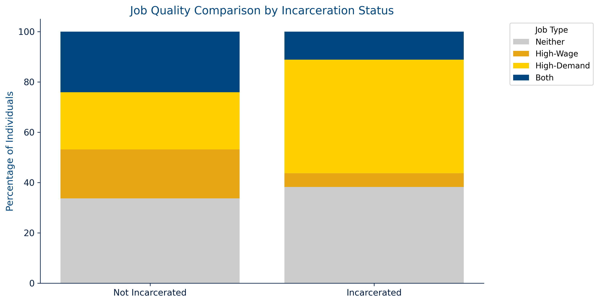
Finding #2: Employment
Incarcerated Kentuckians are more likely than non-incarcerated Kentuckians to be working in jobs projected to grow by 5% or more (“high-demand”), but less likely to be in jobs paying $50,000 or more (“high-wage”).
This indicates that many incarcerated individuals work in in-demand but low-paying roles.

Slide 7
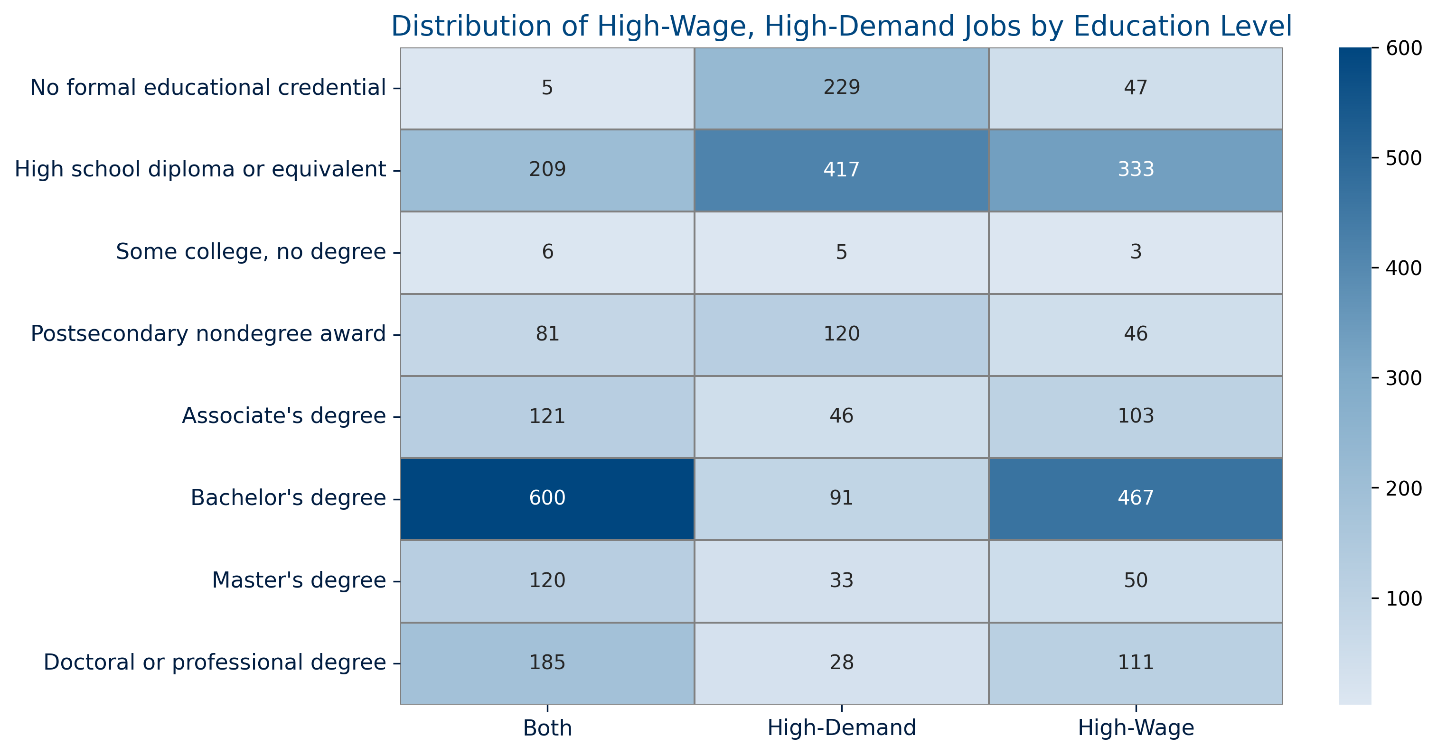
Finding #3: Employment Opportunities
In addition to the significant number of high-wage/high-demand occupations requiring an associate’s degree, postsecondary nondegree awards (such as certificates or diplomas) and bachelor’s degrees also account for a significant number of employment opportunities.
This indicates the importance of not only offering certificate, diploma, and associate degree programs to incarcerated individuals, but also building pathways for students to continue their education after release.

Slide 8
Limitations and Data Issues

Slide 9
Data Issue #1: Determining Incarceration STatus
The dataset does not include a direct “incarcerated” flag. Incarceration status had to be estimated using variables such as group quarters type, age, and income. This approach may have excluded some individuals or introduced classification errors.

Slide 10
Data Issue #2: Combining Datasets
Some individuals were dropped during the merge of ACS housing and demographic data because their serial numbers were not found in the housing dataset. This likely reflects missing or excluded housing data for certain household, such as those in institutional settings.

Slide 11
Data Issue #3: Sample Size
Although the Census dataset is large, merging issues as well as limiting the analysis to Kentucky left a sample of 504 likely incarcerated individuals, which restricts regional or subgroup analysis.

Slide 12
Conclusions
Incarcerated individuals in Kentucky are less likely to have the education necessary to attain high-demand, high-wage jobs.
Postsecondary programs can offer incarcerated individuals pathways to high-demand, high-wage employment by:
Offering terminal certificate, diploma, and associate’s degree programs
Offering associate’s degree programs leading to transfer to bachelor’s degree-granting institutions

Slide 13
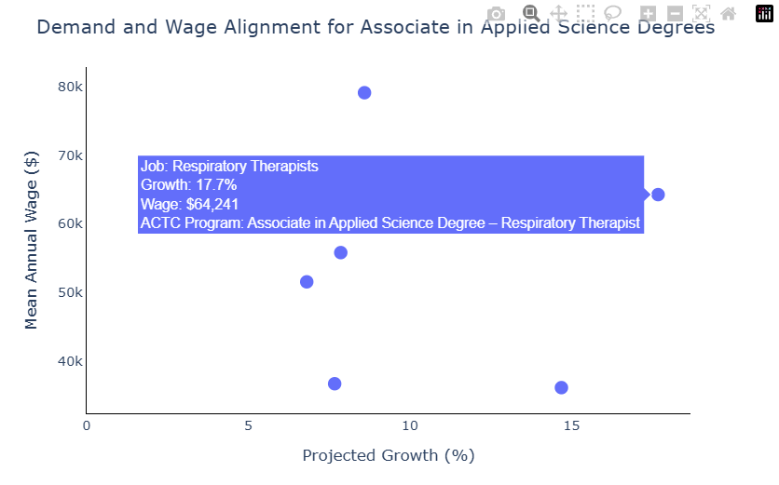
Additional Considerations and Applications
For future projects, cleaned data from this project can also be used to explore the benefits of specific programs at Ashland Community and Technical College, especially those for which an associate’s degree is not strictly required but common and desirable.
Example: Healthcare Occupations Utilizing an Associate in Applied Science Degree

Slide 14
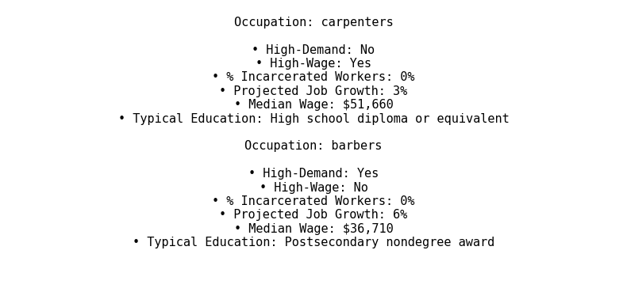
Additional Considerations and Applications
The cleaned data from this project can also be used to explore the benefits of and need for potential occupational training programs ACTC does not already offer.
**Example:** Carpentry and Barbering

