Slide 1
Black jack
By: Ashley, Eva, & Taylor

Slide 2
Who are we?
We are team04, which is comprised of:
Ashley Albert
Product manager
Computer science
Eva frankovic
Scrum master
Computer science
Taylor lamantia
developer
Computer engineering, management

Slide 3
What did we work on?
Ashley
Focused on front-end and documentation
ALSO DID SOME BACK-END
Eva
Focused on the front-end
Also did some back-end
Taylor
Focused on the back-end
Also did some front-end

Slide 4
wHAT IS YOUR TEAM PROJECT?
Our team project is a blackjack game that could be played by anyone anywhere. Blackjack is a traditional poker game where the player plays against the house, in a race to see who can get or get closest to 21. We wanted to create an easy to play game where the user did not have to go through the hassle of signing in and entering credit card information to bet money for the game.

Slide 5
Who is our project for?
USERS RANGE FROM NEWBIE TO CARD SHARK
ANYONE CAN PLAY!
We has five user personas in mind:
Newbie
Risky player
Strategic player
Power player
Card shark
INSTRUCTIONS ON THE SCREEN MAKE IT SIMPLE FOR NEWBIES
Fun for a card shark because they can bet without real-life risks and play continuously for that real casino-feel

Slide 6
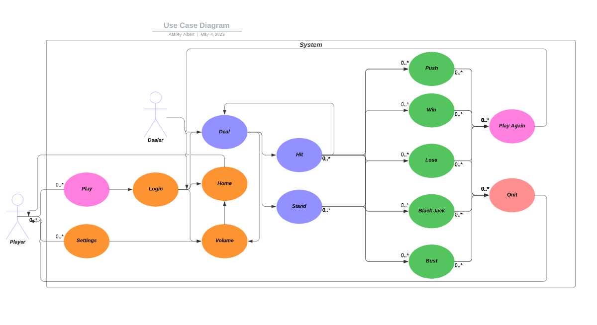
WHo IS OUR PROJECT for?
tHIS IS OUR TEAM’S USE CASE DIAGRAM

Slide 7
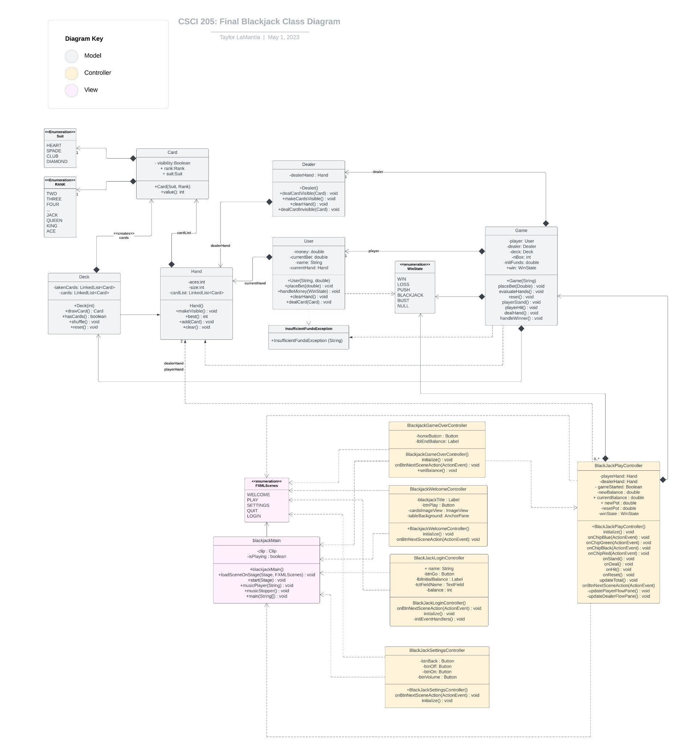
DESIGN

Slide 8
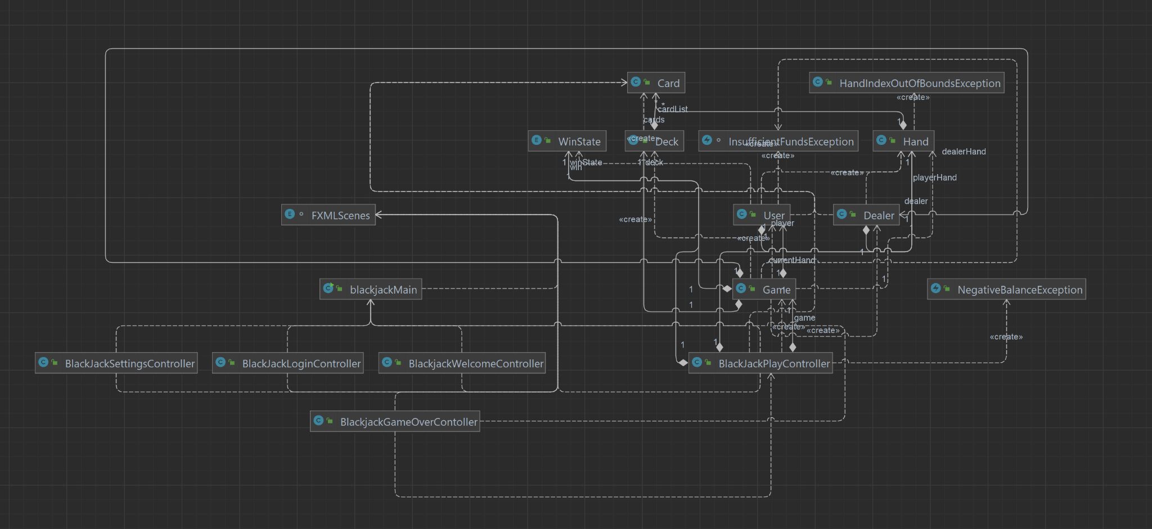

Slide 9
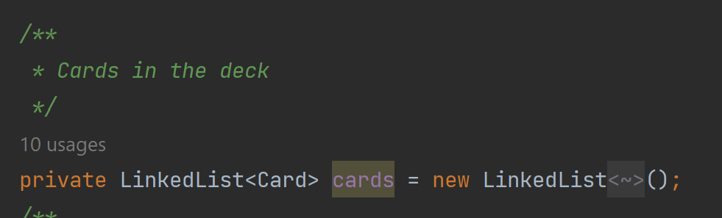
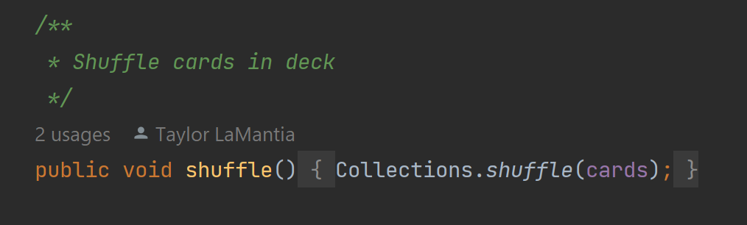
IMPLEMENTATION

Slide 10
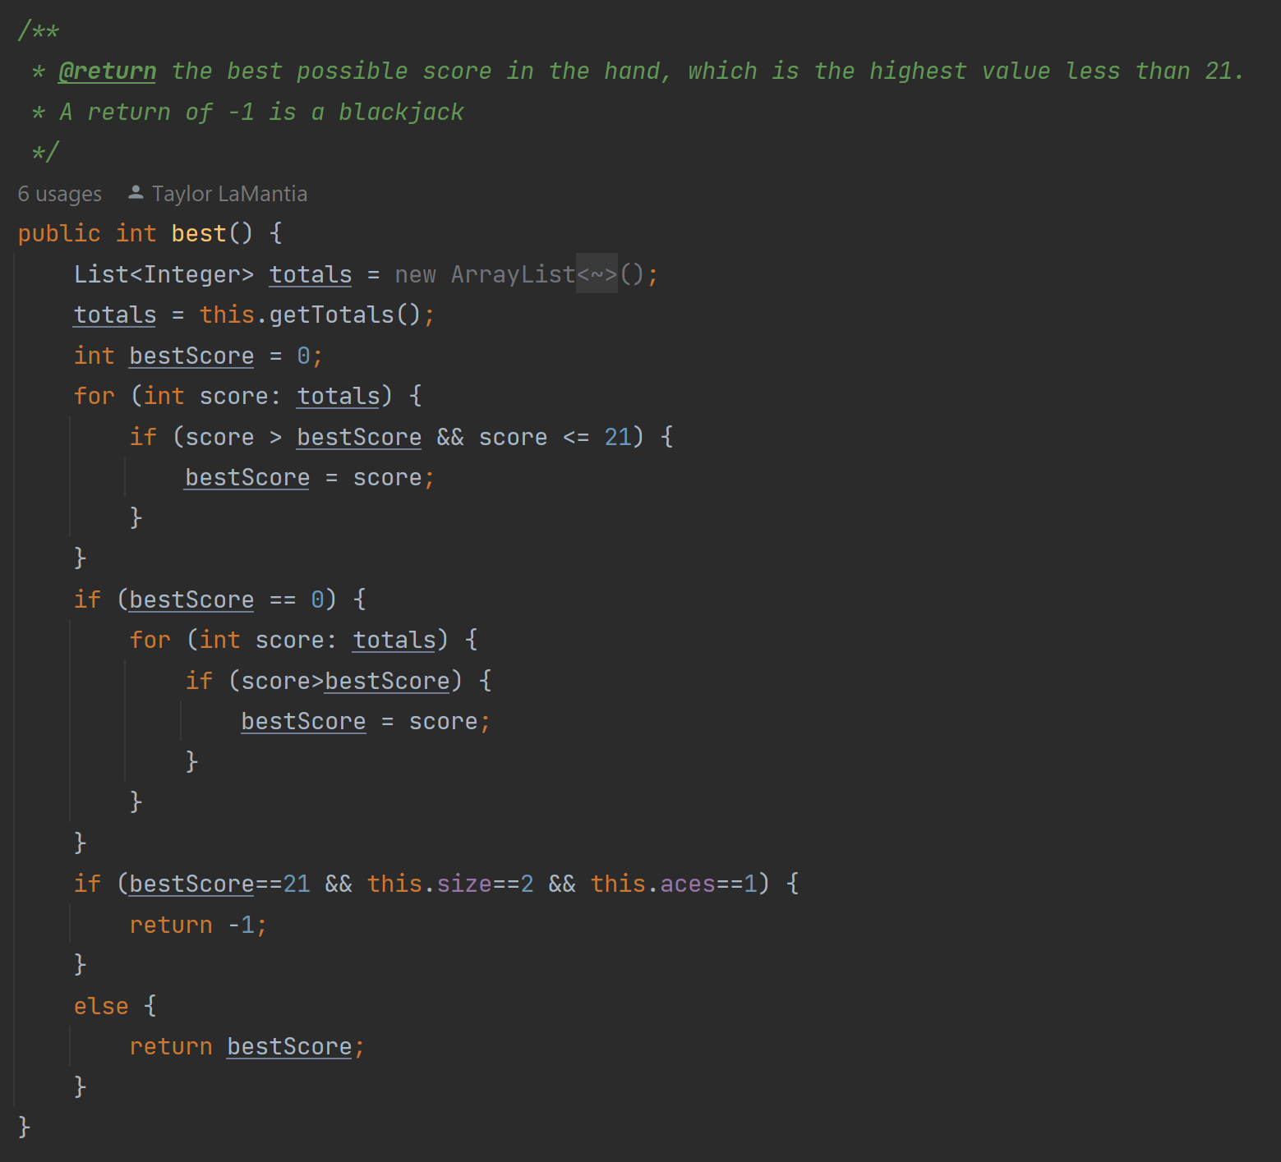
IMPLEMENTATION

Slide 11
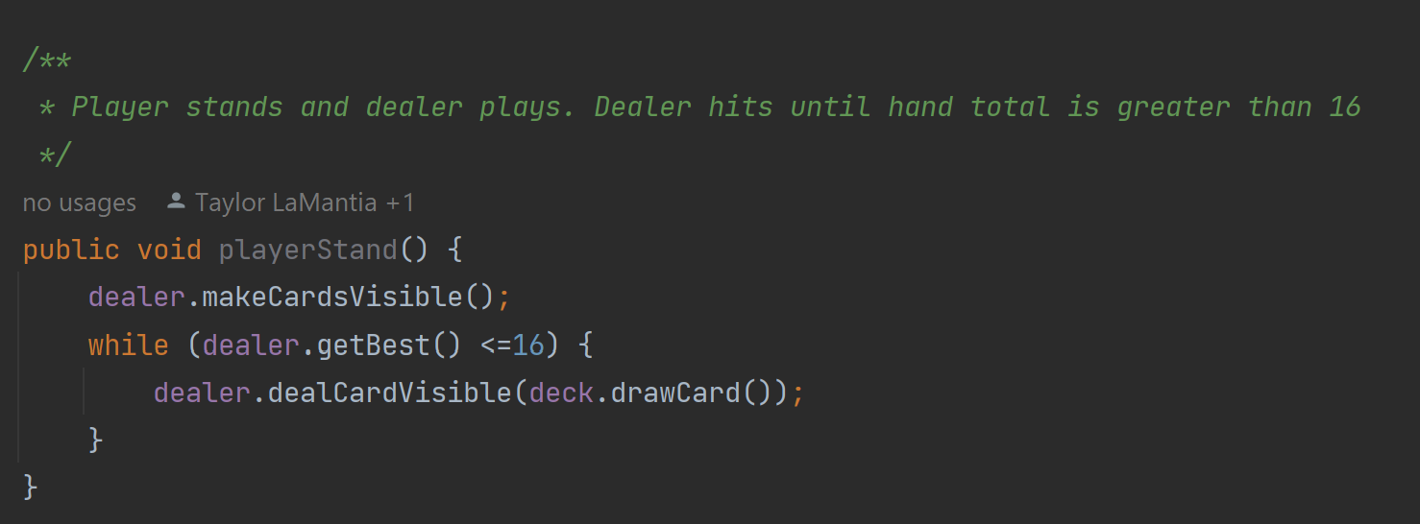
IMPLEMENTATION

Slide 12
implementation
We used scenebuilder to build our gui
We used buttons, imagesviews, flowpanes, labels, text fields, etc.
CSS to customize and style our buttons and other feature
We did not use any third party libraries to develop our UI

Slide 13
DEMONSTRATION
tIME TO TURN TO THE PROGRAM!!

Slide 14
Reflection
Scrum worked fairly well for our team. We only forgot to do the scrum once.
Scrum roles:
Ashley - product manager
Eva - scrum master
Taylor - developer
We did not rotate roles
In our game, the hardest part was getting the cards to appear

Slide 15
REFLECTION
It took us awhile to get used to aiecode and document our work. It was complicated for us to log our hours, but we did get better by the end.
If we were to start again, we would try to find better ways to connect the model and the controller sooner. It is much easier to get the back and front end working once they are connected. We would also try to find better graphics that would make our game more aesthetically pleasing.
This experience will affect our approach in future team-based software engineering projects because it improved our communication skills and making decisions as a team. We also learned that working with others can make projects like these less stressful.

Slide 16
reflection
Successes and challenges:
Success
Connecting the front-end and back-end
Challenge
Implementing the cards on the screen
Git
Time:
We found it hard to estimate our time before actually doing the work because we would have to go back and more time if we found bugs or if it took longer than anticipated

Slide 17
CONCLUSION
We successfully got a working blackjack game by the end of all of the sprints. Our biggest struggle was getting the cards to show, but once we were able to work out the bugs everything was smooth sailing from there. Besides the cards, some other major accomplishments we had was our game flow in relation to the chips functionality as well as the login screen.

Slide 18
Further possibilities
If we had additional time, we would have:
Implemented a split function
Added a timer for difficulty
Improved the graphics

