Slide 1
ABCD PFN Sex Differences Replication Project

Slide 2
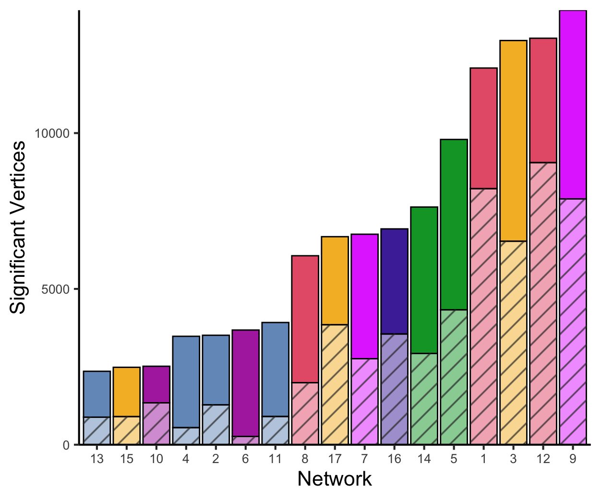
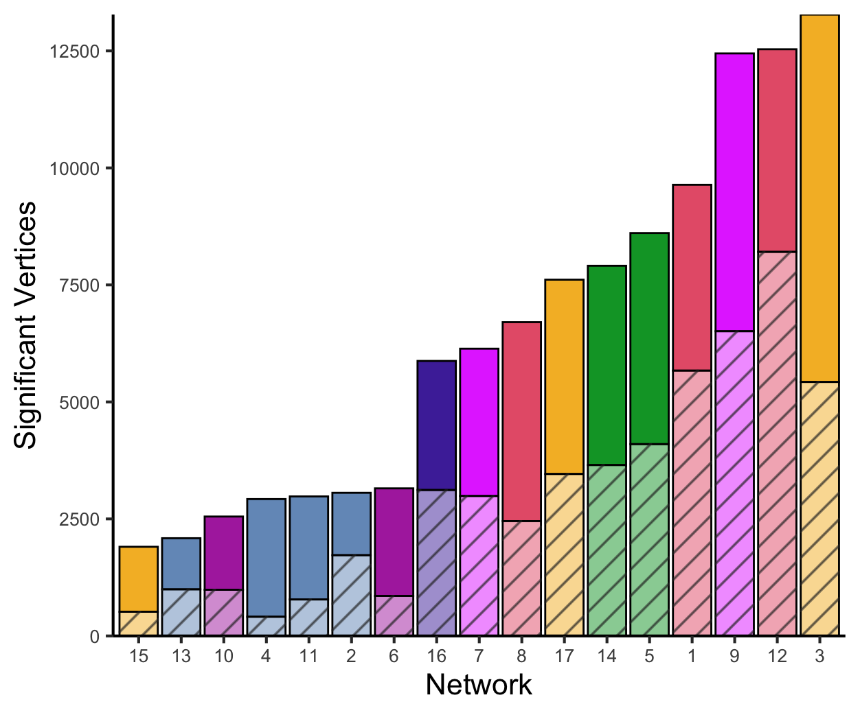
Univariate analysis: GAMs Z-scores barplots
Discovery Set
Replication Set
Notes:
Results generated from the GAMs scripts (abcd_univariate_analysis.R and abcd_univariate_analysis_replication.R) and matrix created from Z FDR sig vector for each of the networks

Slide 3
Univariate analysis: Individual network visualizations
Can be found under results folder -> univariate analysis in github repository
Discovery_univariate_sex_siblings_removed: Contains each individual network GAMs results matrix in .mat format and .csv format
replication_univariate_sex_siblings_removed: Contains each individual network GAMs results matrix in .mat format and .csv format
Discovery_visualizations_2: Contains all of the .dscalar.nii files for each of the networks and a .png of the visualization
replication_visualizations_2: Contains all of the .dscalar.nii files for each of the networks and a .png of the visualization

Slide 4
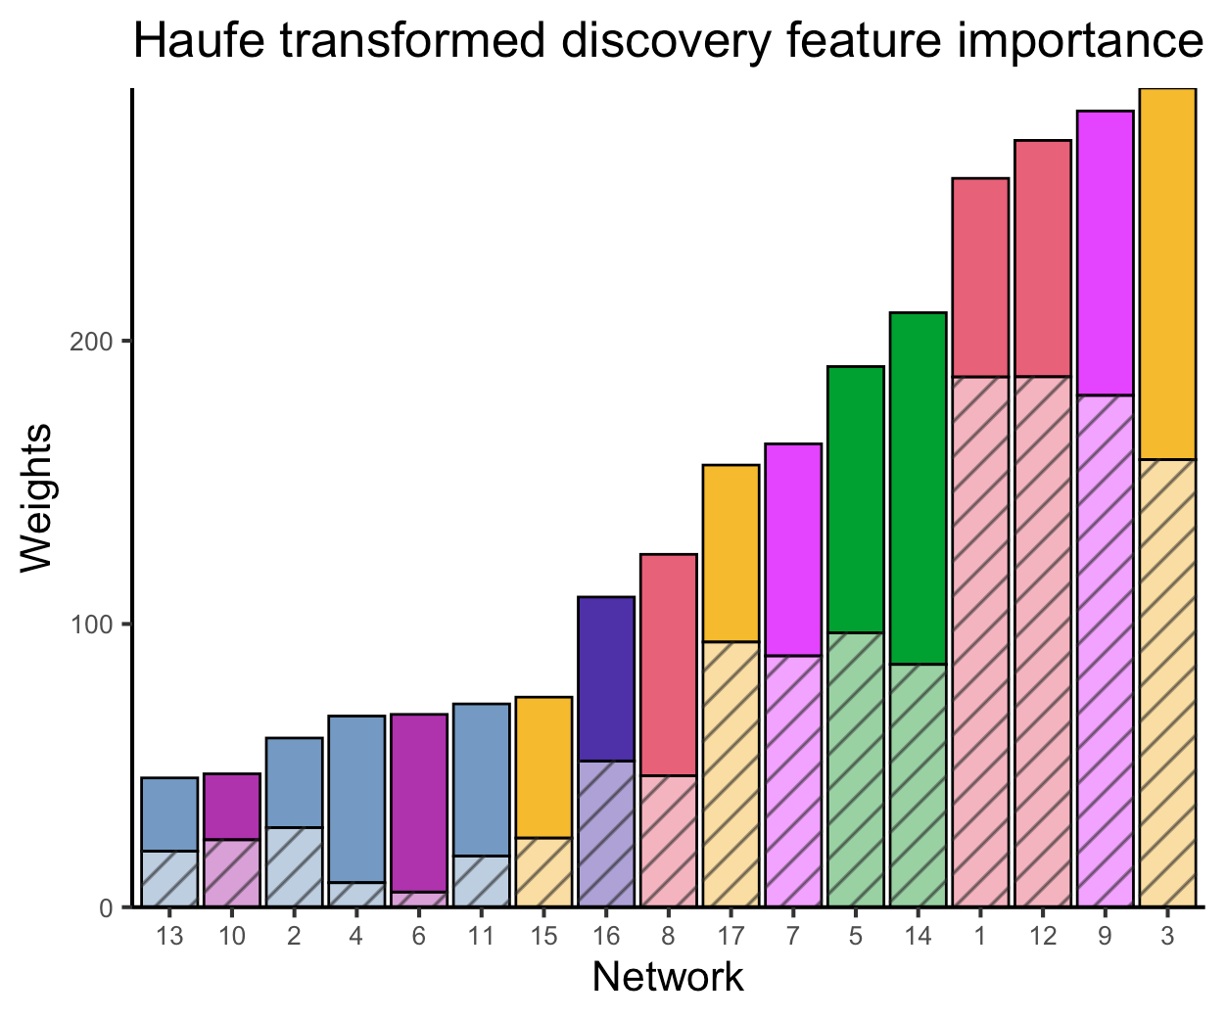
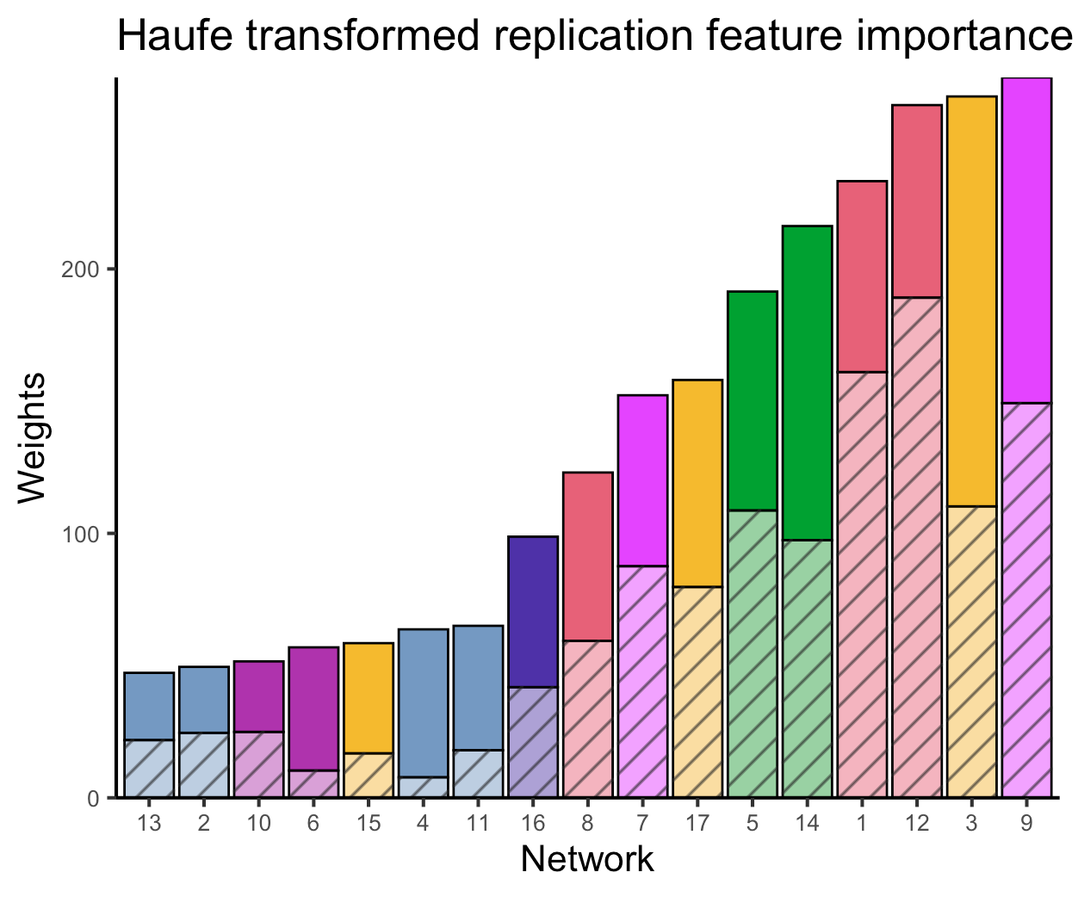
Multivariate analysis: haufe transformed weights barplots 100 iterations
Discovery set
Replication set

Slide 5
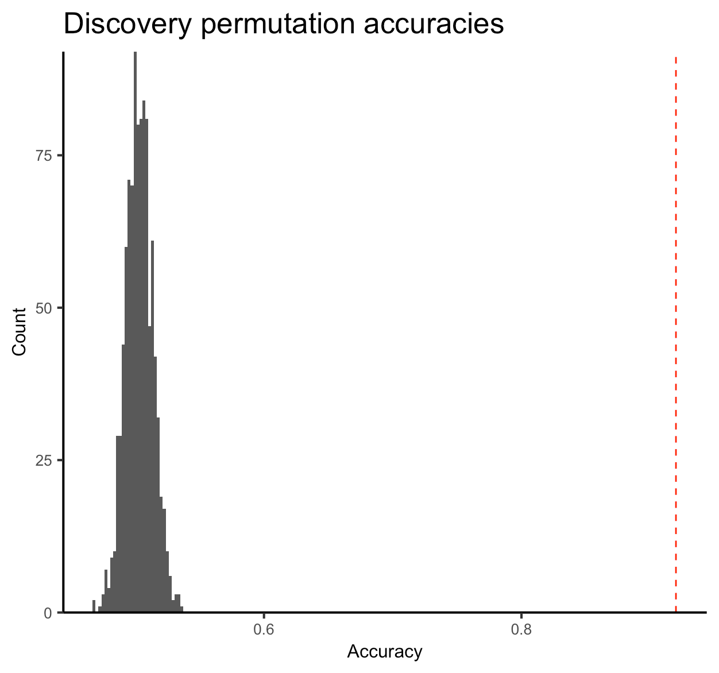
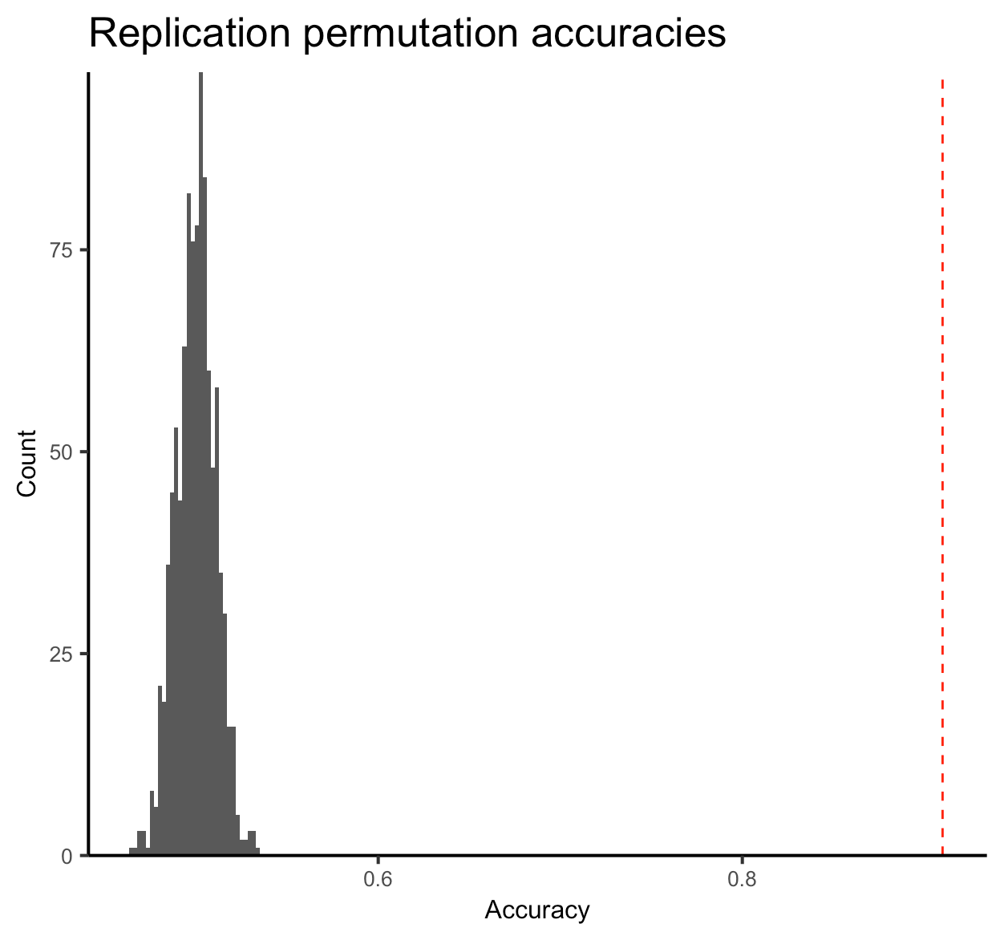
1000 run accuracy histograms
Notes:
,discovery_avg_accuracy,replication_avg_accuracy
0,0.9224506172839506,0.9190487366556538

Slide 6
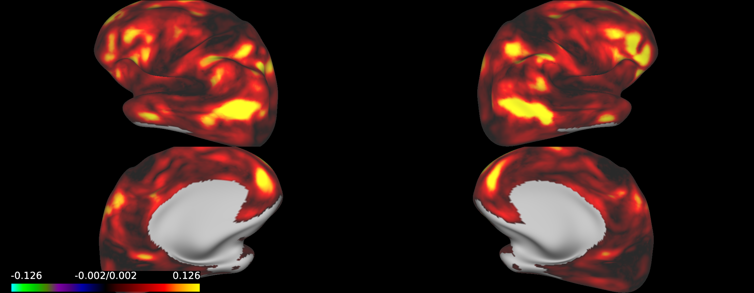
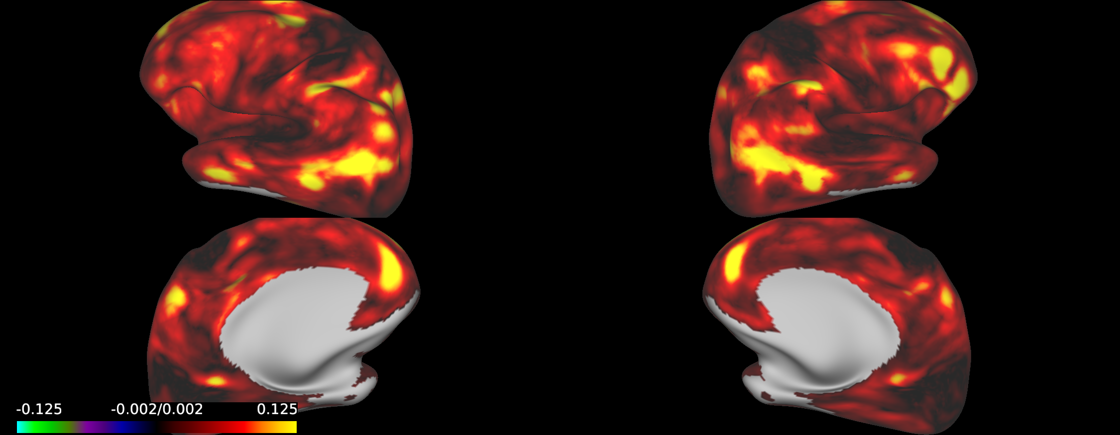
Absolute sum of weights brain map
Discovery set
Replication set

