Slide 1
Electricity & Components

Slide 2
-

Slide 3
Electricity will always
follow the path
of least resistance

Slide 4
Watts = Volts * Amps

Slide 5
Water Analogy
Understand the relationship between Volts and Amps
Volts - Water pressure
Amps - How much water

Slide 6
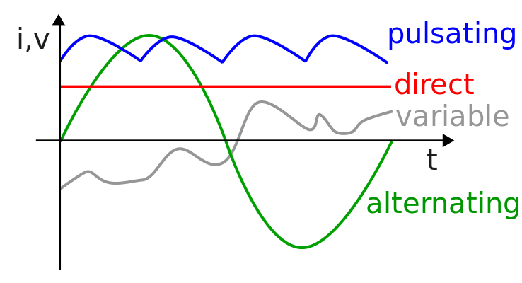
AC vs DC
Alternating Current
The flow of electric charge periodically reverses direction
Direct Current
The flow of electric charge is only in one direction.

Slide 7
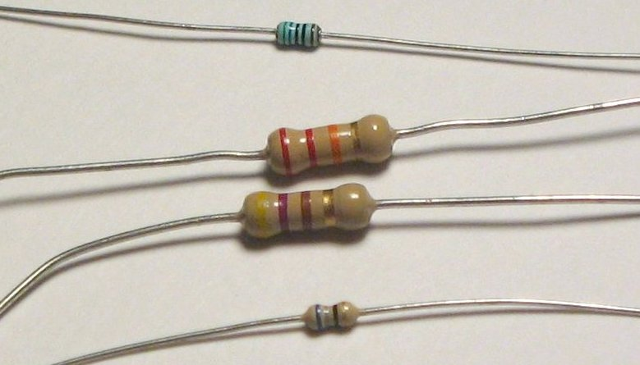
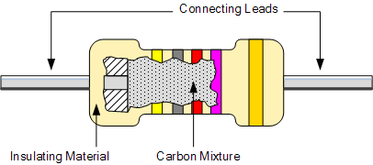
Resistor
Resistors act to reduce current flow, and, at the same time, act to lower voltage levels within circuits.
Measured in Ohms

Slide 8
Resistor - Ohm’s Law
Ohm's law states that the voltage (V) across a resistor is proportional to the current (I), where the constant of proportionality is the resistance (R).
For example, if a 300 ohm resistor is attached across the terminals of a 12 volt battery, then a current of 12 / 300 = 0.04 amperes flows through that resistor.

Slide 9
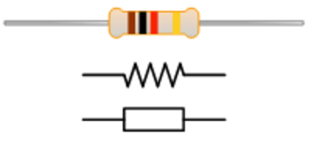
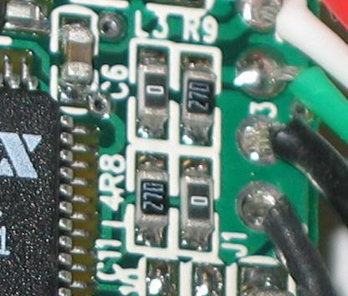
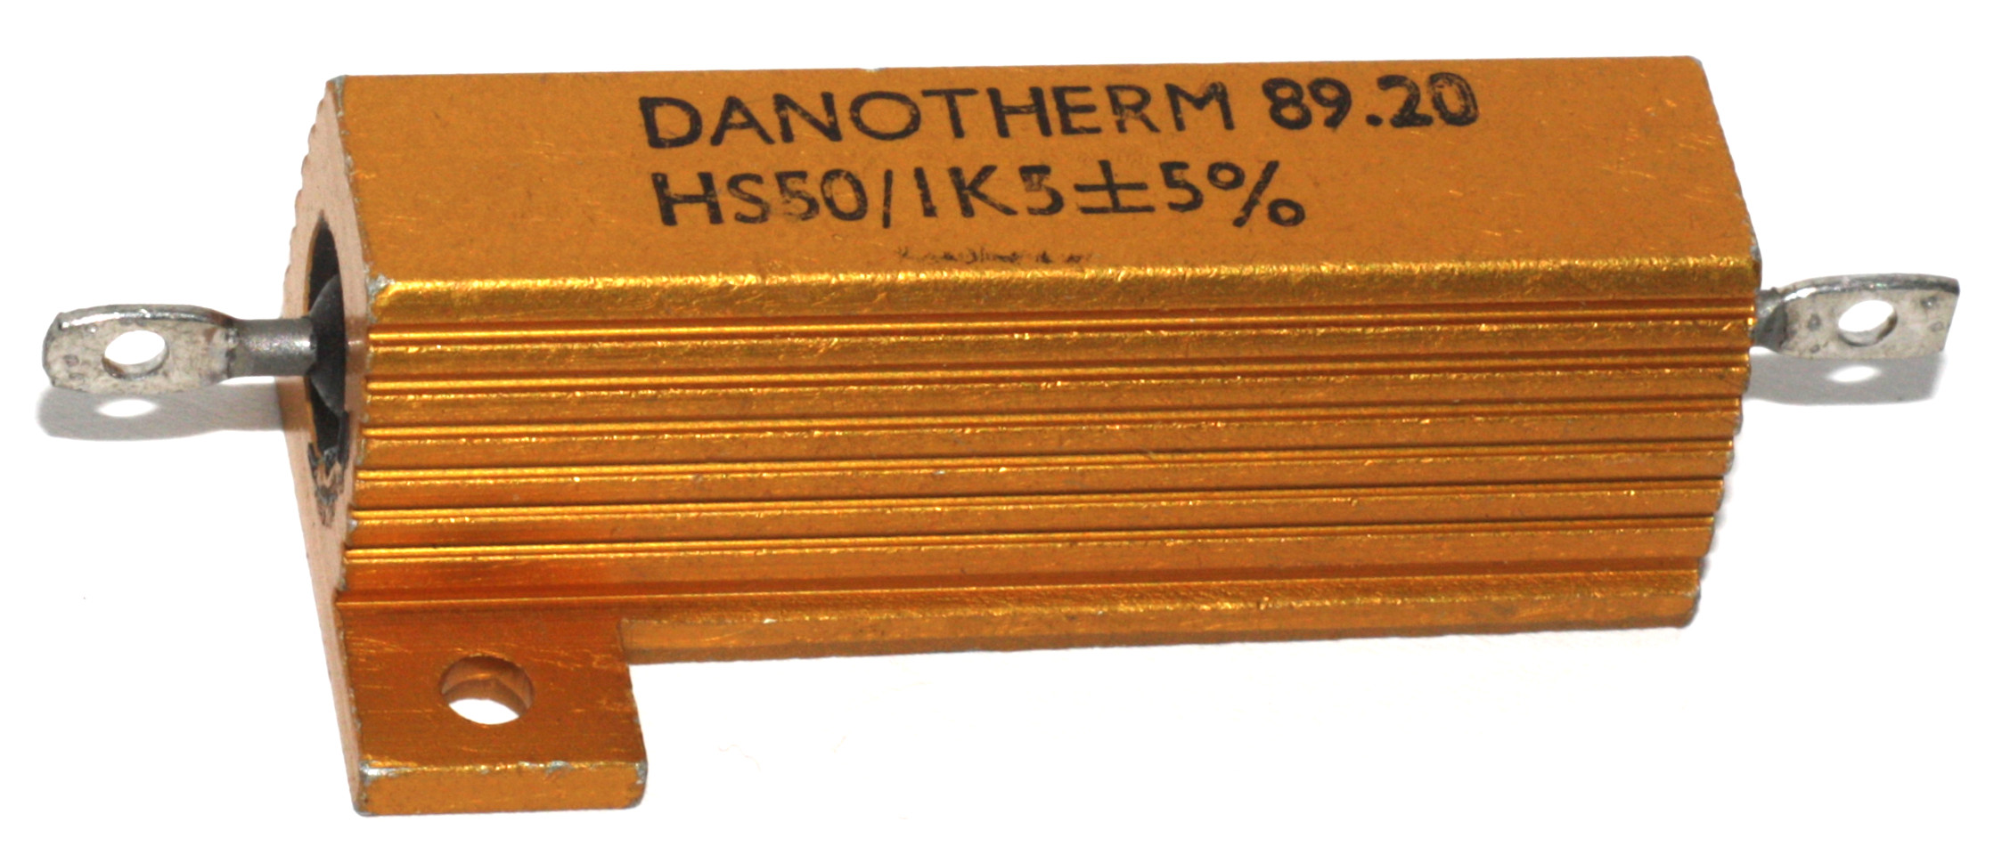

Resistor - Identify

Slide 10
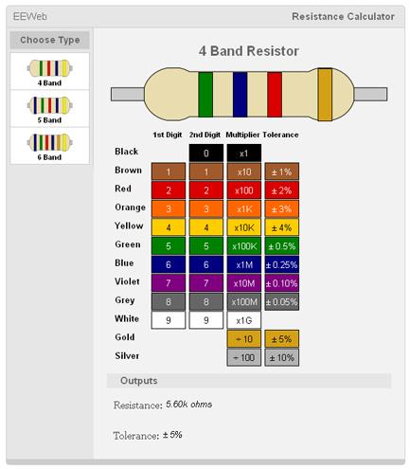
Resistor - Identify

Slide 11
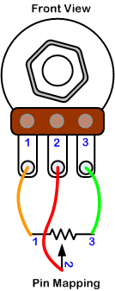
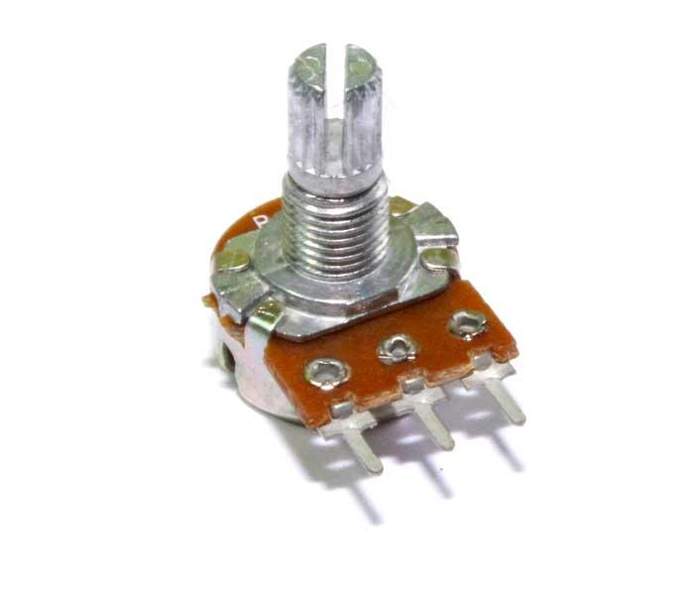
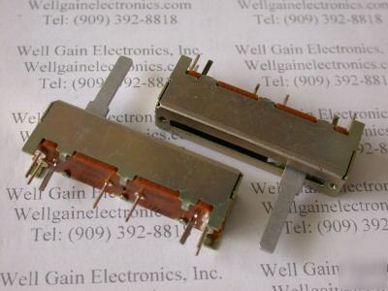
Potentiometer - Pot
Variable Resistor

Slide 12
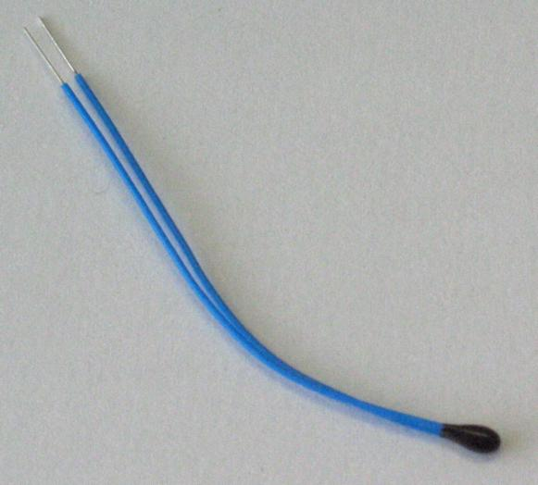
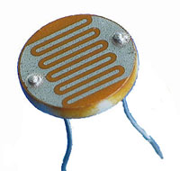
Other Variable Resistors
A thermistor is a type of resistor whose resistance varies significantly with temperature
light-controlled variable resistor

Slide 13
Anode vs Cathode
An anode is an electrode through which positive electric charge flows into a polarized electrical device.
Anode Current Into Device
Anode is usually the positive pole (+)
A cathode is the electrode from which a conventional current leaves a polarized electrical device.
cathode current departs
Cathode is usually the negative pole (-)

Slide 14
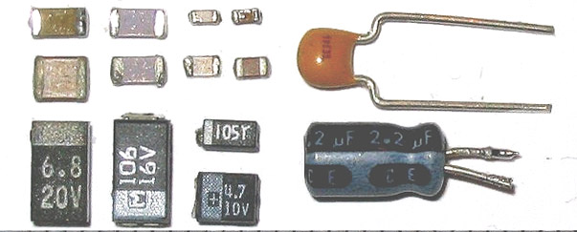
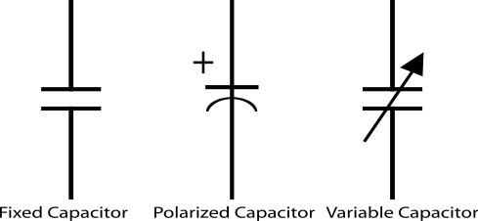
Capacitor
Used to store energy
Measured in farads
Common types are: Ceramic or Electrolytic
Electrolytic have polarity
(+ Long leg and - is the short leg)
Ceramic no polarity

Slide 15
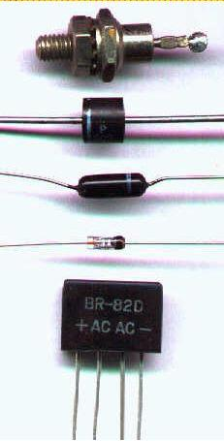

Diode
The most common function of a diode is to allow an electric current to pass in one direction (called the diode's forward direction), while blocking current in the opposite direction (the reverse direction).

Slide 16

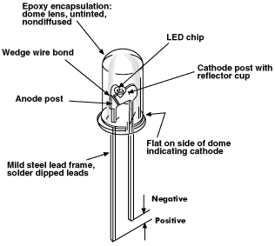
LED - Light Emitting Diode
two-lead semiconductor light source
Has polarity
Long leg Anode (Positive +)
Short leg Cathode (Negative -)

Slide 17
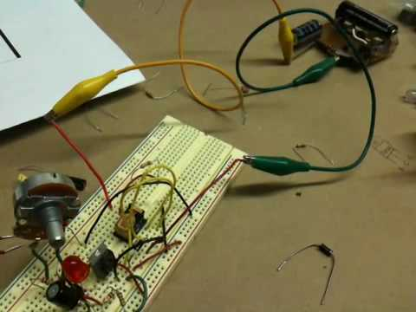
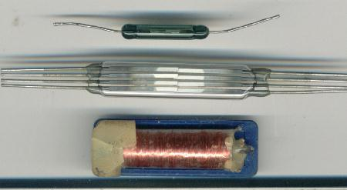
Relay
electrically operated switch.
Many relays use an electromagnet to mechanically operate a switch
Relays are used where it is necessary to control a circuit by a low-power signal (with complete electrical isolation between control and controlled circuits), or where several circuits must be controlled by one signal.

Slide 18
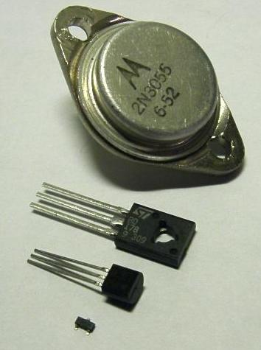
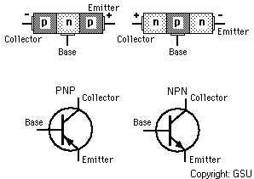
Transistor
semiconductor device used to amplify and switch electronic signals and electrical power
2 main types NPN and PNP
NPN
Add a positive charge to make a connection between 2 negative signals
PNP
Add a negative charge to make a connection between 2 positive signals

Slide 19
