Slide 1
Bitemporal Hands on Session
Notes:
Intro: good morning everyone – and welcome to our session in which we will cover Bitemporal – a new feature introduced in marklogic 8
My name is Jim Clark- I am a product manger and my areas include security/business intelligence, hadoop and Bitemporal. Ive been at MarkLogic for about 2 years (16 months) and prior to MarkLogic I ran a product team in a company who built Saas based Big Data Apps for Financial Services, before that spent time at Oracle in various roles.
Today you have the benefit of dual presenters. I am joined by Fei Xue
Our intent for today is 2-fold. We’d like to provide a laymans definition of bitempora for the newbies, illustrate how we’ve been working with different customers in different verticals to take advantage of this new capability with some use case examples….and then have Fei show us bitemp in action within marklogic.

Slide 2
Part 1:
Overview of bitemporal
Visualization demo
Advanced topics

Slide 3
Bitemporal
Valid time = when it happened
System time = when it was recorded
When did something happen?
When did we find out?
Notes:
Drilling in a bit more….
Using just temporal functionality can only provide a partial answer to the really important questions that help drive the business
What were my credit ratings last Monday?
What was our first quarter profit?
What was the high at a certain day
(Click)x2
With bitemporal in MarkLogic8 you can get a complete view of what did you know, at the time you thought you knew it?
In addition to specific answers – bitemporal can help support important business level initiatives required to support the enterprise.
With the ever increasing regulations enforced by legislation such as Dodd Frank
Financial and insurance institutions are required to be able to answer detailed questions to auditors/regulators as far back as 7 years
All transaction history has to be preserved not only as it is – but as it was - to clear audits
With many types of transactions, parts of the business generate continual updates– those updates are applied to a record over time to more accurately reflect past or current state. Bitemporal will enable the business to see the changes overtime that have occurred against the data with precision and repeatability(Stock Trade or HR transaction)
And finally, Bitemporal functionality can help the business make better decisions by providing a more accurate picture of the past when a particular decision was made, thereby providing more insight into future planning (Backtesting)

Slide 4

3 Types of Temporality
Now
?
Non Temporal
What is it now?
“Car has 220k miles”
2014
2015
Car actually had 200k miles
Unitemporal
What was it then, as we understand it now?
“Car had 200k miles in 2014”
2014
2015
Matt was told car has 100k miles
Matt realized car has 200k miles
“Matt thought car had 100k in 2014 before finding out actually was 200k”
Bitemporal
What was it then, as we understood it at a given time?
2014
2015
Past
Notes:
To understand Bitemporal it is useful to firstly understand the common types of temporality
Now this is a dry subject so I thought I would make this something we can all understand the love of shoes if you are a lady, and the impact of those shoes on your credit balance if you are financing the shoe purchase.
NonTemporal
Allows us to only see what the state is “now”, in this example at 4.30 in the afternoon I look at my credit balance and I see I have no credit, because my wife bought some Jimmy chu’s
Unitemporal
This is more useful it allows us to see WHEN an event occurred, I can now ask a more involved question “what was my credit at 12.30?” the answer is non, your wife waxed the lot at 12:00!
Bitemporal
Bitemporal gives us an additional dimension, it allows us to determine “what we knew” at a given time. In this example we see there is actually a lag between the purchase of the shoes, and the debiting of the money from my account.
Now we can ask “what was my credit as 12.30, as I knew it 12.30”
The answer is we thought we had credit, as the debit had not hit our account yet, but in fact, I had no credit.
This means that I can now defend myself for also buying that “manbag” I had my eyes on at 12.30 ☺

Slide 5
Unitemporal = {valid time}
What happened when?
Bitemporal = {valid time, system time}
What happened when?
When did we find out?
No historical info will be lost with correction

Slide 6
Quiz: Unitemporal? Or Bitemporal?
Unitemporal = {valid time}
Bitemporal = {valid time, system time}
#1. A long time ago, in a galaxy far far away, it is a period of civil war.
#2. As Gregor awoke one morning he found himself transformed into a monstrous vermin the night prior

Slide 7
Why Bitemporal?
Lag
It takes time for event to be recorded
Correction
Things recorded in the past could be corrected
valid time ≠ system time

Slide 8
Bitemporal
All historical changes will NOT be lost
A temporal delete does not actually delete
Should record event, not state

Slide 9
DEMO!

Slide 10
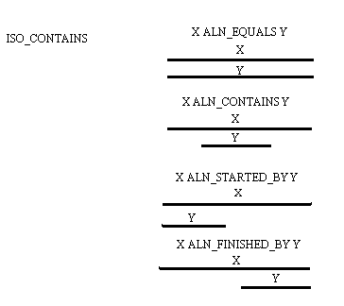

How to Query Bitemporal Doc?

Slide 11
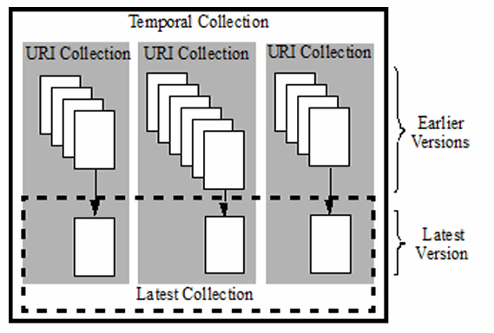
Organization of documents
Bitemporal documents organization
Temporal collection
Uri collection
Latest collection
Other collections
Consider organizing non-temporal documents in its own collection

Slide 12
Bitemporal and non-bitemporal documents
Search for:
‘New York’ OR ‘San Francisco’ AND
restrict it to ‘latest’ temporal documents OR documents in ‘nontemporal’ collection
cts.uris('//', [],
cts.andQuery(
[
cts.orQuery(['New York', 'San Francisco']),
cts.collectionQuery(["latest", 'nontemporalcollection'])
]
)
)

Slide 13
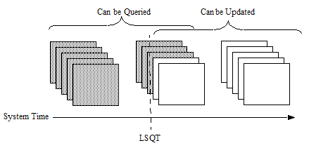
Advanced Topic: LSQT
LSQT = Last Stable Query Time
You can manually set the system start time
Maintain a 'master' system time across multiple clients
A temporal document with a system start time before the LSQT can only be queried
A temporal document with a system start time after the LSQT can be updated / ingested, but not queried

Slide 14
Recap
System is when info is recorded and valid is when info happened
Two reasons to use bitemporal: lag and correction
Mind map of 2d plane is important to understand bitemporal

Slide 15
Part 2:
Install Node.js: https://nodejs.org/download/
Getting MarkLogic 8.0-1: https://developer.marklogic.com/products
Clone app or download ZIP: https://github.com/fxue/bitemporal-demo
Follow guidelines from github README for 6 exercises.

