Slide 1
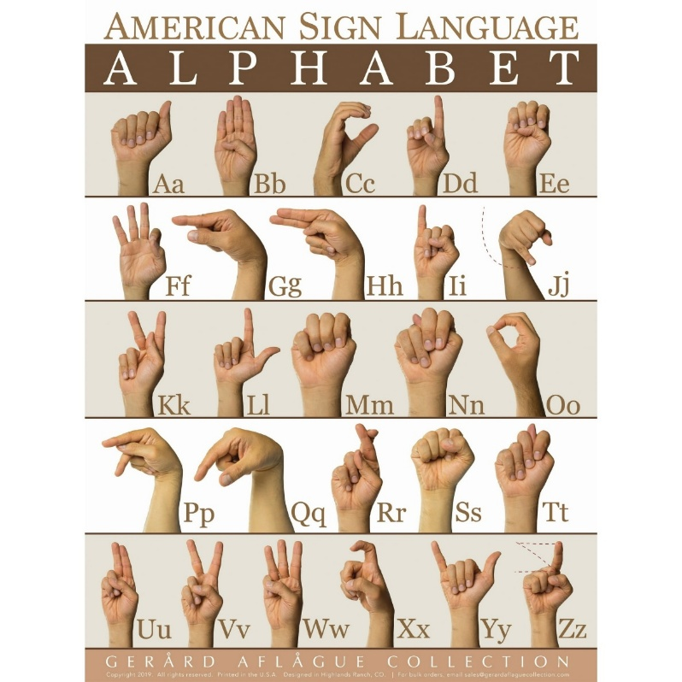

DATS 6303 – Deep Learning
American Sign Language (ASL) Alphabet Classification
Using Deep Learning
A comparative study of ResNet-50 and MobileNetV2
By: Fyrooz Khan & Ashley Gyapomah

Slide 2
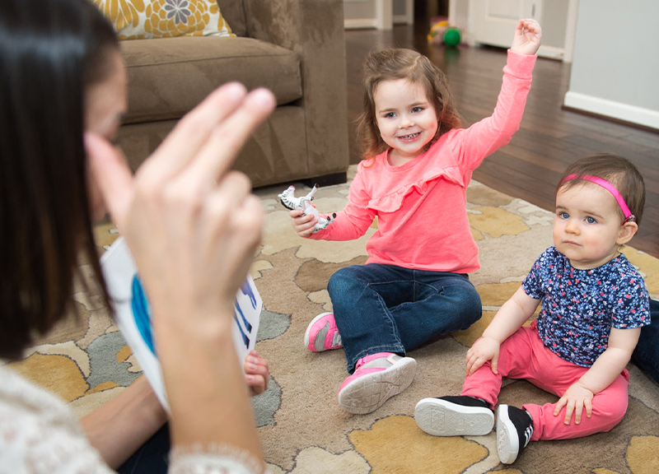
01
MOTIVATION
MOTIVATION
Estimated 1 million Deaf and Hard-of-Hearing population use sign language in the United States
[Rosen et al., 2022]
Sign language use approaches 3% of the U.S. adult population
[Rosen et al., 2022]
Source: Atangan, K. (2019, February 17)
DATS 6303 | Group 6
02

Slide 3
02
Problem & project goal
MOTIVATION
Classify static ASL alphabet handshapes from RGB images using deep learning
Why it matters
Selected problem
Final outcome
Helps recognize ASL signs automatically.
Supports better communication accessibility.
Serves as a first step toward full sign-language recognition systems
Useful for assistive and educational applications.
Compare two transfer-learning models and deploy a webcam-based Streamlit demo
Scope: Letters A–Z
Dynamic signing and full sentence recognition are outside this project.
26
letter classes
DATS 6303 | Group 6
02

Slide 4
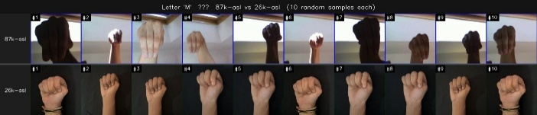
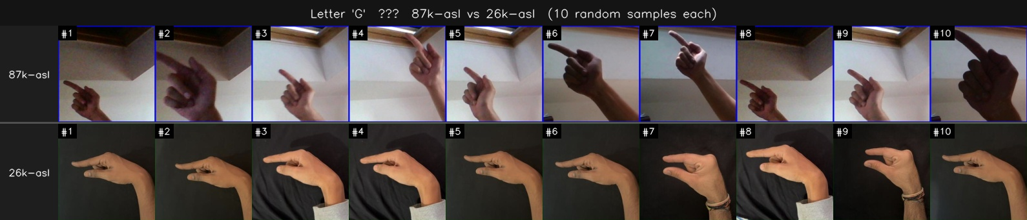
03
Source datasets
DATA
Two public ASL datasets were combined to create a balanced A–Z dataset.
Mendeley ASL Dataset
Kaggle ASL Alphabet
87K
29
26K
26
Kaggle images
raw Kaggle classes
Mendeley images
A–Z classes
Pilot finding: Kaggle dataset -> alone achieved high training accuracy but poor real-time webcam inference because of wide-angle images, low contrast, label noise, and hidden hand features.
M: hidden features
G: label contamination
DATS 6303 | Group 6
04

Slide 5
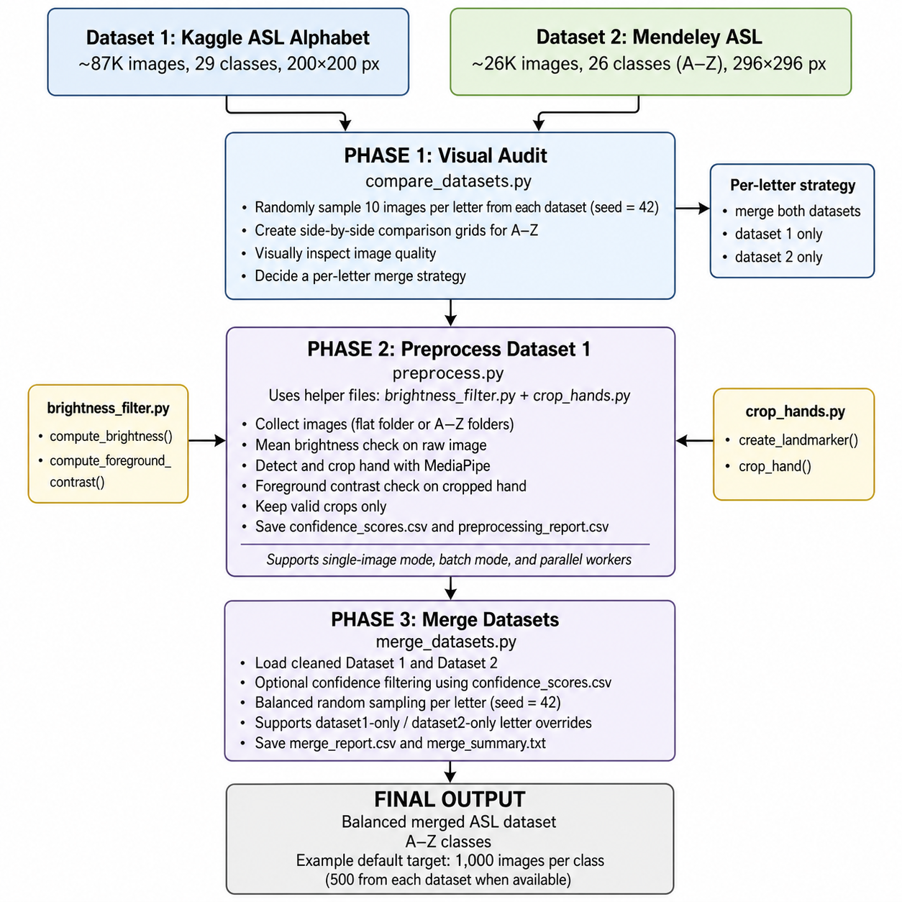
04
Three-phase dataset preprocessing pipeline
PIPELINE
Phase 1: Visual audit
Checked compatibility by orientation, hand shape, and lighting
Phase 2: Preprocess 87K
Applied brightness filtering, hand cropping, and contrast checks
Phase 3: Merge
Created a balanced 26K-image dataset with 1,000 images per class
DATS 6303 | Group 6
06

Slide 6
05
Final split and Model Selection
DATASET
26,000
26
1,000
total images
letter classes
images per class
The standardized dataset is balanced across 26 A–Z letter classes and split with a fixed random seed.
Train
Validation
Test
80%
10%
10%
CHOSEN MODELS
ResNet-50
MobileNetV2
Strong baseline model for high image-classification accuracy.
Good at learning complex hand-shape features.
Lightweight and faster, so it is easier to deploy
Better suited for a Streamlit demo and real-time use.
DATS 6303 | Group 6
07

Slide 7
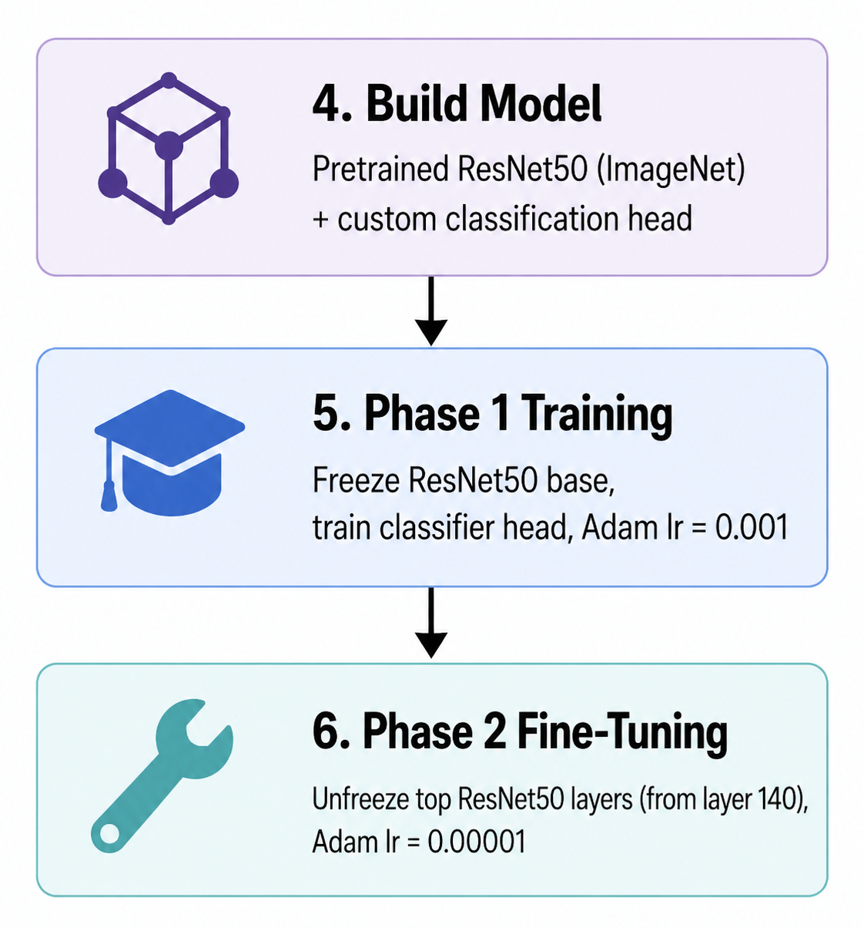
06
ResNet-50 Training algorithm
TRAINING
Two-phase transfer learning adapts pretrained feature extractors to the ASL alphabet task.
Implemented the network in TensorFlow/Keras
Modified ResNet50 for ASL classification
Phase 1 training:
To allow the model to learn how to map ResNet50 image features to the ASL letters
Phase 2 fine-tuning:
To allow the later layers to adjust to the ASL dataset
DATS 6303 | Group 6
09

Slide 8
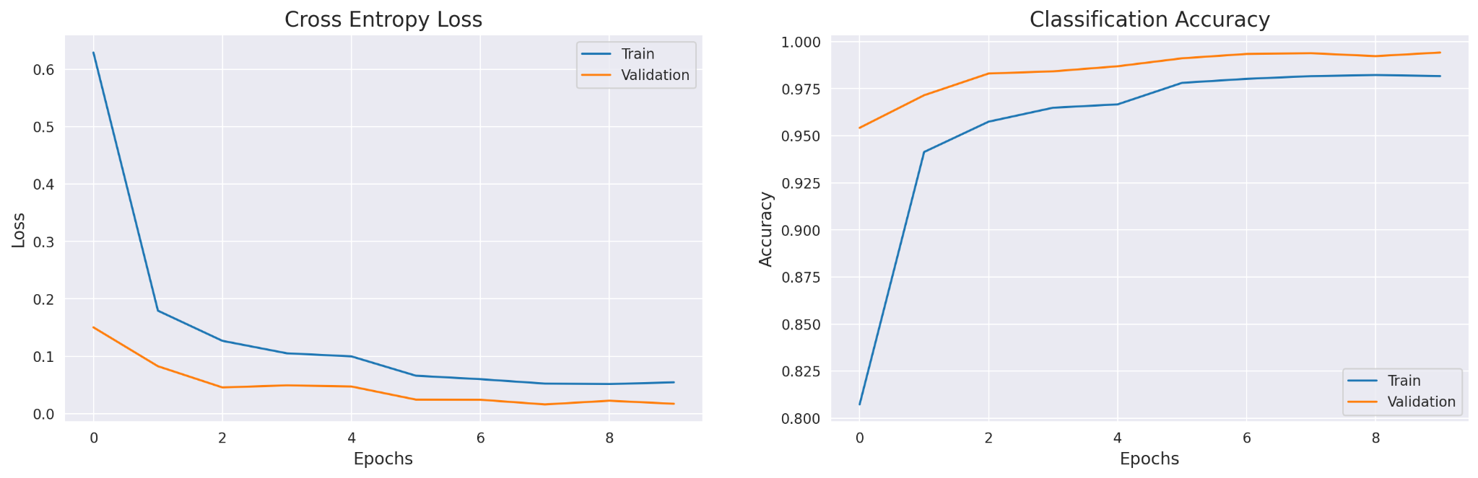
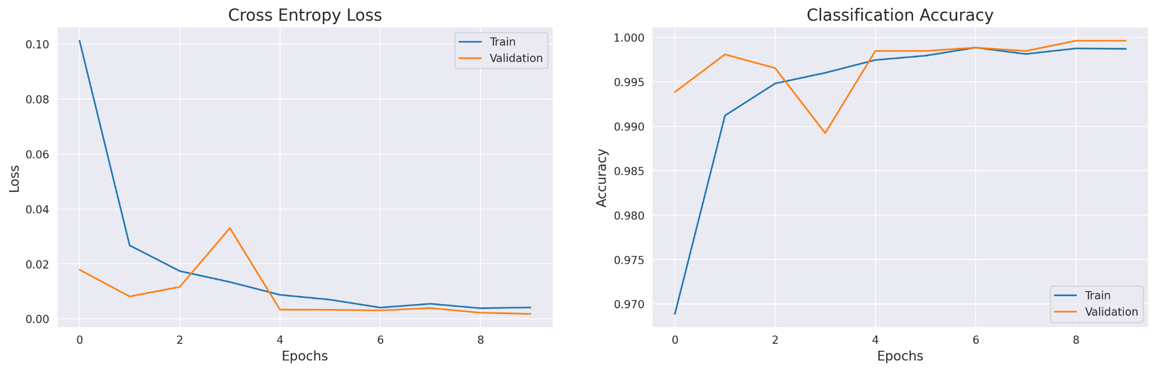
07
Resnet50 Evaluation
METRICS
Phase 1 — frozen base
Training phase
Final val. accuracy
Final val. loss
Phase 1
99.42%
0.0173
Phase 2
99.96%
0.0018
Phase 2 — fine-tuning
Overall accuracy
99.99%
Test loss: 0.0003
DATS 6303 | Group 6
09

Slide 9

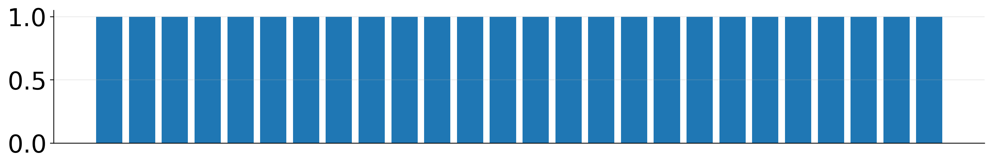
08
Resnet50 Evaluation
ERROR ANALYSIS
No visible class confusion: all 26 letters have perfect per-class scores.
Confusion matrix pattern
Per-class F1 pattern
Check
Result
Test images
2,600
Support per class
100
Confused pairs
None
Per-class F1
1.00 for A–Z
Only diagonal cells are filled: each letter was predicted as itself.
DATS 6303 | Group 6
09

Slide 10
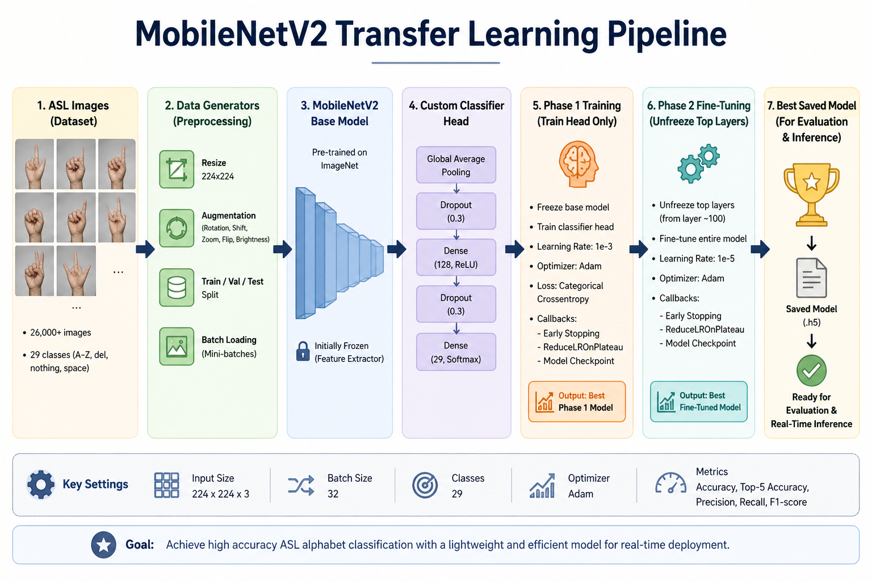
09
MobilenetV2 Training algorithm
TRAINING
Two-phase transfer learning adapts pretrained feature extractors to the ASL alphabet task.
Diagram was created using Generative AI
DATS 6303 | Group 6
09
Notes:
The MobileNetV2 model was trained using a two-phase transfer learning process. First, the classifier head learned the ASL classes using a learning rate of 1e-3. Then, the top layers were unfrozen starting at layer 100 and fine-tuned with a smaller learning rate of 1e-5 to avoid damaging the pretrained features.

Slide 11
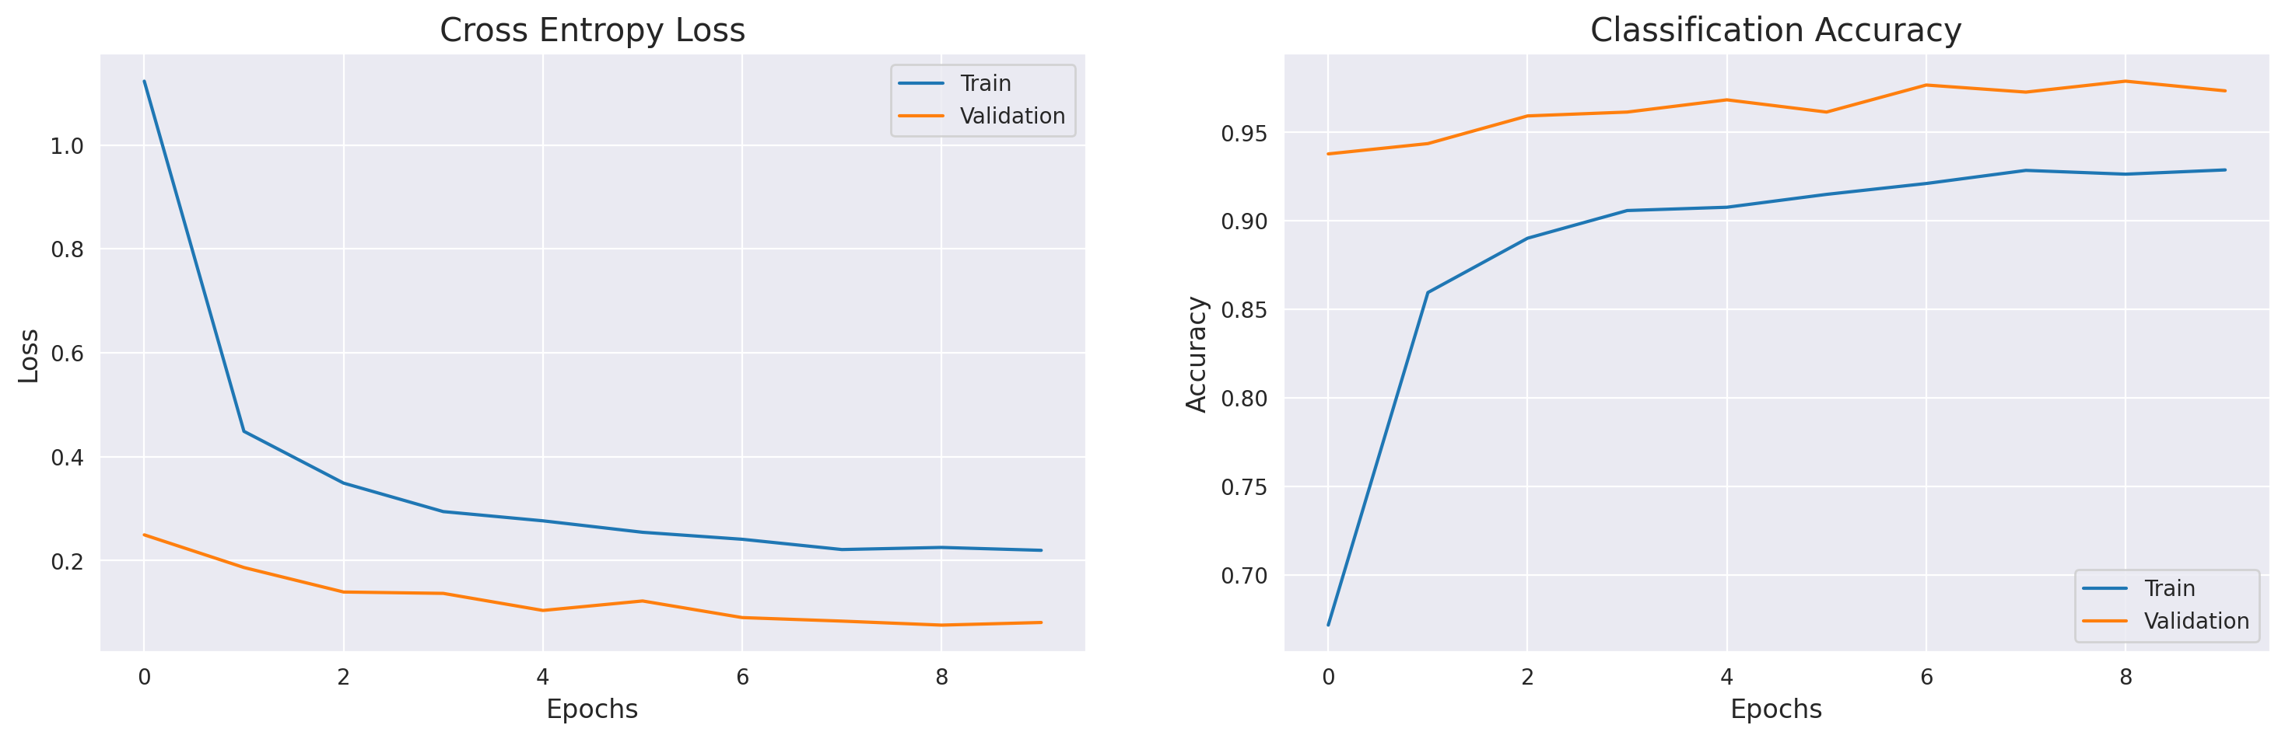
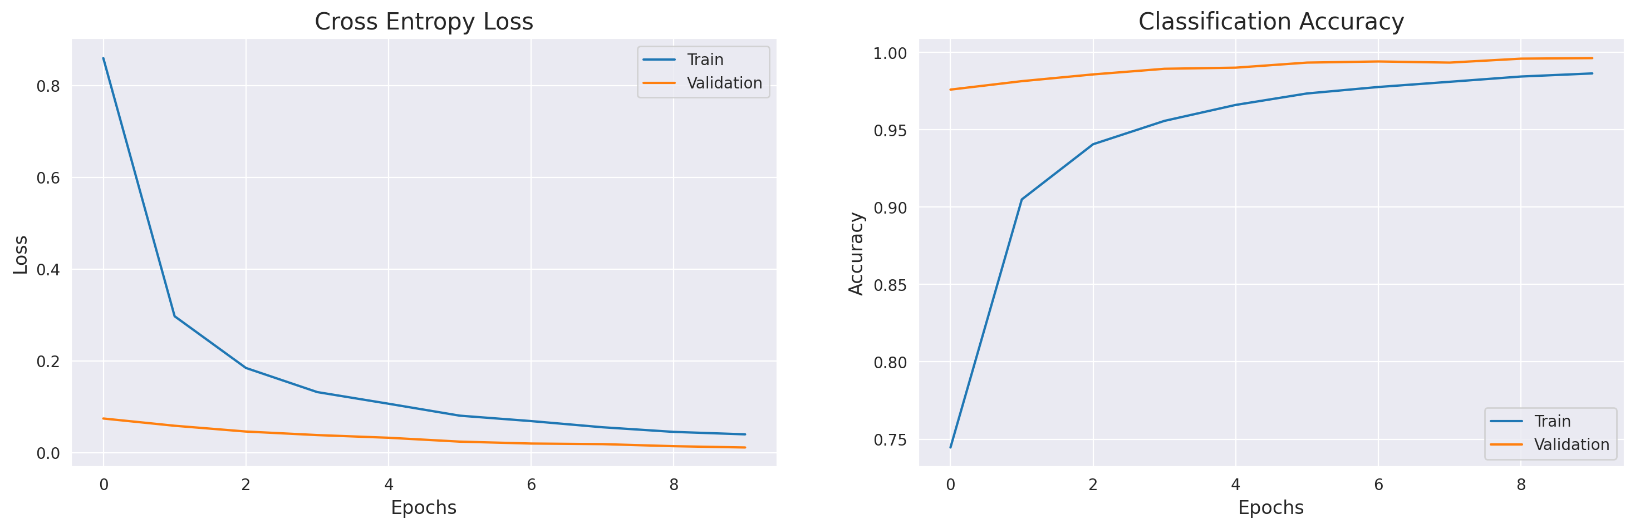
10
MobilenetV2 Evaluation
METRICS
Phase 1 Curve
Phase 1 accuracy: ~67% → ~93%
Phase 2 Curve
Phase 2 accuracy: ~74% → ~98.6%
Validation accuracy reached ~99.6%
DATS 6303 | Group 6
10

Slide 12
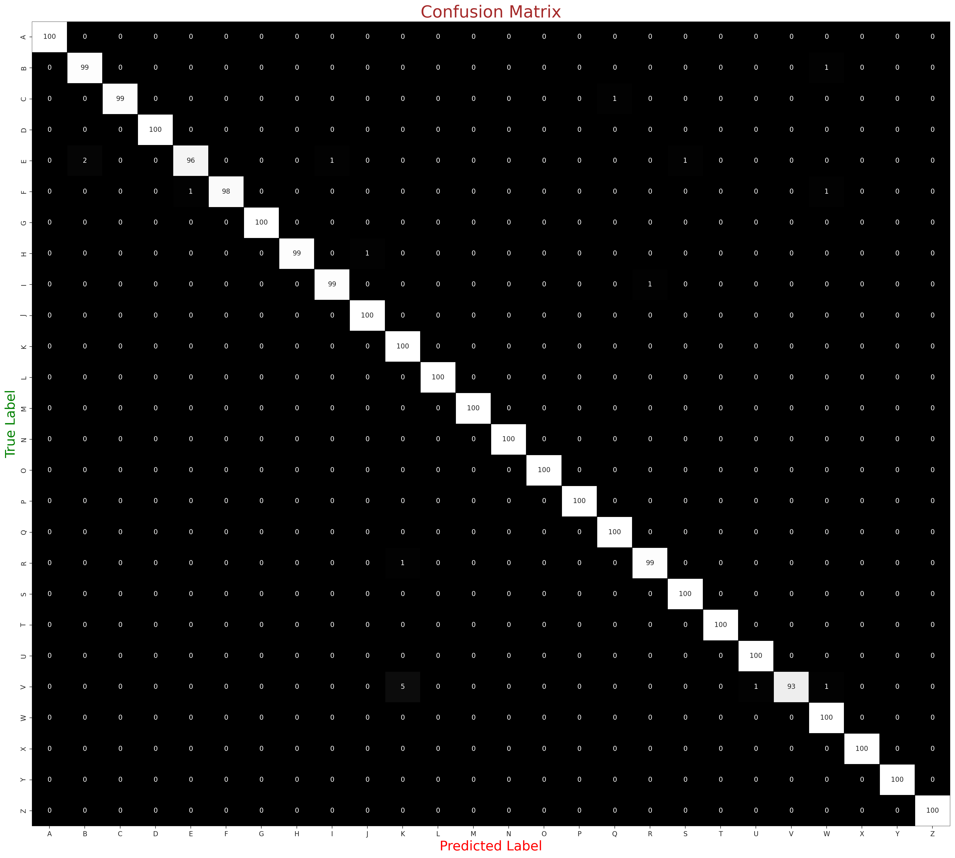
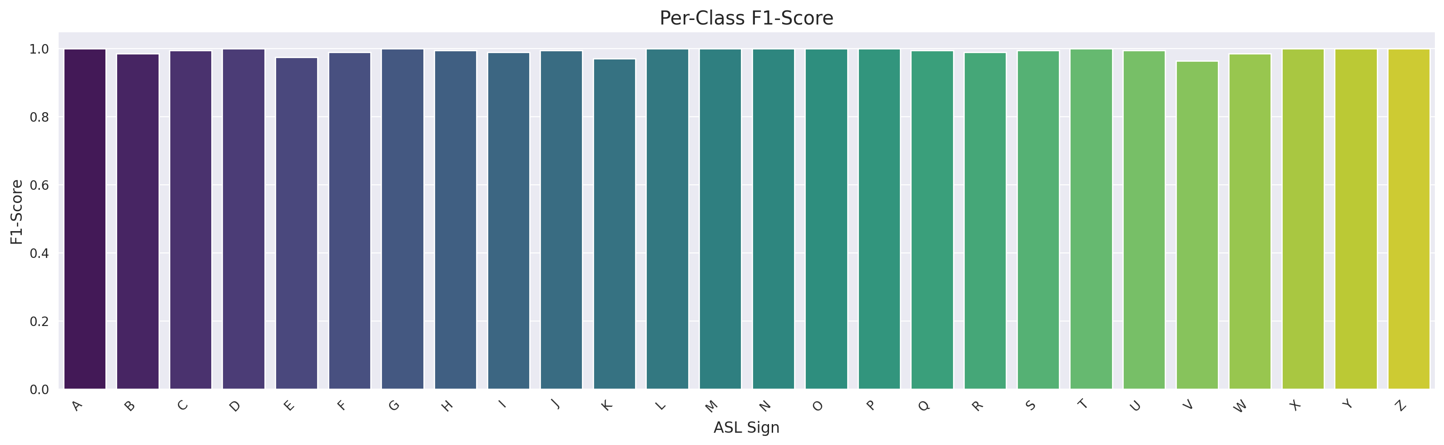
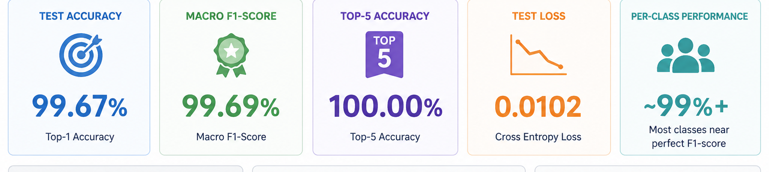
11
MobilenetV2 Evaluation
METRICS
Confusion matrix pattern
Per Class F1-score
Metrics Card
DATS 6303 | Group 6
10

Slide 13
12
Model comparison: accuracy vs. efficiency
MODELS
ResNet-50
MobileNetV2
Peak Accuracy: 99.71%
10x Larger
Heavier and Slower
Peak Accuracy: 99.67%
Lightweight & Efficent
Faster Interface
Higher capacity
More deployable
ResNet-50
MobileNetV2
DATS 6303 | Group 6
08

Slide 14
13
Streamlit demo architecture
DEMO
MobileNetV2 is selected for demo deployment because it is lightweight and efficient
Camera input
MediaPipe
Auto-crop
MobileNetV2
Output
User captures a hand sign
Detect hand landmarks
Crop hand bounding box
Run classifier
Predicted letter + Top-5
Why crop?
User-facing output
Full webcam frames contain background, lighting variation, and hand-size mismatch. Cropping reduces domain shift.
The app displays the predicted class, confidence, cropped hand image, and Top-5 probabilities.
DATS 6303 | Group 6
11

Slide 15
14
Conclusions and next steps
WRAP-UP
Both models achieved near-perfect performance (~99.6% accuracy)
ResNet50 slightly higher accuracy (+0.04%) but with ~10× more parameters
Lower performance on M, N, T, Y → due to visually similar hand shapes & subtle finger differences
Data augmentation + dataset merging → improved robustness and real-world performance
Limitations & Future Work
Static images only (no motion/sequence)
Struggles with similar gestures
Future: video-based models, larger datasets, Vision Transformers
DATS 6303 | Group 6
12

Slide 16
15
References & resources
REFERENCES
Akash (2018), Kaggle ASL Alphabet Dataset; Benabbas (2022), Mendeley ASL Dataset.
He et al. (2016), Deep Residual Learning for Image Recognition — ResNet-50 backbone.
Sandler et al. (2018), MobileNetV2: Inverted residuals and linear bottlenecks.
Lugaresi et al. (2019), MediaPipe framework for hand landmark detection.
Rosen, R. S., Henner, J., & Villwock, A. (2022). How many people use sign language? A national health survey-based estimate. Journal of Deaf Studies and Deaf Education, 28(1), 1–11. https://doi.org/10.1093/jdsde/enac032
TensorFlow / Keras, OpenCV, scikit-learn, Split-Folders, and Streamlit used in implementation.
Project repository: https://github.com/ashleygya03/FinalProject-Group6
DATS 6303 | Group 6
13

Slide 17
THANKS!
Questions?

