Slide 1

Marketing workflows
with ChatGPT
Human originality + machine efficiency
Ashley Joyce / September 29, 2026
01
Notes:
I wanted to explore how ChatGPT could help marketers work more efficiently while keeping human creativity central. I used a hypothetical Werner Bronkhorst wallpaper launch as my case study. What I learned came from the back-and-forth: defining the idea, seeing what the model misunderstood, and turning those corrections into reusable workflow instructions.
MAIN TALK. Target speaking time 25 seconds.
Source: https://openai.com/academy/marketing/
Visual: assets/collection.png. AI-generated hypothetical campaign concept supplied or created in the project. Not a photograph of a real product, event, partnership, or media placement.
Case evidence and review coverage: case-study.md. No live campaign performance or measured time-saving claim.

Slide 2
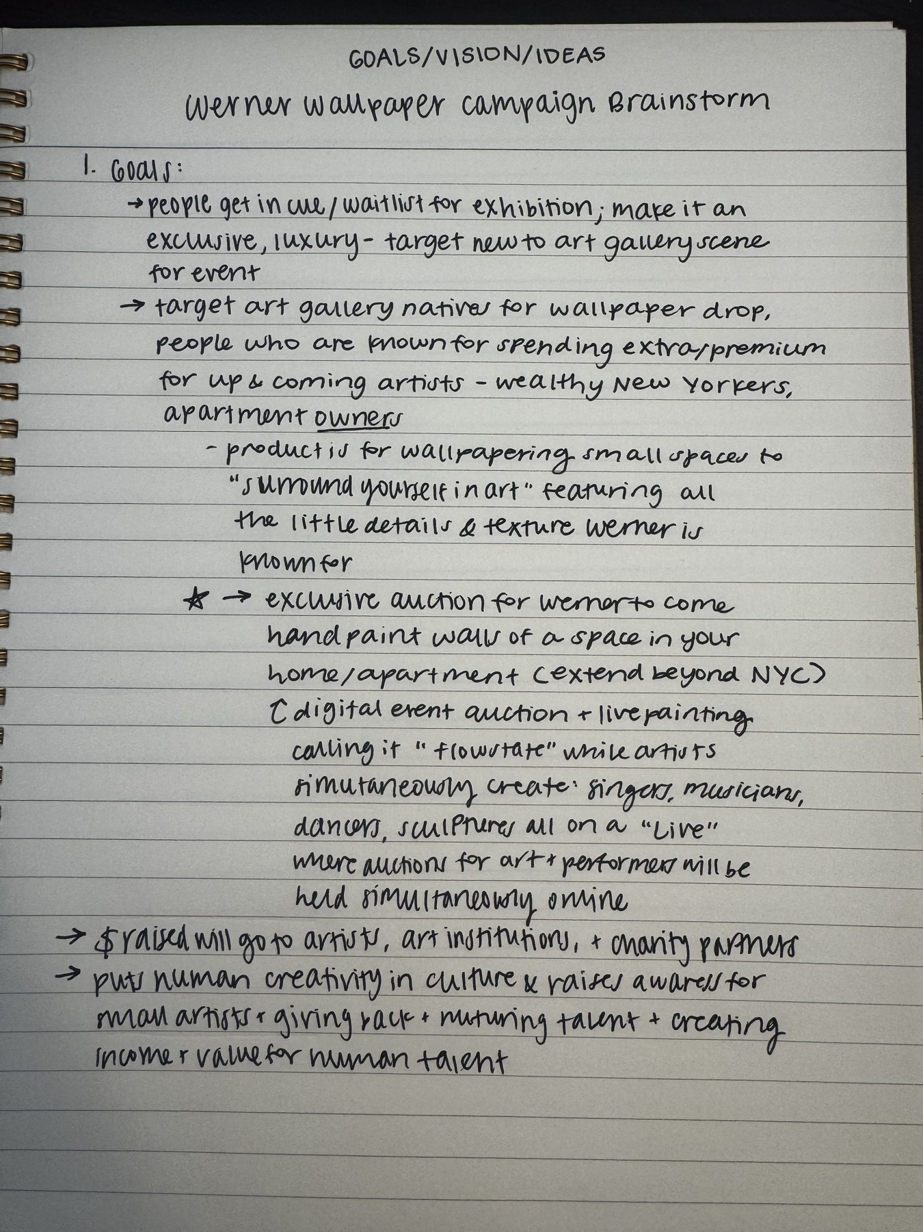
My ideas came first
Readings and planning
Pen-and-paper ideation
AI questions to sharpen the brief
“Keep humans in the driver’s seat for ideation.”
Boussioux et al., 2026, p. 4
02
Notes:
I began by reading about marketing workflows. Claude helped organize the project, and I developed the original ideas on paper, using questions about my goals and vision. The creativity reading recommends keeping humans responsible for early ideation because AI assistance can make different people’s outputs more similar. My rule for ChatGPT was specific: ask questions and pressure-test my thinking before generating directions. That was my chosen working method. It helped preserve the purpose behind the idea: amplifying artists and human talent.
MAIN TALK. Target speaking time 40 seconds.
Source: Boussioux, Doshi, Hauser & Hosanagar, The Hidden Cost of AI-Assisted Creativity, MIT Sloan Management Review, July 9, 2026, p. 4. Supplied PDF. https://doi.org/10.63383/sXIt9497
Visual: assets/human-brainstorm.jpg. Author-provided original handwritten brainstorm. Early concepts shown were later superseded.
Quotation attribution: Boussioux et al., 2026, p. 4.
Case evidence and review coverage: case-study.md. No live campaign performance or measured time-saving claim.

Slide 3

Pressure-testing narrowed the brief
One proposed hotel pilot
A reason for the hotel to invest
Wallpaper launch comes later
Concept image. No confirmed partnership.
03
Notes:
My first idea grew into a much bigger exhibition and creative event. Through questioning, I narrowed it to one proposed paid hotel collaboration, with consumer wallpaper afterward. The useful challenge was: why would the hotel pay? Social attention alone would not answer that. I had to separate the hotel buyer, the event visitor, and the wallpaper customer. We chose The Fifth Avenue Hotel as a hypothetical prospect. Its interest, the product details, and the economics still need real validation. Times Square belongs to the later wallpaper launch.
MAIN TALK. Target speaking time 40 seconds.
Visual: assets/hotel-concept.png. AI-generated hypothetical campaign concept supplied or created in the project. Not a photograph of a real product, event, partnership, or media placement.
Case evidence and review coverage: case-study.md. No live campaign performance or measured time-saving claim.

Slide 4

Specific feedback improved the work
Smaller figures
More visible paint texture
A clearer New York story
New York Minute: three proposed wallpaper designs
04
Notes:
The concept then became New York Minute: Broadway Backstage, Stories on the Streets, and Five Minutes on Fifth Ave. Visual generation made the idea tangible, but my feedback made it more specific. I pushed for tiny figures, finer paint lines, a green-and-cream Fifth Avenue palette, and settings beyond a bedroom. We tried rooms, ceilings, rolls, and billboard concepts. I could see the direction improving, but we did not measure time saved or commercial performance. A polished image was evidence of a creative iteration, not evidence that customers would buy.
MAIN TALK. Target speaking time 40 seconds.
Visual: assets/product-ad.png. AI-generated hypothetical campaign concept supplied or created in the project. Not a photograph of a real product, event, partnership, or media placement.
Case evidence and review coverage: case-study.md. No live campaign performance or measured time-saving claim.

Slide 5
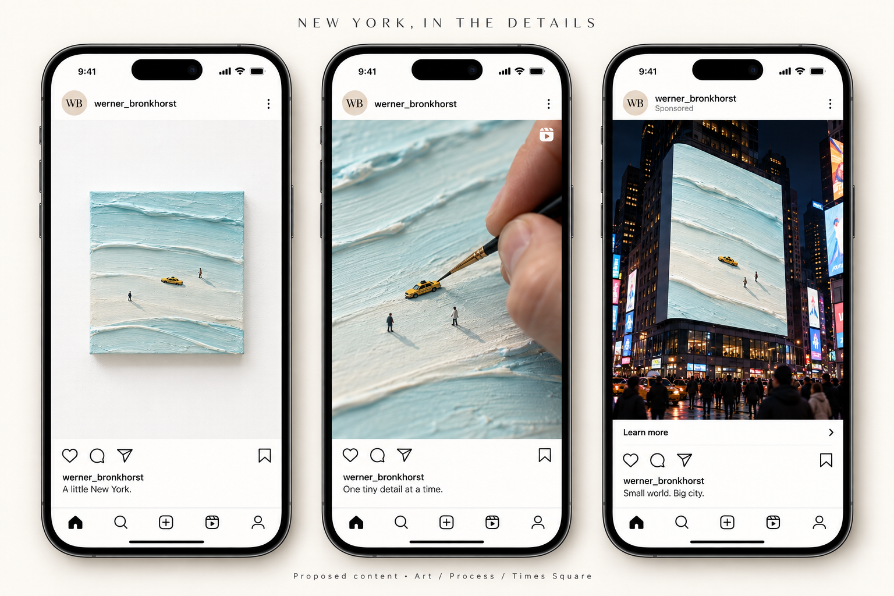
The feed needed more of the artist
My correction: more standalone art, process, and occasional reveals
05
Notes:
Today’s biggest correction was about native content. The first ads looked polished, but I wanted more of the rhythm in Werner’s actual feed: standalone artwork, close-up texture, and the making process, with a campaign reveal occasionally. I supplied screenshots and asked for that feeling. The revised sequence follows one small painting through a process shot and a Times Square reveal. These are AI-generated proposals. If this campaign went live, the process content would need real footage of the artist making the work, and the partnerships would need agreement.
MAIN TALK. Target speaking time 40 seconds.
Visual: assets/native-posts.png. AI-generated hypothetical campaign concept supplied or created in the project. Not a photograph of a real product, event, partnership, or media placement.
Case evidence and review coverage: case-study.md. No live campaign performance or measured time-saving claim.

Slide 6
Corrections became skill instructions
Inputs: brief + references
Process: preserve the approved idea
Checks: facts + fit + useful critique
Output: a draft the marketer can review
“A skill is a reusable, shareable workflow”
OpenAI Academy, Using skills
06
Notes:
A useful skill saves how we want the work done. For example, the ad workflow should inspect my references before writing variations. The concept workflow should preserve my idea, and it should flag generic elements only when they are actually present. My practical tip is to complete a task in chat, correct the output, and then ask ChatGPT to turn the successful process into a SKILL.md. Include the inputs, steps, output format, and quality checks. Then try it on a different brief. Saving a file does not prove the skill works reliably.
MAIN TALK. Target speaking time 45 seconds.
Source: https://openai.com/academy/skills/
Quotation attribution: OpenAI Academy, Using skills.
Case evidence and review coverage: case-study.md. No live campaign performance or measured time-saving claim.

Slide 7
Once live, the workflow changes
Before launch: tracking and a test plan
During launch: channel checks and real feedback
After launch: outcomes and the next experiment
Proposed next phase. No live campaign results yet.
07
Notes:
After launch, I would use different skills. Channel tracking would separate each source and creative version. An experiment plan would define one change, a primary outcome, and a decision rule before the test. Channel management would check links, availability, approvals, and customer questions. A performance digest would distinguish hotel inquiries from wallpaper orders and social engagement. It would also flag missing data and uncertain results. Synthetic reactions can surface questions, but they cannot validate demand. And a QR scan can show response to a billboard without proving that the billboard caused extra sales.
MAIN TALK. Target speaking time 45 seconds.
Source: https://www.thinkwithgoogle.com/_qs/documents/18403/For_pub_on_TwG___External_Playbook_Modern_Measurement_bmzqiud.pdf
Case evidence and review coverage: case-study.md. No live campaign performance or measured time-saving claim.

Slide 8
What I would repeat
Originate
Run
Steer
Save the useful corrections. Test the workflow again.
Reusable skills, templates, and launch plan in the companion repository
08
Notes:
My method is originate, run, and steer. Bring a human idea and real references, use ChatGPT for a specific task, then make the judgment calls. The repository separates workflows we exercised from new skills drafted for launch. A small business could start with one recurring task and a simple review log. The next proof would be better work with less rework, measured over repeated use.
MAIN TALK. Target speaking time 25 seconds.
Source: https://openai.com/academy/marketing/
Case evidence and review coverage: case-study.md. No live campaign performance or measured time-saving claim.

Slide 9
Appendix: the tools serve different roles
Project / Campaign context and files
Chat / Discussion and iteration
Skill / Instructions for a repeatable task
Agent / A system that can choose actions and use tools
A skill file alone does not schedule work or connect accounts.
09 / APPENDIX
Notes:
Use a skill for a repeatable task. Add automation or an agent only when the trigger, data access, permitted actions, and failure handling are clear. A scheduled workflow can follow fixed steps. Agent autonomy is a separate design choice.
OPTIONAL APPENDIX.
Source: https://openai.com/academy/skills/
Source: https://www.anthropic.com/engineering/building-effective-agents
Source: https://openai.com/academy/workspace-agents/
Case evidence and review coverage: case-study.md. No live campaign performance or measured time-saving claim.

Slide 10
Building a skill in chat
1 Run one real task with an approved brief
2 Correct the draft and record why
3 Distill the reusable steps into SKILL.md
4 Try a new case and a difficult case
5 Keep a version and a failure log
A creator can draft the file. People still evaluate its behavior.
10 / APPENDIX
Notes:
Give the creator a successful example and the corrections that mattered. Ask it to preserve current authorization, identify missing inputs, and describe the deliverable. Keep campaign-specific facts in a brief, rather than embedding them as universal instructions. Use the build-skills guide for the installation route available in your product.
OPTIONAL APPENDIX.
Source: https://learn.chatgpt.com/docs/build-skills
Source: https://developers.openai.com/api/docs/guides/agent-evals
Case evidence and review coverage: case-study.md. No live campaign performance or measured time-saving claim.

Slide 11
What we exercised in this project
Pressure-testing: audience and partner value
Concept expansion: hotel experience and collection
Ad adaptation: references, format, and feed fit
Observed in chats and artifacts. No controlled skill benchmark.
11 / APPENDIX
Notes:
The conversations demonstrate these workflow behaviors. They do not establish that every output came from the final saved skill version. Handmade process planning supports the creative work, but the supplied process pictures are generated concepts. Synthetic testing, tracking, and performance reporting remain proposed live-stage workflows.
OPTIONAL APPENDIX.
Case evidence and review coverage: case-study.md. No live campaign performance or measured time-saving claim.

Slide 12
New skills for the live phase
Audience evidence: sourced questions and objections
Experiment planning: fair comparison and decision rules
Channel operations: readiness and response queues
Launch review: product facts, assets, and owners
Skill review: repeatable cases and error checks
New drafts based on readings and this case. Not live-validated.
12 / APPENDIX
Notes:
These five additions turn the library into a full preparation and learning workflow. They produce reviewable documents, not automatic permission to publish, contact customers, or change spend. The repository includes inputs, output contracts, boundaries, and a small evaluation plan for each.
OPTIONAL APPENDIX.
Source: https://academy.openai.com/public/clubs/work-users-ynjqu/resources/chatgpt-work-for-marketing-teams-webinar-resource-guide-2026-08-26
Source: https://developers.openai.com/api/docs/guides/agent-evals
Source: https://developers.openai.com/api/docs/guides/agents/guardrails-approvals
Case evidence and review coverage: case-study.md. No live campaign performance or measured time-saving claim.

Slide 13
Testing the campaign
Question: which message earns sample requests?
Change: copy angle only; hold the creative fixed
Design: random assignment where feasible
Decision: sufficient data, uncertainty, and a guardrail
Organic channel comparisons are observational. Simulated reactions are exploratory.
13 / APPENDIX
Notes:
For a wallpaper launch, first validate whether samples and fulfillment actually exist. Then compare two approved copy angles with the same image, audience eligibility, placement, offer, and time period. Prespecify sample needs, baseline, minimum meaningful effect, budget, and stopping rules. Avoid choosing a winner after a few favorable clicks. For qualitative research, ask what people understand and what prevents purchase.
OPTIONAL APPENDIX.
Source: https://www.thinkwithgoogle.com/_qs/documents/18403/For_pub_on_TwG___External_Playbook_Modern_Measurement_bmzqiud.pdf
Case evidence and review coverage: case-study.md. No live campaign performance or measured time-saving claim.

Slide 14
Measurement follows the business question
Hotel pilot / Qualified inquiries and booking outcomes
Wallpaper / Sample requests, orders, and margin
Content / Attention and qualified site visits
Workflow / Review time, rework, and factual errors
Reported attribution and causal impact answer different questions.
14 / APPENDIX
Notes:
Keep the denominators and time windows consistent. Reconcile purchases and refunds with the commerce record, not just ad-platform totals. Distinguish sample orders from full wallpaper purchases. For a billboard, use a unique landing page or QR code as a response signal. A credible holdout or other suitable causal design would be needed to estimate incrementality. One location with no control cannot support that claim.
OPTIONAL APPENDIX.
Source: https://openai.com/academy/marketing/
Source: https://www.thinkwithgoogle.com/_qs/documents/18403/For_pub_on_TwG___External_Playbook_Modern_Measurement_bmzqiud.pdf
Case evidence and review coverage: case-study.md. No live campaign performance or measured time-saving claim.

Slide 15
A weekly operating rhythm
Daily / Links, stock, delivery issues, comments
Weekly / Reconciled data and content decisions
After a test / Readout and the next question
After a workflow change / Repeat saved cases
The marketer owns publishing, claims, customer replies, and spend decisions.
15 / APPENDIX
Notes:
Channel operations should maintain one source of truth for asset versions and approvals. Log what actually ran, its URL, time zone, owner, and tracking ID. Review cross-channel repetition and creative fatigue without assuming a performance dip proves fatigue. Route recurring installation questions into truthful FAQs or lifecycle content. Escalate product or fulfillment issues to the owner.
OPTIONAL APPENDIX.
Source: https://academy.openai.com/public/clubs/work-users-ynjqu/resources/chatgpt-work-for-marketing-teams-webinar-resource-guide-2026-08-26
Source: https://developers.openai.com/api/docs/guides/agents/guardrails-approvals
Source: https://developers.openai.com/api/docs/guides/agent-evals
Case evidence and review coverage: case-study.md. No live campaign performance or measured time-saving claim.

Slide 16
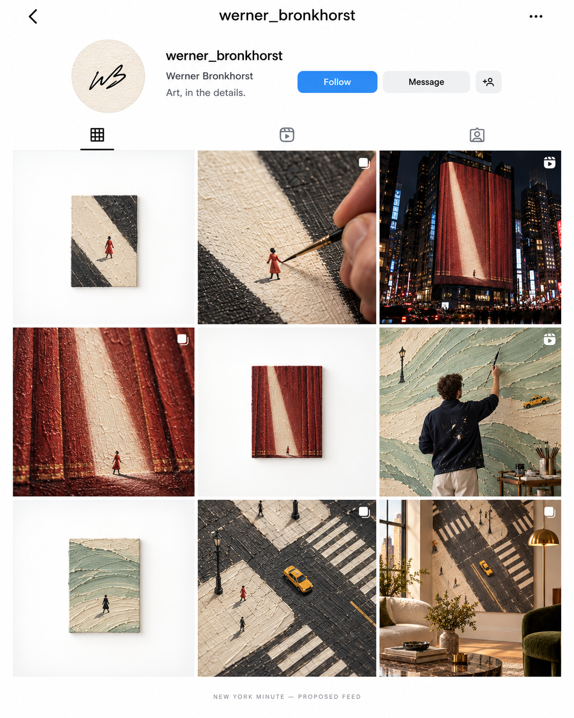
The proposed feed
Art first
Process alongside it
Campaign reveals occasionally
Proposed profile. No live audience response measured.
16 / APPENDIX
Notes:
This image documents an editorial direction, not an optimal posting ratio. The displayed handle and biography are mockup elements. Before use, verify the artist’s actual account details and obtain approval for the creative. Test the mix with real audience behavior rather than assuming the mockup predicts engagement.
OPTIONAL APPENDIX.
Visual: assets/feed.png. AI-generated hypothetical campaign concept supplied or created in the project. Not a photograph of a real product, event, partnership, or media placement.
Case evidence and review coverage: case-study.md. No live campaign performance or measured time-saving claim.

Slide 17

A proposed editorial collaboration
Vogue Living concept. No announced partnership or published coverage.
17 / APPENDIX
Notes:
The concept shows how the same campaign world might appear in an interiors editorial setting and a social placement. It is a pitch visualization only. Editorial coverage, paid partnership, and owned content are different channels with different permissions and disclosure requirements. This slide illustrates channel adaptation, not earned-media success.
OPTIONAL APPENDIX.
Visual: assets/vogue-concept.png. AI-generated hypothetical campaign concept supplied or created in the project. Not a photograph of a real product, event, partnership, or media placement.
Case evidence and review coverage: case-study.md. No live campaign performance or measured time-saving claim.

Slide 18
Readings behind the workflow
OpenAI Academy: ChatGPT for marketing teams; Using skills
Boussioux et al.: The Hidden Cost of AI-Assisted Creativity
Anthropic: Building Effective AI Agents
OpenAI: Build skills; guardrails; workflow evaluation
Google: Modern Measurement Playbook
Full links, quotation locations, and source limits in sources.md
18 / APPENDIX
Notes:
The creativity article supports deliberate sequencing of human ideation and AI assistance. OpenAI provides the marketing tool and skill framework. Anthropic helps distinguish workflows from agents. Google supplies the attribution and incrementality distinction. The Small Business Jam PDF did not load during this review and is not a source for any claim in this deck.
OPTIONAL APPENDIX.
Source: https://openai.com/academy/marketing/
Source: https://openai.com/academy/skills/
Source: https://learn.chatgpt.com/docs/build-skills
Source: https://academy.openai.com/public/clubs/work-users-ynjqu/resources/chatgpt-work-for-marketing-teams-webinar-resource-guide-2026-08-26
Source: https://www.anthropic.com/engineering/building-effective-agents
Source: https://openai.com/academy/workspace-agents/
Source: https://developers.openai.com/api/docs/guides/agent-evals
Source: https://developers.openai.com/api/docs/guides/agents/guardrails-approvals
Source: https://www.thinkwithgoogle.com/_qs/documents/18403/For_pub_on_TwG___External_Playbook_Modern_Measurement_bmzqiud.pdf
Source: Boussioux, Doshi, Hauser & Hosanagar, The Hidden Cost of AI-Assisted Creativity, MIT Sloan Management Review, July 9, 2026, p. 4. Supplied PDF. https://doi.org/10.63383/sXIt9497
Case evidence and review coverage: case-study.md. No live campaign performance or measured time-saving claim.

