Slide 1
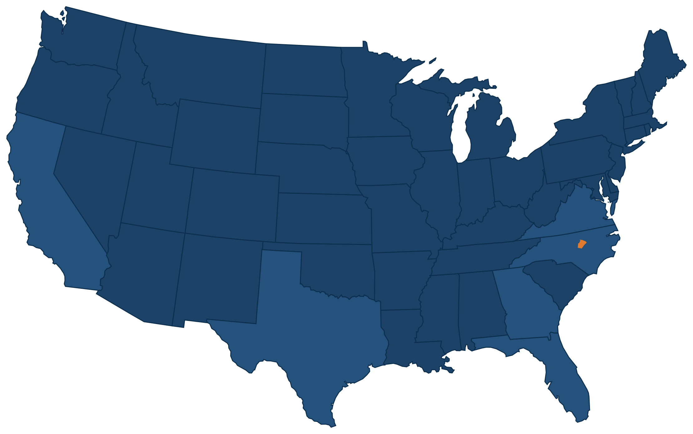
Benchmarking Wake County's Public Engagement
Peer Counties, Proven Practices, and Applications for Wake County
Prepared by the UNC PLCY 698 Capstone Team | October 2026
Sid Ram, Mridhula Bharathwaj, Andrew Owens, Hailey Gardinier, Ashley Ju, Nayan Bala
Notes:
This deck covers Objective 2: how Wake County's engagement practices compare with five peer counties and a set of proven North Carolina and national programs, and which of those practices are realistic for Wake.

Slide 2





One Question - Three Lenses
Which feasible engagement practices would help Wake County reach residents who rarely participate?
Peer Counties
North Carolina Practices
National Models
5 counties
4 programs
2 models
Matched to Wake County on the basis of population, growth since 2020, and urban-suburban mix: Mecklenburg, Travis, Hillsborough, Collin, and Gwinnett.
Buncombe County, the City of Raleigh, the City of Durham, and Mecklenburg County. Same state legal framework as Wake County.
Fairfax County, Virginia, and the City of Fresno, California, were selected primarily for the depth of their community engagement practices.
Lens: Which public engagement tools each county uses.
Lens: The most directly transferable models
Lens: How engagement becomes a standing institution
Source: Team research plan; Objective 1 findings. Appendix
Notes:
We looked at the question three ways. Peer counties tell us what similar governments do as a baseline. North Carolina programs are the easiest to transfer because they operate under the same state law. Fairfax and Fresno are included for depth, not size: they show how engagement becomes part of how a government runs.

Slide 3
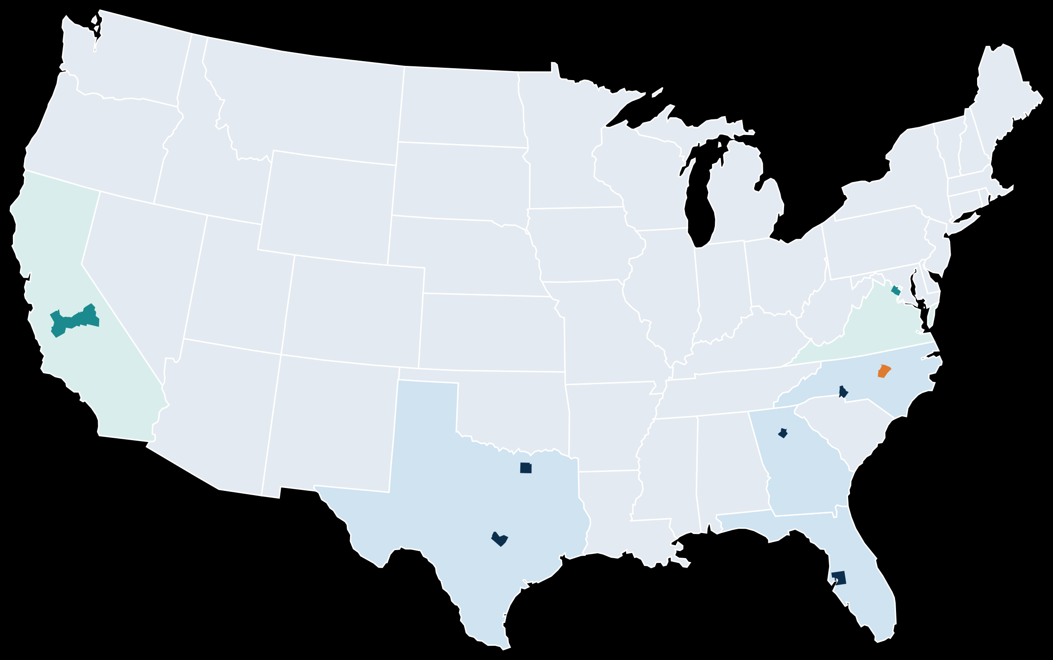
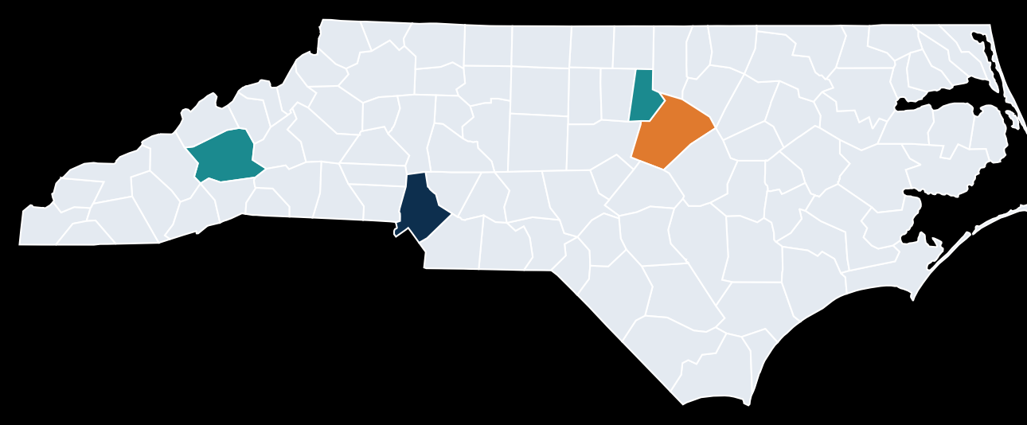
Wake’s Population is Growing Faster than Most Peers
North Carolina practices
Durham
Buncombe
Raleigh, in Wake
Mecklenburg (peer)
Fairfax, VA
Fresno, CA
Benchmark numbers
Wake, NC
County
2025 pop.
Growth since 2020
Gwinnett, GA
Collin, TX
1.30M
21.7%
Wake County
Collin, TX
Wake, NC
1.26M
11.3%
Peer county
Mecklenburg, NC
1.23M
10.6%
Travis, TX
Best-practice jurisdiction
Hillsborough, FL
1.57M
7.8%
Hillsborough, FL
Travis, TX
1.39M
7.7%
Gwinnett, GA
1.02M
6.3%
Source: U.S. Census Bureau QuickFacts, July 1, 2025 estimates (team research by Ashley Ju). Appendix
Notes:
Exact 2025 estimates: Wake 1,257,235 (+11.3%); Mecklenburg 1,233,383 (+10.6%); Travis 1,389,670 (+7.7%); Hillsborough 1,574,115 (+7.8%); Collin 1,297,179 (+21.7%); Gwinnett 1,018,099 (+6.3%). Wake is fourth of six in size but second in growth, so the residents it needs to reach are changing faster than at almost any peer. Mecklenburg is the closest match and shares North Carolina law.

Slide 4
Mecklenburg and Gwinnett Run the Most Standardized Toolkits
Wake
Mecklenburg
Travis
Hillsborough
Collin
Gwinnett
Budget engagement
2 hearings (one evening); 16-day online comment form
Priority survey and dashboard; 2 hearings
Multilingual community survey; budget comment period
Hybrid hearings held in the evening
Truth-in-Taxation hearings
Citizen budget review teams; online comment
Digital platform
Separate pages by project (PLANWake, parks plan)
Engage Mecklenburg portal
Project sites, such as parks
HC Engage hub
Project sites for thoroughfare and freeway plans
None found
Advisory boards
Appointed boards; monthly appointments; district seats
45 boards, including a budget committee
Uniform appointment process
Diversity Advisory Council with reserved seats
Appointed boards
Youth Commission; Outreach Advisory Board
Language access
Board materials in 5 languages + ASL on request; phone interpreting
Bilingual broadcasts; transcripts in 60+ languages
Countywide Language Access Plan
None found
None found
Resident language collaboration group
Access points and outreach
Mobile outreach run by single departments
Community resource centers; hybrid district meetings
Remote phone testimony; 7 community centers
Neighborhood relations office
Open houses in growth towns
Gwinnett 101; mobile recreation unit
Equity or engagement office
Equity office exists; engagement run by departments
Office of Equity and Inclusion; Equity Action Plan
None found
None found
None found
Civic Engagement and Social Impact divisions
Countywide, dedicated tool
Limited or project-specific
None found in public materials
Source: County budget, engagement, and board pages (team research by Hailey Gardinier and Andrew Owens); Wake County website. Ratings are a team assessment. Appendix
Notes:
Each cell names the tool we found, and the shading is our rating. Dark teal means a dedicated, countywide tool. Light blue means something exists but is limited or tied to a single project. Gray means we found nothing in public materials, which does not prove the county does nothing. Wake's column is outlined in orange.

Slide 5



Wake County Has Breadth but Lacks a Countywide Anchor
Engagement toolkit score (out of 12)
Breadth Without Depth
Wake has something in place in all six categories, yet none of them works at the countywide level that Mecklenburg reaches in every category.
12
Leaders Built Infrastructure, Not More Meetings
Mecklenburg and Gwinnett each pair a permanent home for engagement with a portal or a dedicated division.
Wake County’s Gaps Are Coordination Gaps
A single front door, shared standards, and a structured resident role in the budget would close most of the distance to the top peers.
Scoring: 2 points for a countywide, dedicated tool, 1 for a limited one, 0 if none found, across the six categories on the previous slide.
Source: Team assessment of public county materials. Ratings will be validated through Wake department interviews. Appendix
Notes:
Wake ties Hillsborough and sits ahead of only Collin. The point is not the score itself. Wake has activity everywhere, but each piece belongs to one department. The counties at the top made engagement a countywide function with a home and an owner.

Slide 6






Six Barriers Point to Six Action Areas
BARRIER No shared definition or standard across departments
1. Set a shared engagement standard
Buncombe ICEP framework; One Fairfax
BARRIER Transportation, work schedules, and childcare keep residents away
2. Take engagement to residents
Buncombe intercepts; Raleigh Engagement on the Go; Fresno
BARRIER Low trust, and the same residents show up each time
3. Work through trusted messengers
Raleigh and Buncombe Community Connectors; Fresno; Fairfax
BARRIER Language help is mostly available on request
4. Centralize language access
Fairfax Language Access Program; Travis County plan
BARRIER Opportunities are scattered across many departments
5. Create one front door
Engage Mecklenburg; Engage Fairfax; HC Engage
BARRIER Residents rarely see what their input changed
6. Close the loop and measure
Durham; Mecklenburg; Fairfax dashboards
Source: Barriers from Objective 1 findings; practices from team research on peer counties, North Carolina programs, and national models. Appendix
Notes:
Each barrier from Objective 1 maps to one practice area, and the next six slides take them one at a time. Each slide ends with the same panel: where Wake stands today, what adopting the practice would take, and our feasibility rating.

Slide 7
A Shared Standard Creates One Countywide Baseline
Buncombe County: One Engagement Ladder Across All Departments
Fairfax County: Eight Considerations That Define Engagement
Partner
Language access
Plain language
Culture
Accessibility
Engage
Digital equity
Virtual access
Geography
Meeting time
Consult
Inform
Under One Fairfax, departments set their own goals and action plans, staff are trained on equity tools, and the county publishes results broken down by group. The standard is shared, but each department owns its plan.
Level of resident influence →
Buncombe's Community Engagement office uses the ICEP levels to define public participation across its outreach, surveys, town halls, focus groups, and board recruitment.
Both models preserve departmental flexibility while establishing a shared definition of engagement. The models also clearly distinguish between simple education and meaningful engagement.
Wake County today
No common countywide definition. Each department chooses its own methods and level of resident influence.
What it would take
Mostly policy and training work. The IAP2 levels from our Objective 1 classification could serve as the starting point.
FEASIBILITY
High
Source: Buncombe County Community Engagement; One Fairfax Policy; Fairfax County Strategic Plan Annual Report. Appendix
Notes:
This is the foundation for everything else. Buncombe shows a simple four-level ladder. Fairfax shows the next step: a short list of considerations every plan must address, plus department-level goals and public reporting.

Slide 8



Taking Engagement to Residents Widens Participation
Buncombe County 2043 Comprehensive Plan
How Peer Communities Addressed Each Barrier
5,233
residents engaged over two years
Transportation and geography
Raleigh's Engagement on the Go vehicle works as a mobile city hall, prioritizing neighborhoods with limited access to resources.
Childcare and family duties
Durham and Fresno provide childcare; Buncombe adds child-friendly activities to meetings.
100+
events hosted or attended
Work schedules
Buncombe varies days and times and offers paper and online options; Fresno meets near transit at hours that suit working residents.
95
intercept events at schools, festivals, and markets
Cost of showing up
Durham's budget conversations offer food, interpretation, and participant gift cards.
Wake County today
Libraries, Public Health, and Workforce Development run mobile outreach, and the parks plan staffed festival booths.
What it would take
Share a countywide outreach calendar and add an engagement station to existing mobile routes and events.
FEASIBILITY
High
Source: Buncombe County 2043 Comprehensive Plan; City of Raleigh; City of Durham; Institute for Local Government (Fresno); CBS17; Objective 1 findings. Appendix
Notes:
Buncombe's numbers show the payoff of going where people already are. The key point for Wake is that the hardware already exists. Several departments run mobile units, so this is mostly a coordination job, not a new program.

Slide 9



Trusted Messengers Reach Residents Who Are Rarely Engaged
WHAT WE HEARD FROM WAKE COUNTY PARTNERS
Raleigh Community Connectors
Buncombe Community Connectors
Trusted community leaders should act as liaisons between the County and residents.
Paid residents with lived experience share project information and carry community questions back to City staff.
8 part-time connectors, employed through community organizations, staff 16 Community Engagement Markets.
Fresno General Plan
Fairfax Community Roundtable
Underrepresented communities are already over-researched, so outreach should run through groups they trust.
A refugee ministry and a family resource center helped design outreach built on one-on-one conversations and festival-style meetings.
19 members, with seats for underrepresented groups, helped the police department review its foot pursuit policy.
Wake County today
No countywide connector program. Most input still comes through surveys and public meetings.
What it would take
Stipends and community organization contracts. A pilot in two or three communities keeps cost contained.
FEASIBILITY
Medium
Source: City of Raleigh; Buncombe County; Institute for Local Government (Fresno); Fairfax County Annual Report; Wake partner conversations. Appendix
Notes:
Every strong model pays or contracts with people the community already trusts. That matches what Wake partners told us, including the warning that some communities are tired of being studied. A small paid pilot would test this before any countywide rollout.

Slide 10
Centralized Language Access Builds Capacity and Reduces Costs
Fairfax Language Access Program, FY2025
Where Wake County Stands on the Path Forward
606
28
On request
Countywide plan
Central in-house team
translation requests
departments served
Wake today: Board materials in 5 languages plus ASL with one business day notice; phone and video interpretation for staff
Travis County: a Language Access Plan sets rules for every department
Fairfax: one internal team handles translation for departments countywide
+110%
−34%
requests vs. FY2024
outside translation spending
17%
of Wake residents age 5 and older speak a language other than English at home.
Two full-time translators in the Office of Public Affairs handle requests from across the county.
Wake County today
Language help exists, but it is request-based and tied to specific meetings or departments.
What it would take
Route department requests through one hub first. Fairfax runs its program with two translators.
FEASIBILITY
Medium
Source: Fairfax County Strategic Plan Annual Report; Travis County Language Access Plan (Community Impact); Wake County language access pages. Appendix
Notes:
Fairfax nearly doubled its translation output while spending a third less on outside vendors, because the work moved in-house. Wake's starting point is solid but reactive. A first step is a single intake point for language requests, which shows demand before any hiring decision. Exact Fairfax figures: 606 requests, 109.7 percent growth, 34.1 percent lower external written translation spending.

Slide 11






One Front Door Makes Participation More Accessible
Illustrative Concept
How Peers Put It Into Practice
Make Your Voice Heard in Wake County
1
Engage Mecklenburg
Projects, surveys, events, and boards in one place. Residents build a profile and choose which alerts they get.
Active projects
Open surveys
Upcoming events
2
Engage Fairfax
Brings selected county projects and surveys onto one platform with several ways to respond.
3
HC Engage (Hillsborough)
A countywide hub where residents find Hillsborough's input opportunities.
Boards and commissions
Budget input
Get notified
Wake County today
PLANWake, the parks plan, the budget form, and other input each live on separate pages or survey links.
What it would take
A platform license and a simple rule for which projects get listed. Departments keep their own methods.
FEASIBILITY
Medium
Source: Engage Mecklenburg; Fairfax County inclusive engagement page; Hillsborough County; Wake County website. Appendix
Notes:
The mockup is illustrative, not a design proposal. The point is that residents should not need to know which department owns a decision before they can weigh in. Mecklenburg is the closest model because it operates under the same state law.

Slide 12




Closing the Loop Shows Residents How Their Input Mattered
1) Ask Early
2) Let Residents Prioritize
3) Report Back
4) Measure Who Participates
Durham holds Community Conversations at the start of the budget process, in person and online, and shares findings with City Council.
Gwinnett seats citizen budget review teams, and Durham residents propose and vote on $2.4M in one-time projects.
Mecklenburg pairs its budget priority survey with a public dashboard of the results.
Fairfax dashboards break results down by population and place, showing who is missing, not just how many came.
Wake County partners expressed interest in the strategies behind participatory budgeting, such as early resident input and visible follow-through, rather than in participatory budgeting itself.
Wake County today
The Strategic Plan aims to raise by 10% the share of residents who agree the County engages them well.
What it would take
A short "what we heard, what we did" summary after each process, then a participation dashboard tied to that goal.
FEASIBILITY
High
Source: City of Durham; Mecklenburg County Budget Engagement; Gwinnett County Budget in Brief 2026; Fairfax County Annual Report; Wake County Strategic Plan. Appendix
Notes:
This is the step most often skipped. The Strategic Plan already commits Wake to improving how residents rate its engagement, and the cheapest way to move that number is to show residents what happened to what they said. Participatory budgeting is shown for its techniques, not as a recommendation.

Slide 13
Four of the Six Practices Build on Wake County's Strengths
QUICK WINS
STRATEGIC INVESTMENTS
How We Evaluated Each Practice
2
3
Effort and Cost
New staff, new spending, procurement, and how many departments must change.
Reach
Evidence from peers that the practice brings in residents who rarely take part, and how directly it answers an Objective 1 barrier.
Wake County's Head Start
Practices 1, 2, 4, and 6 extend existing assets: IAP2 work, mobile units, language services, and Strategic Plan Goal 4.
Go to residents
Trusted messengers
1
Shared standard
4
Central language access
Reach Among Underrepresented Communities →
6
5
One front door
Close the loop
EASY ADD-ONS
HOLD FOR LATER
Placement is a team assessment and will be tested with OOE and department leads.
Effort and Cost for Wake County →
Source: Team assessment drawing on peer county and best practice research in this deck. Appendix
Notes:
Higher on the chart means more reach into underrepresented communities; further right means more effort. The three quick wins (shared standard, taking engagement to residents, closing the loop) need little new money. Trusted messengers have the highest reach but need contracts and stipends. A countywide portal is worth doing but works best after a shared standard exists, or it becomes another list of disconnected links.

Slide 14
A Phased Path From Standards to Infrastructure
0 to 6 months
6 to 18 months
18 to 36 months
Our next steps
Set the foundation
Extend reach
Build infrastructure
Finish department interviews to confirm Wake County's baseline ratings
Review feasibility ratings with OOE and the County Manager's Office
Turn the top practices into Deliverable 3 recommendations with success metrics
Adopt a shared engagement definition and minimum standards/categories
Publish a "what we heard, what we did" summary after each process
Coordinate mobile outreach across departments
Pilot Community Connectors in two or three communities and regional offices
Route language requests through one hub (i.e. through the implementation of in-house translation resources)
Launch a countywide engagement portal
Report participation by population and place
Note: Sequencing is a starting point for discussion with Wake County partners, not a final recommendation.
Source: Team synthesis of this deck's findings. Appendix
Notes:
The order matters. Standards come first because a portal or a connector program needs a shared definition of good engagement to work against. The most expensive items come last, after pilots show what works in Wake.

Slide 15
Appendix
Sources for All Figures and Practices in This Deck
Peer county data and tools
North Carolina and national practices
Wake County baseline

Slide 16
Sources: Peer County Data and Engagement Tools
Population and growth (U.S. Census Bureau QuickFacts)
Wake County, NC
Mecklenburg County, NC
Travis County, TX
Hillsborough County, FL
Collin County, TX
Gwinnett County, GA
Mecklenburg County
Budget engagement
Engage Mecklenburg portal
Advisory boards
Office of Equity and Inclusion
Travis County
Budget community engagement
Project participation (CDBG)
Language Access Plan (Community Impact)
Hillsborough County
Budget public hearings
HC Engage and customer service
Diversity Advisory Council
Collin County
Budget and Truth-in-Taxation
Thoroughfare plan project site
Northeast freeway public meeting
Citizen academy
Gwinnett County
Budget in Brief 2026
Outreach Advisory Board
Language equity
Civic Engagement and Social Impact

Slide 17
Sources: Practices and Wake County Baseline
North Carolina practices
Buncombe County Community Engagement (ICEP, Connectors)
Engage Buncombe: 2043 Comprehensive Plan outreach
Buncombe 2043 Comprehensive Plan (adopted)
Raleigh Community Connectors
Raleigh Engagement on the Go
Durham 2026 Community Conversations
Durham Participatory Budgeting
National models
One Fairfax Policy
Fairfax County Strategic Plan Annual Report
Fairfax inclusive community engagement
Fresno General Plan case (Institute for Local Government)
Wake County baseline
FY2027 recommended budget and hearing schedule
Board of Commissioners translation and interpretation
Language access and support
Language and communication access (17% figure)
Advisory boards and appointments
Strategic Plan adoption
Parks master plan festival outreach (CBS17)
East Wake Counts engagement page

