Slide 1

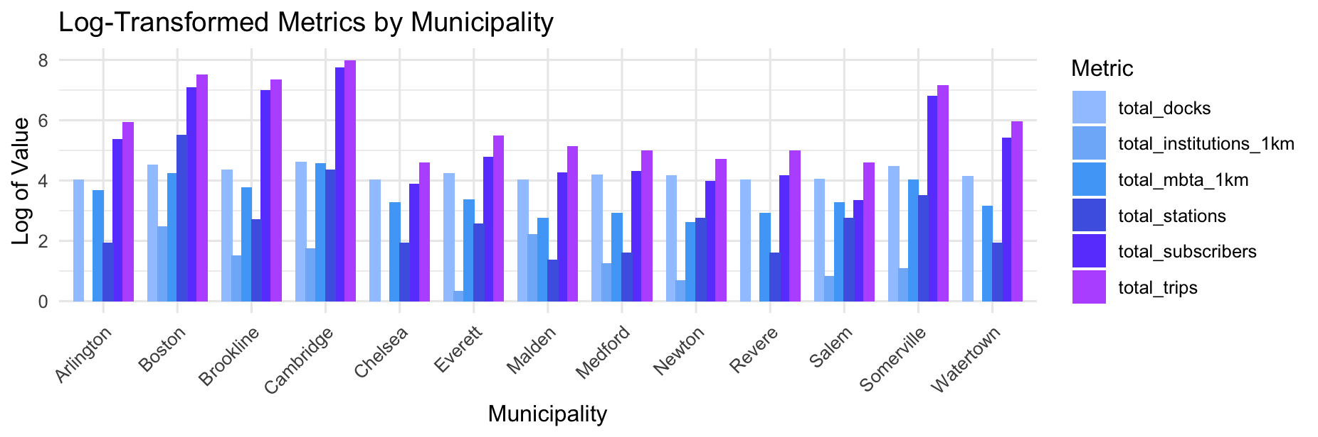
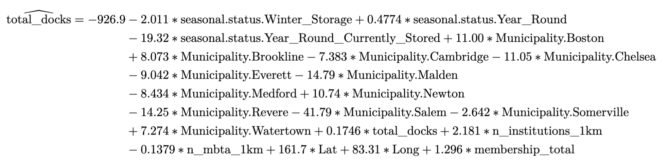
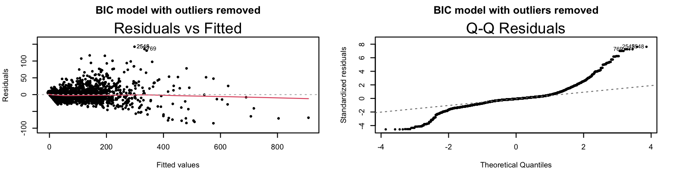
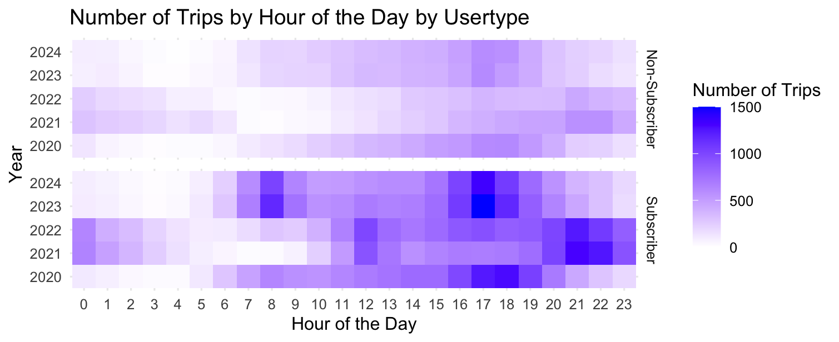
Bluebike Subscriber Summer Usage Pattern
Determinants of a Station’s Popularity
Ashley Kang
Wellesley College Class of 2025 Data Science Major Capstone
Introduction
Results and Model
Background:
Bluebike is a public transportation system centered in the Metro Boston area that offers users over 4,500 bikes from more than 480 stations, ranging from Arlington to Watertown.
Research Question:
What station characteristics and demographic factors contribute to the popularity of Bluebike stations in Massachusetts during the summer months?
Data and Methods
Sources
Bluebike Trips for the summer months from 2020 to 2024
Attributes: start/end stations (station id, trip duration, trip displacement)
Bluebike Station Data
Attributes: station information (total docks, municipality, seasonal status)
Institution Location Data
Attribution: name, location (Lat, Long, State Abbreviations)
MBTA Train Station Data
Attribution: name, location (Lat, Long)
Massachusetts Weather Data
Attributions: TMAX, TMIN, PRCP
Data Manipulation
Merged all the user datasets and added/calculated necessary columns (e.g. year, month, trip duration, trip displacement)
Using the station data, for each station, calculated the number of trips that started/ended at that station, number of trips that were made by subscribers, number of institutions within the 1km boundary, and number of MBTA stations within the 1km boundary
The data is aggregated monthly.
Tested models using a full model and compared them using AIC and BIC for model selection.
Figure 2: Barplot by municipality showing the distribution of five key factors along with total trips as the response variable. We can see that most of the factors are positively correlated with the response variable total_trips.
Based on the observations, the linear model appears to be the best model for predicting the popularity of a station, which I have defined as the total number of trips that started and ended at that station.
Figure 3: Residual v. Fitted plot for the final model. This plot shows that the linearity assumption meets.
Discussion and Conclusion
The average minimum and maximum temperatures, as well as precipitation variables, do not have an impact on the model. This could be due to the consistent summer temperatures over the years, as the temperature during the summer does not vary significantly over years.
Limitation: The relationship between the predictors and the outcome may be non-linear, which standard linear models may not fully capture.
Future work: I can add tourist attractions as a factor since people tend to visit Boston to tour the area.
Figure 1: Heatmap of the number of trips by hour of the day by user type (subscriber vs. non-subscriber)

