Slide 1

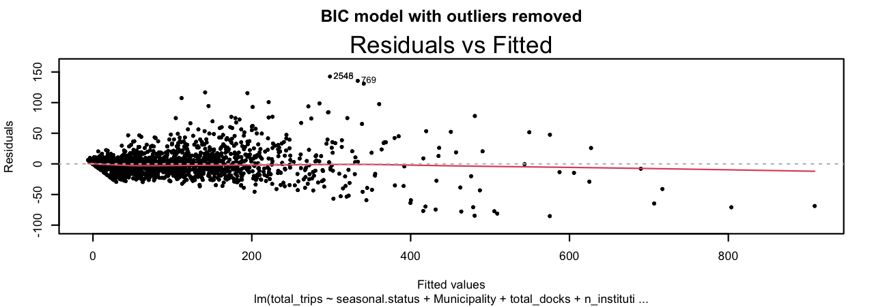
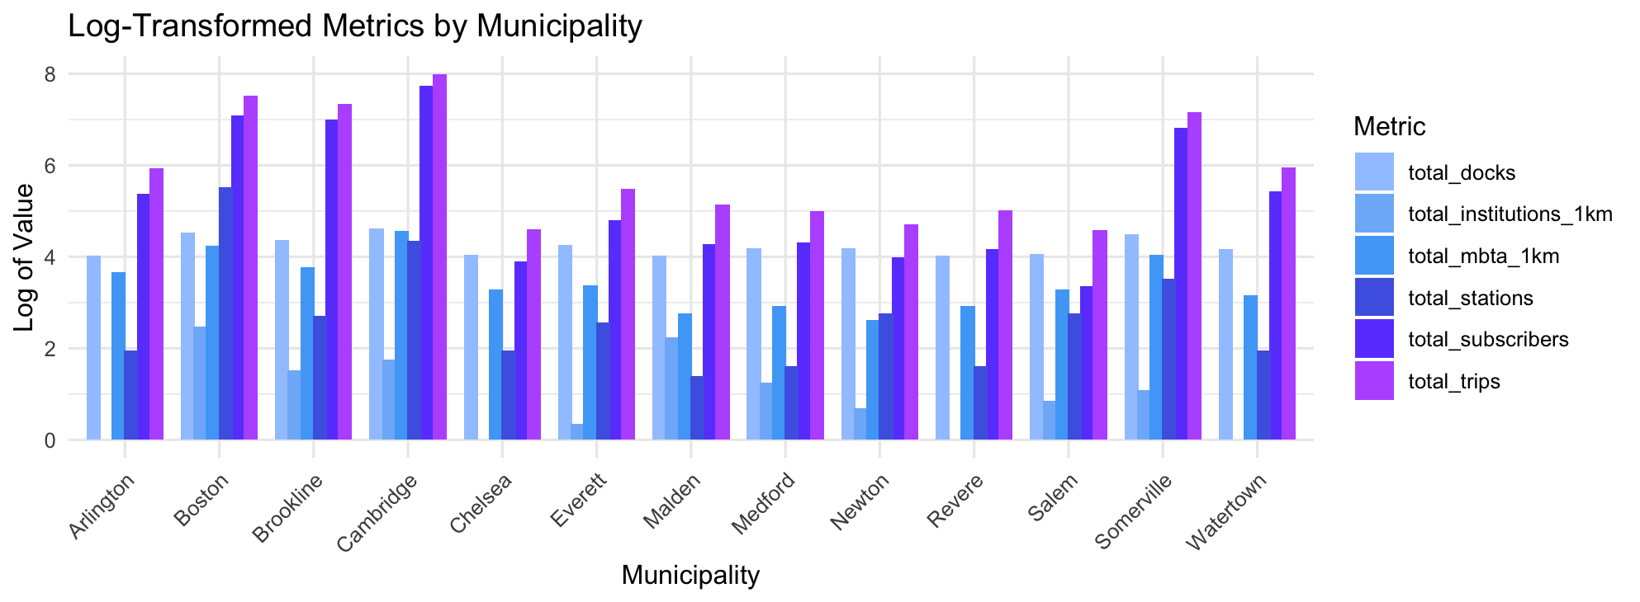
Bluebike Summer Usage Pattern:
Determinants of a Station’s Popularity
Ashley Kang Wellesley College Class of 2025 Data Science Major Capstone
Introduction
Methodology
Background:
Bluebike is a public transportation system centered in the Metro Boston area that offers users over 4,500 bikes from more than 480 stations, ranging from Arlington to Watertown.
Research Question:
What station characteristics and demographic factors contribute to the popularity of Bluebike stations in Massachusetts during the summer months?
STEP 1: Check multicollinearity: remove the ‘population’ variable due to the VIF score being 53
STEP 2: Identify the best first order model by comparing multiple metrics, including the 10-fold CV
 | Full Linear Model | AIC | BIC | BIC outliers Removed
RMSE | 18.798 | 18.829 | 18.831 | 18.721
R squared | 0.965 | 0.965 | 0.964 | 0.965
MAE | 11.539 | 11.544 | 11.515 | 11.476
p | 26 | 23 | 21 | 21
Data Cleaning
Sources:
Bluebike Station Data
Indiv. station information: total docks, municipality, seasonal status, location (lat. / long.)
Bluebike 2020-2024 trip history for the summer months (June through Sept.)
Indiv. trip information: total duration, user’s membership status, start/end station
Higher Educational Institution Data
US institution information: name, location (lat. / long.), state abbreviations
MBTA Train Station Data
Individual station information: name, location (lat. / long.)
Massachusetts Weather Data
avg. minimum temperature, avg. maximum temperature, avg. precipitation
Used separate datasets (above/below the Charles) due to limited datasets
New variables:
Trip Duration (Numeric)
Trip Displacement (Numeric)
Population (Numeric)
n_institution_1km (Numeric): institutions within 1km of the station
n_mbta_1km (Numeric): MBTA stations within 1km of the station
Data Manipulation:
Dimensions: 8800 observations x (27 predictors + 1 response)
Aggregated monthly
Removed rows with missing and non-imputable station information
Tested Full, AIC, and BIC first-order models for model selection
Table 1: Table for comparing the four models. We can see that the all three metrics don’t vary much by model, but the BIC model with the significant outliers removed tends to be slightly better.
STEP 3: Check the assumptions for the best model
Figure 2: The larger cluster observed in the plot corresponds to a higher concentration of observations in Boston, Cambridge, and Somerville. This grouping is expected, given the greater number of data points from these municipalities. Despite this, the residuals appear to be evenly distributed around the zero line across the range of fitted values, suggesting that the model satisfies the constant variance assumption.
Results and Model
Based on the observations, the linear model appears to be the best model for predicting the popularity of a station, which I have defined as the total number of trips that started and ended at that station.
Predictor | Coefficient | Predictor | Coefficient | Predictor | Coefficient
Intercept | -926.9 | Municipality - Revere | -14.25 | Municipality - Watertown | 7.274
Seasonal status: winter storage | -2.011 | Municipality - Salem | -41.79 | Total Docks | 0.1746
Seasonal status: year round currently stored | -19.32 | Municipality - Somerville | -2.642 | Institutions within 1km of the Station | 2.181
Municipality - Cambridge | -7.383 | MBTA Stations within 1km of the Station | -0.1379 | Latitude | 161.7
Municipality - Chelsea | -11.05 | Seasonal status: year round | 0.4774 | Longitude | 83.31
Municipality - Everett | -9.042 | Municipality - Boston | 11 | Number of Trips made by Subscribers | 1.296
Municipality - Malden | -14.79 | Municipality - Brookline | 8.073
Municipality - Medford | -8.434 | Municipality - Newton | 10.74
Figure 3: the The linearity and equal variance assumptions are broadly met.
Table 2: Table of my final model’s predictors and coefficients. Positive coefficients are highlighted in blue, and negative coefficients are highlighted.
Discussion and Conclusion
Discussion: The weather related variables do not have an impact on the model. This could be due to the consistent summer temperatures over the years, as the temperature during the summer does not vary significantly over years.
Limitation & Future Work: The relationship between the predictors and the outcome may be non-linear, which standard linear models may not fully capture. I will propose the Random Forests method to better capture complex, non-linear patterns in my predictors. Also for a better prediction, I can add tourist attractions as a factor since people tend to visit Boston to tour the area.
Figure 1: Barplot by municipality showing the distribution of five key factors logged along with total trips as the response variable. We can see that most of the factors are positively correlated with the response variable total_trips.

