Slide 1

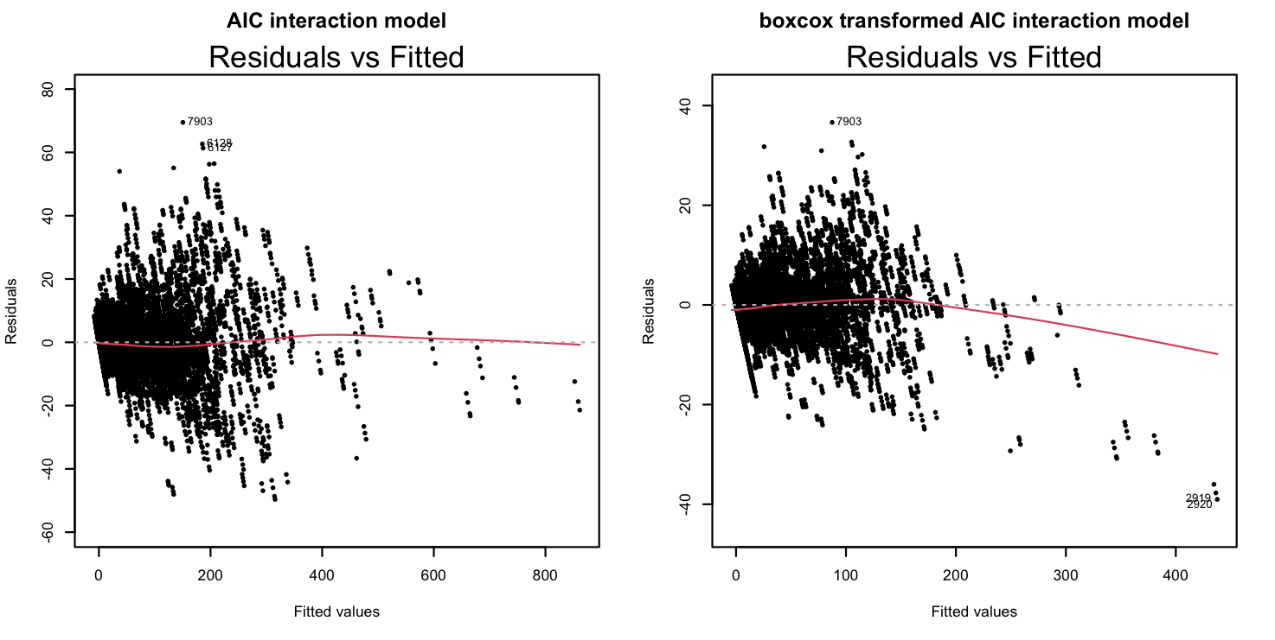
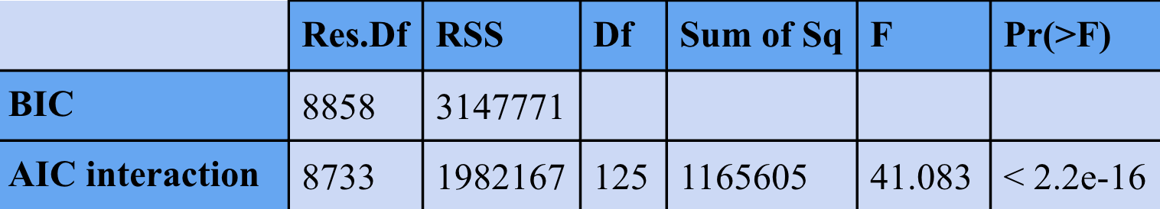
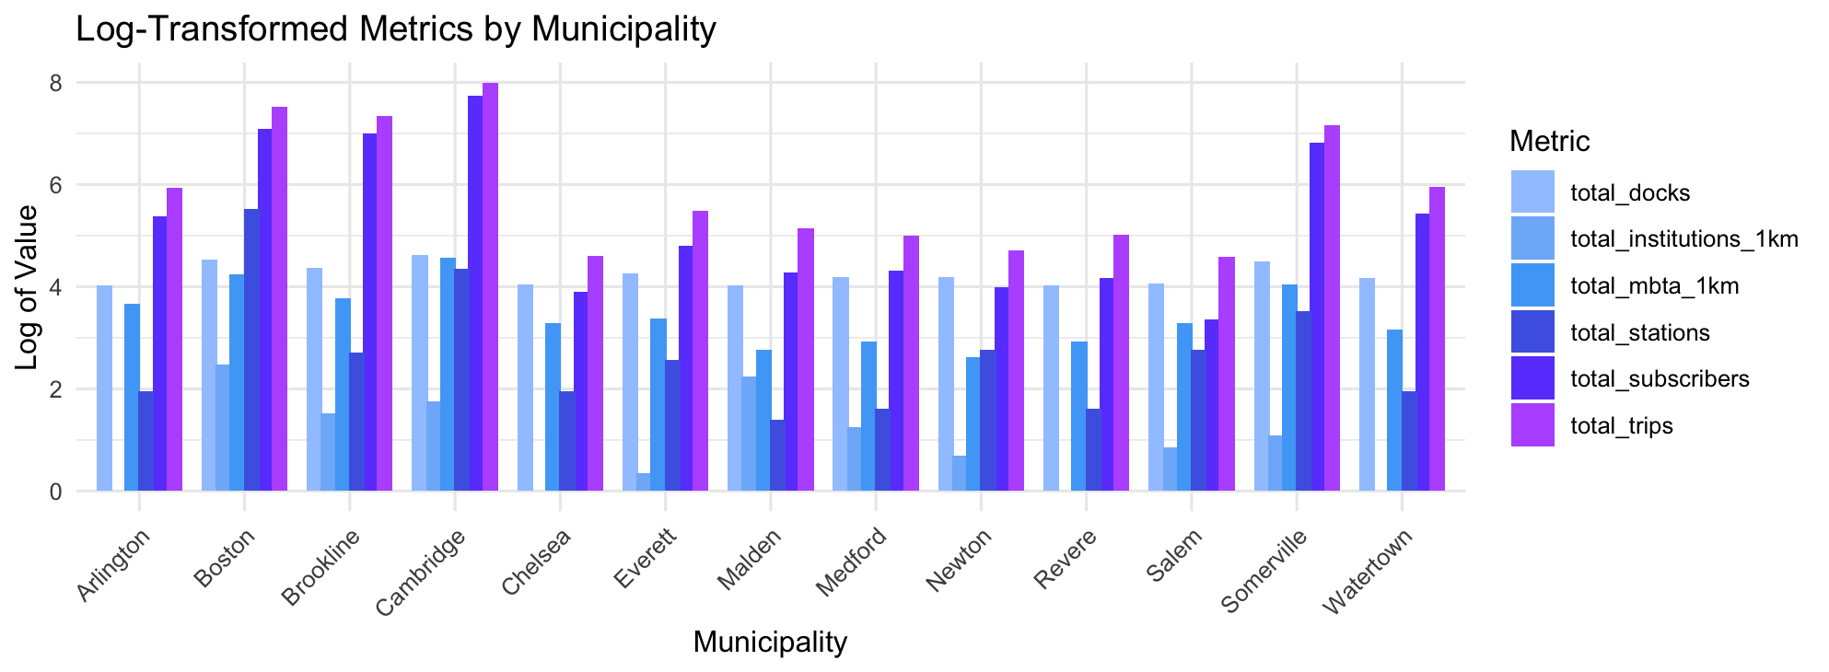
Bluebike Summer Usage Pattern:
Determinants of a Station’s Popularity
Ashley Kang Wellesley College Class of 2025 Data Science Major Capstone
Introduction
Methodology
Background:
Bluebike is a public transportation system centered in the Metro Boston area that offers users over 4,500 bikes from more than 480 stations, ranging from Arlington to Watertown.
Research Question:
What station characteristics and demographic factors contribute to the popularity of Bluebike stations in Massachusetts during the summer months?
STEP 1: Check multicollinearity: remove the ‘population’ variable due to the VIF score being 53
STEP 2: Identify the best first order model by comparing multiple metrics, including the 10-fold CV
 | Full Linear | AIC | BIC | BIC no outliers | AIC interaction | AIC interaction no outliers | BIC interaction
RMSE | 18.798 | 18.829 | 18.831 | 13.922 | 15.071 | 11.155 | 15.470
R^2 | 0.965 | 0.965 | 0.964 | 0.973 | 0.977 | 0.984 | 0.976
MAE | 11.539 | 11.544 | 11.515 | 9.326 | 9.474 | 7.621 | 9.742
p | 26 | 23 | 21 | 21 | 146 | 146 | 65
Data Cleaning
Sources:
Bluebike Station Data
Indiv. station information: total docks, municipality, seasonal status, location (lat. / long.)
Bluebike 2020-2024 trip history for the summer months (June through Sept.)
Indiv. trip information: total duration, user’s membership status, start/end station
Higher Educational Institution Data
US institution information: name, location (lat. / long.), state abbreviations
MBTA Train Station Data
Individual station information: name, location (lat. / long.)
Massachusetts Weather Data
avg. minimum temperature, avg. maximum temperature, avg. precipitation
Used separate datasets (above/below the Charles) due to limited datasets
New variables:
Trip Duration (Numeric)
Trip Displacement (Numeric)
Population (Numeric)
n_institution_1km (Numeric): institutions within 1km of the station
n_mbta_1km (Numeric): MBTA stations within 1km of the station
Data Manipulation:
Dimensions: 8800 observations x (27 predictors + 1 response)
Aggregated monthly
Removed rows with missing and non-imputable station information
Tested Full, AIC, and BIC first-order models and interaction models for model selection
Table 1: Table for comparing the six models. We can see that the all three metrics don’t vary much by the non-interactive model, but the AIC model with interaction tends to be slightly better with the lowest RMSE, highest R squared, and lowest MAE. The threshold for determining the outliers is 4/n.
STEP 3: Check the assumptions for the best model, which is the AIC interaction model with outliers removed
Figure 2: This is a plot of the AIC interaction model with outliers removed and transformed using the Box-Cox method. This transformation is better as the vertical spread is more stable compared to the one before transformation. The larger cluster observed in the plot corresponds to a higher concentration of observations in Boston, Cambridge, and Somerville. This grouping is expected, given the greater number of data points from these municipalities. Despite this, the residuals appear to be evenly distributed around the zero line across the range of fitted values, suggesting that the model satisfies the constant variance assumption.
STEP 4: Conduct a partial F test to compare the AIC interaction model with the first-order BIC model (these two models are nested) to determine if the interaction terms are necessary.
Table 2: This is the table of the anova result of the first order BIC model and the AIC interaction model. From this table, we can calculate the partial F-stat, which is 41.0832, which ends up having the p value of 0.
Results and Model
Based on the observations, the interactive model appears to be the best model for predicting the popularity of a station.
Predictor | Coefficient | Predictor | Coefficient | Predictor | Coefficient
Intercept | 5628000 | n_institutions_1km:n_mbta_1km | 0.1646 | n_institutions_1km:Long | -54.46
Longitude | 79180 | n_institutions_1km | -4055 | avg_TMIN:avg_TMAX | -0.09651
Lat:membership_total | 2.868 | Latitude | -109600 | Lat:Long | -1537
Long:membership_total | 2.801 | n_mbta_1km:membership_total | -0.00719 | total_docks:n_mbta_1km | -0.03006
Table 3: Table of my final model’s predictors and coefficients (only included the predictors with the most significant p-value)
Positive coefficients are highlighted in blue, and negative coefficients are highlighted.
Discussion and Conclusion
Discussion: The weather related variables do not have an impact on the model. This could be due to the consistent summer temperatures over the years, as the temperature during the summer does not vary significantly over years.
Limitation & Future Work: I was able to find out that the relationship between the predictors and the outcome are non-linear, but there might be other methods I could try to better capture complex, non-linear patterns in my predictors. Also for a better prediction, I can add tourist attractions as a factor since people tend to visit Boston to tour the area.
Figure 1: Barplot by municipality showing the distribution of five key factors logged along with total trips as the response variable. We can see that most of the factors are positively correlated with the response variable total_trips.

