Slide 1
A Greener Emerald City
UTEK 2023: Programming
Team 3: Winnie Hsiang,
Ashley Leal,
Zuha Mujib,
Danelle D’Souza
Notes:
UTEK.ipynb - Colaboratory (google.com)

Slide 2
Table of Contents
01
03
02
Part 1: Graph Construction
Part 3: Optimal Path and Time
Part 2: Optimal Path

Slide 3
01
Part 1: Graph Construction

Slide 4
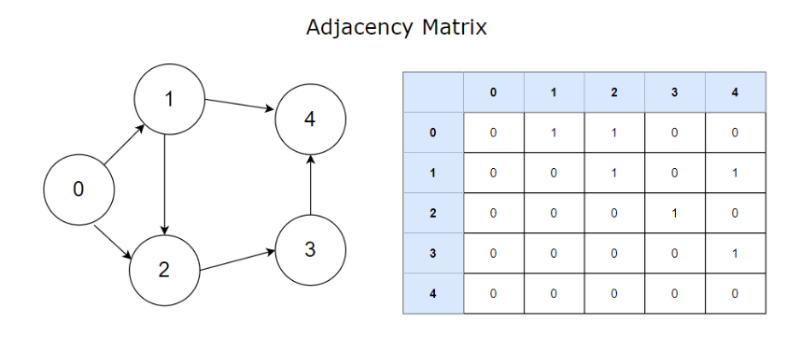
THE PROBLEM
Data on the connections between intersections is provided in a way that could be made much clearer
One method would be graphical representation (left),
However, the mayor is requesting that we create a program that will create a matrix relaying the same information (right)

Slide 5
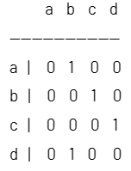
THE GOAL
Input
Output
Organizing pairs of intersections into an adjacency matrix in the most efficient manner
Code written in Python
String-handling
Avoiding direct handling of dynamically allocated memory
An array
Pairs of intersections (Ex. a->b, b->c, c->d, d->b)

Slide 6
BREAKING DOWN THE PROBLEM
The data is provided in a way that can be read easily by humans, but not so easily by computers
Solution: parsing the input to create pairs
The names of intersections may differ, causing our array to not align properly
Solution: iterating through unique names from the input to find the longest name and creating appropriate buffers

Slide 7
THE OVERALL SOLUTION
Start
Create an empty 2D array (matrix)the names of the intersections displayed as the row and column titles
Iterate through the matrix to identify the pairs within the matrix (replace 0s with 1s for correct pairs)
User input
Parse input
Adjacency Matrix
Organize the pairs of intersections (ex. a->b becomes a tuple where “start” = a and “end” = b)
Longest string and its length, list of unique strings
End

Slide 8
EDGE CASE HANDLING
Intersection names of varying length
The longest name is used to create buffer among the intersection names along the first column
Each name is considered when adding buffer along all other columns
Invalid user input
An error message is displayed
Single path inputted
The method of creating our array and storing pairs ensures that an appropriately sized array is displayed regardless of number of paths inputted

Slide 9
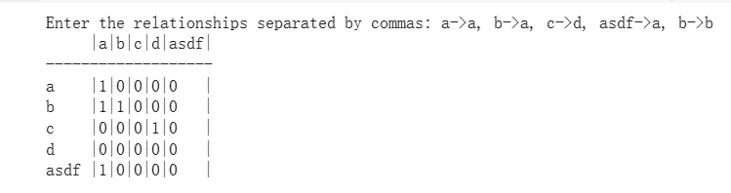
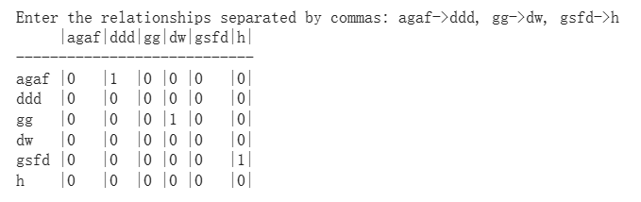
Examples edge cases
When we have input a->a
When we have a long input: asdf

Slide 10
02
Part 2: Optimal Path
Notes:
Now, Winnie and I will be explaining how we arrived at our solution for part 2

Slide 11
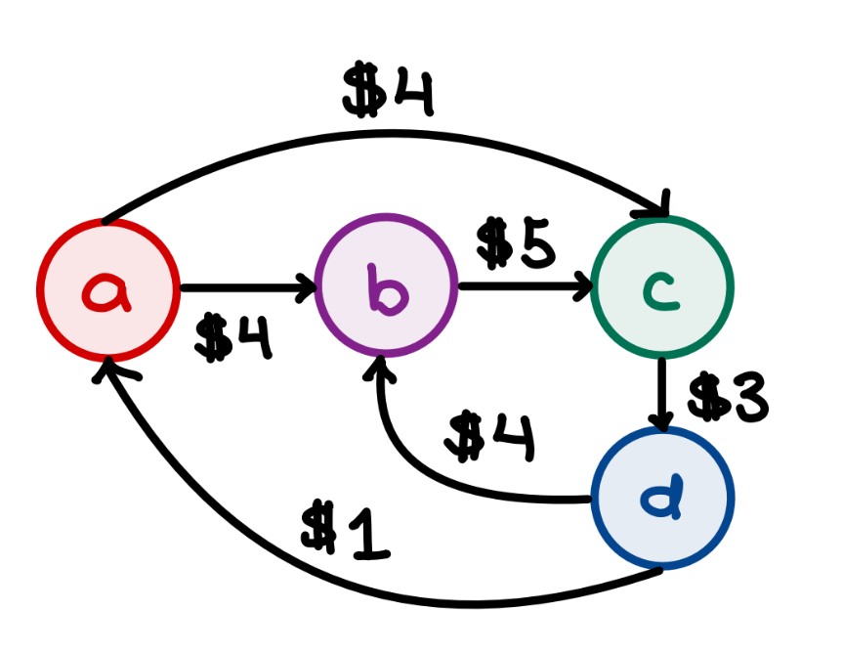
THE PROBLEM
Find the most cost-effective route from a starting point to an endpoint, making sure to visit every node at least once.
Notes:
For part2, the user inputs relationships, similar to part 1, but now each node traversal also has an associated cost. Now our goal is to find the most cost effective path from a given start node to a given endpoint with the condition that every node (or intersection) must be visited at least once.

Slide 12
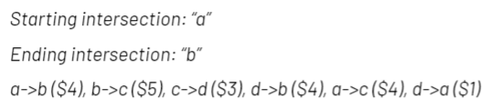
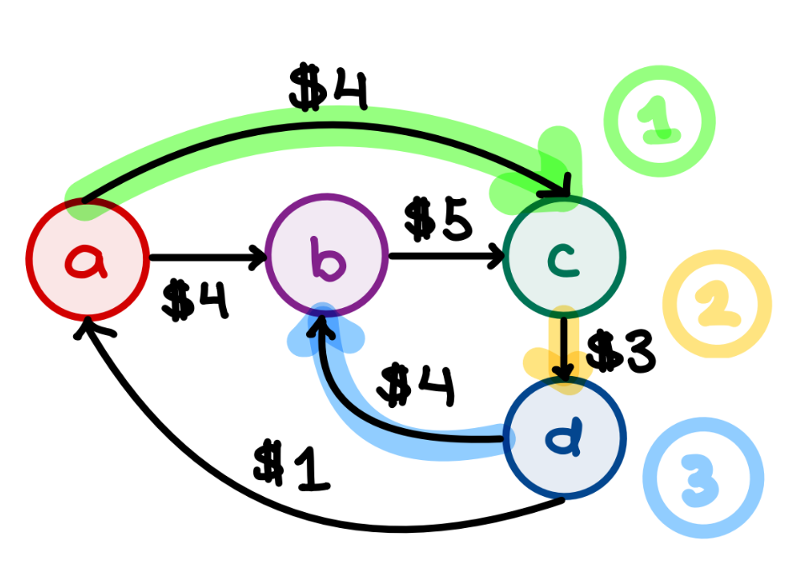
THE PROBLEM (cont.)
In this example, the best path is:
a->c, c->d, d->b
Cost: $11
Notes:
In this example, the user is trying to travel from node a to node b. The best valid path is a to c, c to d and finally d to b. There is a shorter and significantly cheaper path, which is the one directly connecting a and b, however this path is considered invalid because it doesn’t visit all of the nodes at least once.

Slide 13
THE THOUGHT PROCESS
INPUT
- Starting Intersection
- Ending Intersection
- Path Input (eg. a->b ($4), b->c ($5)...)
Parse Input
Start
OUTPUT
- Minimum cost path
(eg. a->c, c->d, d->b)
- Cost
Recursive algorithm
End
Notes:
In order to use our time effectively for this problem, we split up this problem into well defined parts. So, this is a very high level flow chart of our thought process. We recognized that the first task is to handle the user input. Similar to part 1, the user input is in the form of a long string with unneeded characters, so we have to parse this input and extract node connections as well as their associated cost. Then, we concluded that a recursive algorithm would be necessary to determine the minimum cost path. We chose to use a recursive algorithm so that we could go through every possible path and use backtracking to determine the valid path with the lowest cost. Finally, the program outputs the minimum cost path as a series of subpaths or node connections along with the cost of this path.

Slide 14
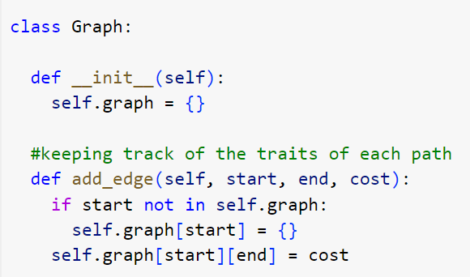
THE SOLUTION: DEFINE A GRAPH CLASS
Sets up an empty dictionary to store graph properties
add_edge is a method within the Graph class that sets up an edge with a given start node, end node, and cost
Edge: a connection between two nodes in a Graph

Slide 15
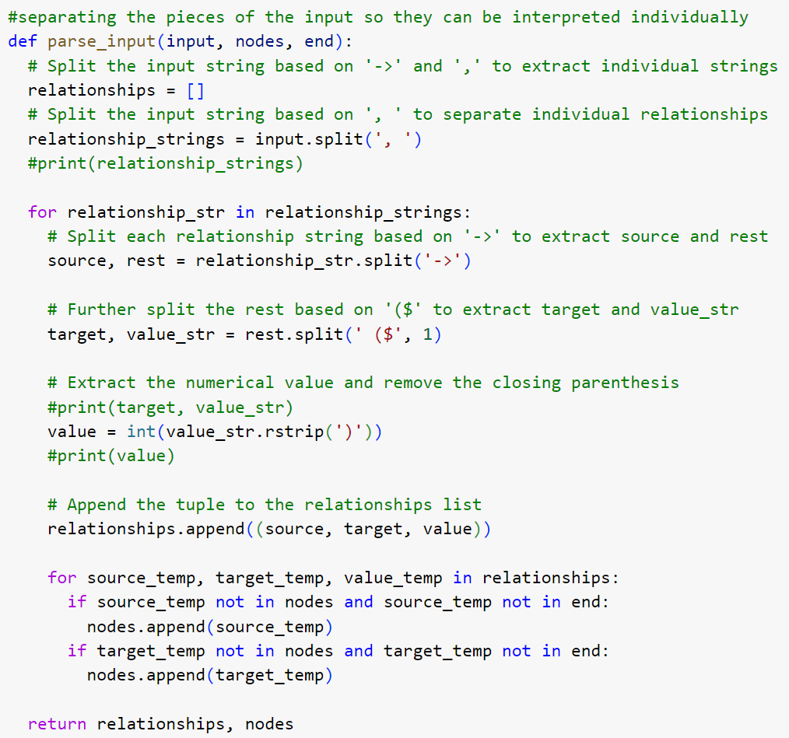
THE SOLUTION: PARSE INPUT FUNCTION
Extract start and end nodes of each subpath from the user’s input using string methods

Slide 16
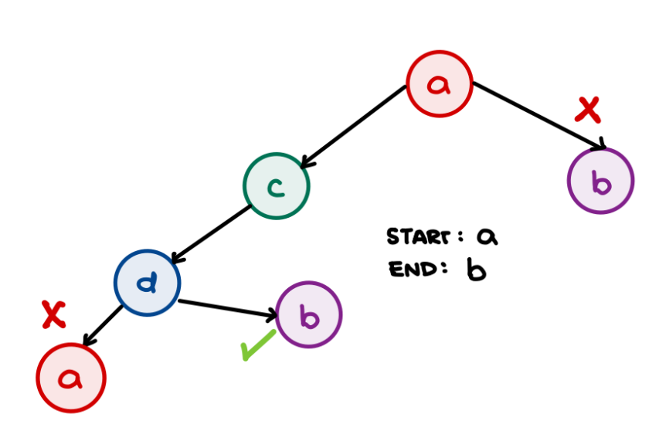
THE SOLUTION: RECURSIVE ALGORITHM
Backtracking recursive algorithm to explore all possible paths
Minimum cost is updated as algorithm finds new valid paths
Calculates cost of each valid path and compares it to the “current” minimum

Slide 17
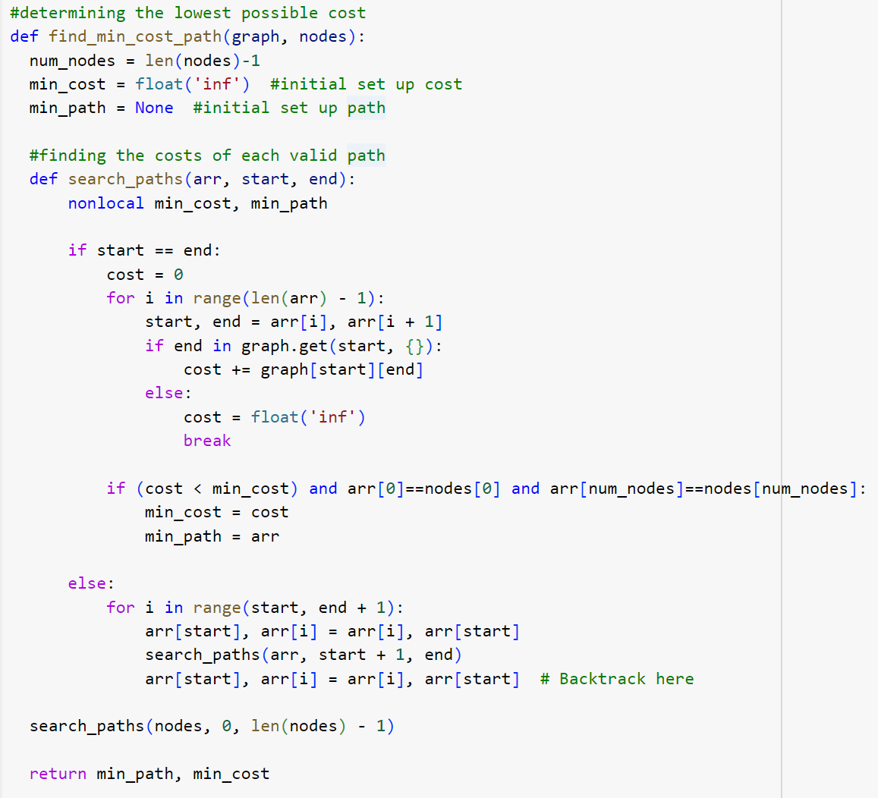
THE SOLUTION: RECURSIVE ALGORITHM
Recursive base case:
All possible paths have been explored
Minimum cost path is found among them

Slide 18
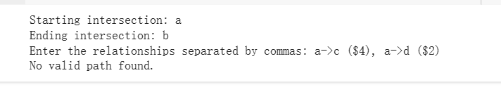
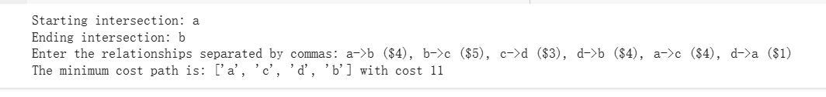
HANDLING EDGE CASES
When there is no valid path found. (No a->b)
When there are several paths found.

Slide 19
03
Part 3: Optimal Path and Time

Slide 20
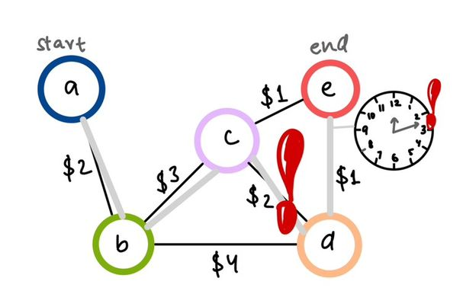
THE PROBLEM
What about the cooldown period, time to reach an intersection?
All node connections have a cooldown period

Slide 21
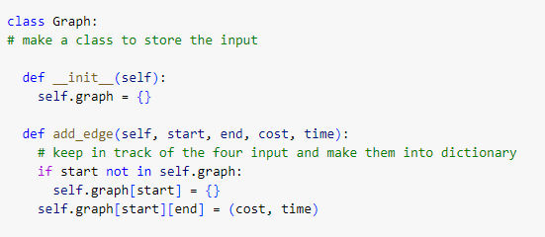
THE SOLUTION: OPTIMIZED PATHFINDING TIME TO COST
Updating add_edge to set up a connection between nodes with time

Slide 22
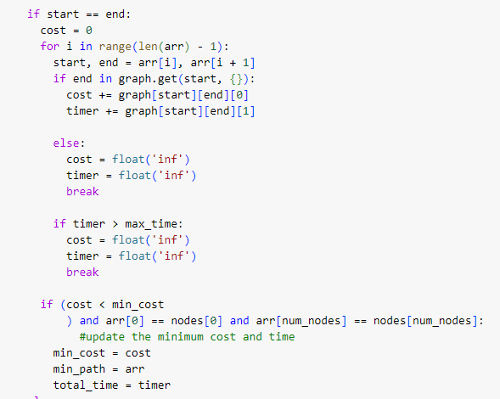
THE SOLUTION:
Checking for time first and then the minimal cost.
‘Timer’ calculated with cost
Recursive call to backtrack all possibilities

Slide 23
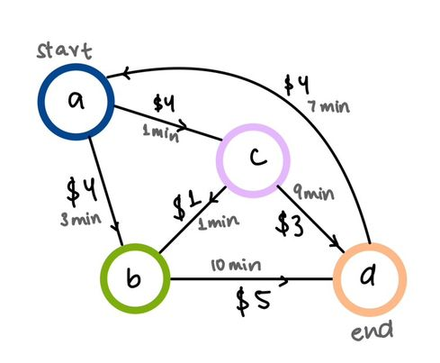
FEASIBLE COST BUT INSUFFICIENT COOLDOWN TIME
maxTime = 11 mins
best path:
a->c->b->d
Cost: $10
Time: 11 mins
maxTime = 2 mins
best path: []
No valid path
Cost: -1
Time: -1
Notes:
Imagine being called at 2 am by the mayor about an issue faced…the path with the lowest coost for power transfer between intersections was considered but each path between two nodes also have a cooldown period. Give power transfer between nodes The cooldown period provides a necessary buffer to ensure that the system has enough time to adjust and stabilize after each path and preventing the risk of overloading transmission lines therefore giving it precedence over the cost.
//As shown in the diagram the shortest path reaching all nodes with the lowest cost is connected with the grey path but looking at the time as we
To tackle this problem we recognized that it required looking for all possible paths while keeping the cost the lowest and staying inside the max time provided, so we decided to update our code for part 2 to handle the time problem as well and edded cases to it accordingly.
In the class Graph as mentioned by Ashley/Winnie before we updated the add_edge function that set up the connection between the nodes and added the time for each path inputted into to it. We tuppled it with the cost to make sure they are in the same position in the matrix created for the cost in the previous part.
We added a timer to calculate the time it takes for each possible pathway and compared it with the maxTime provided making sure it is a valid pathway(the path which we have time provided for) and make the recursion call to discover all possibilities for the paths but do remember to check for the case when the start and end node is the same and exchangin the positions at the end to make sure the path going in the opposite direction between two nodes can also be considered.
Tested for our own created test cases and the ones provided to ensure our code was working
We considered the case where none if the paths were within the maxTime provided as shown in the example:

Slide 24
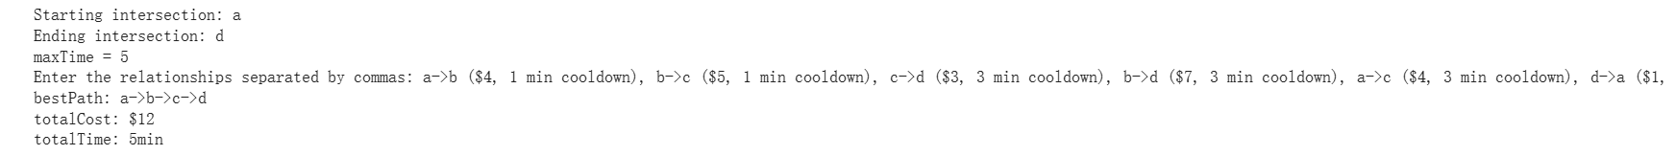
Example Edge Cases
When we have no path within the time limit:
Although cheapest path is a->c->d, but it violates the time constraint

Slide 25
SOURCES
PARSING INPUT:
https://www.w3schools.com/python/python_ref_string.asp
RECURSIVE ALGORITHM:
https://www.geeksforgeeks.org/min-cost-path-dp-6/
https://www.programiz.com/dsa/backtracking-algorithm
https://www.javatpoint.com/mini-max-algorithm-in-ai

Slide 26
THANK YOU !
Do you have any questions?

