Slide 1

CareerStar
How I spec-built a ratings agency with a team of AI agents.
BUILT WITH BMAD — SPEC-DRIVEN DEVELOPMENT
Ashley Libasci
Math + CS, UIUC ’27 · ashleylibasci.com
Capital One · August 6, 2026
Notes:
Hi, I'm Ashley. This summer I built a ratings agency for careers. The site's fine — but the part I actually want to show you is how it got built, because the workflow is more interesting than the product. Quick tour of the thing, then the build. (0:45)

Slide 2

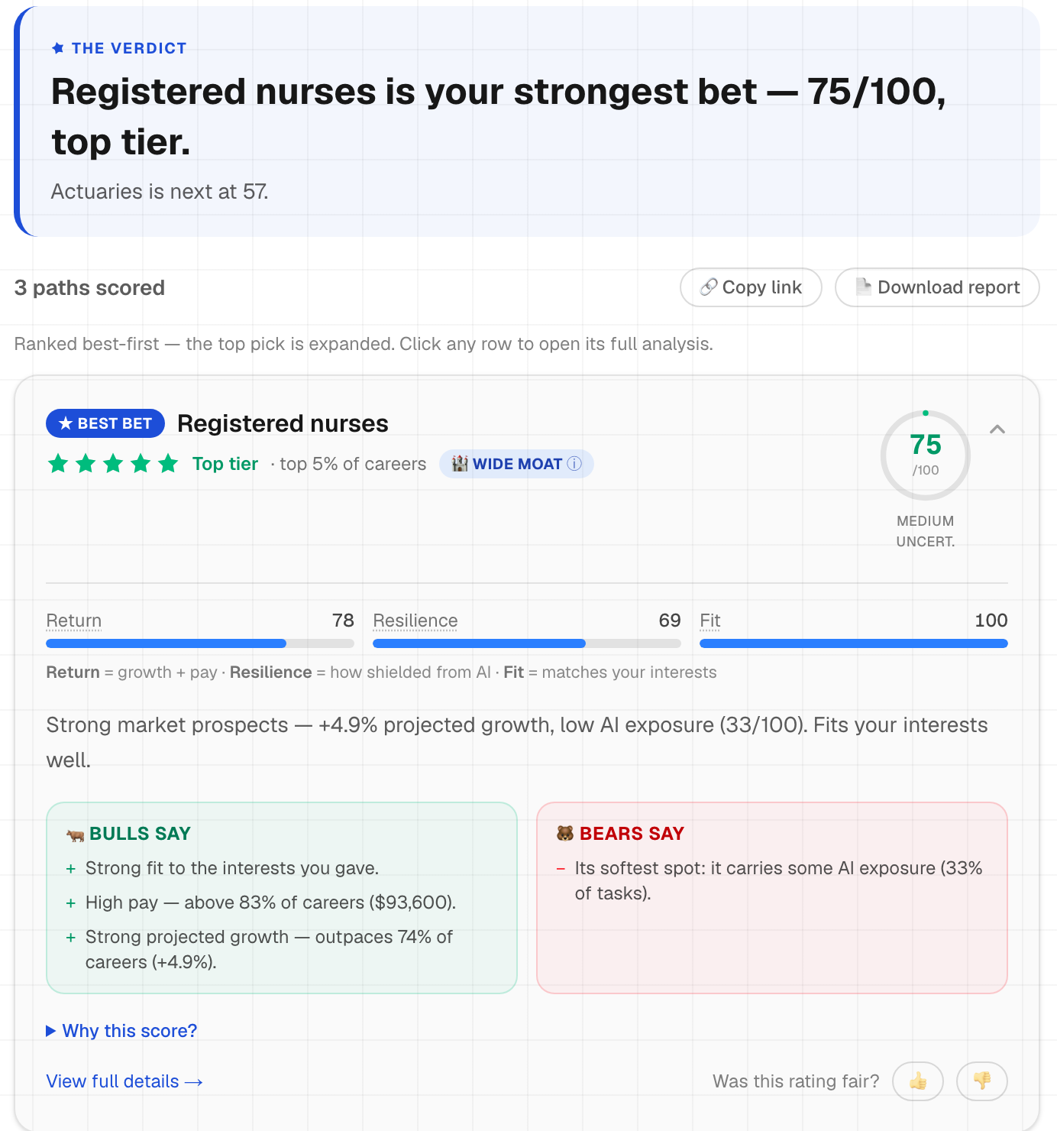
CareerStar rates careers the way you rate assets
01 · THE THING ITSELF
730
U.S. occupations, every one rated
5
rival scoring models, swappable live
10%
of careers earn five stars — it’s a forced curve
The product is the demo. The build is today’s story.
ashleylibasci.com/rate — live, as shipped
2
Notes:
Ninety seconds so the rest makes sense. Every U.S. occupation gets a 0-100 score, same shape as a risk-adjusted return. Stars on a forced curve, moats borrowed from Morningstar, and you can swap the scoring model live. That's the product. Now the actual talk. (1:00)

Slide 3
There’s a name for how this was built
02 · THE METHOD
BMAD
Breakthrough Method for Agile AI-Driven Development — open source, agent-based.
Spec-driven development: write the spec first. The AI codes to the contract.
What that means in practice
Requirements, architecture, and acceptance criteria exist before any code does — every agent works against them.
What it isn’t: vibe coding
Prompt as you go, context evaporates. Fine for a weekend hack, fatal for a real system.
My first project with it. It converted me.
3
Notes:
When people hear 'AI wrote most of my code' they picture vibe coding: prompt, paste, pray. This is the other school. The framework is BMAD — open source, agent-based — and the school it belongs to is spec-driven development: you write the contract first, then the AI codes against it. First project I've built with it, and it converted me. Next two slides are what it actually looks like. (1:00)

Slide 4
The pipeline: plan it, build it, attack it
03 · BMAD
PLAN
A PM agent interrogated the idea into a PRD. An architect agent locked 7 invariants the code must never break.
1 PRD · 7 invariants
BUILD
A dev agent coded story by story against acceptance criteria, tests first — the whole backlog, to done.
7 epics · 28 stories · 35 tests
ATTACK
A cast of reviewer personas tears into every change. A retro after each epic feeds the next one.
review after every change
→
→
The invariant that mattered most —
“The LLM never computes a number.”
Locked in the architecture before a line of scoring code existed.
4
Notes:
Three phases, and every number on this slide is a file in the repo. Plan: the PM agent keeps asking why — my fluffy answers died in that interview, and the PRD was better than anything I'd have written alone. The architect locked seven invariants, and the big one: the LLM never computes a number. Build: seven epics, twenty-eight stories, thirty-five tests. Attack: next slide. (2:00)

Slide 5
My code reviews are a room full of arguing characters
04 · BMAD PARTY MODE
The cast
What they caught
a hiring manager asking what interviewers will ask
a fact-checker tracing every number to a file
a copy chief deleting machine-sounding prose
a QA lead, a design critic, one professional grump
The fit overclaim. My methodology page described skill-vector matching before the vectors were wired in. Caught, rebuilt, then published as the story of the catch.
The buried back-test. The hiring-manager persona fought twice to keep my strongest evidence above the fold. It was right.
They argue with each other. I judge.
Even this deck went through that room.
5
Notes:
BMAD calls this party mode, and it's the part that hooked me. Reviews aren't one agreeable AI saying 'great job' — they're personas with opposite priorities fighting it out, and I judge. Best catch: my own methodology page overclaimed how fit worked. Caught in review, rebuilt right, then published the story of the catch — now the strongest section of my case study. And yes — this deck went through the same room. Fun fact for Q&A: that review caught a half-finished sentence on this very slide. (1:30)

Slide 6
Same AI. Opposite discipline.
05 · THE DIFFERENCE
VIBE CODING
SPEC-DRIVEN
Prompt, paste, pray
Spec first: PRD, architecture, stories
Accept whatever runs
35 deterministic tests, CI on every push
One agreeable assistant
A cast of adversarial reviewers
The LLM does the math
The LLM never computes a number
Claims
A back-test, a robustness grid, an open CSV
AI typed most of this project. The discipline is the difference.
6
Notes:
I won't pretend AI didn't type most of this — that's the point. The difference isn't the tool. It's whether a spec exists before the prompt, tests after it, an adversarial pass before shipping, and a human who can defend every decision. (1:00)

Slide 7
The three questions under every rating
06 · THE IDEA
What do you get?
Growth and pay — how fast the career is growing, and what it pays.
BLS projections
What can kill it?
How much of the day-to-day work AI can already do.
AI-exposure research
Does it fit you?
The job’s real skill profile, matched to your interests.
O*NET database
7
Notes:
Back to the product — this is how you'd size up a stock, asked about a career. What do you get: growth and pay, from BLS. What can kill it: AI, from published exposure research. Does it fit you: real skills data from O*NET. Three questions, three public datasets. Next: those sentences written down — and then the decisions that shaped the math. (1:00)

Slide 8
Those three sentences, written down
07 · THE FORMULA
Return = ½ growth + ½ pay
what you get — each as a rank against all 730
Risk = 0.7 AI + 0.3 volatility
what can kill it
Value = Return × (1 − 0.6 Risk)
reward, discounted by risk
Score = 70% Value + 30% Fit
blend in the match to you — out of 100
None of these shapes is a default. Every line beat an obvious alternative — that argument is the next slide.
8
Notes:
Read it top to bottom: what you get, what can kill it, discount one by the other, blend in fit. Don't defend the constants yet — that's the next slide's job. Just land that the whole model is four lines you can read aloud, and every ranking on the site comes from these four lines and nothing else. (0:45)

Slide 9
Each line is a decision, not a default
08 · THE DERIVATION
Ranks, not raw units
You can’t average a percent and dollars. Every input becomes a percentile against all 730 — so a score means “versus every alternative you could pick.”
shapes Return
Multiply risk, don’t subtract it
Subtraction lets a safe dead end beat a risky rocket on safety alone. Risk discounts the reward instead — and 0.6 caps it, so risk erases at most 60% of return, never all of it.
shapes Value
Priors, not fitted constants
There’s no dataset of correct career choices to train on. So the weights are judgment calls said out loud — re-scored 729 times, checked by five rival formulas, labeled “close call” when the answer flips.
shapes the weights
9
Notes:
This is the slide for 'why this design over the obvious one.' Ranks, because you can't average a percent and dollars — and because the real question is versus your alternatives. Multiply, because subtracting risk lets a safe dead end win on safety alone. And priors, because there's nothing to fit on — no labeled dataset of correct career choices exists — so instead of pretending precision I declare the constants and stress-test them: 729 perturbations, five rival models, close calls labeled. If they remember one slide of math, make it this one. (1:30)

Slide 10
I tested it on a decade that already happened
09 · THE RECEIPTS
0.39
48%
37 vs 46
~0
rank correlation vs
what really happened
of real decliners flagged
(33% by chance)
median 2014 score —
decliners vs growers
added by the AI term —
correct: no LLMs in 2014
Me, volunteering the awkward number:
The government’s plain projections beat my full model on that decade, 0.411 to 0.39. That’s the model working — the AI term is a bet about the coming decade, and the tested one had no LLMs in it.
And the back-test never tunes the weights: fit to the test and it stops being a test.
10
Notes:
Slow down here. I pulled the 2014 BLS projections from the Internet Archive, scored 2014's job market with today's formula, and graded it against what happened by 2024 — 647 occupations. It works: decliners flagged at 48% versus 33% by chance. Then I volunteer the awkward number before anyone asks: plain BLS beat my full model. And that's the model working — no LLMs existed, the AI term had nothing to price. Held out, never fitted. (1:30)

Slide 11
Deploying it taught me more AWS than the practice exams
10 · THE INFRASTRUCTURE
CODE
GitHub. Push to main — that’s the whole release process.
ENGINE
AWS Amplify builds the Next.js app and runs the server-rendered parts.
EDGE
CloudFront serves it worldwide; Route 53 holds ashleylibasci.com.
→
→
Cloud Practitioner concepts this made real
★ managed services
★ edge caching
★ shared responsibility
★ DNS + certificates
Studying for the cert now — this is where the flashcards became things I’d actually debugged.
11
Notes:
Push to main, Amplify builds, CloudFront serves from the edge, Route 53 holds the domain. The whole pipeline is a git push. I'm studying for Cloud Practitioner, and this is where the flashcard concepts became real things I'd debugged. Speaking of shared responsibility — next slide is my favorite bug of the summer. (1:30)

Slide 12
The rate limiter that never fired
11 · WAR STORY
1
What I did
Keyed rate limits on the last X-Forwarded-For hop — the textbook advice, since everything left of it is forgeable.
2
What production did
30 rapid requests. Zero rate-limit hits. Every request got a fresh bucket.
3
Why
Amplify’s router appends CloudFront’s own IP after the client’s. The “last hop” was never the client — it was Amazon.
4
The fix
Second-to-last hop, a global cap as backstop, and a regression test pinning the header shapes.
Practice exams don’t teach proxy chains. Production does.
12
Notes:
My favorite bug. I did the textbook thing — trust the last X-Forwarded-For hop. Then production: thirty rapid requests, zero rate limits. Amplify's router was appending CloudFront's own edge IP after the real client IP, so the last hop was never the client. It was Amazon. Fix: second-to-last hop, global backstop, regression test pinning the exact header shapes. Forty seconds of story, a semester of networking. (1:30)

Slide 13
Three things worth stealing
Write the spec before the prompt
2034
I re-run the back-test on the 2024–34 decade and publish how my ratings aged.
Ratings agencies should eat their own cooking.
the discipline, not the model, is what made this work
Publish what your model gets wrong
the awkward numbers bought more trust than the good ones
Pick tools that make rigor fun — mine was BMAD
fun is load-bearing — review you enjoy is review you run
Thanks — questions? ashleylibasci.com · github.com/ashleylibasci/careerstar
Notes:
Three things worth stealing: write the spec before the prompt. Publish what your model gets wrong — the awkward numbers bought me more trust than the good ones. Pick tools that make rigor fun — mine was BMAD — because fun is load-bearing. And in 2034 I re-run the back-test on the decade my model actually bet on, and publish how the ratings aged. Ratings agencies should eat their own cooking. Thanks. (0:45)

Slide 14
Weights, stars, and robustness
BACKUP · Q&A
“Why 0.7 and not 0.6?”
Because I had to pick something and there’s nothing to fit on. So I say “prior” out loud and stress-test instead: 729 perturbations, five rival models, close calls labeled.
“How do the stars work?”
Forced relative curve, straight from Morningstar: top 10% get five stars, next 22.5% get four, and so on — recomputed live under the user’s own weights.
“Isn’t AI exposure just decline by another name?”
No. Across all 730, exposure and projected growth are nearly uncorrelated. Exposure knows something growth doesn’t.
14

Slide 15
Back-test details
BACKUP · Q&A
“Where did 2014 wages come from?”
The archived table has no 2015 wages, so pay percentiles use today’s ranking as a proxy — pay order barely moves. A growth-only variant shows the proxy changes almost nothing. All disclosed.
“Biggest misses?”
It liked oil-and-gas jobs in 2014; oil crashed. It underrated couriers; e-commerce boomed. Both named on the site, raw data downloadable.
“Survivorship?”
SOC-2010 joined to SOC-2018 on matching codes; reorganized occupations drop out and the counts are published — 647 joined.
15

Slide 16
Stack, and the Anthropic connection
BACKUP · Q&A
“Stack?”
Next.js 16, React 19, TypeScript, Tailwind 4, AWS Amplify. 35 unit tests on the scoring library, pipeline scripts rebuilding every dataset from source, open CSV and code on GitHub.
“What did the AI get wrong?”
Plenty — that’s what the review cast is for. Best one: the fit overclaim. Caught in review, rebuilt properly, published as the case study centerpiece.
“Anthropic’s labor research?”
Same upstream dataset (Eloundou 2023). Their 2026 work layered real usage on it: 97% of observed use inside tasks rated feasible — consistent with my exposure input.
16

Slide 17
BMAD, up close
BACKUP · Q&A
“What does the framework actually produce?”
A paper trail in the repo: a PRD, an architecture doc holding the 7 invariants, epics.md with all 28 stories and acceptance criteria, sprint-status.yaml tracking every story to done, and the review transcripts.
“Where does the review cast live?”
As personas the framework convenes against every change — the hiring manager, the fact-checker, the copy chief, the QA lead, the design critic, the grump. Their arguments end up as files too.
“Would you use it again?”
Yes. The transferable part is the habit — spec before prompt, adversarial review before ship — and that works with any coding agent. The framework just made rigor the default instead of the chore.
17

