Slide 1

Rating careers like stocks
Exploring development with the BMAD AI agentic framework — and how to host a simple website on AWS.
Ashley Libasci
CareerStar — live at ashleylibasci.com
Capital One · August 6, 2026
Notes:
Hi, I'm Ashley. This summer I built a ratings agency for careers — it rates them the way you'd rate assets. Today is three things: the product for context, the way it was built — an AI agentic framework called BMAD — and how the whole thing is hosted on AWS. (0:30)

Slide 2

Hi, I’m Ashley
01 · ABOUT ME
School
University of Illinois Urbana-Champaign — Math + CS, Class of ’27.
Right now
Cybersecurity intern at BCU · studying for AWS Cloud Practitioner.
This summer
Built CareerStar — a career-ratings site, live at ashleylibasci.com. AI agents typed most of it; that story is this talk.
Off the clock
[ hobbies go here — two or three, in your own words ]
2
Notes:
Thirty seconds on me: Math and CS at UIUC, class of '27. Right now I'm a cybersecurity intern at BCU and studying for the AWS Cloud Practitioner cert — both of which show up later in this talk. This summer I built CareerStar. [Add a line about hobbies here.] (0:45)

Slide 3
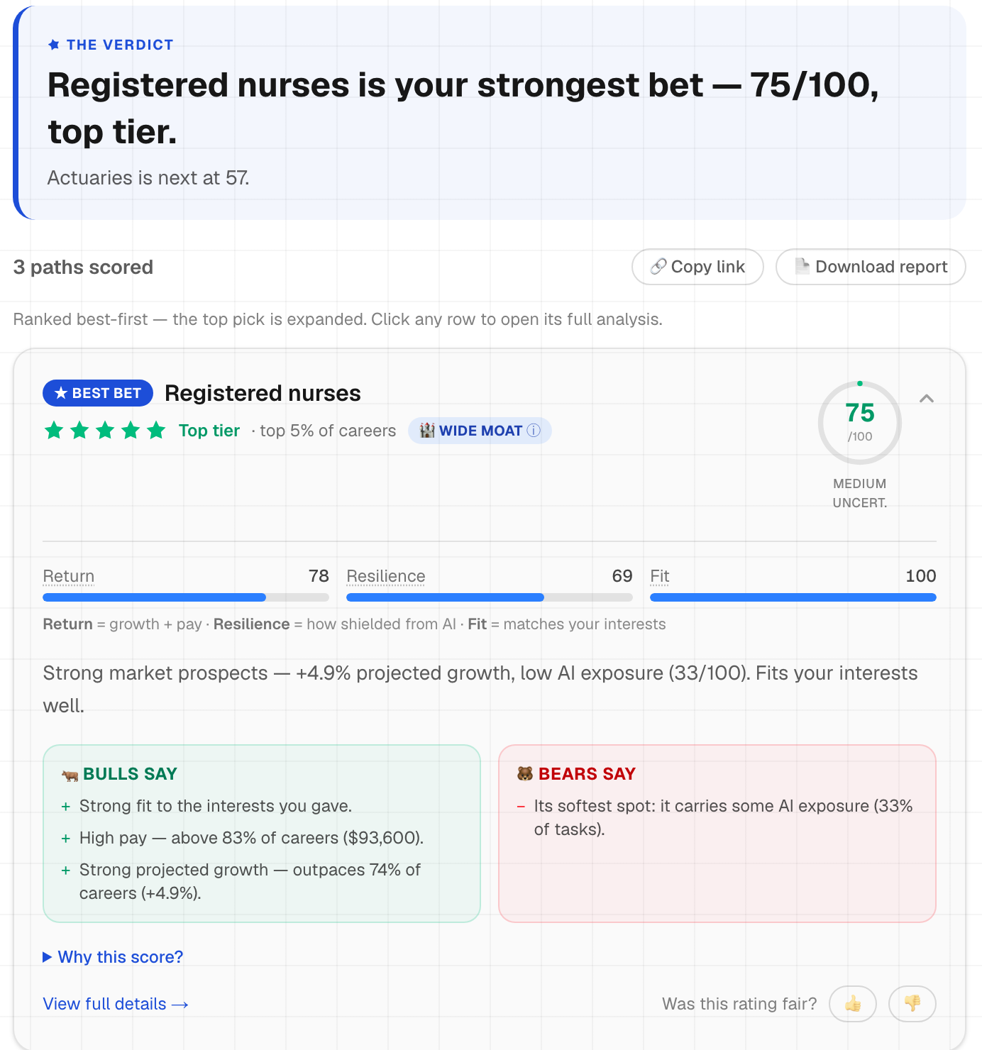
CareerStar rates careers the way you rate assets
02 · THE PRODUCT
730
U.S. occupations, every one rated
5
rival scoring models, swappable live
10%
of careers earn five stars — it’s a forced curve
The product is the demo. The build is today’s story.
ashleylibasci.com/rate — live, as shipped
3
Notes:
Ninety seconds so the rest makes sense. Pick the careers you're weighing, add your interests, and every path gets a 0-100 score — growth and pay, discounted by AI risk, blended with fit. Stars on a forced curve, bulls and bears on every card, and five rival scoring models you can swap live. That's the product. Now the build. (1:30)

Slide 4
Four lines — and each one is a decision
03 · THE MATH
Return = ½ growth + ½ pay
ranks, not raw units — you can’t average a percent and dollars
Risk = 0.7 AI + 0.3 volatility
AI carries the weight, because AI is the thesis
Value = Return × (1 − 0.6 Risk)
multiply, don’t subtract — a safe dead end shouldn’t beat a risky rocket
Score = 70% Value + 30% Fit
blend in the match to you — out of 100
The constants are priors, not fitted — and I say so. There’s no dataset of correct career choices to train on. So every ranking is re-scored 729 times with the weights shaken ±20%, plus by five rival formulas — if the answer flips, the site says “close call.”
4
Notes:
Four lines, readable out loud — and every line is a decision, not a default. Ranks, because you can't average a percent and dollars; the real question is 'versus my alternatives.' AI carries the risk weight because AI is the thesis. Multiply instead of subtract, because subtraction lets a safe dead end beat a risky rocket on safety alone — 0.6 caps the damage. And the honest part: the constants are priors. Nothing to fit them on. So every ranking gets re-scored 729 times plus five rival formulas, and shaky answers are labeled 'close call' instead of sold as verdicts. (2:00)

Slide 5
Same AI. Opposite discipline.
04 · THE DIFFERENCE
VIBE CODING
AGENTIC FRAMEWORK
Prompt, paste, pray
Spec first: PRD, architecture, stories
Accept whatever runs
35 deterministic tests, CI on every push
One agreeable assistant
A cast of adversarial reviewers
The LLM does the math
The LLM never computes a number
Claims
A back-test, a robustness grid, an open CSV
AI typed most of this project. The discipline is the difference.
5
Notes:
I won't pretend AI didn't type most of this — that's the point. When people hear 'AI wrote my code' they picture the left column: prompt, paste, pray, accept whatever runs. An agentic framework is the right column: a spec exists before the prompt, tests after it, an adversarial review before shipping, and a human who can defend every decision. The tool is identical. The discipline is the difference — and the framework that enforced it is the next slide. (1:30)

Slide 6
BMAD: plan it, build it, attack it
05 · BMAD
Breakthrough Method for Agile AI-Driven Development — open source, agent-based.
PLAN
A PM agent interrogated the idea into a PRD. An architect agent locked 7 invariants the code must never break.
1 PRD · 7 invariants
BUILD
A dev agent coded story by story against acceptance criteria, tests first — the whole backlog, to done.
7 epics · 28 stories · 35 tests
ATTACK
A cast of reviewer personas argues over every change — QA, design critic, fact-checker, one professional grump. I judge.
review after every change
→
→
The invariant that mattered most —
“The LLM never computes a number.”
Locked in the architecture before a line of scoring code existed.
6
Notes:
The framework is BMAD, and every number on this slide is a file in the repo. Plan: a PM agent interrogates the idea into a PRD — my fluffy answers died in that interview — and an architect locks invariants; the big one: the LLM never computes a number. Build: seven epics, twenty-eight stories, thirty-five tests. Attack is my favorite: BMAD calls it party mode — reviewer personas with opposite priorities argue over every change and I judge. Best catch: my own methodology page overclaiming how fit worked — caught, rebuilt, published as the story of the catch. And yes, even this deck went through that room. (2:30)

Slide 7
How the site is hosted: three pieces
06 · AWS, PART 1
CODE
GitHub. Push to main — that’s the whole release process.
ENGINE
AWS Amplify builds the Next.js app and runs the server-rendered parts.
EDGE
CloudFront serves it worldwide; Route 53 holds ashleylibasci.com.
→
→
Cloud Practitioner concepts this made real
★ managed services
★ edge caching
★ shared responsibility
★ DNS + certificates
Studying for the cert now — this is where the flashcards became things I’d actually debugged.
7
Notes:
Hosting, part one: the pieces. There is no server I manage. GitHub holds the code and the push to main is the release. Amplify is the engine — it builds the Next.js app and runs the server-rendered parts as managed functions. CloudFront serves it from the edge worldwide, and Route 53 holds the domain. Four Cloud Practitioner flashcard concepts became real things I'd debugged. Part two is the recipe if you want to do this yourselves. (1:30)

Slide 8
Hosting your own: the recipe
07 · AWS, PART 2
1
Put it on GitHub
The repo is the deployment artifact. No servers to provision, nothing to SSH into.
2
Connect AWS Amplify
Point Amplify at the repo. From then on every push to main builds and deploys automatically.
3
Add your domain
Route 53 for DNS; Amplify provisions and renews the HTTPS certificate for you.
4
Then trust nothing
Verify from the outside, like an attacker would. My rate limiter passed every local test — and never fired once in production.
Deploying this taught me more AWS than the practice exams.
8
Notes:
The recipe, four steps. Repo on GitHub. Connect Amplify and pushes become deploys. Add the domain in Route 53 — Amplify handles the certificate. And step four is the one nobody tells you: verify from outside. My rate limiter passed every local test and never fired once in production — Amplify's proxy chain meant the 'client IP' I keyed on was actually Amazon's. Full war story is in the backup if anyone wants it in Q&A. Practice exams don't teach proxy chains; production does. (1:30)

Slide 9
Closing thoughts: three things worth stealing
Write the spec before the prompt
2034
I re-run the back-test on the 2024–34 decade and publish how my ratings aged.
Ratings agencies should eat their own cooking.
the discipline, not the model, is what made this work
Publish what your model gets wrong
the awkward numbers bought more trust than the good ones
Pick tools that make rigor fun — mine was BMAD
fun is load-bearing — review you enjoy is review you run
Thanks — questions? ashleylibasci.com · github.com/ashleylibasci/careerstar
Notes:
My thoughts, having done it — three things worth stealing. Write the spec before the prompt: the discipline, not the model, made this work. Publish what your model gets wrong — the awkward numbers bought me more trust than the good ones. Pick tools that make rigor fun — mine was BMAD — because fun is load-bearing. And in 2034 I re-run the back-test on the decade my model actually bet on, and publish how the ratings aged. Ratings agencies should eat their own cooking. Thanks. (0:45)

Slide 10
The rate limiter that never fired
BACKUP · WAR STORY
1
What I did
Keyed rate limits on the last X-Forwarded-For hop — the textbook advice, since everything left of it is forgeable.
2
What production did
30 rapid requests. Zero rate-limit hits. Every request got a fresh bucket.
3
Why
Amplify’s router appends CloudFront’s own IP after the client’s. The “last hop” was never the client — it was Amazon.
4
The fix
Second-to-last hop, a global cap as backstop, and a regression test pinning the header shapes.
Practice exams don’t teach proxy chains. Production does.
10
Notes:
My favorite bug, in full. Textbook advice: trust the last X-Forwarded-For hop. Production: thirty rapid requests, zero rate limits — Amplify's router appends CloudFront's own edge IP after the real client, so the last hop was never the client. It was Amazon. Fix: second-to-last hop, global backstop, regression test pinning the exact header shapes. (1:30 if asked)

Slide 11
Weights, stars, and robustness
BACKUP · Q&A
“Why 0.7 and not 0.6?”
Because I had to pick something and there’s nothing to fit on. So I say “prior” out loud and stress-test instead: 729 perturbations, five rival models, close calls labeled.
“How do the stars work?”
Forced relative curve, straight from Morningstar: top 10% get five stars, next 22.5% get four, and so on — recomputed live under the user’s own weights.
“Isn’t AI exposure just decline by another name?”
No. Across all 730, exposure and projected growth are nearly uncorrelated. Exposure knows something growth doesn’t.
11

Slide 12
Back-test: I tested it on a decade that already happened
BACKUP · Q&A
“The headline numbers?”
Scored 2014’s job market with today’s formula, graded against what happened by 2024: rank correlation 0.39; 48% of real decliners flagged (33% by chance). Plain BLS beat the full model, 0.411 to 0.39 — expected, since the AI term had no LLMs to price in 2014. Never tuned to the test.
“Where did 2014 wages come from?”
The archived table has no 2015 wages, so pay percentiles use today’s ranking as a proxy — pay order barely moves. A growth-only variant shows the proxy changes almost nothing. All disclosed.
“Biggest misses? Survivorship?”
It liked oil-and-gas jobs; oil crashed. It underrated couriers; e-commerce boomed. Both named on the site. SOC-2010 joined to SOC-2018 on matching codes — 647 joined, counts published.
12

Slide 13
Stack, and the Anthropic connection
BACKUP · Q&A
“Stack?”
Next.js 16, React 19, TypeScript, Tailwind 4, AWS Amplify. 35 unit tests on the scoring library, pipeline scripts rebuilding every dataset from source, open CSV and code on GitHub.
“What did the AI get wrong?”
Plenty — that’s what the review cast is for. Best one: the fit overclaim. Caught in review, rebuilt properly, published as the case study centerpiece.
“Anthropic’s labor research?”
Same upstream dataset (Eloundou 2023). Their 2026 work layered real usage on it: 97% of observed use inside tasks rated feasible — consistent with my exposure input.
13

Slide 14
BMAD, up close
BACKUP · Q&A
“What does the framework actually produce?”
A paper trail in the repo: a PRD, an architecture doc holding the 7 invariants, epics.md with all 28 stories and acceptance criteria, sprint-status.yaml tracking every story to done, and the review transcripts.
“Where does the review cast live?”
As personas the framework convenes against every change — the hiring manager, the fact-checker, the copy chief, the QA lead, the design critic, the grump. Their arguments end up as files too — and this deck went through the same room.
“Would you use it again?”
Yes. The transferable part is the habit — spec before prompt, adversarial review before ship — and that works with any coding agent. The framework just made rigor the default instead of the chore.
14

