Slide 1

ECE455 Project 1 Traffic Light System
FEB 24, 2021
Pouya shiri

Slide 2
Outline
Project Definition
RTOS Programming
Shift Register (SPC)
Software Timers
Proposed Steps

Slide 3
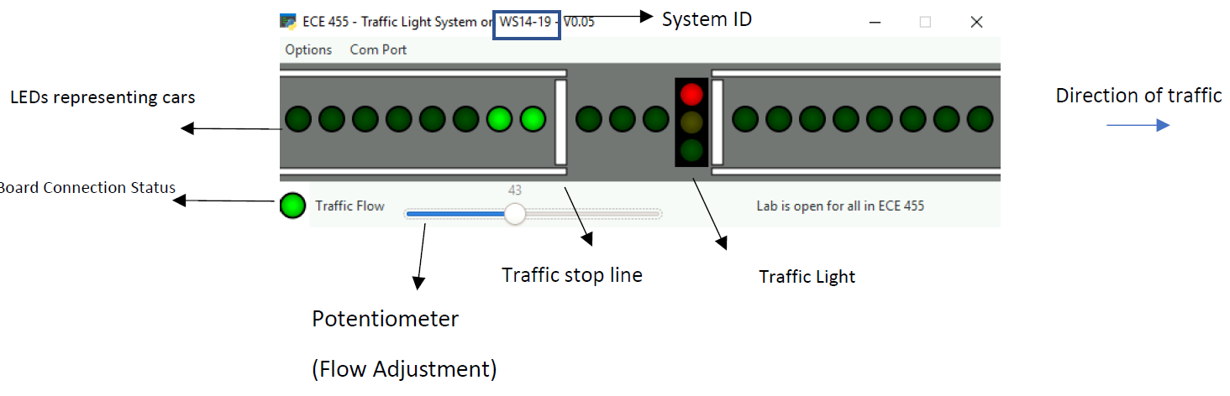
Project Definition
This is traffic_light_system application inside ECE455 folder on Desktop
A Python app that gets information from the board
When you debug your project, it is updated based on the code

Slide 4
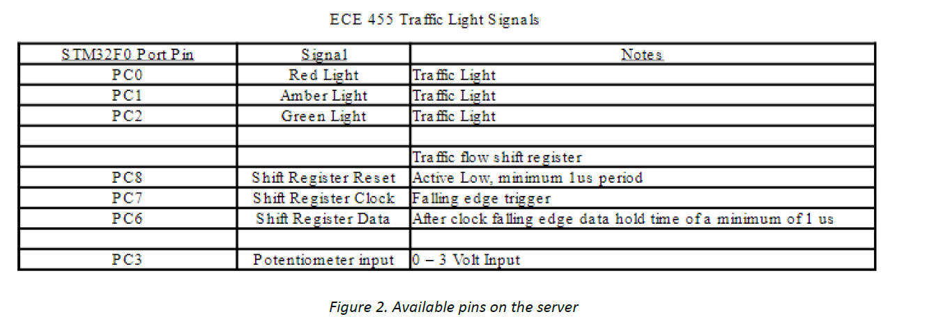
Project Definition
Use project 0 as the startup project
It gives you some hints for using tasks and queues
Watch the video regarding GPIO and ADC setup

Slide 5
RTOS Programming
Isolating different procedures as Tasks
Easier implementation, cleaner code
Better manipulation of actions and events
Can add/modify constraints and deadlines
The trade-off: more tasks -> more resource usage, probably more difficult to handle. There is an optimum number of tasks
Sample Tasks for this project
Updating traffic
Reading the traffic rate

Slide 6
Shift Register (SPC)
Provide multiple outputs using few pins (3 pins)
Each SPC IC provides 8 outputs → 3 ICs are stacked
Use Clear pin to reset outputs
Push your desired input to the outputs one-by-one
Must be done so fast that application requirement holds
In your lab, for example human eye should not perceive pushing of inputs
Q0
Data (PC6)
Shift Register
Reset (PC8)
Clock (PC7)
Q18

Slide 7

Shift Register (SPC)
Operating Mode | Reset PC8 | Data PC6 | Clock PC7 | Q0 | Q1-Q18
Reset(Clear) |  | X | X | L | L
Insert H + Shift | H | H |  | H | Q0-Q17
Insert L + Shift | H | L |  | L | Q0-Q17
Use GPIO_SetBits and GPIO_ResetBits
You may use a short FOR loop to generate a delay for the transitions
Example: loading 1010 into a 4 bit output
Reset(Clear) → output = 0000
Insert L + Shift → output = 0000
Insert H + Shift → output = 1000
Insert L + shift → output = 0100
Insert H + Shift → output = 1010

Slide 8
Software Timers
Execute a callback function at a set time in the future
FreeRTOS Functions: xTimerCreate, xTimerChangePeriod, etc.
Converting milliseconds to ticks: pdMS_TO_TICKS

Slide 9
Proposed Steps
Setup GPIO → Setup SPC → Setup ADC
Make sure they are functional using the monitor app (traffic_light_system)
Setup software timers
Design and implement tasks and queues

