Slide 1
Credit One

Slide 2
Business Questions
How can Credit One decide how much credit to allow customers? How can Credit One decide if someone qualifies for credit or should not qualify for credit?
Background context: Increase in customer defaults over the past year; Searching for more effective way to determine credit eligibility; May be able to predict likelihood of default based on customer demographics
Business considerations: Team will work as quickly and efficiently to provide a report to Credit One’s stakeholders in order to assist with financial decisions

Slide 3
Analysis Plan:
Analysis goal: Determine if customers should be given credit and if so, how much
Data provided: Amount of given credit, gender, education, marital status, age, history of past payments over 6 months, and payment delay status; There are 30,000 data points of existing customers.
Procedure: data cleaned and examined, exploratory data analysis including visualizations to look for patterns, and modeling before communicating recommendations and insights.

Slide 4
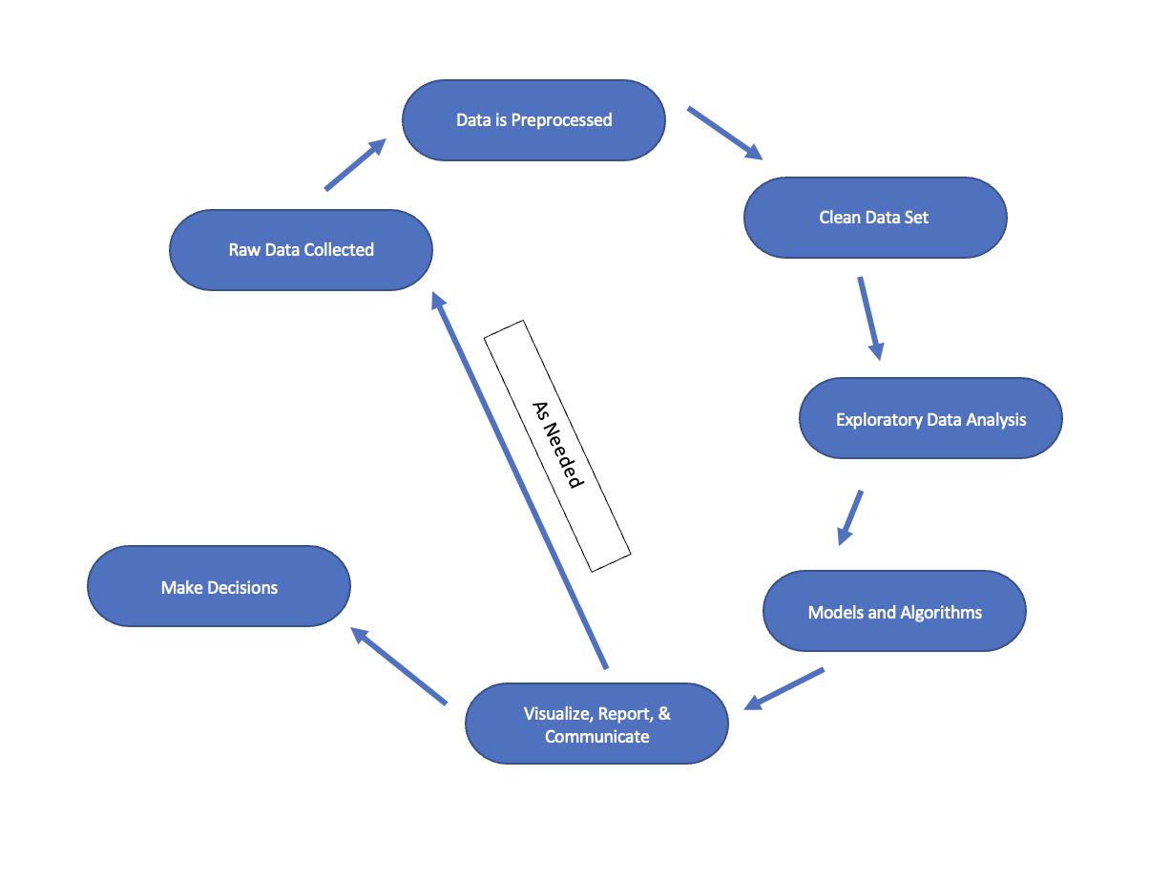
Workflow Visualization

Slide 5
Data Collection
Data is obtained from an SQL database
Data will be cleaned and validated using Python and other libraries
Data will be managed securely: confidentiality will be maintained and only those working with the data will have access to it in order to ensure privacy

Slide 6
Initial Insights
Introductory look at the data shows that some data issues will need to be addressed, such as:
features that should be numeric (examples: gender, education, next default payment)
Some data is duplicated

