Slide 1
Prism Profitability
Finance, Marketing, and Website Solutions
Ashley Mosman
27. 03. 2025

Slide 2
Agenda
Overview
KPIs
Suggestions
Questions
Financial Health
Customer Interactions,
Revenue,
Traffic overview
ROAS
Decrease payment failure
Decrease refunds
Increase members
Comprehensive Meta Review
Explain and Clarify

Slide 3
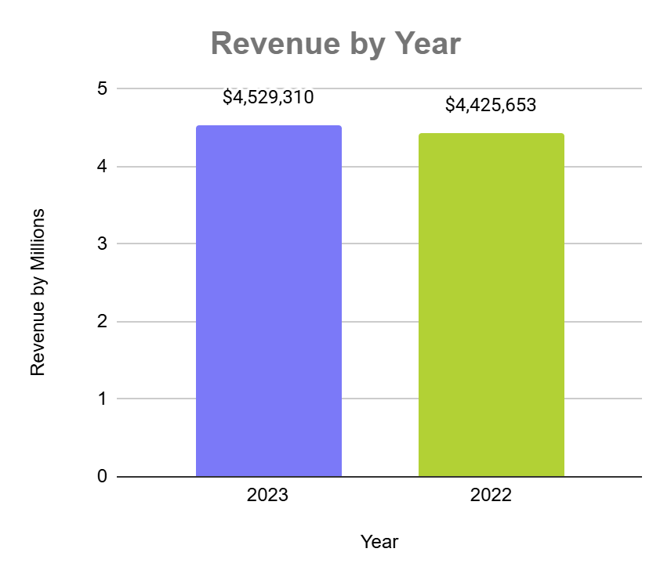
Financial Health
Revenue
Gross Profit Margin
Customer Retention Rates
47.5%
2023
46.6%
2022
25.4%
2023
2.6%
2022

Slide 4
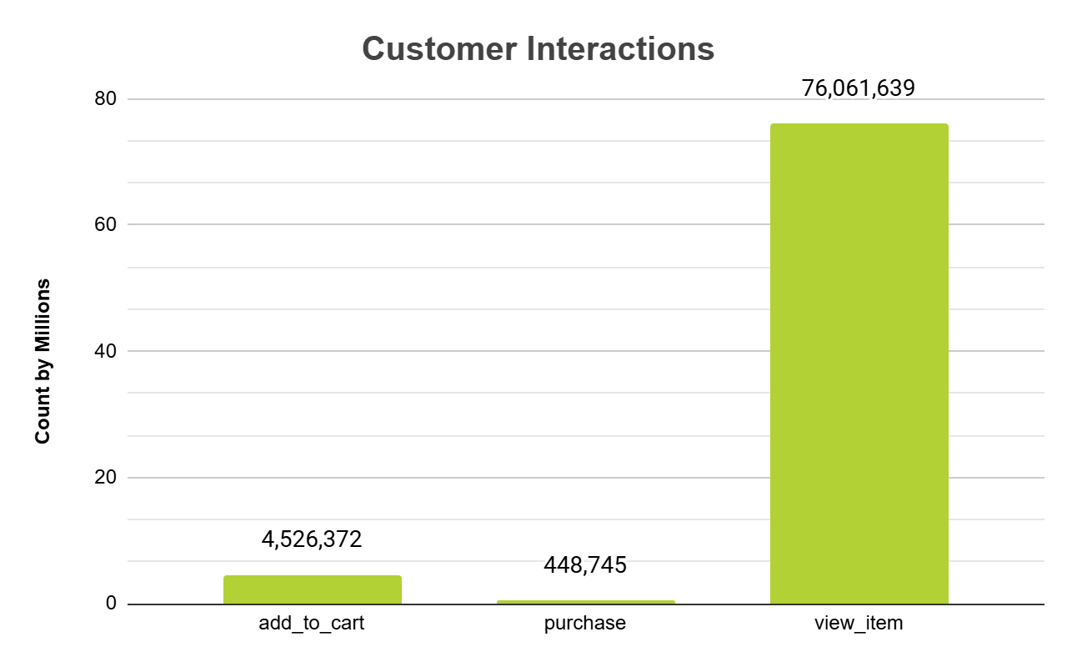
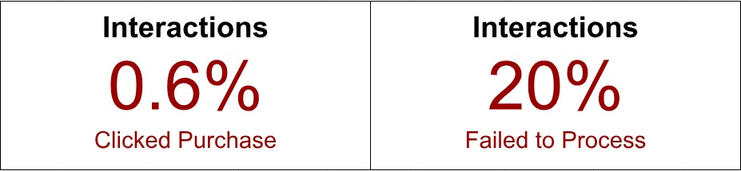
Interactions

Slide 5
Decrease Payment Failure
Investigate:
Payment gateway issues
Technical glitches
Slow processing
Preferred payment methods
Limited payment options
Poor mobile check-out experience
Mobile optimisation issues

Slide 6
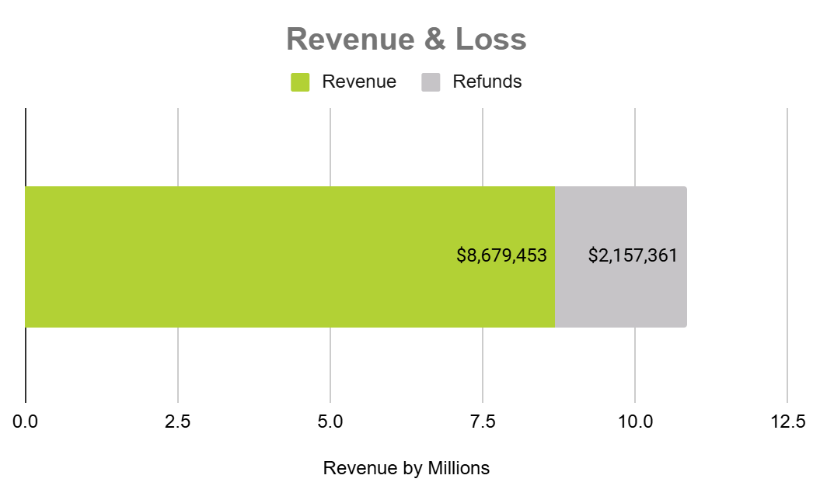
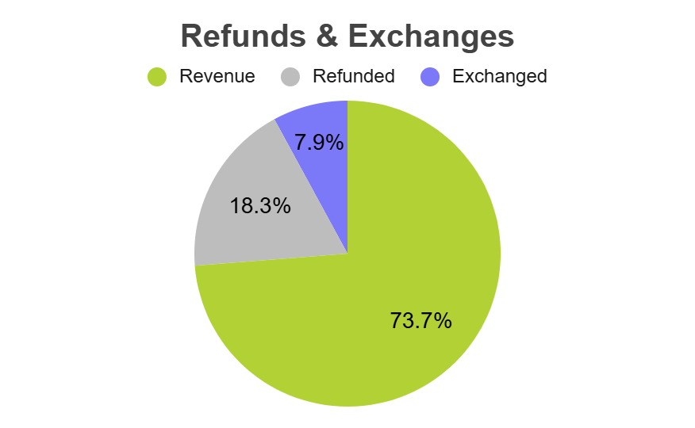
Missed Revenue Opportunities

Slide 7
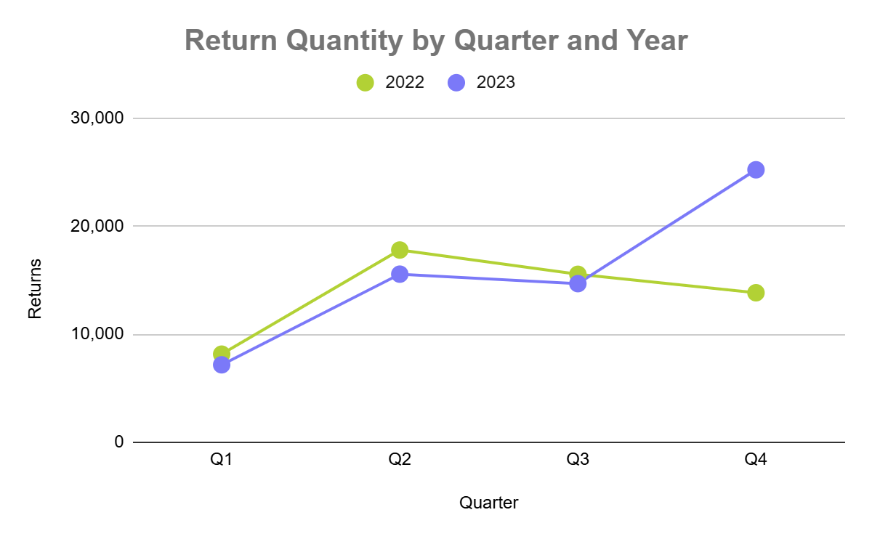
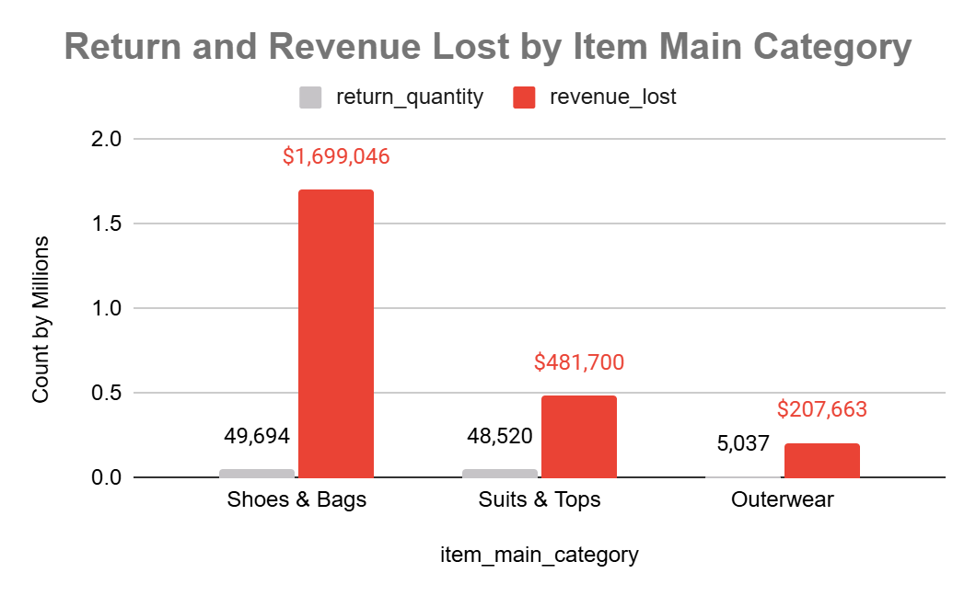
Missed Revenue Opportunities

Slide 8
Decrease Refunds
Improve
Product descriptions and images
Detailed product descriptions
Customer reviews and ratings
Accurate sizing information
Size guides
Fit & sizing advice
Enhance product quality
Quality control
Product testing

Slide 9
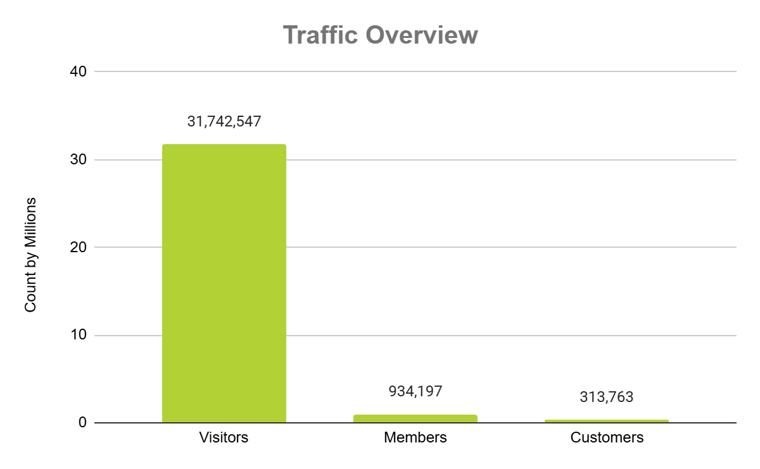
Traffic Overview
Increase Members
Optimize the registration process
Simplify registration process
Social media login options
Offer incentives and rewards
Discounts and promotions
Referral program
Improve website user experience
Personalization
Responsive and mobile-friendly design

Slide 10
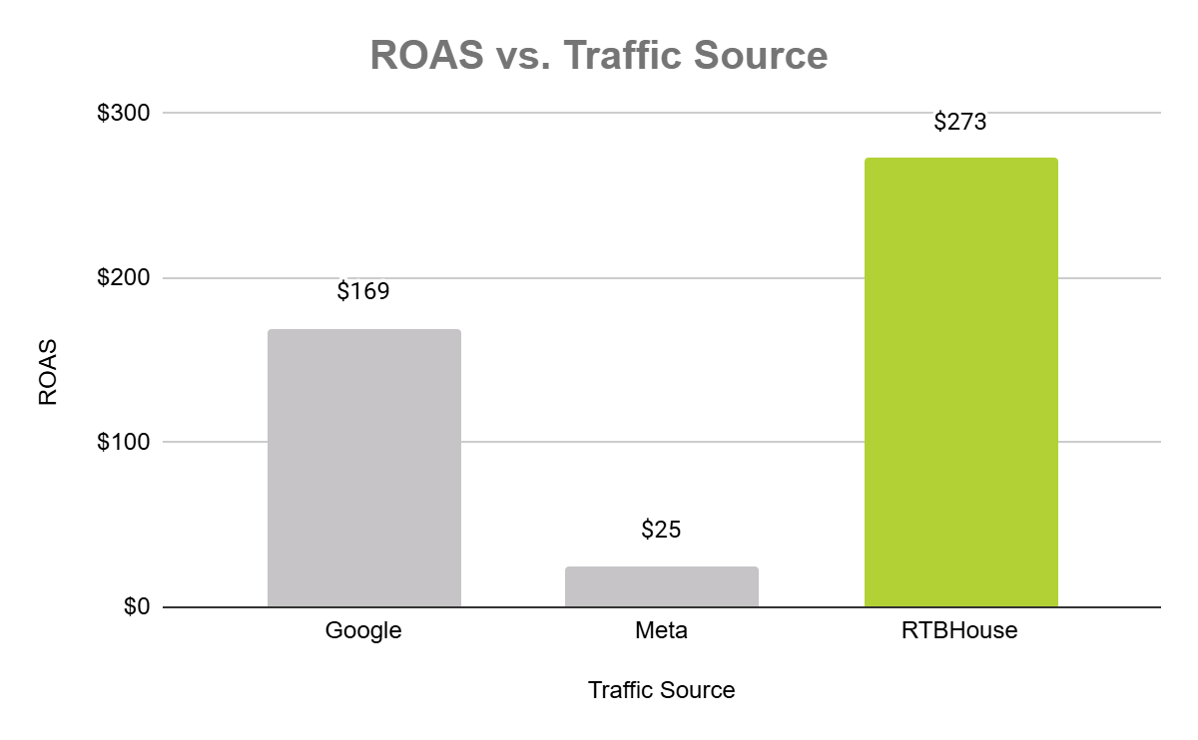
Return on Ad Spend
Comprehensive Meta Review:
Review ad targeting
Optimise ad creatives
Landing page optimisation
Reallocate budget

Slide 11
Thank You
Ashley Mosman

