Slide 1
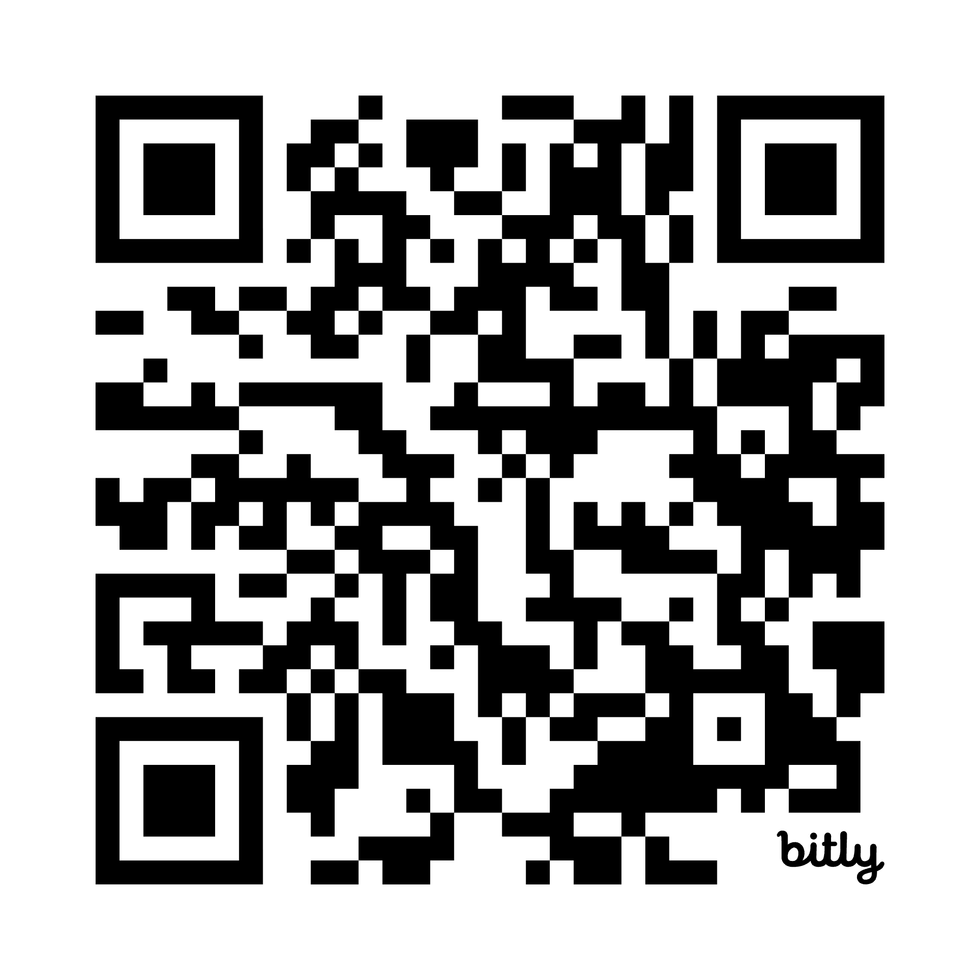
Seize the Data:
Around the World of Statistics in Five Days
scan for slides
Ashley Mullan
Vanderbilt University
WSDS 2026

Slide 2
Setting the Scene
Audience
The course was offered for incoming 9th/10th and 11th/12th grade students.
Timeline
The course ran for
one week over the summer with five
six-hour days.
Goal
The course was designed to cover the broad (bio)statistical landscape and basic coding skills in R.
Slide 1 of 18

Slide 3
Challenges
Audience
Math and data background
Willingness
to engage with course
Application interests
Slide 2 of 18
Notes:
Different levels of algebraic comfort, logs, etc.
Biomedical, finance, real estate, entertainment.

Slide 4
Challenges
Audience
Math and data background
Willingness
to engage with course
Application interests
Timeline
Long days
Accelerated schedule
Dedicated project time
Little to no homework
Slide 2 of 18
Notes:
6 hours of instruction, 5 days
Project had to be entirely in class.

Slide 5
Challenges
Audience
Math and data background
Willingness
to engage with course
Application interests
Timeline
Long days
Accelerated schedule
Dedicated project time
Little to no homework
Goals
Balance between broad scope and enough detail
Balance between foundations and application
Slide 2 of 18
Notes:
Give them the big picture of what’s out there but enough to try themselves.

Slide 6
Course Scaffolding
Daily Topics
Lectures
Activities
Recaps
Project
Presentation
Slide 3 of 18

Slide 7
Daily Topics
Each day covered statistical concepts or skills (bio)statisticians and data scientists use frequently.
Slide 4 of 18

Slide 8
Daily Topics
Each day covered statistical concepts or skills (bio)statisticians and data scientists use frequently.
  Types of variables, well-defined research questions, common study designs, and limitations of measurement
Slide 4 of 18
Notes:
Categorical v numeric, nominal v ordinal, continuous v discrete. Blurry lines.
Different names they might see for X and Y and defining populations.
Common study designs to get into correlation vs causation
Bias, measurement error, missingness.

Slide 9
Daily Topics
Each day covered statistical concepts or skills (bio)statisticians and data scientists use frequently.
  Types of variables, well-defined research questions, common study designs, and limitations of measurement
  Data summarization, wrangling, and visualization in R
Slide 4 of 18
Notes:
Measures of center and spread,
Reading accessing and dplyr style things, ggplot

Slide 10
Daily Topics
Each day covered statistical concepts or skills (bio)statisticians and data scientists use frequently.
  Types of variables, well-defined research questions, common study designs, and limitations of measurement
  Data summarization, wrangling, and visualization in R
  Regression mechanics, interpretation, and diagnostics
Slide 4 of 18
Notes:
Building up from y=mx+b to interpretations, then the parallel to logistic and poisson regression.
Focused on diagnostics for linear.

Slide 11
Daily Topics
Each day covered statistical concepts or skills (bio)statisticians and data scientists use frequently.
  Types of variables, well-defined research questions, common study designs, and limitations of measurement
  Data summarization, wrangling, and visualization in R
  Regression mechanics, interpretation, and diagnostics
  Navigating the scientific literature, presentation design,
  and giving critical feedback
Slide 4 of 18
Notes:
PICOTS framework, places to find sources
what not to do when making a presentation
Feedback to help them as they work on projects

Slide 12
Daily Topics
Each day covered statistical concepts or skills (bio)statisticians and data scientists use frequently.
  Types of variables, well-defined research questions, common study designs, and limitations of measurement
  Data summarization, wrangling, and visualization in R
  Regression mechanics, interpretation, and diagnostics
  Navigating the scientific literature, presentation design,
  and giving critical feedback
  Public speaking and statistics in the media
Slide 4 of 18

Slide 13
Activities
We usually began with a journaling-style activity where students responded to questions that would come up in lecture.
Slide 5 of 18
Notes:
Journaling gave me a sense of what they knew already and gave me something to call back to while lecturing. Also a fun lil break to play some tunes in class.

Slide 14
Activities
We usually began with a journaling-style activity where students responded to questions that would come up in lecture.
Longer lectures were broken up with small-group activities, where students would apply the newly introduced concepts.
Slide 5 of 18
Notes:
Often in small groups

Slide 15
Activities
We usually began with a journaling-style activity where students responded to questions that would come up in lecture.
Longer lectures were broken up with small-group activities, where students would apply the newly introduced concepts.
Each topic would conclude with another journaling-style activity, where students would jot down a few takeaways.
Slide 5 of 18

Slide 16
Activities
We usually began with a journaling-style activity where students responded to questions that would come up in lecture.
Longer lectures were broken up with small-group activities, where students would apply the newly introduced concepts.
Each topic would conclude with another journaling-style activity, where students would jot down a few takeaways.
All coding topics were introduced with sample code and practice questions that could be answered by tweaking the sample code.
Slide 5 of 18
Notes:
Quarto notebooks they could follow along with, run code, and then a tiny change, like a variable name or a color or something.
If a new function was needed, it was directly introduced

Slide 17
Activities
We usually began with a journaling-style activity where students responded to questions that would come up in lecture.
Longer lectures were broken up with small-group activities, where students would apply the newly introduced concepts.
Each topic would conclude with another journaling-style activity, where students would jot down a few takeaways.
All coding topics were introduced with sample code and practice questions that could be answered by tweaking the sample code.
Groups for each topic’s activity were randomized.
Slide 5 of 18
Notes:
Gave them the chance to move around and meet people

Slide 18
Activities
We usually began with a journaling-style activity where students responded to questions that would come up in lecture.
Longer lectures were broken up with small-group activities, where students would apply the newly introduced concepts.
Each topic would conclude with another journaling-style activity, where students would jot down a few takeaways.
All coding topics were introduced with sample code and practice questions that could be answered by tweaking the sample code.
Groups for each topic’s activity were randomized.
Days 2-5 began with a friendly competition to recap past topics.
Slide 5 of 18
Notes:
This is where the key takeaways came in handy when I was making cahoot questions

Slide 19
Examples: Journaling Intro
What is/are …
Data
Similarity/difference
Assumptions
“Strong” conclusions
Reliable sources
Slide 6 of 18
Notes:
Gives me a baseline of what they’re working with, helps me prompt throughout the lecture

Slide 20
Examples: Journaling Intro
What is/are …
Data
Similarity/difference
Assumptions
“Strong” conclusions
Reliable sources
Why do we …
Design experiments
Visualize data
Pick certain subjects or values to measure
Make models
Slide 6 of 18
Notes:
Gets them thinking about “good” and “bad” of each

Slide 21
Examples: Journaling Intro
What is/are …
Data
Similarity/difference
Assumptions
“Strong” conclusions
Reliable sources
Why do we …
Design experiments
Visualize data
Pick certain subjects or values to measure
Make models
What can go wrong during …
Data collection
Data analysis
Communication of results
Peer review
Slide 6 of 18
Notes:
Get them to question and not take things at face value

Slide 22
Examples: Middle Activity
Translate abstract ideas into concrete examples
Slide 7 of 18
Notes:
Abstract: concept to measurement, pros and cons
Previous: Recurring question like memes, project data comes up, course slides
Standard curriculum: scientific method, picots
Consequences: bias

Slide 23
Examples: Middle Activity
Translate abstract ideas into concrete examples
Go through previously introduced material and align it
with the theme of the lecture
Slide 7 of 18
Notes:
Abstract: concept to measurement, pros and cons
Previous: Recurring question like memes, project data comes up, course slides
Standard curriculum: scientific method, picots
Consequences: bias

Slide 24
Examples: Middle Activity
Translate abstract ideas into concrete examples
Go through previously introduced material and align it
with the theme of the lecture
Take standard curriculum and re-examine with a data lens
Slide 7 of 18
Notes:
Abstract: concept to measurement, pros and cons
Previous: Recurring question like memes, project data comes up, course slides
Standard curriculum: scientific method, picots
Consequences: bias

Slide 25
Examples: Middle Activity
Translate abstract ideas into concrete examples
Go through previously introduced material and align it
with the theme of the lecture
Take standard curriculum and re-examine with a data lens
Motivate code as a way to streamline computation
Slide 7 of 18
Notes:
Abstract: concept to measurement, pros and cons
Previous: Recurring question like memes, project data comes up, course slides
Standard curriculum: scientific method, picots
Consequences: bias

Slide 26
Examples: Middle Activity
Translate abstract ideas into concrete examples
Go through previously introduced material and align it
with the theme of the lecture
Take standard curriculum and re-examine with a data lens
Motivate code as a way to streamline computation
Discuss pros and cons of competing approaches
Slide 7 of 18
Notes:
Abstract: concept to measurement, pros and cons
Previous: Recurring question like memes, project data comes up, course slides
Standard curriculum: scientific method, picots
Consequences: bias

Slide 27
Examples: Middle Activity
Translate abstract ideas into concrete examples
Go through previously introduced material and align it
with the theme of the lecture
Take standard curriculum and re-examine with a data lens
Motivate code as a way to streamline computation
Discuss pros and cons of competing approaches
Consider consequences of analytic choices
Slide 7 of 18
Notes:
Abstract: concept to measurement, pros and cons
Previous: Recurring question like memes, project data comes up, course slides
Standard curriculum: scientific method, picots
Consequences: bias

Slide 28
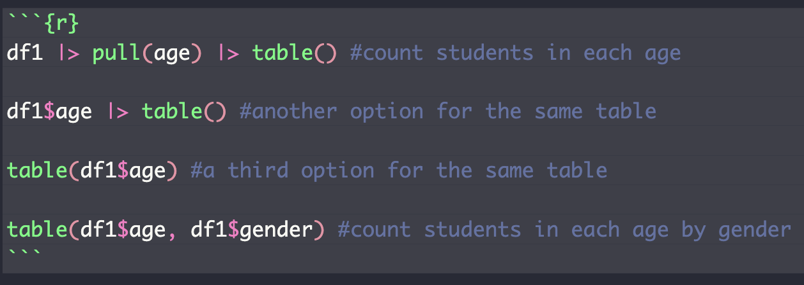
Examples: Code
Code examples provided multiple syntax options to
empower students to develop a style that made sense
to them and explore packages that streamline common tasks.
Slide 8 of 18
Notes:
Piping, base, tidy, accessing, data structures

Slide 29
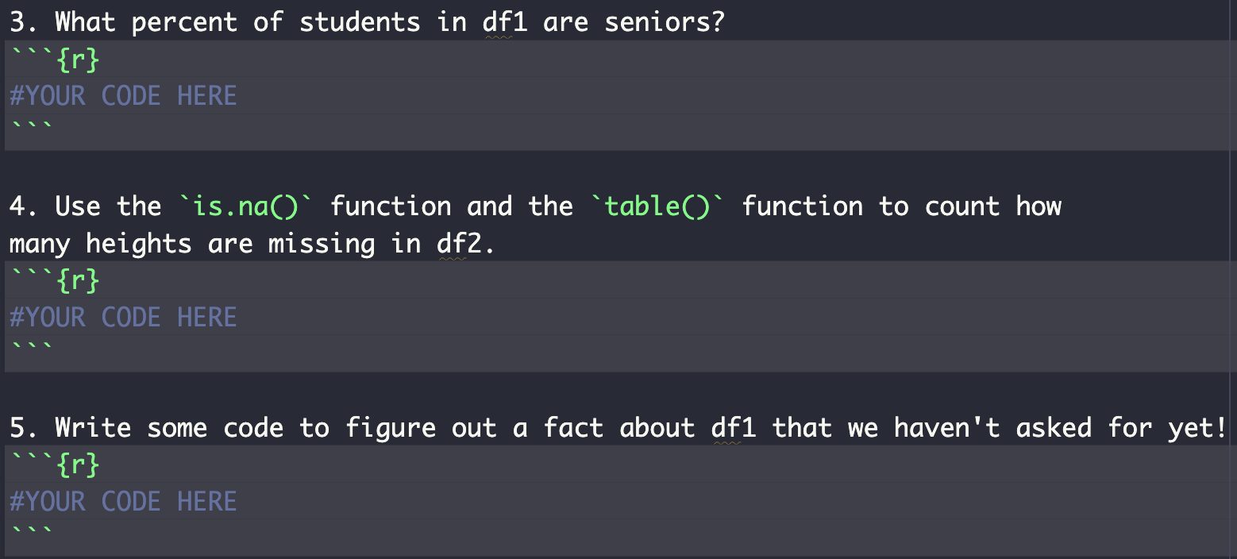
Examples: Code
Practice questions varied in difficulty and flexibility to give students different opportunities to succeed.
Slide 9 of 18
Notes:
Talk through in words, opportunities to read documentation, translate common tasks into algorithmic thinking

Slide 30
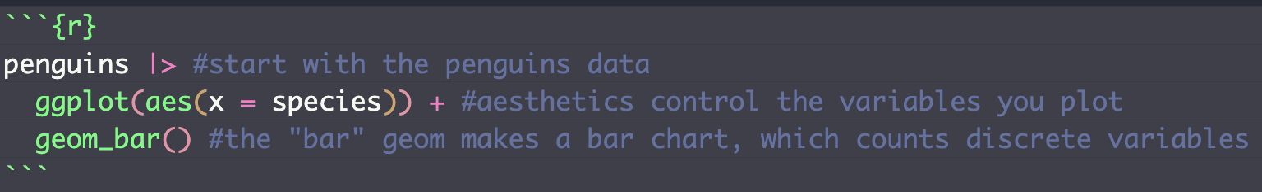
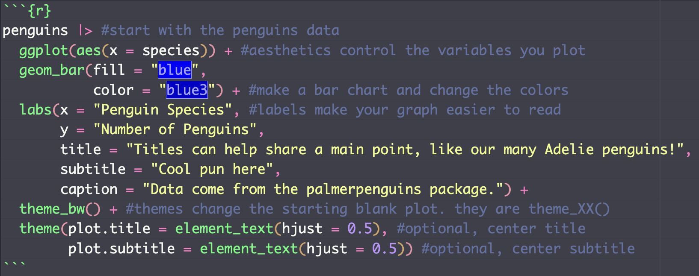
Examples: Code
Slide 10 of 18
Notes:
Watching plots evolve, teaching both code and design choices

Slide 31
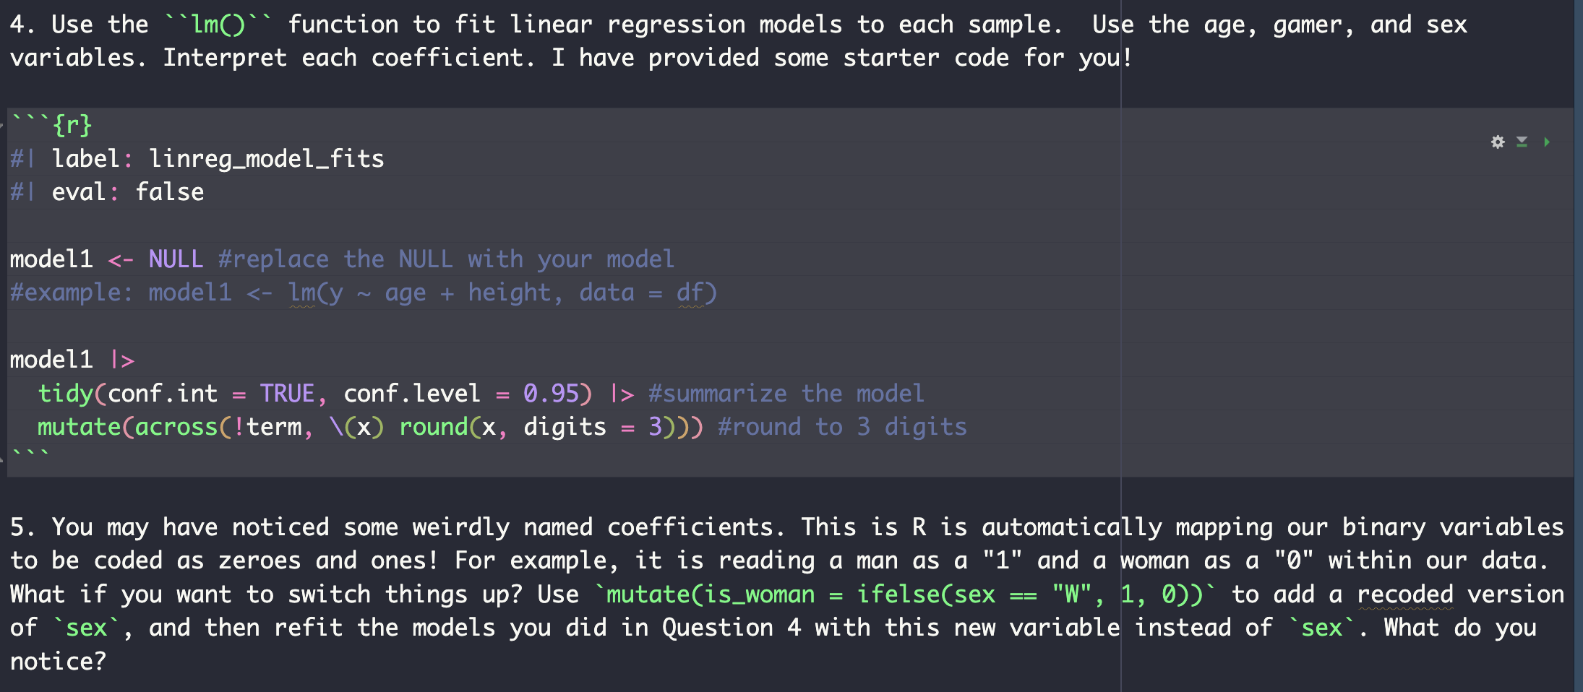
Examples: Code
Modeling questions provided starter code and invited students to tweak covariates and encoding options.
Slide 11 of 18
Notes:
Gets students to watch for details, gives them the chance to dig into syntax, also helps with interpretation

Slide 32
Project
Students were introduced to six datasets on Day 1, and they ranked them by interest level to help the instructor make groups.
Slide 12 of 18
Notes:
Spanned a wide variety of interests, pre cleaned but different formats.

Slide 33
Project
Students were introduced to six datasets on Day 1, and they ranked them by interest level to help the instructor make groups.
In groups of three or four, students designed research questions about their data and answered them with descriptive statistics, visualizations, and regression.
Slide 12 of 18

Slide 34
Project
Students were introduced to six datasets on Day 1, and they ranked them by interest level to help the instructor make groups.
In groups of three or four, students designed research questions about their data and answered them with descriptive statistics, visualizations, and regression.
Each team combined their questions into a presentation that introduced the data and their findings.
Slide 12 of 18

Slide 35
Project
Students were introduced to six datasets on Day 1, and they ranked them by interest level to help the instructor make groups.
In groups of three or four, students designed research questions about their data and answered them with descriptive statistics, visualizations, and regression.
Each team combined their questions into a presentation that introduced the data and their findings.
Presentations were given on the final day of class, and the students in the audience were invited to share strengths they observed in each presentation.
Slide 12 of 18

Slide 36
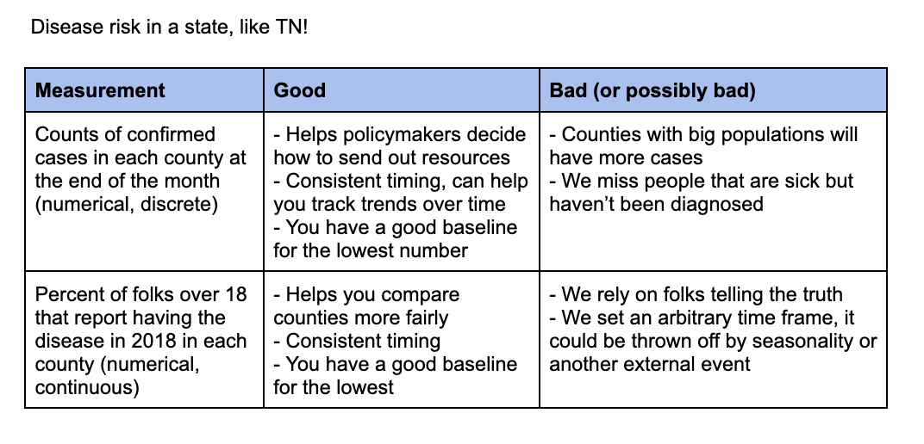
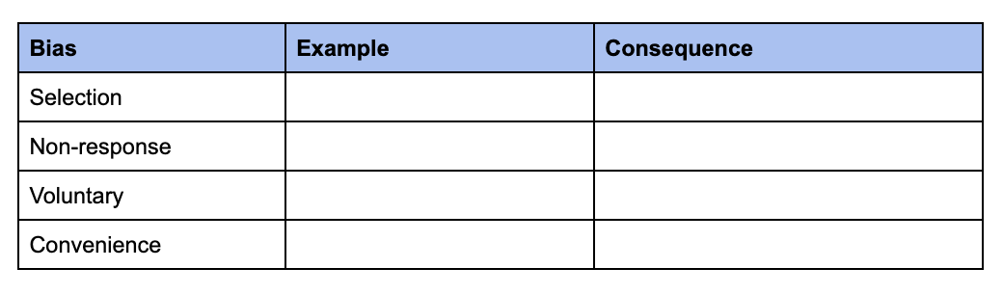
Overall Learning Goals
I hoped students would leave this course with the instinct to explore and question real data they encounter.
Both the hands-on activities and the project kept this goal in mind.
Slide 13 of 18

Slide 37
The Elephant in the Room
In this course, I employed the following AI policy.
We are in an exciting time where generative AI tools can help us work more efficiently. However, it is essential that students develop foundational skills so they can critically evaluate output from a generative AI model. For this course, students must obtain permission from the instructor before using any generative AI tools beyond the immediate output Google provides.
This policy had mixed results.
Slide 14 of 18

Slide 38
Watch Out For:
Open-ended activities can run longer than expected
Slide 15 of 18

Slide 39
Watch Out For:
Open-ended activities can run longer than expected
Students may come up with research questions that require advanced data wrangling
Slide 15 of 18

Slide 40
Watch Out For:
Open-ended activities can run longer than expected
Students may come up with research questions that require advanced data wrangling
Tech installation challenges may be different on each machine, causing some students to speed through setup
and some to fall behind the group
Slide 15 of 18

Slide 41
Watch Out For:
Open-ended activities can run longer than expected
Students may come up with research questions that require advanced data wrangling
Tech installation challenges may be different on each machine, causing some students to speed through setup
and some to fall behind the group
Choose the level of depth for your treatment of model diagnostics wisely
Slide 15 of 18

Slide 42
Watch Out For:
Open-ended activities can run longer than expected
Students may come up with research questions that require advanced data wrangling
Tech installation challenges may be different on each machine, causing some students to speed through setup
and some to fall behind the group
Choose the level of depth for your treatment of model diagnostics wisely
Make sure you have examples ready to go for any activities where you ask students to look for resources
Slide 15 of 18

Slide 43
Students Really Enjoyed
Working through code examples
The group project
Learning from peers
Recapping each topic
Support from the teaching team during activity time
Having access to all course materials
Slide 16 of 18

Slide 44
Takeaways
Giving open-ended instructions but having examples in your back pocket gives new statistics students the flexibility to explore the things that interest them most
Slide 17 of 18

Slide 45
Takeaways
Giving open-ended instructions but having examples in your back pocket gives new statistics students the flexibility to explore the things that interest them most
Providing space for students to apply definitions and abstract concepts to their own interests sparks thoughtful discussion
Slide 17 of 18

Slide 46
Takeaways
Giving open-ended instructions but having examples in your back pocket gives new statistics students the flexibility to explore the things that interest them most
Providing space for students to apply definitions and abstract concepts to their own interests sparks thoughtful discussion
Starting with the data landscape before jumping straight into coding builds student confidence
Slide 17 of 18

Slide 47
Takeaways
Giving open-ended instructions but having examples in your back pocket gives new statistics students the flexibility to explore the things that interest them most
Providing space for students to apply definitions and abstract concepts to their own interests sparks thoughtful discussion
Starting with the data landscape before jumping straight into coding builds student confidence
Vetting interim pieces of a larger project earlier can save you headaches later
Slide 17 of 18

Slide 48
THANKS!
Any questions?
      📧 ashley.e.mullan@vanderbilt.edu
💻 ashleymullan.github.io
Slide 18 of 18

