Slide 1

Adjusting for Measurement Error to Quantify the Relationship Between Diabetes and Local Access to Healthy Food
Ashley E. Mullan
March 2024

Slide 2

Follow along with me!
https://bit.ly/ashley_talks

Slide 3
Motivation

Slide 4
Healthy Eating ➡️ Healthy Living
A healthy diet increases the likelihood of good overall health and decreases risk of preventable illness (World Health Organization, 2019).
Maintaining a healthy diet requires consistent access to healthy food, which may be hindered by geography or income.
Review studies found high prevalence of diabetes in food-insecure households (Gucciardi et al., 2014).
Notes:
Food insecurity = access + ability, plenty of more socioeconomic factors we haven’t thrown in

Slide 5
Measuring Food Access 📏
Count the number of healthy food retailers in a given radius (i.e., density)
Compute the distance to the nearest healthy food retailer (i.e., proximity)
Create an indicator of “low” food access that evaluates to 1 if zero healthy food retailers exist within a given distance (e.g., 0.5 miles or 1 mile).

Slide 6
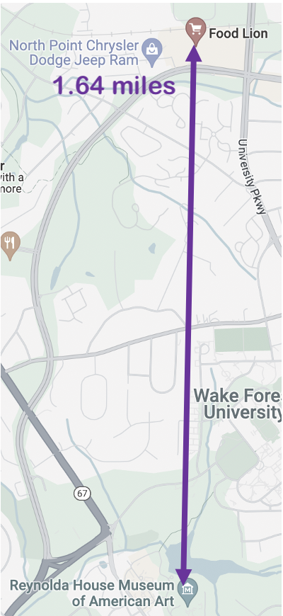
Distance Computations
The Haversine distance is a trigonometric function of latitude and longitude.
It ignores physical obstacles, so it underestimates the true distance between two points and is considered error-prone.
The Haversine distance in the image is impassable, as it crosses a pond.
Figure: Haversine distance from
Reynolda Manor House
to a nearby Food Lion

Slide 7
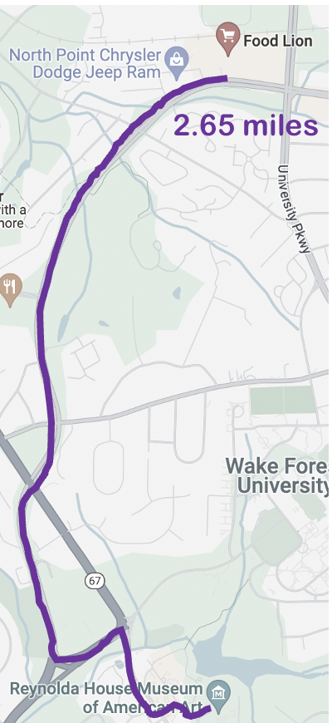
Distance Computations
The route-based distance works around obstacles.
It is more accurate than the Haversine distance but is computationally expensive.
Figure: Route distance from
Reynolda Manor House
to a nearby Food Lion

Slide 8
Research Questions
Can we use a function of distance to healthy food retailers to quantify food access in the Piedmont area of North Carolina, even if this function is subject to measurement error?
Can we estimate the relationship between low food access and diabetes prevalence?

Slide 9
Methods

Slide 10
Notation
X is an error-free binary explanatory variable for low food access based on route-based distances
X* is an error-prone version of X based on Haversine distances
Z is an error-free covariate vector
Y is a count of diabetes cases in the area of interest
Q is an indicator of whether an observation has been queried
We want to estimate the coefficients 𝛽 from the Poisson model of Y | X, Z.

Slide 11
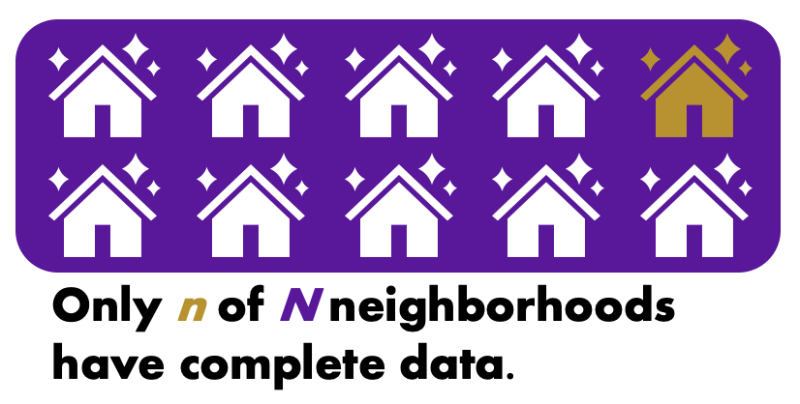
Two-Phase Design
Having some correct route-based distances is better than none.
Error-prone Haversine distances are available for all N neighborhoods, and we can use them to create our indicator of low food access X* that is subject to misclassification.
In addition to X*, we query route-based distances to create our indicator X for n neighborhoods, where n < N.
Figure: An example of two-phase design.

Slide 12
Modeling Options
Gold Standard
Naïve Regression
Complete Case Analysis
Maximum Likelihood Estimation
👍
This method achieves optimal bias and variance.
👎
This method assumes we have all of the correct data available.

Slide 13
Modeling Options
Gold Standard
Naïve Regression
Complete Case Analysis
Maximum Likelihood Estimation
👍
The model is easy to fit and utilizes information from the error-prone data for all N neighborhoods.
👎
The model is biased by a function of the sensitivity and specificity (Shaw et al., 2020).

Slide 14
Modeling Options
Gold Standard
Naïve Regression
Complete Case Analysis
Maximum Likelihood Estimation
👍
The model is unbiased, as it uses the error-free measurements.
👎
The model does not take the unqueried data into account.

Slide 15
Modeling Options
Gold Standard
Naïve Regression
Complete Case Analysis
Maximum Likelihood Estimation
👍
The model utilizes information from both the queried and unqueried observations.
👎
This method is not (yet) implemented in existing software.
Notes:
Gold naïve complete multiple MLE

Slide 16
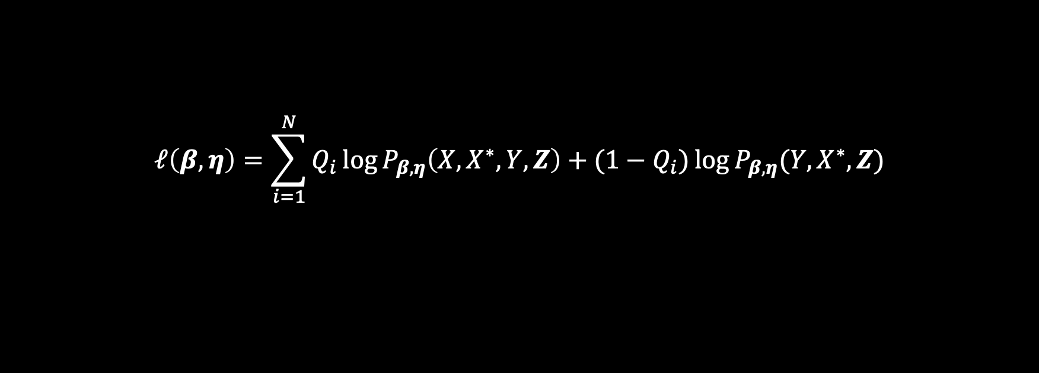
More on the MLE
$$ℓ\left(β,η\right)=\sum_{i=1}^{N}{Q_{i}\log{P_{β,η}\left(X,X^{∗},Y,Z\right)+(1−Q_{i})\log{P_{β,η}(Y,X^{∗},Z)}}}$$
un
queried neighborhoods

Slide 17



More on the MLE
Poisson
error
$P\left(Y,X,Z,X^{∗}\right)=P\left(Y∣X, X^{∗},Z\right)P(X∣$ $X^{∗},Z)P(X^{∗},Z)$
$=P_{β}\left(Y∣X,Z\right)P(X∣$ $X^{∗},Z)P(X^{∗},Z)$
$∝P_{β}\left(Y∣X,Z\right)P(X∣$ $X^{∗},Z)$
$$P\left(Y,X^{∗},Z\right)=\sum_{x=0}^{1}{P(Y,X=x,Z,X^{∗})}$$

Slide 18
Simulations

Slide 19
Roadmap 🛣️
We vary:
Sample size N
Queried sample size n
Error mechanism
We compare:
Gold Standard
Complete Case
Naïve Model
MLE
We observe the effect of interest $\hat{β_{1}}$ (truth = 0.155) and the relative efficiency.

Slide 20
Figure: Box plot comparing method performance across different query percentages
Notes:
Add caption

Slide 21
Figure: Box plot comparing method performance across different error settings

Slide 22
Summary
Across all four query settings, the MLE remains fairly unbiased.
As we vary the size of the queried sample n, the MLE recovers up to 91% of the efficiency of the gold standard model and beats the complete case model in every case.
As we introduce more error into the input data, the MLE remains fairly unbiased.
As we vary the error, the MLE recovers between 70 and 83% of the efficiency of the gold standard model.

Slide 23
Case Study

Slide 24
Piedmont Triad Food Access Landscape
Error-Prone Low Access
True Low Access
Not Low Access
Figure: Food access landscape of the Piedmont triad

Slide 25
Figure: Summary of error rates in the Piedmont case study
Error Snapshot

Slide 26
Figure: Diabetes prevalence estimates using four methods
One Mile Radius

Slide 27
Wrap-Up

Slide 28
Future Directions
Expand case study
Improve query design
Tipping point analysis

Slide 29
References
E. Gucciardi, M. Vahabi, N. Norris, J. P. Del Monte, and C. Farnum. The intersection between food insecurity and diabetes: a review. Current nutrition reports, 3:324–332, 2014.
World Health Organization. Healthy diet, 2019. URL https://iris.who.int/handle/10665/325828.
P. A. Shaw, R. H. Keogh, et al. STRATOS guidance document on measurement error and misclassification of variables in observational epidemiology: part 2—more complex methods of adjustment and advanced topics. Statistics in medicine, 39(16):2232–2263, 2020.
L. Tang, R. H. Lyles, C. C. King, D. D. Celentano, and Y. Lo. Binary regression with differentially misclassified response and exposure variables. Statistics in Medicine, 34(9):1605–1620, 2015.
S. Lotspeich, A. Mullan, L. D’Agostino McGowan, and S. Hepler. Combining straight-line and map-based distances to investigate food access and health. In Preparation, 2023+

Slide 30


Thank you!

