Slide 1
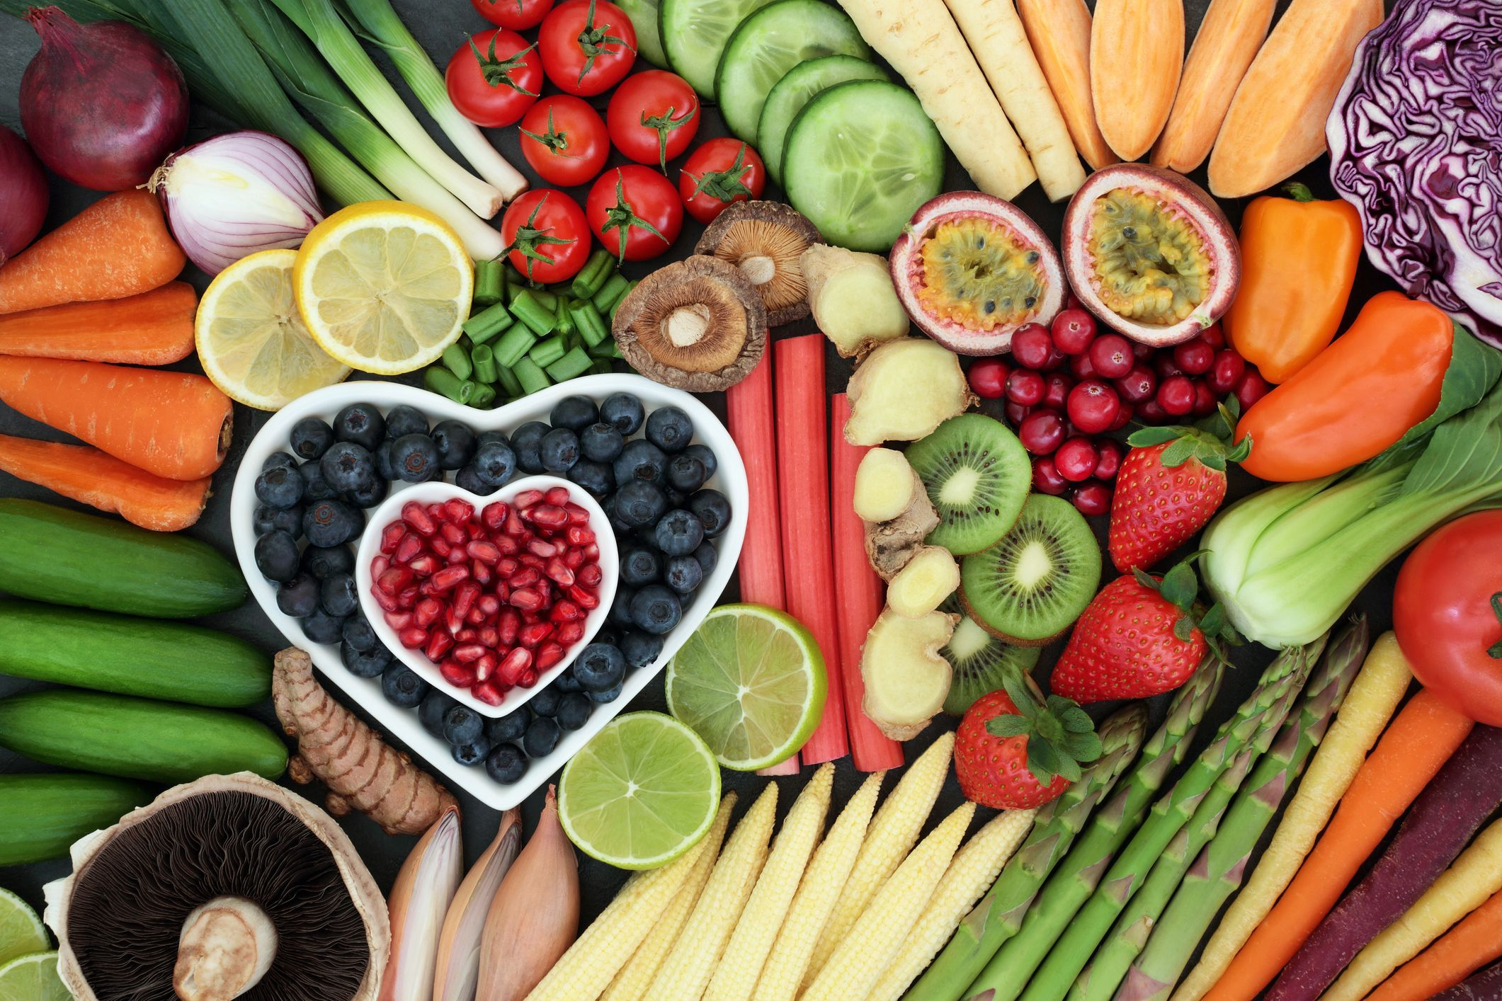
Healthy Food
Healthy Life

Slide 2
