Slide 1

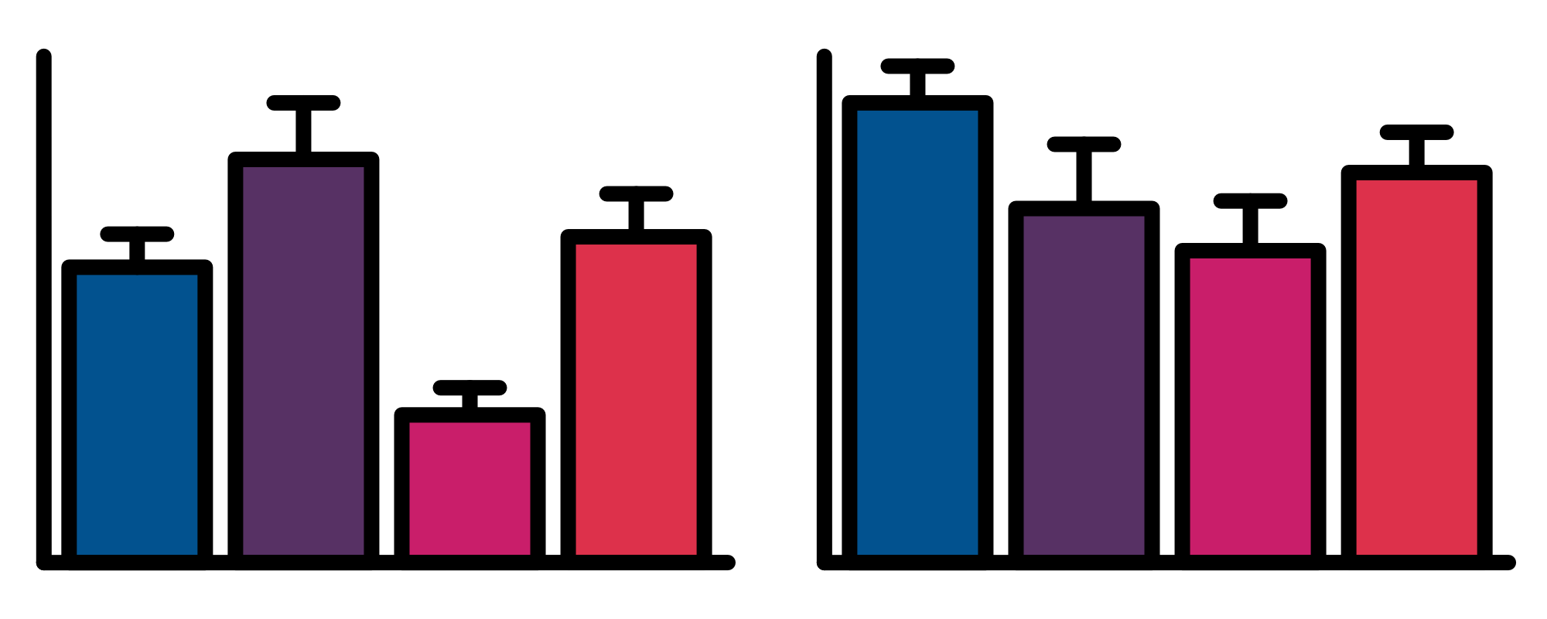

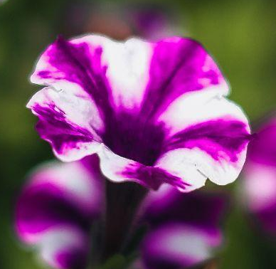
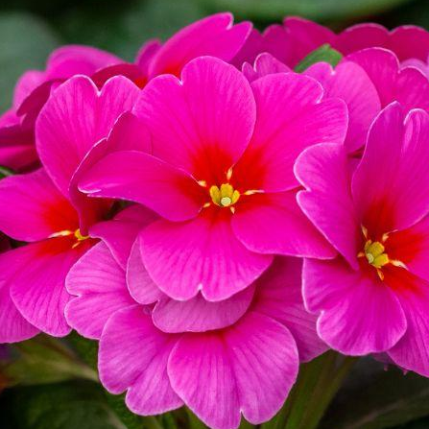


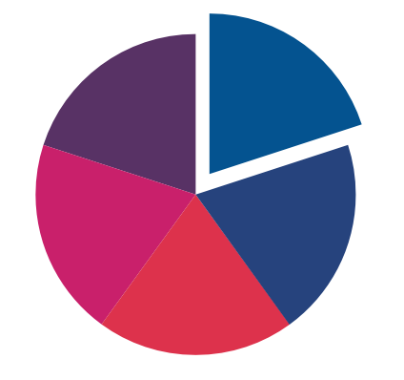

PUT YOUR TITLE HERE - IT CAN BE RELATIVELY LONG AS MANY POSTER TITLES ARE
Poster Presenter₁, Author Two₁, Author Three₂, Author Four₃
1. Institution One, Location, Country,
2. Institution Two, Location, Country,
3. Institution Three, Location, Country
INTRODUCTION
RESULTS
In our ambitious quest to redefine the very essence of scientific poster creation, we embarked upon a journey that transcended the mundane confines of conventional academia. Our mission, executed with a vibrant palette of colors and a legion of fervent design enthusiasts, was to thrust the time-honored tradition of poster presentations into a bold new era, one where aesthetics and information converge seamlessly to craft a narrative that leaves an indelible imprint on the minds of our audience.
This study endeavors to unearth the hidden treasures of crafting scientifically captivating posters. We sought to harness the potent alchemy that fuses data and design, transforming these information-laden canvases into dynamic, visually immersive experiences. Our ultimate aspiration is to revolutionize the very way we communicate scientific insights.
After countless iterations, sleepless nights, and the relentless pursuit of artistic excellence, we stand on the precipice of unveiling the fruits of our artistic odyssey. Our findings herald a watershed moment in the symbiotic relationship between visual elements and the assimilation of scientific information.
The strategic integration of colors, fonts, and imagery has harnessed an unprecedented level of viewer engagement. As a consequence, the eyes of our audience were not merely opened; they were widened in astonishment, brows were raised in admiration, and, on occasion, gasps of awe filled the room.
Column 1
Column 2
https://www.pexels.com/@fayette-reynolds-m-s-181007507/
Row 1
Figure 3: Title of figure
In this intricate choreography of data points, we witness the elegant pas de deux between variables X and Y. As they twirl through the graph, notice the graceful arcs and dramatic sweeps, each step revealing a new facet of their intricate relationship. This mesmerizing performance represents the culmination of rigorous research and analytical finesse, where the mysteries of correlation and causation merge in a captivating waltz. Join us in this dance of discovery as we unravel the secrets hidden within the steps of our data partners.
Row 2
METHODS
Our experimental methodology was a nuanced dance between pixels and imagination, akin to composing a symphony with fonts, layouts, and graphics as our notes. We ventured into uncharted territories within the scientific sphere of design, challenging convention and embracing creativity. Our creative laboratory evolved into a vibrant space where precision and artistic intuition coexisted harmoniously, guiding us toward pioneering the era of visually arresting scientific posters.
Every element was scrutinized and tested, not just for aesthetic appeal but also for its profound impact on viewer engagement and comprehension. Each choice, from the color scheme to the font selection, was subjected to meticulous evaluation, ensuring that our creative endeavors were firmly rooted in both artistic innovation and scientific rigor.
Figure 2: Title of figure
In this panel, we capture the beauty of serendipity in everyday life. Each image unveils a story, a moment frozen in time, reminding us that the unexpected can often be the most delightful.
From fleeting rainbows to chance encounters, these snapshots celebrate the art of being in the right place at the right time. Life's little surprises are the true treasures we cherish.
Our data offers irrefutable proof that scientific posters, when infused with the alchemy of artistic finesse, possess the power to captivate audiences in ways that were previously beyond imagination.
It beckons us to break free from the bonds of formulaic presentations, unlocking an exciting realm of engagement that defies convention.
Figure 1: Title of figure
This caption humorously alludes to the mysterious nature of the Bermuda Triangle within the context of a triangular graph, adding a playful disclaimer that suggests data might vanish within this graph's boundaries and warns against attempts to recover it
1
2
3
DISCUSSION AND CONCLUSION
REFERENCES
Step 1:
Some info about the first step
Step 2:
This is the penultimate step
Step 3:
Finally the third and final step
The implications of our study reach far beyond the confines of mere poster presentations; they strike at the very heart of academic discourse itself.
The union of aesthetics and science, as witnessed in this exploration, ignites a spark of curiosity and passion within the scientific community. It challenges established norms and encourages a fearless embrace of unconventional design choices.
In conclusion, our study offers an unequivocal endorsement of the transformative potential that lies at the intersection of art and science within the domain of poster design. It can be a great tool to highlight and/or bold a statement in your conclusion which you are trying to get across to the audience.
By infusing the power of visual storytelling into our presentations thereby unlocking an entirely new realm of engagement and understanding.
https://www.pexels.com/photo/pink-petaled-flowers-712152/
https://www.pexels.com/photo/blooming-flowers-growing-in-rows-in-pots-7141236/
https://www.pexels.com/photo/close-up-of-purple-petunias-with-stripes-17079467/
https://www.pexels.com/photo/close-up-view-of-purple-flowers-5396363/
https://qrgenerator.gg/qr/url
No
No
No
Yes

Slide 2
HEADING HERE
Poster Presenter₁, Author Two₁, Author Three₂, Author Four₃
1. Institution One, Location, Country,
2. Institution Two, Location, Country,
3. Institution Three, Location, Country
Logo goes here
INTRODUCTION
RESULTS
Introduction text
Results text
Figure 3: Title of figure
Caption
METHODS
Methods text + insert optional image/figure
Figure 2: Title of figure
Caption
Results text
Figure 1: Title of figure
Caption
DISCUSSION AND CONCLUSION
REFERENCES
Discussion/Conclusion text
Discussion/Conclusion text
References/acknowledgements s+ optional QR code

Slide 3
HEADING FONT
Subheading font
ONE PANEL WIDTH
TWO PANEL WIDTH
Colour palette
ONE PANEL WIDTH
TWO PANEL WIDTH
ONE PANEL WIDTH
TWO PANEL WIDTH
ONE PANEL WIDTH
TWO PANEL WIDTH
ONE PANEL WIDTH
TWO PANEL WIDTH
One panel width text box + optional background colour
Two panel width text box + optional background colour
Two panel width text box + optional background colour
Figure Box: Title of figure
Caption
THREE PANEL WIDTH
THREE PANEL WIDTH
THREE PANEL WIDTH
THREE PANEL WIDTH
THREE PANEL WIDTH
Three panel width text box + optional background colour
Three panel width text box + optional background colour
Three panel width text box + optional background colour

